Slide 1
Status of Operational AMV products at EUMETSAT
R. Borde, M. Carranza, and O. Hautecoeur

Slide 2
Content
AMVs from Geostationary Satellite status
MSG Planning
Recent activities on GEO AMVs since IWW13
Upcoming activities
AMVs from Low Earth Orbiting Systems status
Upcoming Metop satellite changes
Recent activities on LEO AMVs
Upcoming changes and activities
Mid-Term strategy and activities

Slide 3
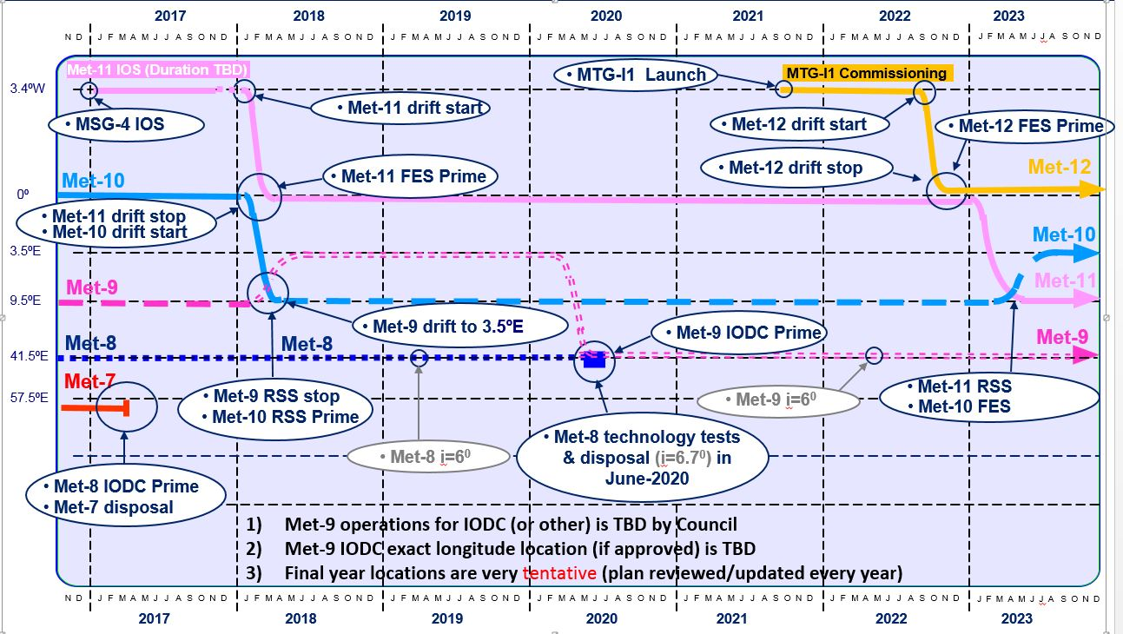
Meteosat Planning Reference Baseline - 2018
From the document: EUM/STG-OPSWG/43/18/DOC/02

Slide 4
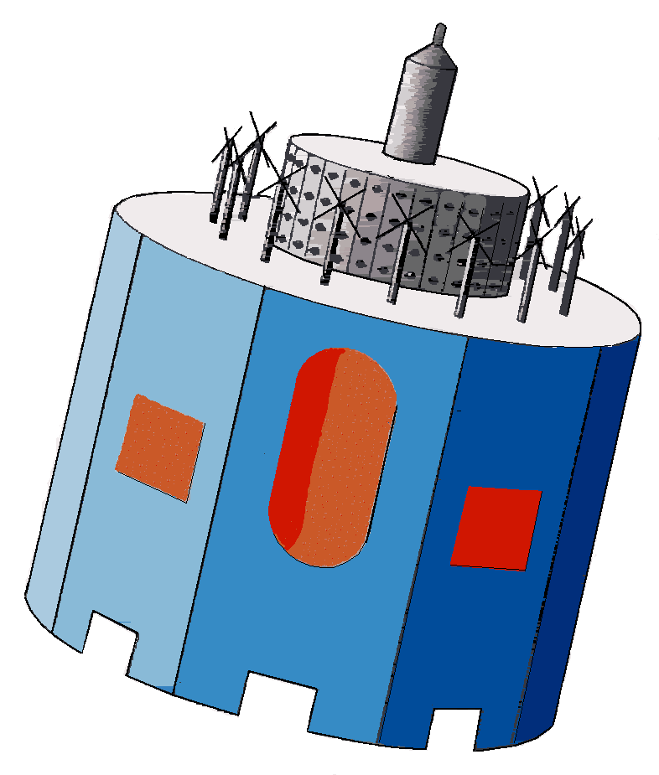
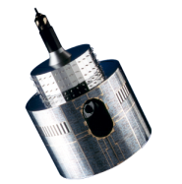
Current MSG space segment configuration
Met-11
Met-9
Met-10
Met-8
3.4°W
0°
3.5°E
9.5°E
41.5°E
Rapid Scan Service
IODC
Full Earth Scan
Back up Met-11
Back up Met-10 RSS

Slide 5
Recent activities on GEO AMVs.
Meteosat 11 prime FES (February 2018)
Meteosat 8 prime over IODC (February 2017)
MTG prototype developed from MSG code
Comparison MTG - MSG.
See Manuel’s talk, Technical and Scientific Verifications of the EUMETSAT MTG-FCI AMV Prototype.’
Adaptation to HIMAWARI data, comparison with KMA.
See Soomin’s poster, : ‘AMV Inter-Comparison Between GK-2A and MTG Algorithm Using Himawari8/AHI Data.’
3rd Intercomparison study
See Plenary presentation.

Slide 6
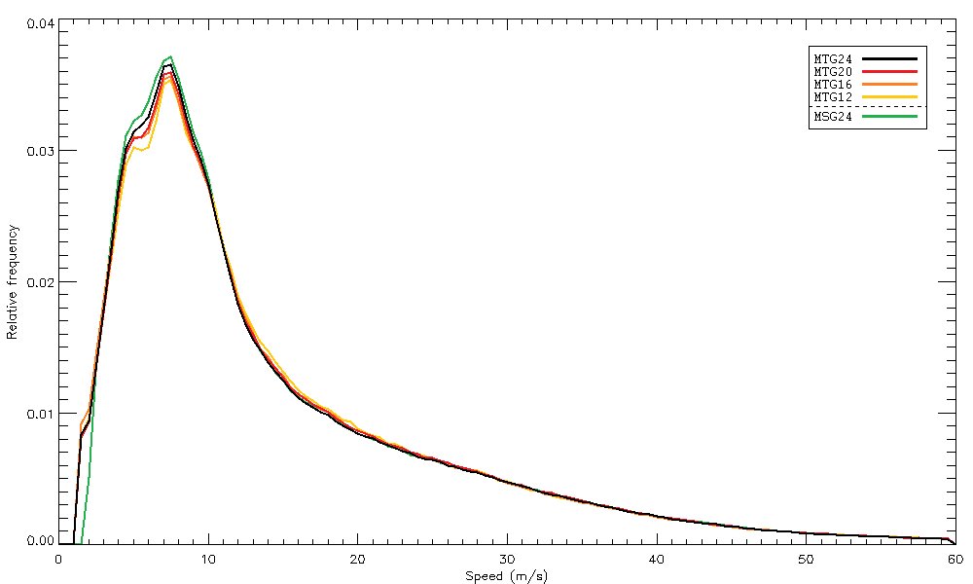
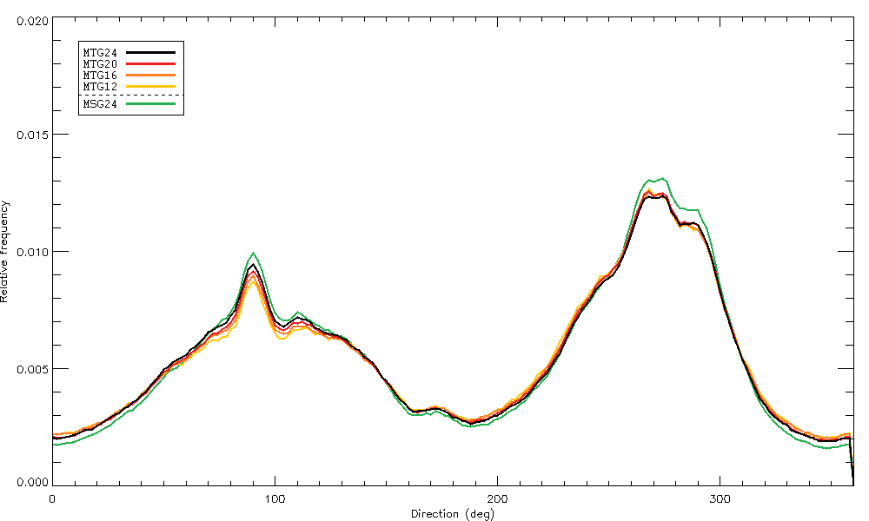
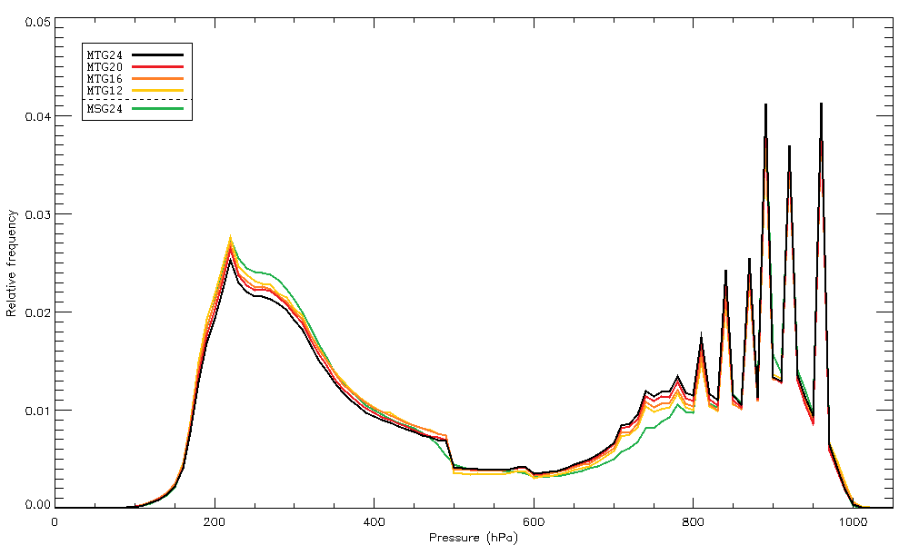
MSG vs MTG algorithms using MSG data
AMV histograms; Periode: 14/05/2016 – 14/06/2016 ; QI>80
MTG algo extracts 8% more AMVs, especially at mid and low levels
Direction differences due to MSG averaging.
MSG AMVs slightly higher.

Slide 7
Future activities on GEO AMVs.
Operations activities
Change BUFR format
MTG prototype
Comparison of MSG and MTG codes performances
Verification against reference code (L2PF activities, 2019)
Scientific validation using Himawari data (Collaboration with KMA)
New developments
Use OCA microphysics to improve AMV HA.
Develop speed and direction error estimates from Level1.5 data navigation errors

Slide 8
Metop-C Launch
Metop-C launch :
  Launch site Kourou (Arianespace CSG) instead of Baikonur;
  Launch vehicle Soyuz ST-B with Fregat-M upper stage;
  New payload adapter ring with regards to Metop-A/B;
  Launch :
    Period : 20/09/18 – 31/12/2018
    (later than originally planned due to Metop-A longevity);
    Target Launch Date : 21 Sept 2018 @00:47 UTC; (current baseline)
    (= 20 Sept 2018 @21:47 Kourou, 18 September (Kourou time under formalisation)
  Separation in visibility of both launcher and LEOP stations.
From the document: EUM/STG-OPSWG/43/18/VWG/04

Slide 9

Metop-C Phasing Approach
  Metop-C Commissioning to be performed in an approximately
  equal-spaced phasing configuration = “Tristar” configuration:
  dual-/tri-Metop processing algorithms products may (to be checked during Metop-C commissioning) be adapted;
  Tristar retained at least until end of Metop-C Commissioning;
  After Metop-C Commissioning, options:
  retain Tristar configuration; OR
  establish “Trident” configuration;
  (Metop-B/C in current Metop-A/B configuration,
  with Metop-A midway between).
  After Metop-A de-orbiting, re-establish current
  dual-Metop configuration with Metop-B/C.
  decision will be based on user feedback, taking
  into account optimal phasing wrt. Metop-SG satellites.
Metop-B
Metop-A
Metop-C
From the document: EUM/STG-OPSWG/43/18/VWG/04

Slide 10
Recent activities on LEO AMVs.
Drift of Metop A (change of production rules)
Inter-comparison of the 3 AVHRR wind products.
See Olivier’s talk: ‘Intercomparison of the different AVHRR winds products at EUMETSAT.’
3D IASI winds
Integration of new model that consider both Q, T and O3.
Adaptation to IASI data
Demonstration period
See Olivier’s talk: ‘3D IASI Winds Product at EUMETSAT.’

Slide 11
Future activities on LEO AMVs.
Commissionning of Metop C
Tristar configuration of Metop satellites
3D IASI winds
Scientific validation and comparison.
Operational production foreseen (mid 2019)
Development of EPS-SG VII AMV prototype
Development of Sentinel 3 SLSTR AMVs

Slide 12

Product characteristics (Dual)
Dual configuration on 9:30 orbit
  ~45-55 minutes of separation between
  successive views
Coverage
  Production on Northern and Southern
  Hemispheres (poleward of 45°)
  ~1 observation around 9:00-10:00 (local solar time)
  Same around 21:00-22:00 (ascending part) for latitude 60°.
Timeliness
  For SH products: ~1h - 1h30 after South Pole overpass
  For NH products: ~1h - 2h30 after North Pole overpass (depending on possible secondary dump on McMurdo station)

Slide 13

Product characteristics (Tristar)
Metop-B
Tristar configuration on 9:30 orbit
  ~30-35 minutes of separation between
  successive views
  Quality will benefit from the reduced time gap
  Coverage will benefit from increased overlap area
Coverage
  Production on Northern and Southern
  Hemispheres (poleward of 45°)
  ~3-4 successive observations around 9:00-10:00 (local solar time)
  Same around 21:00-22:00 (ascending part) for latitude 60°.
  Time consistency will benefit from successive observations capability
Timeliness
  For SH products: ~1h - 1h30 after South Pole overpass
  For NH products: ~1h - 2h30 after North Pole overpass (depending on possible secondary dump on McMurdo station)
Metop-A
Metop-C

Slide 14
Main users wind requirements for near future
Get smaller scale information to feed regional models
  Better spatial and/or temporal resolutions
  Appropriate QI for mesoscale winds ?
Better quality AMVs
  Speed and direction error estimates
  Height assignment error estimate
Get 3D wind profiles
  Lidar missions (Aeolus)
  IR sounders

Slide 15
Perspectives for MTG-FCI
Improvements expected from MTG-FCI data
  Repeat cycle 15 min (MSG SEVIRI) 10 min (MTG FCI)
  Pixel size 3 km (MSG SEVIRI) 2 km (MTG FCI)
Main changes from MSG AMV scheme
  Use 3 images instead of 4 (1/2 hourly product)
  No averaging process
  Better Cloud product expected to set the altitude
MTG FCI AMV prototype developed
  Adapted to both MSG data and Himawari data
  Scientific validation on going

Slide 16
Perspectives for EPS-SG VII
Improvements expected
  Channels used 1 (AVHRR) 4 (VII)
  Pixel size 1 km (AVHRR) 0.5 km (VII)
Main changes from AVHRR scheme
  Use cloud product to set AMV altitude
  Extraction of AMVs in 2 WV channels
  VII data needs to be re-projected before tracking
EPS-SG VII AMV prototype still to be developed

Slide 17
Perspectives for Sentinel 3 SLSTR
Very similar to AVHRR
Main changes from AVHRR scheme
  SLSTR data needs to be re-projected before tracking
S3/SLSTR AMV prototype still to be developed
 | AVHRR | SLSTR
Band used for AMV extraction | 10.8 micron | 10.85 micron
Pixel resolution | 1 km at nadir | 1 km at nadir
Swath | ~2900 km | 1400 km (nadir view) 740 km (oblique view)
Cloud mask | Yes | Not ready
Cloud product | No | No
Height assignment | EBBT or IASI | EBBT or stereo (oblique view swath)
Temporal gap between consecutive images | ~100 min | ~100 min

Slide 18
Perspectives for MTG-IRS
Software can be adapted to MTG-IRS data
  Dwell of 160x160 pixels (IRS) 2x2 pixel (IASI)
  Pixel size of 4km (IRS) 12 km (IASI)
Sparse data not a huge problem
MTG-IRS 3D wind product could be as follow:
  4 km resolution
  Using image pairs (30 min gap) and the current baseline [3-4 3-4 3-4 3-4 3-4; 2-4 2-4 2-4 2-4; 1-4 1-4 1-4] allow a ½ hourly product over Europe (LAC-4) and ~3 series of 3 products per day for LAC-1,2.

Slide 19
3D winds MTG-IRS product characteristics
Coverage
  4 LAC (Local Area Coverage) defined
  LAC4 covers Europe, Mediterranean Basin and North Atlantic. It is acquired every 30 minutes.
  Pixel sampling = 4 km at SSP
  Spatial resolution enhanced will allow the use in High Res NWP application
Profile
  20 levels from 10 to 1000 hPa, covering Low Stratosphere to Surface
Frequency
  Number of products per day depends on acquisition scheme.
  Current baseline:
    48 products for LAC4
    16 products for LAC3
    12 products for LAC2
    8 products for LAC1
Timeliness (expected)
  ~45 minutes after LAC acquisition
Fulfill the Global NWP and High Res NWP application requirements

Slide 20
Aeolus ???
Aeolus science meeting
EUMETSAT, 29 May 2018
The European Space Agency (ESA) and the European Organisation for the
Exploitation of Meteorological Satellites (EUMETSAT) are happy to invite you to attend the Aeolus Science meeting on 28 November 2017. The topic of the meeting is the preparations of the meteorological community for the assessment of Aeolus and its potential for a follow-on

Slide 21
Thanks for attention
Questions ?

