Slide 1
Operational Wind Products
at NOAA/NESDIS
Hongming Qi¹, Jaime Daniels², Jeff Key², Paul Chang²
Nicholas Esposito¹, Andrew Bailey², Jeffrey Augenbaum¹
1: NOAA/NESDIS/OSPO/Satellite Products & Services Division
2: NOAA/NESDIS/STAR
April 23, 2018
14th International Winds Workshop
Jeju City, South Korea

Slide 2
TOPIC
Status of GOES and POES Satellites
Operational AMV System and Products
Operational ASCAT Processes and Products
New AMV Products and Operational Plan
Satellite Product Distribution and Access

Slide 3
TOPIC
Status of GOES and POES Satellites
Operational AMV System and Products
Operational ASCAT Processes and Products
New AMV Products and Operational Plan
Satellite Product Distribution and Access

Slide 4
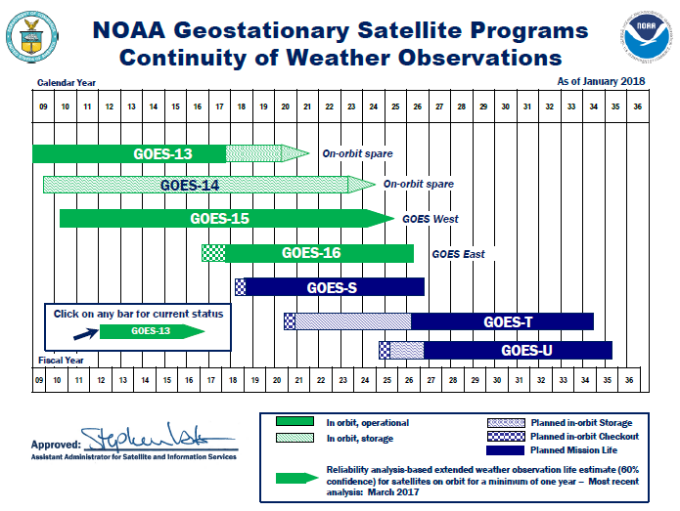
GOES Flyout Schedule

Slide 5
GOES Constellation

Slide 6
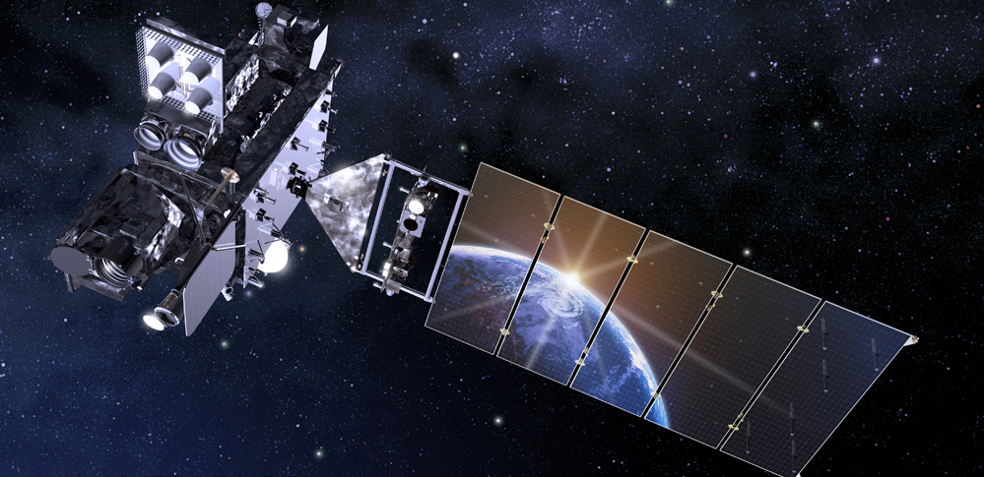
GOES 16
Launched on November 19th, 2016
Located at 75.2 West
Post Launch Product Validation Schedule
GOES 16 L2+ Product Validation Status

Slide 7
GOES-16/17 Product Maturity Level
Beta: Products are only made available to cal/val users via PDA to gain familiarity with data formats and parameters as well as provide assistance to the science teams. The Product has been minimally validated and may still contain significant errors and is not optimized for operational use.
Provisional: Product ready for operational use but has documented known issues. Product analyses are sufficient to communicate product performance to users relative to expectations.
Full: Product is operational. All known product anomalies are resolved and/or documented and shared with the user community

Slide 9
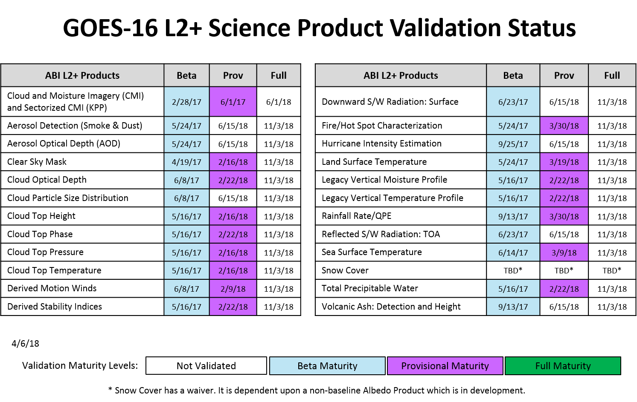

Slide 10
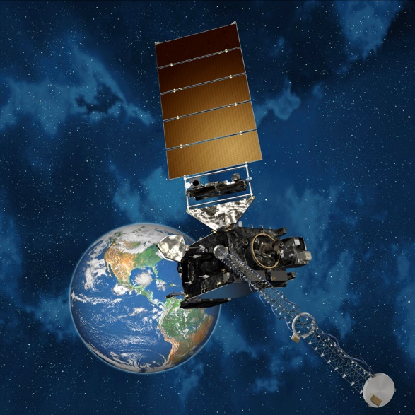
GOES 17
Launched on March 1st, 2018
Located at 89.5 West
Post Launch Product Validation Schedule

Slide 11
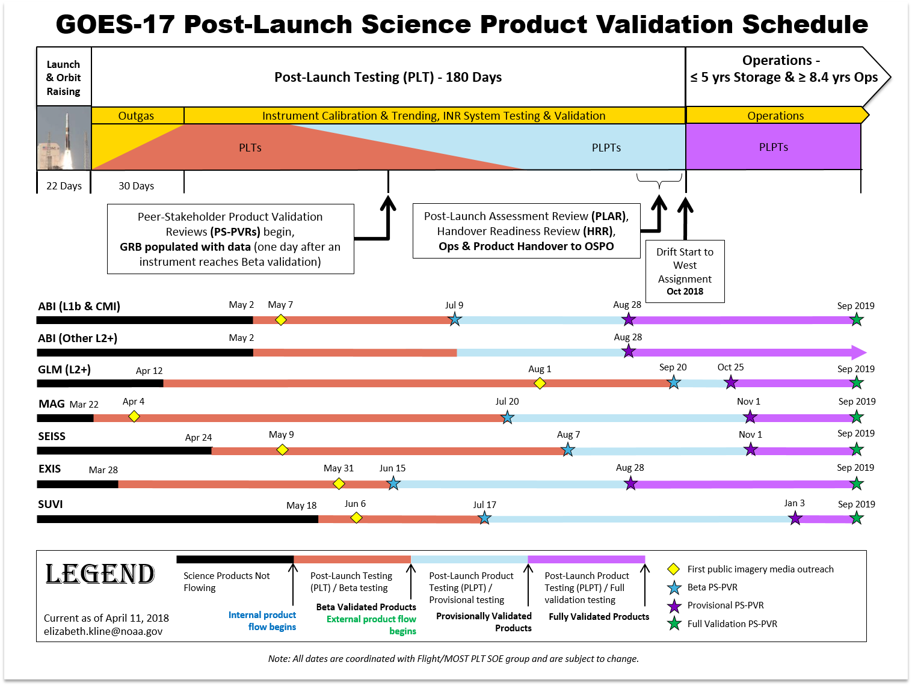

Slide 12
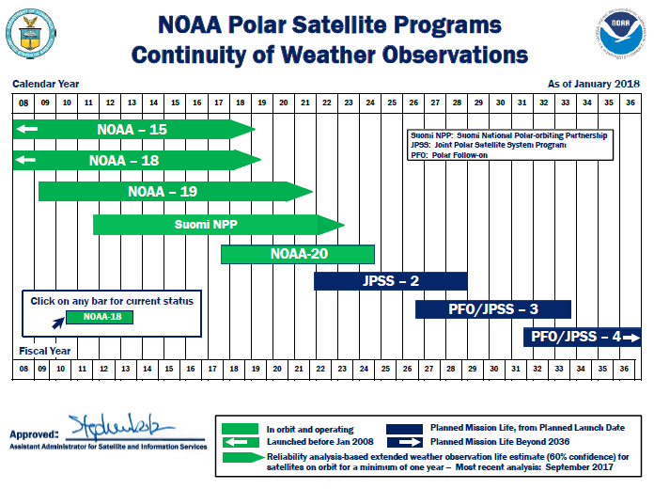
POES Flyout Schedule

Slide 13
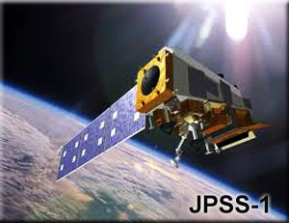
S-NPP and NOAA-20
SUOMI NPP (launched in October 2011) is the predecessor to the JPSS series spacecraft
NOAA-20 (formerly JPSS-1) was launched on November 18, 2017 and the first spacecraft of NOAA's next generation of polar-orbiting satellites

Slide 14
JPSS Program Data Products

Slide 15
TOPIC
Status of GOES and POES Satellites
Operational AMV System and Products
Operational ASCAT Processes and Products
New AMV Products and Operational Plan
Satellite Product Distribution and Access

Slide 16
Operational AMV System
GOES-R Ground System
Generate GOES-16 AMV products in NetCDF4
Will generate GOES-17 AMV products
OSPO NDE System
Generate S-NPP VIIRS Polar Winds
Convert GOES-16 AMV into BUFR format
Will generate NOAA-20 VIIRS Polar Winds

Slide 17
Operational AMV System
Legacy GOES and POES AMV System
Continue to generate GOES-15, MODIS, and AVHRR AMV products
Heritage Winds algorithm

Slide 18
Updates on Ops AMV Products
GOES-13 AMV was terminated in January 2018
GOES-16 AMV products reach the provisional maturity level in February 2018
GOES-16 AMV is in NetCDF4 and BUFR (Heritage and New)
GOES-16 AMV is available on OSPO PDA and GTS

Slide 19
Operational AMV Products (1/5)
AMV Products | Frequency (min) | Image Sectors | Image Interval (min) | WMO Header
GOES-16 (GOES East)
LWIR (11.2um) Cloud-drift | 5 | MESO | 5 | INRX01 (Heritage) INRX11 (New)
 | 15 | CONUS | 5
 | 60 | FULL DISK | 15
SWIR (3.9um) Cloud-drift | 5 | MESO | 5 | INRX02 (Heritage) INRX12 (New)
 | 15 | CONUS | 5
 | 60 | FULL DISK | 15
Visible (0.64um) Cloud-drift | 5 | MESO | 5 | INRX03 (Heritage) INRX13 (New)
 | 15 | CONUS | 5
 | 60 | FULL DISK | 15

Slide 20
Operational AMV Products (2/5)
AMV Products | Frequency (min) | Image Sectors | Image Interval (min) | WMO Header
GOES-16 (GOES East)
Water Vapor-Cloud Top (6.2um) | 5 | MESO | 5 | INRX04 (Heritage) INRX14 (New)
 | 15 | CONUS | 5
 | 60 | FULL DISK | 15
Water Vapor-Clear Sky (6.2um) | 5 | MESO | 30 | INRX05 (Heritage) INRX15 (New)
 | 15 | CONUS | 30
 | 60 | FULL DISK | 30
Water Vapor-Clear Sky (6.9um) | 5 | MESO | 30 | INRX06 (Heritage) INRX16 (New)
 | 15 | CONUS | 30
 | 60 | FULL DISK | 30
Water Vapor-Clear Sky (7.3um) | 5 | MESO | 30 | INRX07 (Heritage) INRX17 (New)
 | 15 | CONUS | 30
 | 60 | FULL DISK | 30

Slide 21
Operational AMV Products (3/5)
AMV Products | Frequency (min) | Image Sectors | Image Interval (min) | WMO Header
GOES-15 (GOES West)
LWIR (10.68um) Cloud-drift | 60 | PACUS | 15 | JCCX11
 | 60 | NHEM/SHEM | 30
SWIR (3.9um) Cloud-drift | 60 | PACUS | 15 | JRCX11
 | 60 | NHEM/SHEM | 30
Water Vapor (6.55um) | 60 | NHEM/SHEM | 30 | JGCX11
Visible (0.625um) Cloud-drift | 60 | PACUS | 15 | JJCX11
 | 60 | NHEM/SHEM | 30

Slide 22
Operational AMV Products (4/5)
AMV Products | Frequency (min) | Image Sectors | Image Interval (min) | WMO Header
GOES-15 (GOES West) SOUNDER
Sounder WV (7.4um) | 60 | Tropical | 60 | JMCX11
Sounder WV (7.0um) | 60 | Tropical | 60 | JPCX11
AQUA/TERRA MODIS
LWIR (11um) Cloud-drift | 100 | NHEM/SHEM (poleward 65º) | 100 | JBCX11 (TERRA) JICX11 (AQUA)
Water Vapor (6.7um) | 100 | NHEM/SHEM (poleward 65º) | 100 | JLCX11 (AQUA)

Slide 23
Operational AMV Products (5/5)
AMV Products | Frequency (min) | Image Sectors | Image Interval (min) | WMO Header
AVHRR
LWIR Cloud-drift | 100 | NHEM/SHEM (poleward 65º) | 100 | JCVX98 (Metop-B) JCVX95(N19) JCVX97(Metop-A) JCVX94(N18) JCVX91(N15)
S-NPP VIIRS
LWIR (10.76um) Cloud-drift | 100 | NHEM/SHEM (poleward 65º) | 100 | INVX01 INVX02 INVX03

Slide 24
OSPO NDE Process Monitoring

Slide 25
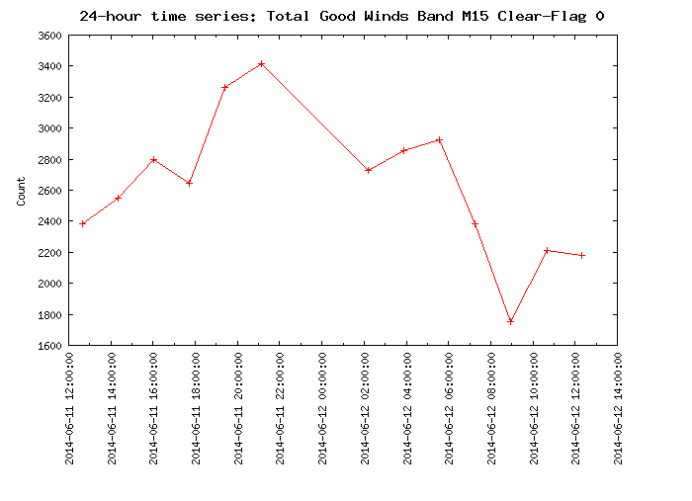
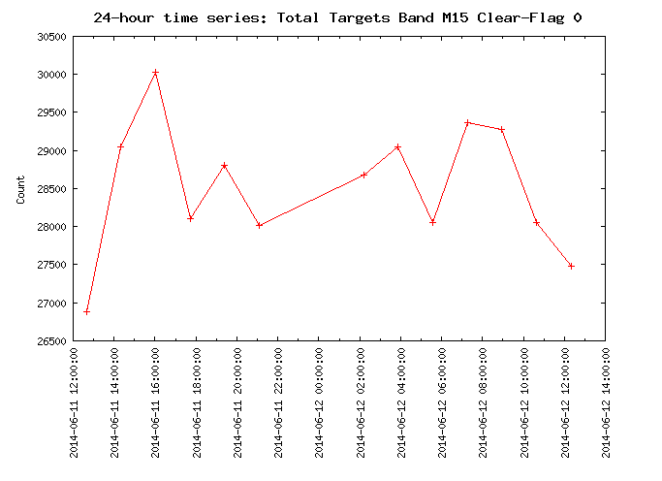
VPW Quality Monitoring
The real time quality monitoring tool has one database as the backend
More information of the process and products on metadata and database
Benefit the monitoring of AMV product quality in the longer term
Automatic email warning notification

Slide 26
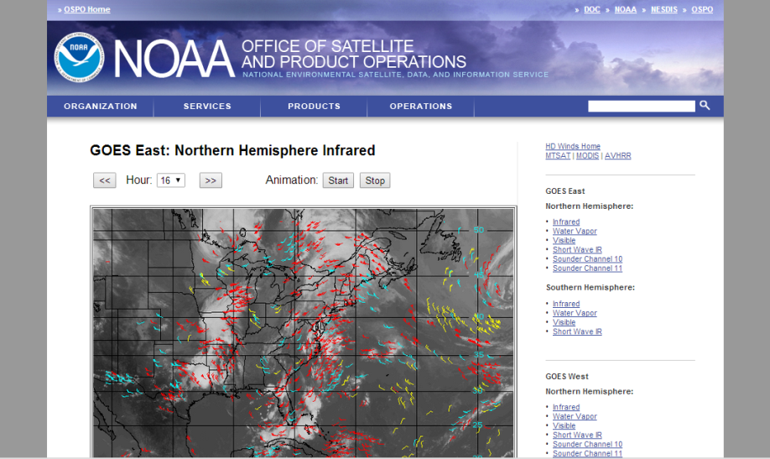
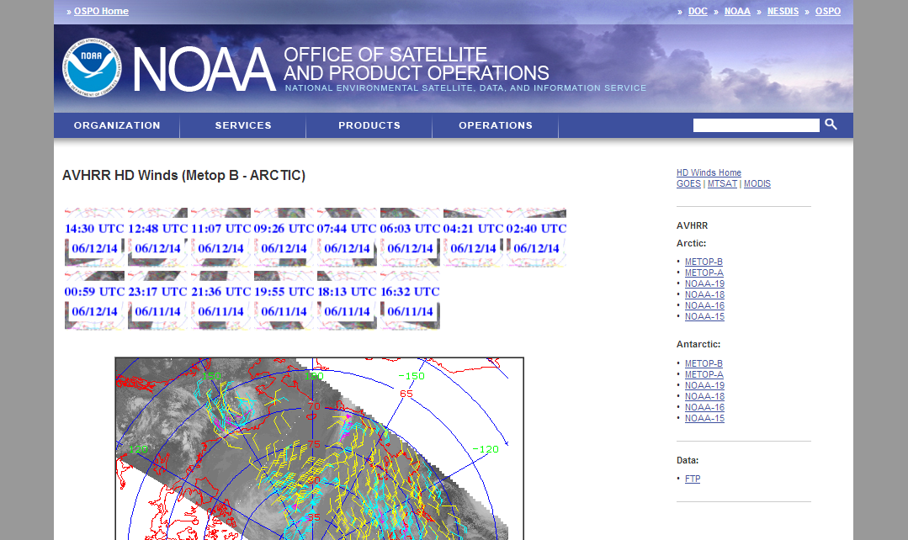
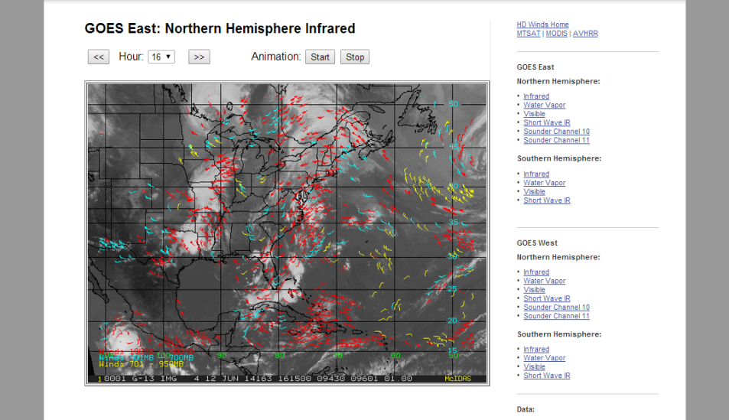
OSPO AMV Products Web Pages
http://www.ospo.noaa.gov/Products/atmosphere/hdwinds/index.html

Slide 27
Operational AMV Products Distribution
The former DDS server at OSPO has been replaced by the enterprise PDA (Product Distribution and Access) system
All operational GOES 15/16, AVHRR, MODIS, and S-NPP AMV products are distributed via PDA and are also available via GTS

Slide 28
TOPIC
Status of GOES and POES Satellites
Operational AMV System and Products
Operational ASCAT Processes and Products
New AMV Products and Operational Plan
Satellite Product Distribution and Access

Slide 29
Operational ASCAT Winds (1/2)
Metop-B and Metop-A ASCAT
50 km and 25 km OSVW products
50 km
3-min granule files in BUFR and binary
3-min ASCAT-lite files for NAWIPS (binary)‏
25 km
3-min granule files in BUFR and binary
3-min ASCAT-lite files for NAWIPS (binary)‏
3-min ASCAT-lite files for AWIPS (BUFR)‏

Slide 30
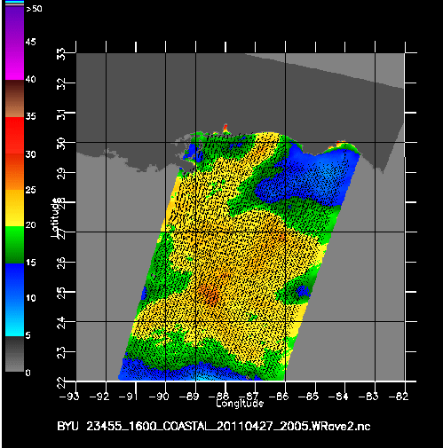
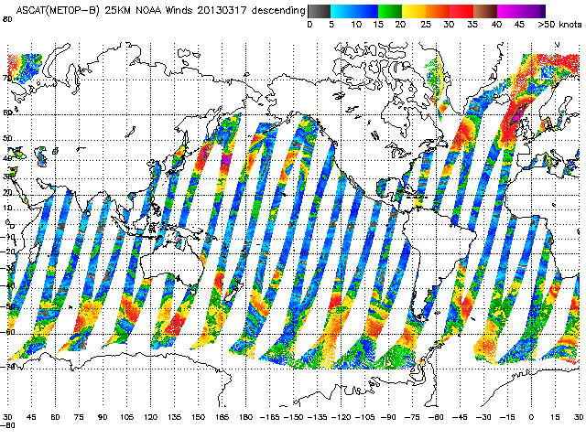
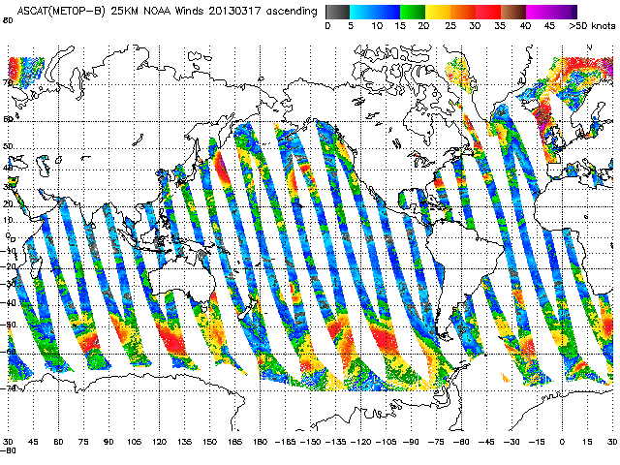
Operational ASCAT Winds (2/2)
Enhanced resolution wind products
Tropical cyclone storm sector wind speed imagery

Slide 31
ASCAT Winds Monitoring
A Java based automatic monitoring tool for ASCAT winds
Monitoring the process on 3-minute granule level
Ability to display the status from data ingest, process and distribution

Slide 32
Operational ASCAT Winds Distribution
ASCAT winds are distributed via PDA system
Main NOAA users
National Hurricane Center (NHC)/Tropical Prediction Center (TPC)
Ocean Prediction Center
Alaska and Pacific Regions
Coastal Weather Forecast Offices
Great Lakes Weather Forecast Offices
Environmental Modeling Center (EMC)

Slide 33
Day to Day Uses of ASCAT at NOAA’s Ocean Prediction Center (OPC)
Identify weather features
Marine wind warnings
Short term marine forecasts
Real-time Verification

Slide 34
TOPIC
Status of GOES and POES Satellites
Operational AMV System and Products
Operational ASCAT Processes and Products
New AMV Products and Operational Plan
Satellite Product Distribution and Access

Slide 35
GOES-17 AMV
GOES-17 will replace GOES-15 as operational GOES West in November, 2018 (Exact date is TBD)
GOES-17 AMV products will be at provisional maturity level in September, 2018
NOAA/NESDIS will provide users GOES-17 AMV in NetCDF4 and BUFR (Heritage and New)
Will be distributed via PDA and GTS

Slide 36
GOES-17 AMV Products (1/2)
AMV Products | Frequency (min) | Image Sectors | Image Interval (min) | WMO Header
GOES-17 (GOES West)
LWIR (11.2um) Cloud-drift | 5 | MESO | 5 | INLX01 (Heritage) INLX11 (New)
 | 15 | CONUS | 5
 | 60 | FULL DISK | 15
SWIR (3.9um) Cloud-drift | 5 | MESO | 5 | INLX02 (Heritage) INLX12 (New)
 | 15 | CONUS | 5
 | 60 | FULL DISK | 15
Visible (0.64um) Cloud-drift | 5 | MESO | 5 | INLX03 (Heritage) INLX13 (New)
 | 15 | CONUS | 5
 | 60 | FULL DISK | 15

Slide 37
GOES-17 AMV Products (2/2)
AMV Products | Frequency (min) | Image Sectors | Image Interval (min) | WMO Header
GOES-17 (GOES East)
Water Vapor-Cloud Top (6.2um) | 5 | MESO | 5 | INLX04 (Heritage) INLX14 (New)
 | 15 | CONUS | 5
 | 60 | FULL DISK | 15
Water Vapor-Clear Sky (6.2um) | 5 | MESO | 30 | INLX05 (Heritage) INLX15 (New)
 | 15 | CONUS | 30
 | 60 | FULL DISK | 30
Water Vapor-Clear Sky (6.9um) | 5 | MESO | 30 | INLX06 (Heritage) INLX16 (New)
 | 15 | CONUS | 30
 | 60 | FULL DISK | 30
Water Vapor-Clear Sky (7.3um) | 5 | MESO | 30 | INLX07 (Heritage) INLX17 (New)
 | 15 | CONUS | 30
 | 60 | FULL DISK | 30

Slide 38
NOAA-20 VPW
Similar to S-NPP VPW, OSPO will generate VPW from NOAA-20 with GOES-R winds algorithm
Expected to be operational in March 2019

Slide 39
AVHRR AMV Products
Current AVHRR AMV products are generated from the legacy winds algorithm. The updated AVHRR AMV products will be generated from GOES-R winds algorithm
NOAA/NESDIS is going to generate them in operation on OSPO NDE system around October 2019
Metop-C AVHRR AMV will be generated too

Slide 40
MODIS AMV Products
MODIS AMV products will continue to be generated from the legacy system. The legacy system will be retired in 2022
Currently there is no plan to transition MODIS AMV products into OSPO NDE system. MODIS will have to be ended in 2022 with the retired legacy system

Slide 41
Heritage BUFR Product
New WMO-approved AMV BUFR table will replace the heritage BUFR table in operation
The GOES-16/17 AMV in the heritage BUFR table will be provided till the end of April, 2019
NOAA-20 VPW product and the updated AVHRR AMV products will be generated only in new BUFR table (Need the heritage BUFR products?)

Slide 42
TOPIC
Status of GOES and POES Satellites
Operational AMV System and Products
Operational ASCAT Processes and Products
New AMV Products and Operational Plan
Satellite Product Distribution and Access

Slide 43
PDA at OSPO
PDA – Product Distribution and Access System
All near real time distribution is done from PDA
GOES-16/17 data and products
S-NPP and NOAA-20 products
Other products from currently supported missions

Slide 44
PDA at OSPO
Highly automated, user driven process
User managed search and tailoring
OSPO to manage and update international user subscriptions
Due to capacity constraints, user access to NOAA’s near real-time terrestrial data distribution systems, such as the PDA, must be justified with a critical 24x7 public mission need.

Slide 45
ESPC Notifications, Status, and Contacts
24/7 Help Desk | ESPCOperations@noaa.gov
ESPC Messages | http://www.ssd.noaa.gov/PS/SATS/messages.html
User Services | SPSD.UserServices@noaa.gov
Data Access | NESDIS.Data.Access@noaa.gov
Facebook | www.facebook.com/NOAANESDIS
Twitter | www.twitter.com/noaasatellites
Press releases | http://www.nesdis.noaa.gov/news_archives/
Data Access Policy | http://www.ospo.noaa.gov/Organization/About/access.html

Slide 46
Contact Information for Operational Wind Products
Hongming Qi
Winds PAL (Product Area Leader)
at NOAA/NESDIS/OSPO
Email: Hongming.Qi@noaa.gov

Slide 47
For more information visit www.ospo.noaa.gov
www.facebook.com/NOAANESDIS
www.youtube.com/user/NOAASatellites
twitter.com/NOAASatellites
www.flickr.com/photos/noaasatellites

