Slide 1
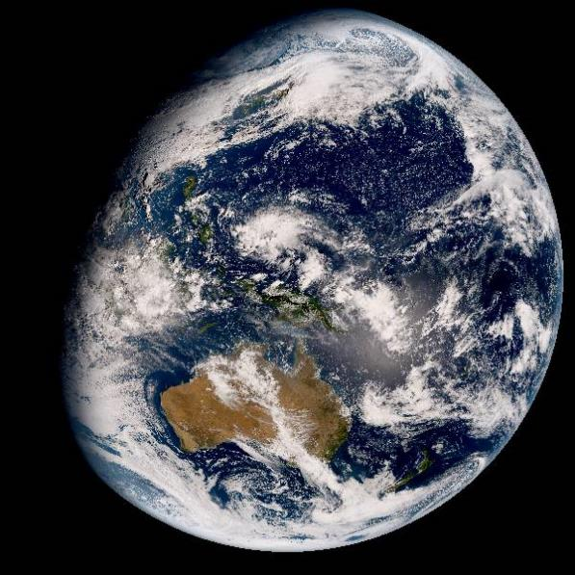
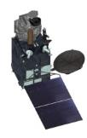

CURRENT STATUS OF ATMOSPHERIC MOTION VECTORS AT JMA
JMA/MSC
Kenichi Nonaka
IWW14@Jeju, 23-27 April, 2018

Slide 2
Contents
Mission schedule and configuration of Himawari-8/-9
Navigation and Calibration errors of Himawari-8/-9
AMV of health check operations of Himawari-9
  Comparison between H-8 AMV and H-9 AMV by using the Health Check data
Current status of Himawari-8/9 AMV
Summary

Slide 3



Himawari-8/9 Mission Schedule
 | 2005 | 2006 | 2007 | 2008 | 2009 | 2010 | 2011 | 2012 | 2013 | 2014 | 2015 | 2016 | 2017 | 2018 | 2019 | 2020 | 2021 | 2022 | 2023 | 2024 | 2025 | 2026 | 2027 | 2028 | 2029
MTSAT-1R Meteorological Mission MTSAT-2 Meteorological Mission
Himawari-8 Himawari-9
Operational
In-orbit standby
In-orbit standby
Operational
In-orbit standby
Launch
Operational
In-orbit standby
Manufacturing
In-orbit standby
Operational
Launch
Himawari-8 has been operational since July 2015.
Himawari-9 was launched in November 2016 and has started in-orbit standby since 10 Mar, 2017 and MTSAT-2 terminated its meteorological mission.
Himawari-9 will continue in-orbit standby until 2022 and it will be operational until 2029 as a successor to Himawari-8.

Slide 4


Contingency Plan
In case of Himawari-8 anomaly or scheduled maintenance, Himawari-9 performs back-up of the observation.
Himawari-9 data dissemination quickly starts after the anomaly;
  VIS (Band 01-03) : ~ 4 hours after
  NIR/IR (Band 04-16) : ~ 24 hours after
Himawari-8 observation is cancelled due to a scheduled maintenance basically once a year for several hours.
Himawari-8 and -9 system ensures the availability of equivalent observation data until 2029.

Slide 5







Full Disk / Regional Observation
in 10 min Repeat Cycle
Fixed observation area
Flexible observation area
Fixed observation area
Region 2
2000 x 1000km
(SW Japan)
Every 2.5 min.
Region 3
1000 x 1000 km
(Target Area)
Every 2.5 min.
Region 5
1000 x 500 km
(Landmark Area)
Every 30 sec.
Region 1
2000 x 1000km
(NE Japan)
Every 2.5 min.
Region 2
2000 x 1000km
(SW Japan)
Every 2.5 min.
Region 4
1000 x 500 km
(Landmark Area)
Every 30 sec.
Full Disk Observation
Every 10 min.
Region 1
2000 x 1000km
(NE Japan)
Every 2.5 min.
Full Disk Observation
Every 10 min.
Full Disk Observation
Every 10 min.

Slide 6
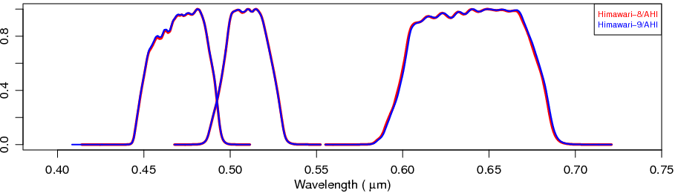
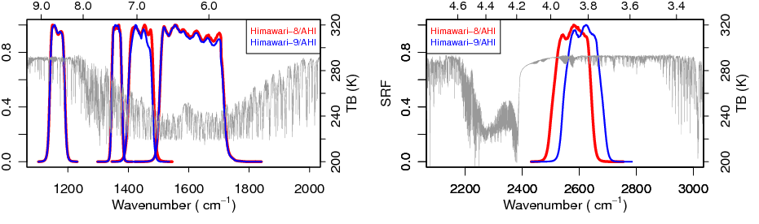
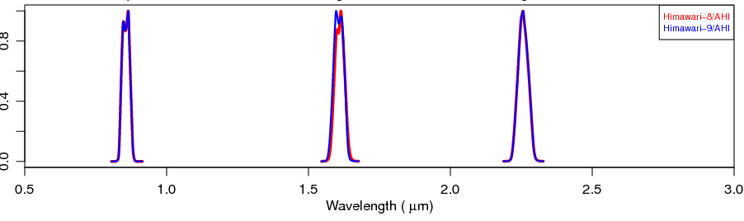
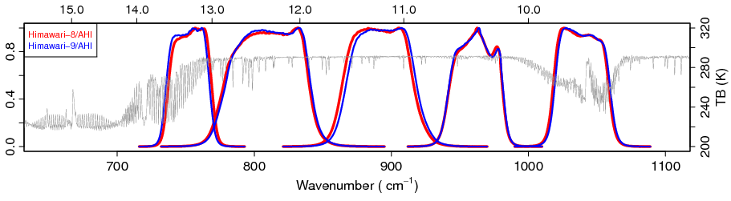
Configuration and Characteristics of Himawari-8/-9 AHI
AHI Band Configuration
 | B01 | B02 | B03 | B04 | B05 | B06 | B07 | B08 | B09 | B10 | B11 | B12 | B13 | B14 | B15 | B16
Central Wave length [μm] | 0.47 | 0.51 | 0.64 | 0.86 | 1.6 | 2.3 | 3.9 | 6.2 | 6.9 | 7.3 | 8.6 | 9.6 | 10.4 | 11.2 | 12.4 | 13.3
Spatial Resolution [km] | 1 | 1 | 0.5 | 1 | 2 | 2 | 2 | 2 | 2 | 2 | 2 | 2 | 2 | 2 | 2 | 2
Spectral Response Functions of AHI-8 and AHI-9
Wavelength [μm]
Wavelength [μm]
VIS
MWIR
SWIR
NIR
Wavelength [μm]
LWIR

Slide 7
Contents
Mission schedule and configuration of Himawari-8/-9
Navigation and Calibration errors of Himawari-8/-9
AMV of health check operations of Himawari-9
  Comparison between H-8 AMV and H-9 AMV by using the Health Check data
Current status of Himawari-8/9 AMV
Summary

Slide 8
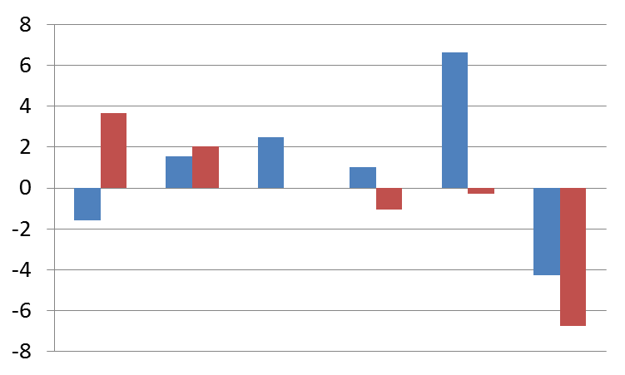
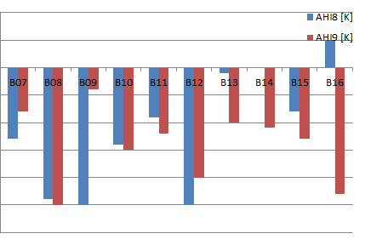
Calibration Validation in AHI-8/-9
(VIS/NIR)
14-28 Feb. 2017
Relative biases of Himawari-9: between +4% and -7%
AHI w.r.t. VIIRS reflectance [%]
Himawari-8/AHI
Himawari-9/AHI
0.47 0.51 0.64 0.86 1.6 2.3 [μm]
(IR)
14-28 Feb. 2017
Himawari-8/AHI
Himawari-9/AHI
Brightness temperature of infrared bands was validated with regard to the LEO hyper-spectral sounder (Metop/IASI) at the standard scene.
0.0 K
TBB Bias of Himawari-8/9
at the standard scene
-0.1 K
Himawari-9’s TBB biases: within -0.25 K
-0.2 K
-0.3 K
3.9 6.2 6.9 7.3 8.6 9.6 10.4 11.2 12.4 13.3
[μm]

Slide 9
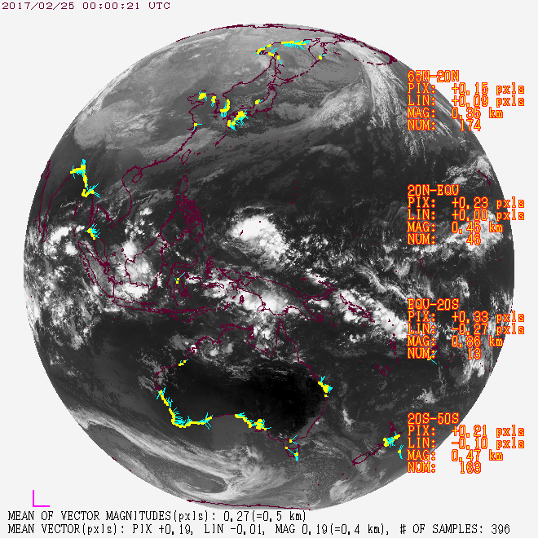
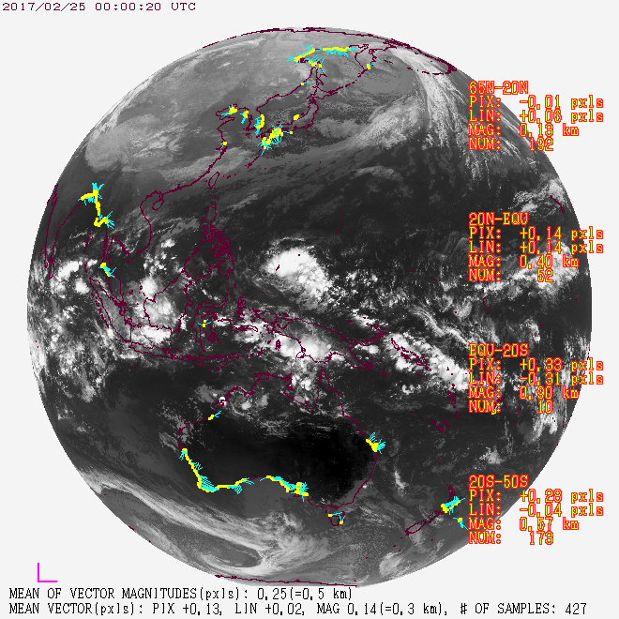
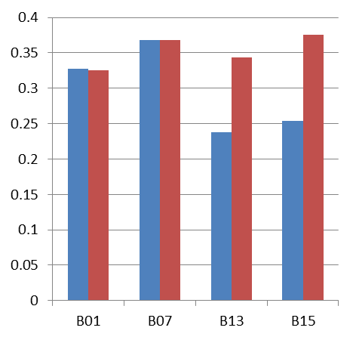
Image Navigation Error in AHI-8/-9
B13 (10.4 μm) image navigation error at 00 UTC on 25 Feb. 2017
Diurnally-averaged image navigation errors on 25 Feb. 2017
AHI-8 AHI-9
[km at SSP]
56 μrad
(2km@SSP)
0.47 3.9 10.4 12.4 [μm]
Himawari-8/AHI
Himawari-9/AHI
Reference points
Navigation error vector
Reference points
Navigation error vector
Generally less than 11 μrad (0.4 km) at sub satellite point (SSP)

Slide 10
Contents
Mission schedule and configuration of Himawari-8/-9
Navigation and Calibration errors of Himawari-8/-9
AMV of health check operations of Himawari-9
  Comparison between H-8 AMV and H-9 AMV by using the Health Check data
Current status of Himawari-8/9 AMV
Summary

Slide 11
Himwari-9 Health Check and Backup Operation
 | 2015 | 2016 | 2017 | 2018 | 2019 | 2020 | 2021 | 2022 | 2023 | 2024 | 2025 | 2026 | 2027 | 2028 | 2029
Himawari-8 Himawari-9
Operational
In-orbit standby
In-orbit standby
Operational
<- H-9 Health Check Op.
<- H-9 Backup Op. of H-8 (scheduled)
Himawari-9 started back up operation of Himawri-8 since 10 March, 2017.
Health check operations were performed four times (HC-1 to 4).
Health check operation (HC) | Operation term | except maintaining and tuning
HC-1 | 29 May – 12 Jun, 2017 | 31 May – 12 Jun
HC-2 | 29 Aug – 13 Sep, 2017 | 31 Aug – 13 Sep
HC-3 | 28 Nov – 12 Dec, 2017 | 1 – 12 Dec
HC-4 and Backup Operation | 31 Jan – 15 Feb, 2018 (13 Feb – 14 Feb, 2018) | 2 – 14 Feb
Notes:
.

Slide 12
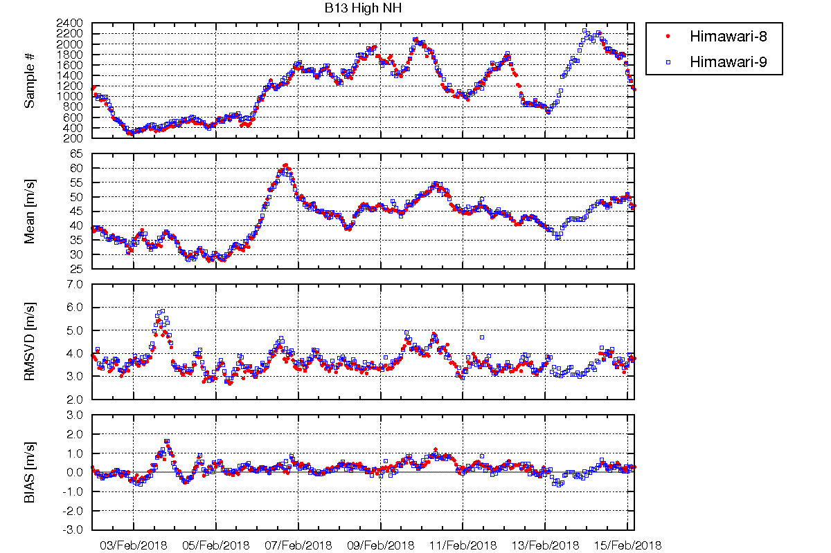
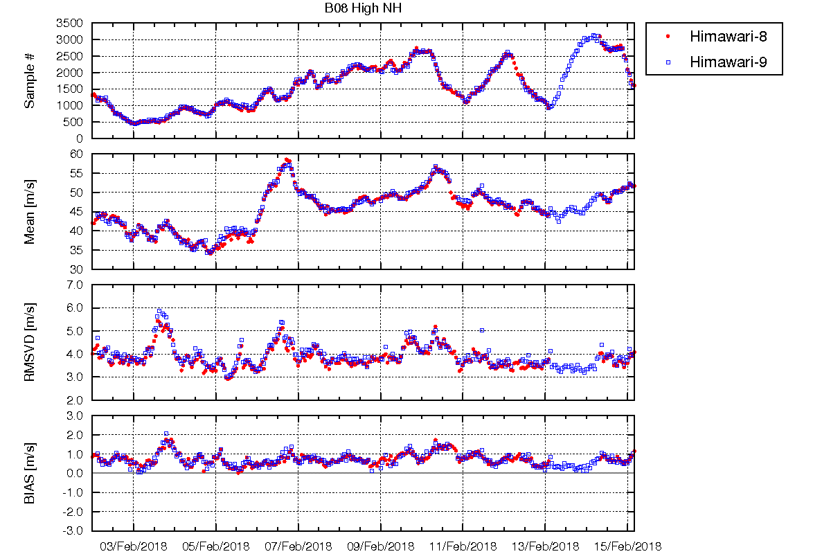
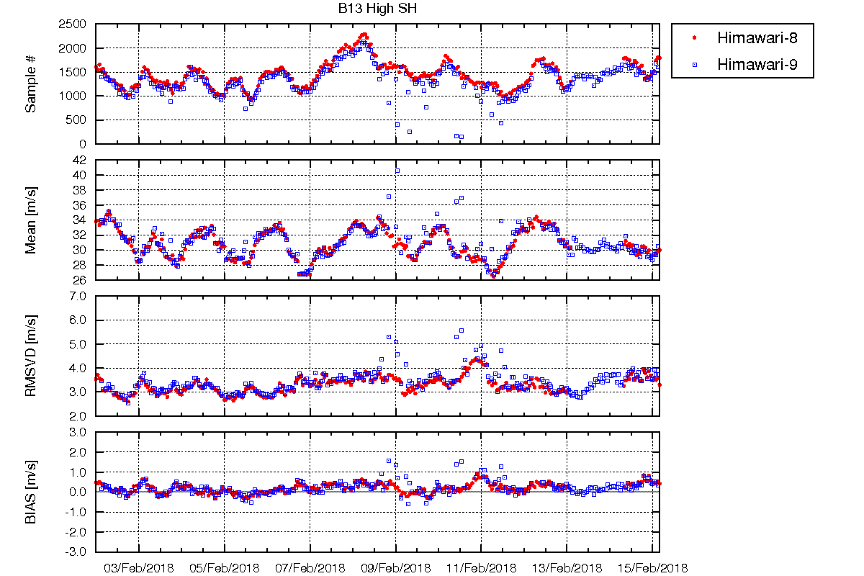
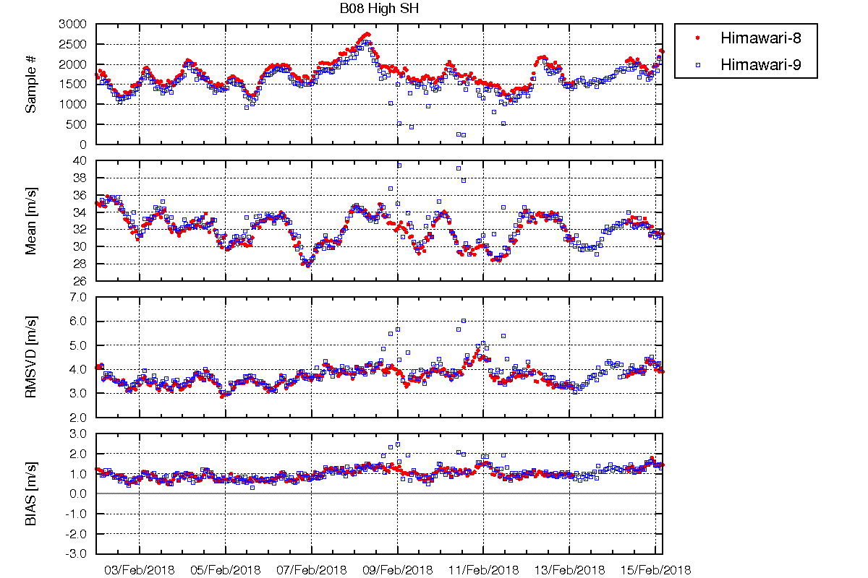
Time Series of O-B Statistics of Himawari-9 AMV Health Check (02 – 15 Feb, 2018)
including H-9 Backup Operation (13 – 14 Feb, 2018)
IR 10.4um North (>20N) Upper
WV 6.2um North (>20N) Upper
Backup op. of H-8
Backup op. of H-8
IR 10.4um South (>20S) Upper
WV 6.2um South (>20S) Upper
Himawari-9’s navigation was not stabilized. In this case, it especially affected to AMVs of SH and TR.
Its cause is now under investigation…

Slide 13
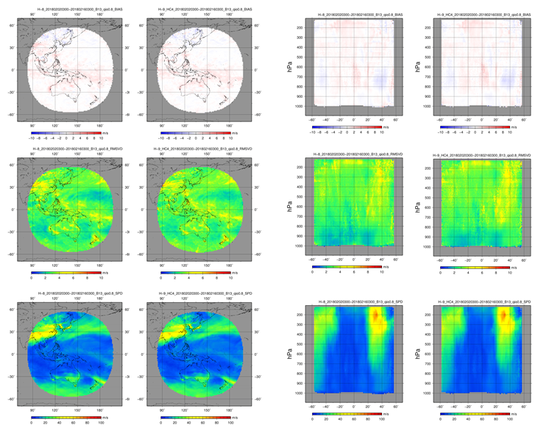
O-B statistics of Himawari-8 and -9 @HC-4
IR (Band13, 10.4um)
QI(w/oFCST)>0.8
Himawari-8
Himawari-9
Himawari-8
Himawari-9
BIAS
BIAS
RMSVD
RMSVD
SPD
SPD

Slide 14
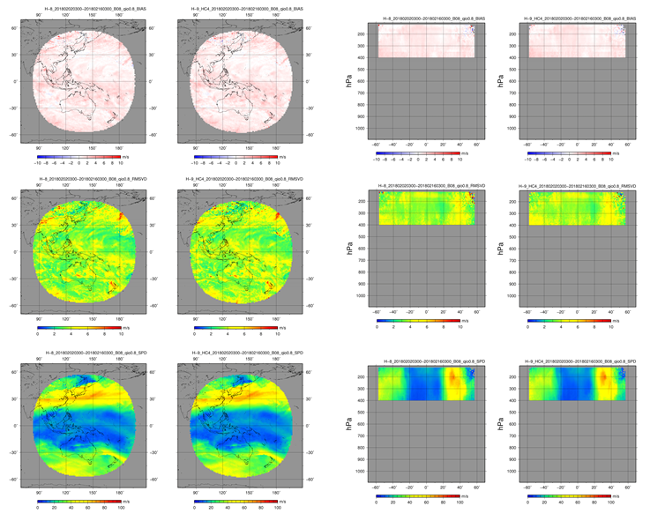
O-B statistics of Himawari-8 and -9 @HC-4
WV (Band08, 6.2um)
QI(w/oFCST)>0.8
Himawari-8
Himawari-9
Himawari-8
Himawari-9
BIAS
BIAS
RMSVD
RMSVD
SPD
SPD

Slide 15
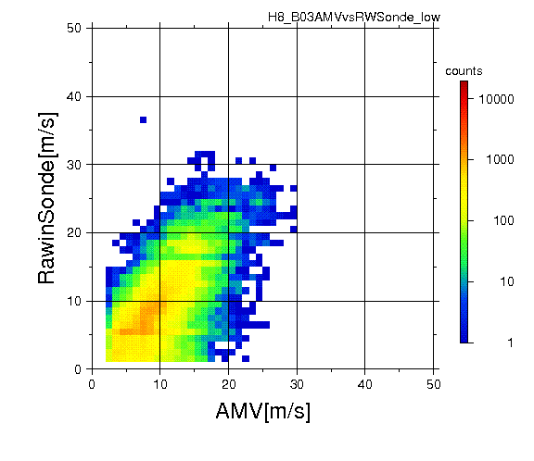
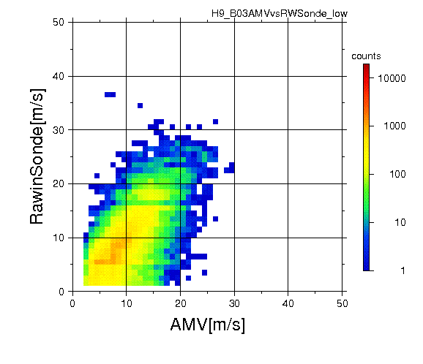
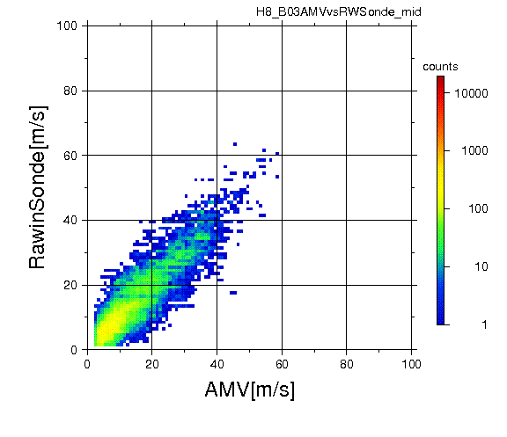
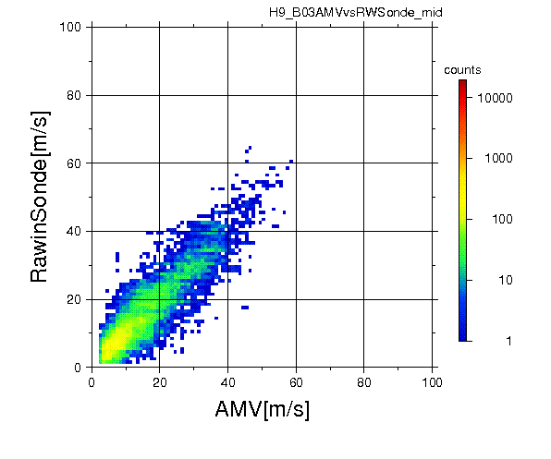
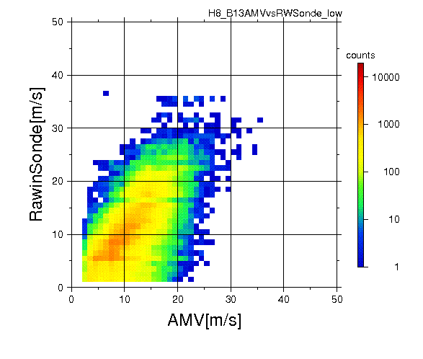
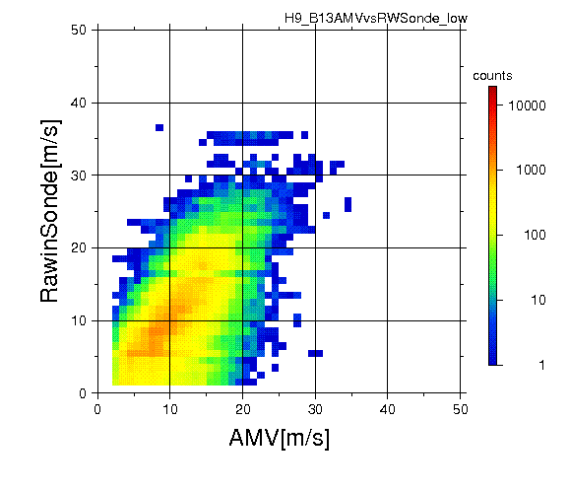
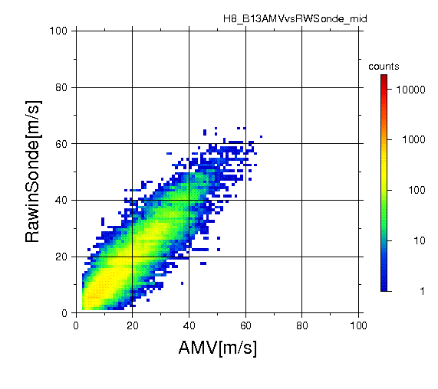

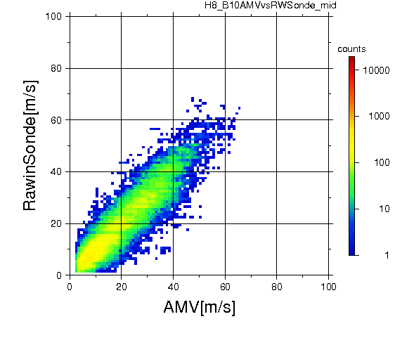

Rawinsonde statistics of Himawari-8 and -9 @HC-4
VIS(0.64um) Lower
VIS(0.64um) Mid
Himawari-8
Himawari-8
Himawari-9
Himawari-8
Himawari-9
IR(10.4um) Lower
IR(10.4um) Mid
Himawari-8
Himawari-9
Himawari-8
Himawari-9
WV(7.3um) Mid
Himawari-8
Himawari-9
Sonde Statistics Collocation cond.
QI(w/ fcst) > 0.85
within 150 km FM station
AMV Height within 50hPa (< 700hPa)
AMV Height within 35hPa (>700hPa)

Slide 16
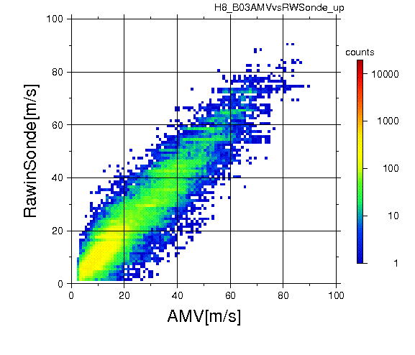

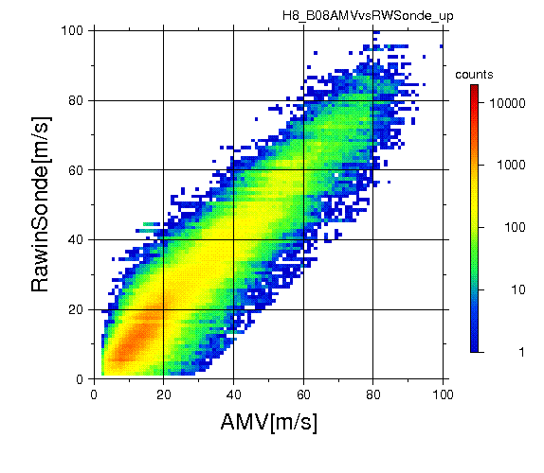
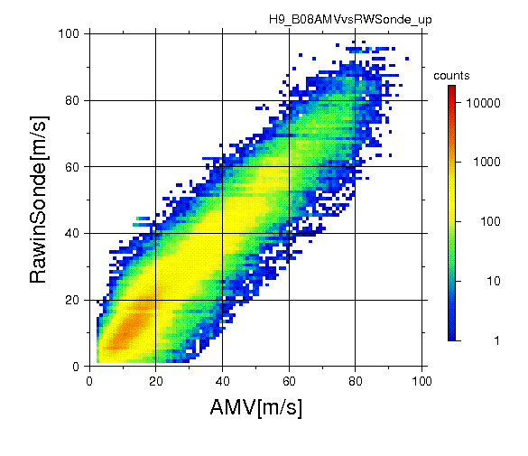
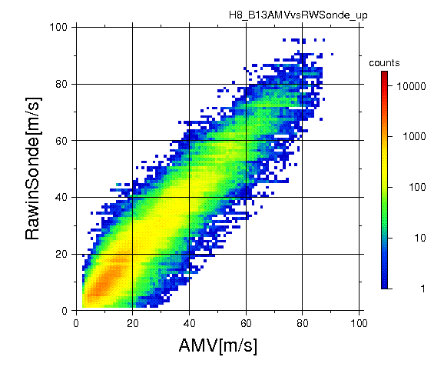
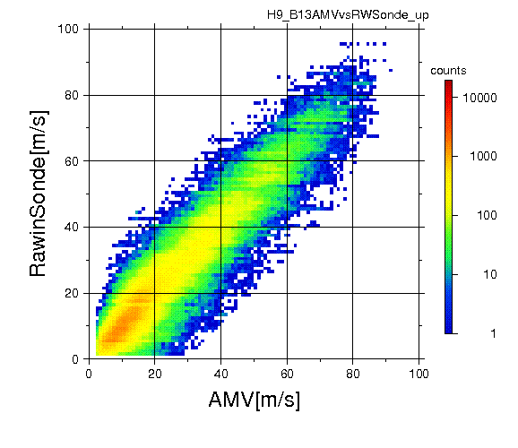
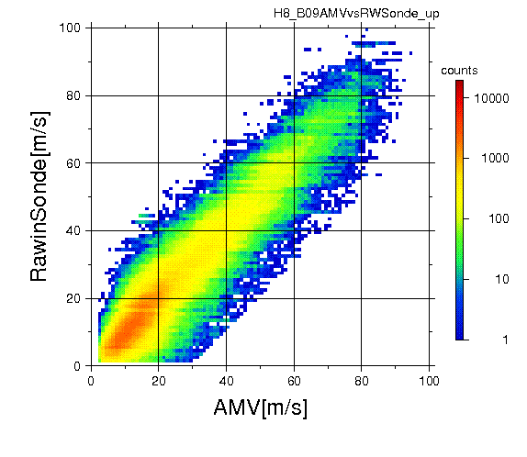
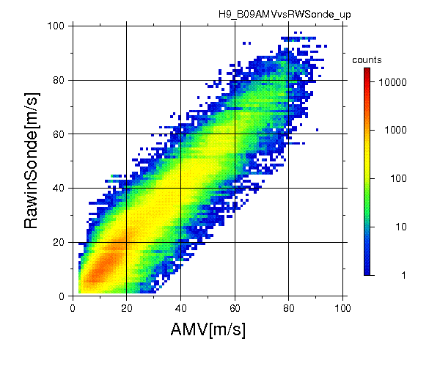

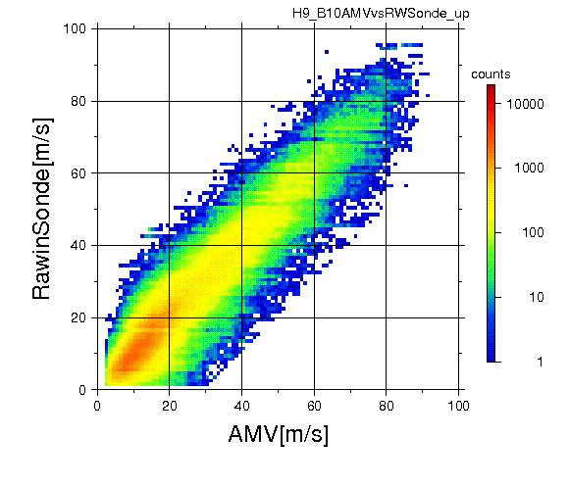
Rawinsonde statistics of Himawari-8 and -9 @HC-4
VIS(0.64um) Upper
WV(6.2um) Upper
Himawari-8
Himawari-9
Himawari-8
Himawari-9
IR(10.4um) Upper
WV(6.9um) Upper
Himawari-8
Himawari-9
Himawari-8
Himawari-9
WV(7.3um) Upper
Himawari-8
Himawari-9
Sonde Statistics Collocation cond.
QI(w/ fcst) > 0.85
within 150 km FM station
AMV Height within 50hPa (< 700hPa)
AMV Height within 35hPa (>700hPa)

Slide 17
Contents
Mission schedule and configuration of Himawari-8/-9
Navigation and Calibration errors of Himawari-8/-9
AMV of health check operations of Himawari-9
  Comparison between H-8 AMV and H-9 AMV by using the Health Check data
Current status of Himawari-8/9 AMV
Summary

Slide 18
Current Status of Himawari-8/9 AMV
AMV for global NWP
AMV for global NWP
spatial density : 34 km at nadir
temporal density : Hourly computed
Input data resolution : 2km and 10 min.
High-resolution AMV for global NWP
spatial density : 18 km at nadir (x 3)
temporal density : half-hourly computed (x 2)
Input data resolution : 2km and 10 min.
AMV for mesoscale NWP
Hi-Res AMVs and RS-AMVs
→ ・typhoons monitoring
・NWP trial using
from July 2017 (now internal only)
AMV for mesoscale NWP (Japan area)
spatial density : 20 km at nadir
temporal density : Hourly computed
target box size : 7x7 and 31x31 pixels
Input data resolution : 2km and 10 min.
RS-AMV for Japan area
spatial density : 3.5 km at nadir
temporal density : 10 min.
target box size : 7x7 and 31x31 pixels
Input data resolution
  IR and WV : 2km and 5 min.
  VIS : 0.5km and 2.5min.
RS-AMV for target observation
spatial density : 2.5 km at nadir
temporal density : 10 min.
target box size : 5x5 and 31x31 pixels
Input data resolution
  IR and WV : 2km and 5 min.
  VIS : 0.5km and 2.5min.
New AMV products started providing operationally from July 2017 for internal users .
Dissemination of new products to overseas is planed to start after establishment of transmission way

Slide 19
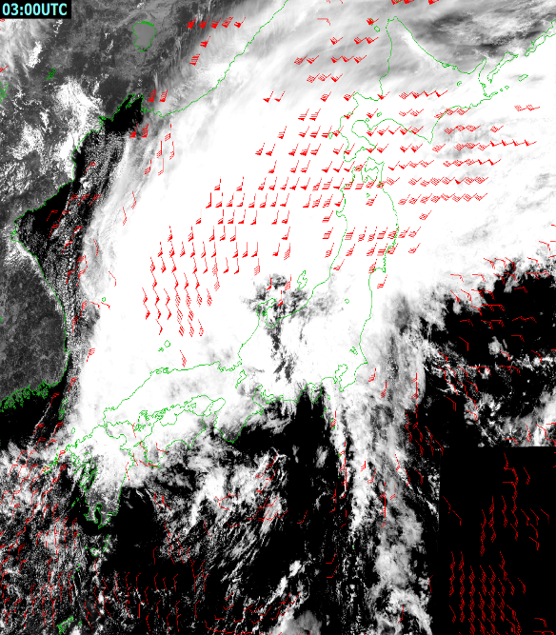
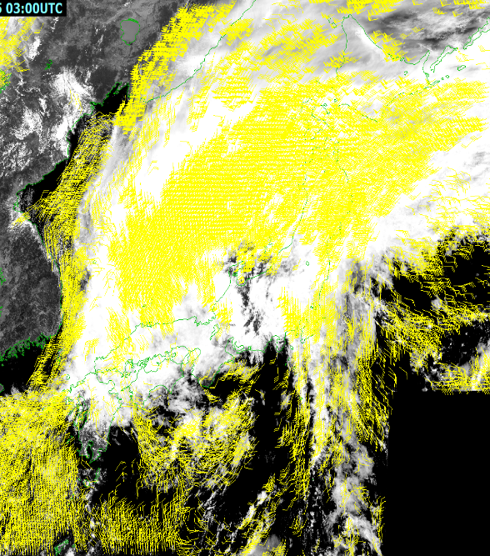
Himawari-8 RS-AMVs for mesoscale NWP
Severe heavy rainfall event occurred in Kanto and Tohoku regions of Japan, 9 to 11 Sep. 2015.
courtesy of Kunii, M. , JMA
03 UTC 9 Sep. 2015
Himawari-8 AMVs (operational)
RapidScan-AMVs
Quantity is enhanced in Himawari-8 RapidScan AMVs

Slide 20
Impact of RS-AMVs on mesoscale NWP
Example of the RS-AMVs were assimilated by a mesoscale regional model.
Severe heavy rainfall
Kanto and Tohoku region in Japan in Sep. 2015
3-hr accumulated rainfall (mm)
OSE at JMA/MRI with NHM-LETKF.
15UTC 9 Sep., 2015
JMA/RAP Observation
FCST: w/o H-8 RS-AMV
FCST: w/ H-8 RS-AMV
The forecasted band of intense rain was shifted eastward and is closer to the observation by the assimilation of the RS-AMVs from Himawari-8.
Kunii, M. et al., 2016: Ensemble Data Assimilation and Forecast Experiments for the September 2015 Heavy Rainfall Event in Kanto and Tohoku Regions with Atmospheric Motion Vectors from Himawari-8. SOLA, 12, 209-214.

Slide 21
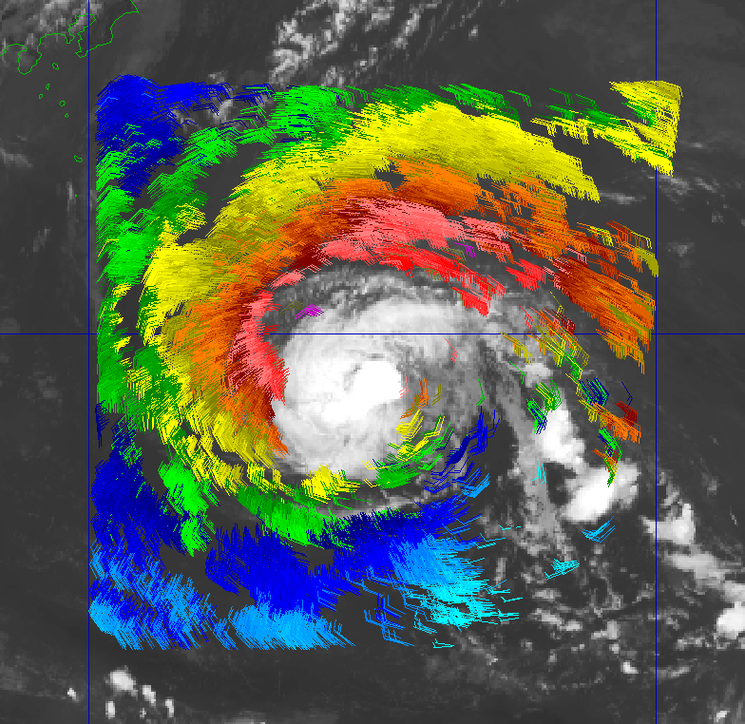
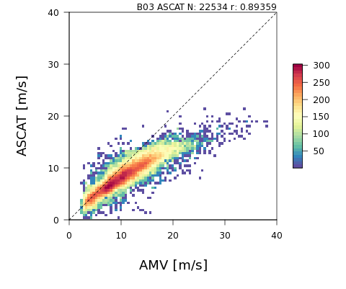
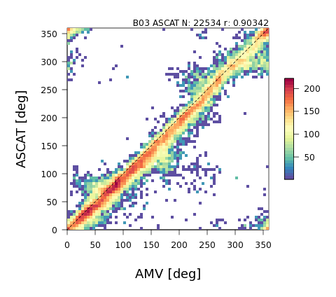

Himawari-8 RS-AMVs for typhoon analysis
Between low level AMVs and sea surface winds of ASCAT, they have good correlation around a typhoon. Sea surface winds estimated from low-level AMVs are provided to the Tokyo Typhoon Center to use for their operational typhoon analysis.
low-level AMV vs ASCAT
Low level AMVs (AMV height ≥ 700hPa , QI(w/o forecast) ≥ 0.8)
To estimate ocean wind speed by low-level AMVs around a typhoon using linear regression
-> monitor typhoons
Estimated sea surface wind by VIS AMV 03UTC 26 Jul. 2017
Estimated sea surface wind from the low-level RS-AMVs (IR and VIS) that are calculated every 10min using 5min/2.5min interval images.

Slide 22
Summary
Himawari-9 was launched in Nov 2016 and its backup operation of Himawari-8 started from May, 2017.
H-9 health check operations has been performed and its AMVs were checked by using these data. AMVs of Himawari-8 and -9 had almost same statistical features.
Health Check operations of Himawari-9 are planned a few times a year and Himawari-9 and its AMV will be checked continuously.
RS/Hi-res AMV of Himawari-8/9 has begun to be used for JMA’s typhoon monitoring and has started to be used for assimilation studies.

Slide 23
Other Topics of Himawari-8/9 AMV
Himawari-8 AMVs were not disseminated due to the image quality degradation during 25 March, 2018. The quality degradations were related with image navigation and it had occurred occasionally since 10 March, 2018. But this anomaly was restored at 02UTC 27 March, 2018.
JMA’s super computer system is updated on Jun 2018. Himawari AMVs are derived and are provide by the new system from this time.

Slide 24
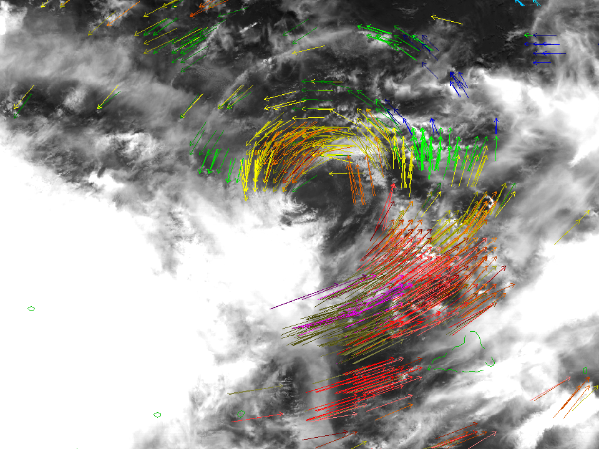
감사합니다
Thank you

Slide 25
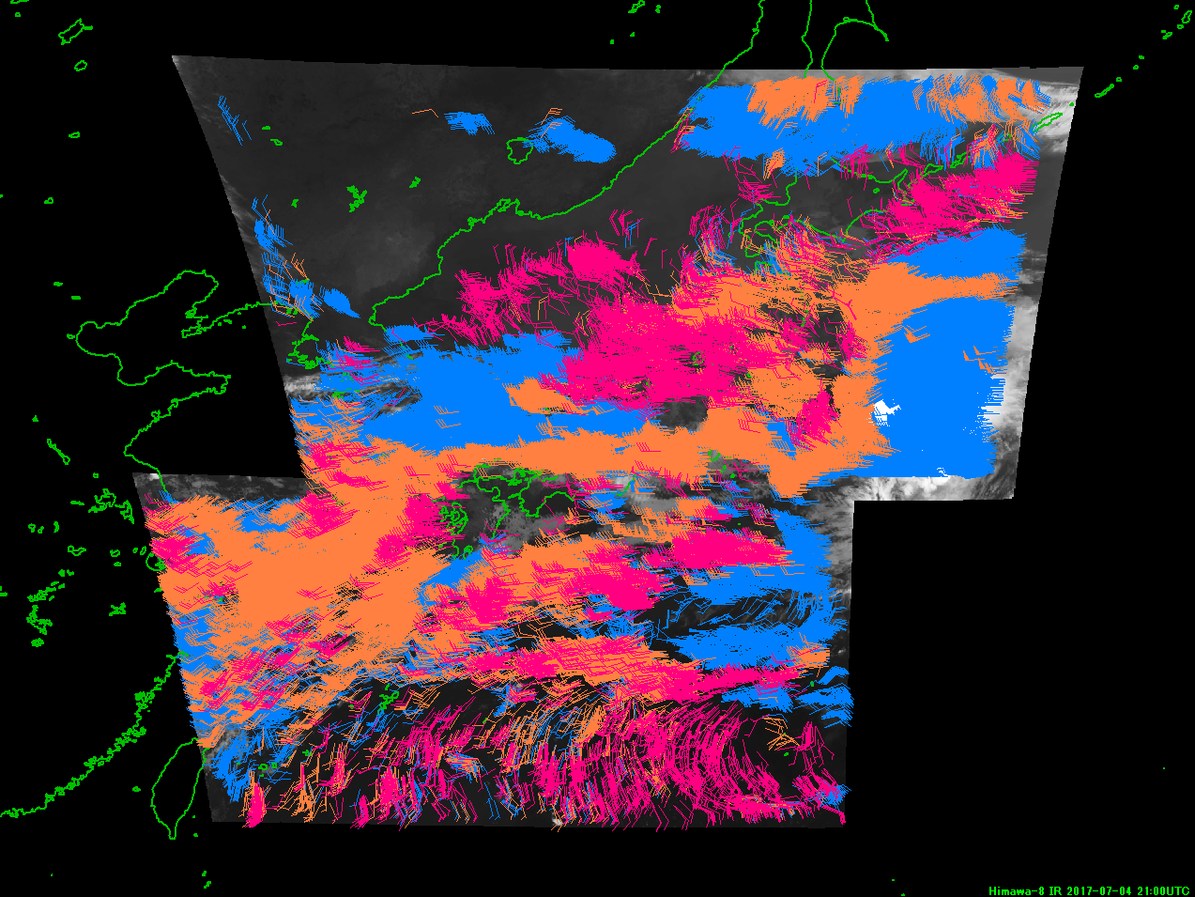
Rapid Scan AMV (RS-AMV) from
AHI Japan area observation
<- AMV derived from IR (10.4um) imagery
Resolution: 2km
Interval: 5min
Blue: High level (<400hPa)
Orange: Medium level (400-700hPa)
Magenta: Low-level (>700hPa)
Target box size :
7x7 (14km) and
31x31 (62km) pixels

Slide 26
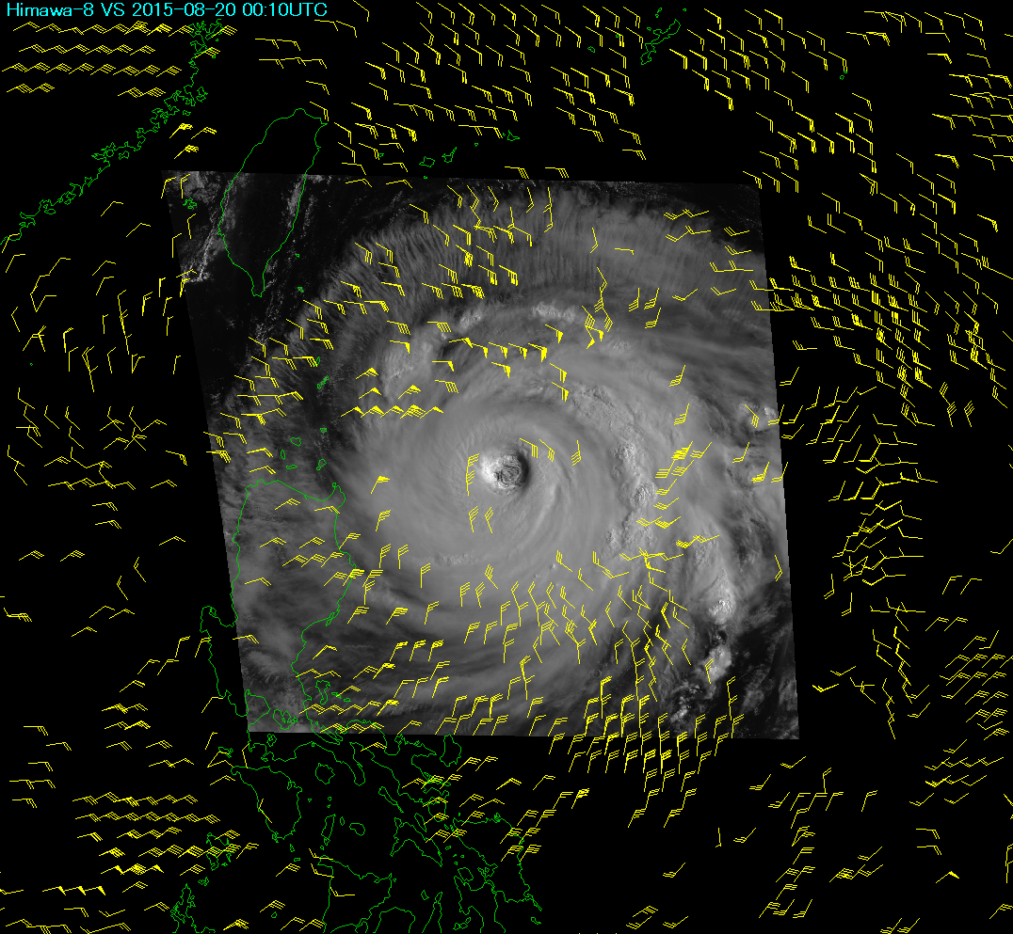
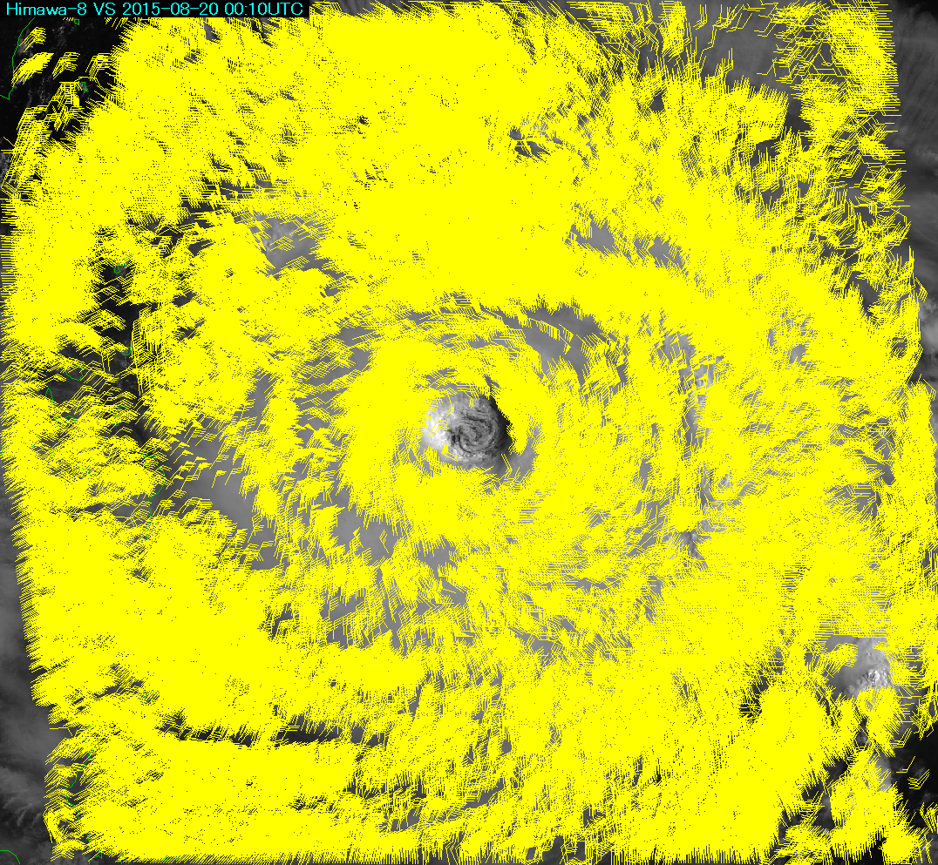
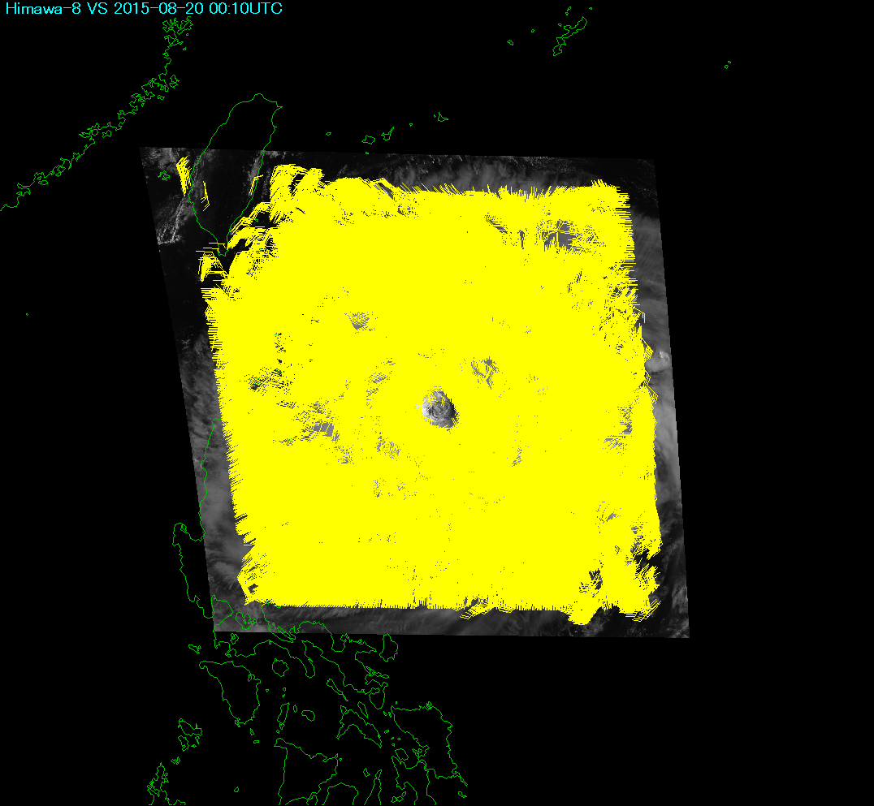
RS-AMV from AHI target observation (Typhoon)
Operational Himawari-8 AMV
IR and VIS AMVs (QI>60, 00UTC August 20th 2015 )
Increase of data quality and quantity ->
Improvement on temporal and spatial resolution
Using 10 min. and 2 km resolution
Himawari-8 Rapid Scan AMV
Target box size : 5x5 (2.5km) and 31x31 (15km) pixels
Using 2.5 min. and 0.5 km (VIS)

Slide 27
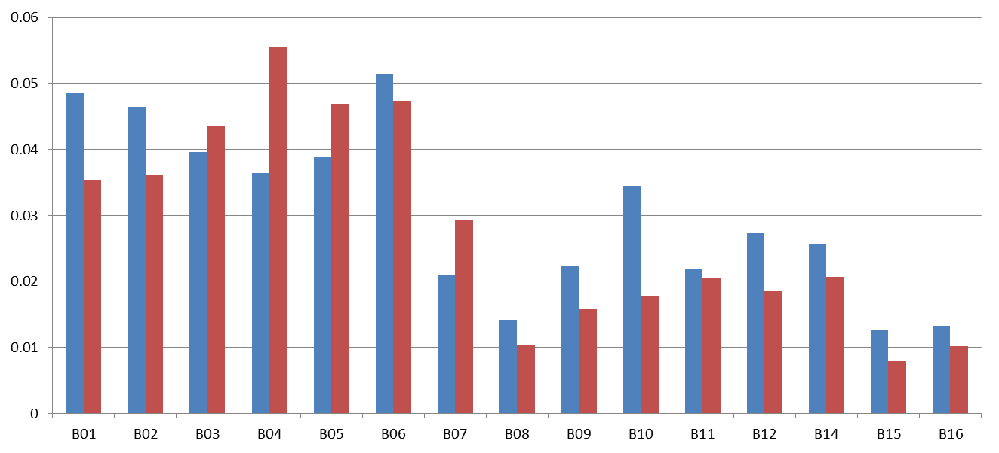
Band-to-band co-registration errors
in AHI-8/-9
Band-to-Band Co-registration Errors with regard to B13
(diurnally-averaged value on 25 Feb. 2017)
Himawari-8/AHI
Himawari-9/AHI
[km at SSP]
0.47 0.51 0.64 0.86 1.6 2.3 3.9 6.2 6.9 7.3 8.6 9.6 11.2 12.4 13.3 [μm]
Less than 1.6 μrad (0.06 km) at sub satellite point

Slide 28
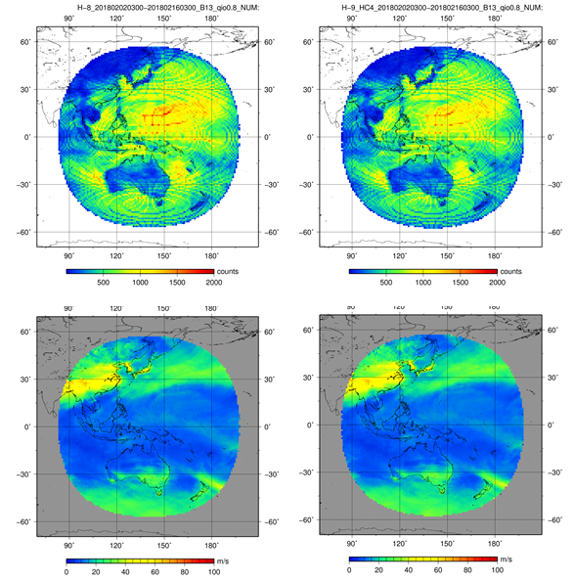
First guess departure O-B statistics H-8 vs H-9 @HC-4
H-8 IR NUM
H-9 IR NUM
H-8 IR SPD
H-9 IR SPD
QI(w/oFCST)>0.8

Slide 29
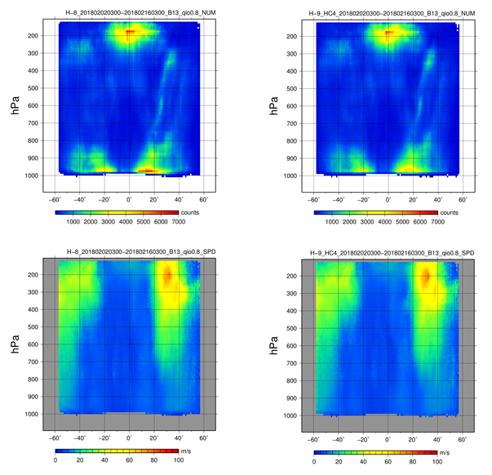
First guess departure O-B statistics H-8 vs H-9 @HC-4
H-8 IR NUM
H-9 IR NUM
H-8 IR SPD
H-9 IR SPD
QI(w/oFCST)>0.8

