Slide 1
Technical and scientific verifications of the EUMETSAT MTG-FCI AMV prototype
Manuel Carranza
Régis Borde

Slide 2
Summary
The MTG-FCI AMV prototype
Comparison of the MSG and MTG-FCI algorithms
Results of the MTG-FCI algorithm with Himawari-8 data
Estimation of AMV speed and direction errors
Future work

Slide 3
The MTG-FCI AMV prototype Characteristics of the AMV prototype
Largely based on the MSG AMV processor.
Processing based on three images, instead of four.
CCC method used for tracking.
Final AMV coordinates set to the position of the tracked feature, not the centre of the target box.
OCA used as main height assignment method, instead of CLA.
Computation of AMV height standard deviation and height error.
No intermediate product averaging. Second intermediate component used as final product instead.

Slide 4
The MTG-FCI AMV prototype Status of the AMV prototype
Able to run with MSG data.
Adapted to use Himawari-8 data from various sources:
JMA
KMA
3rd AMV Intercomparison Study (using ACHA cloud-top product)
MTG-FCI Level-2 test data expected for this year.
Possibility to adapt the prototype to GOES-R data (time permitting).

Slide 5
Summary
The MTG-FCI AMV prototype
Comparison of the MSG and MTG-FCI algorithms
Results of the MTG-FCI algorithm with Himawari-8 data
Estimation of AMV speed and direction errors
Future work

Slide 6
Comparison of the MSG and MTG-FCI algorithms Test case
Comparison of the algorithms using the same MSG images and ancillary data.
One month of data: 14/05/2016 – 14/06/2016.
Channels used:
channel 2 (VIS 0.2 µm);
channel 5 (WV 6.2 µm, only cloudy AMVs);
channel 6 (WV 7.3 µm, only cloudy AMVs);
channel 9 (IR 10.8 µm, several target box sizes).
Results filtered by QI > 80% (forecast independent).
Statistics computed against forecast.

Slide 7
Comparison of the MSG and MTG-FCI algorithms Algorithm similarities and differences
The MTG-FCI algorithm used is very similar to that of MSG:
3 km spatial resolution;
15 minutes temporal resolution;
CCC method used for tracking;
OCA used as main height assignment method.
The main differences are:
three images (at HH:15, HH:30, HH:45) instead of four (at HH:00, HH:15, HH:30, HH:45);
reference image at HH:30 (backward plus forward tracking) instead of HH:00 (only forward tracking);
no intermediate product averaging; the second component is used as final product instead.

Slide 8
Comparison of the MSG and MTG-FCI algorithms Average number of AMVs per product and channel
 | VIS 0.2 µm
 | MSG 24 | MTG 24 | MTG – MSG
all | 3,425 | 3,831 | +11.9%
high | 830 | 829 | –0.1%
mid | 591 | 705 | +19.3%
low | 2,004 | 2,297 | +14.6%
 | WV 6.2 µm (cloudy)
 | MSG 24 | MTG 24 | MTG – MSG
all | 4,038 | 4,076 | +0.9%
high | 3,880 | 3,857 | –0.6%
mid | 158 | 219 | +38.6%
low | – | – | –
 | WV 7.3 µm (cloudy)
 | MSG 24 | MTG 24 | MTG – MSG
all | 5,151 | 5,137 | –0.3%
high | 4,073 | 4,028 | –1.1%
mid | 1,078 | 1,109 | +2.9%
low | – | – | –
 | IR 10.8 µm
 | MSG 24 | MTG 24 | MTG – MSG
all | 7,610 | 8,228 | +8.1%
high | 3,358 | 3,317 | –1.2%
mid | 1,189 | 1,349 | +13.5%
low | 3,062 | 3,560 | +16.3%

Slide 9
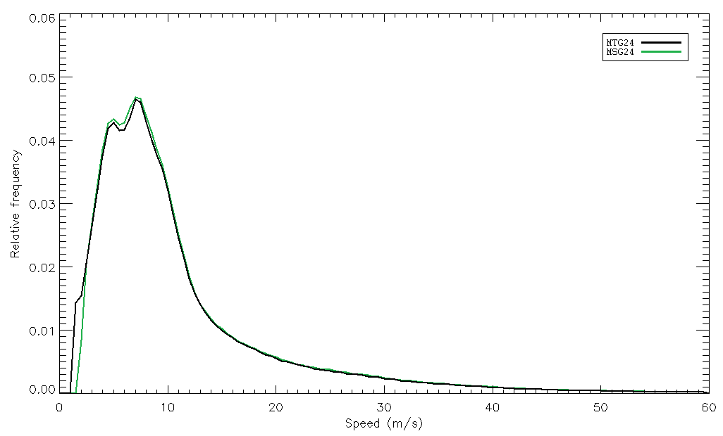
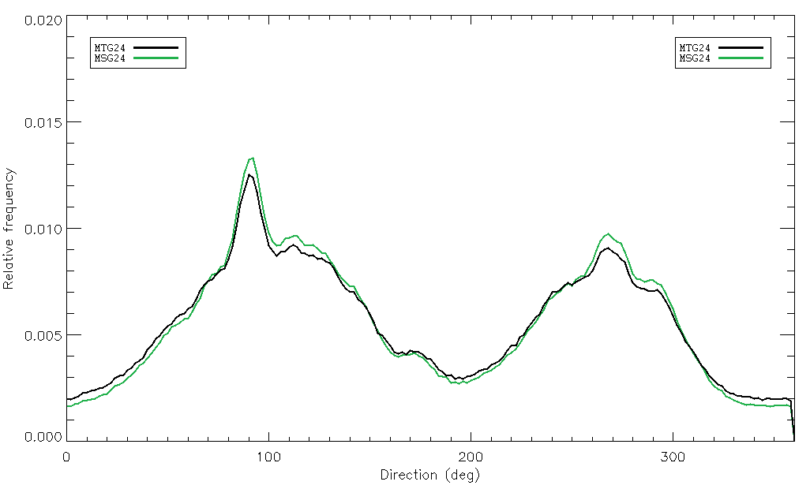
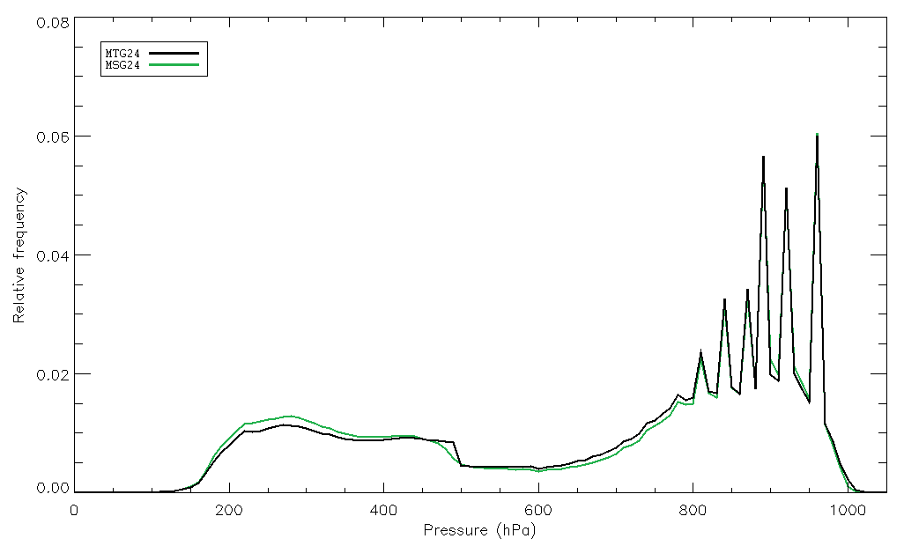
Comparison of the MSG and MTG-FCI algorithms Normalised AMV histograms – VIS 0.2 µm
Histograms are very similar.
MSG AMVs slightly faster (fewer mid- and low-level AMVs).
Directions vary slightly due to MSG averaging.
MSG AMVs slightly higher (fewer mid- and low-level AMVs).

Slide 10
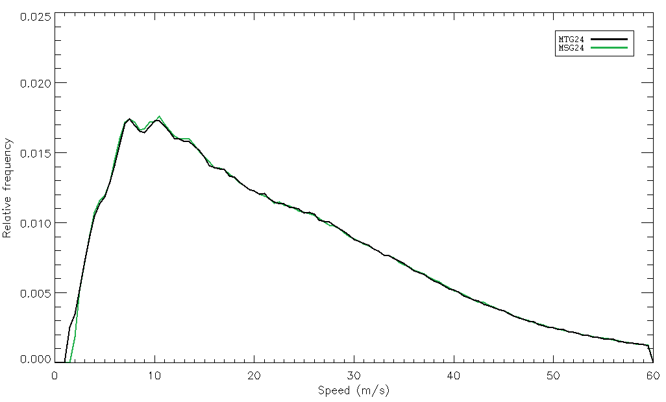
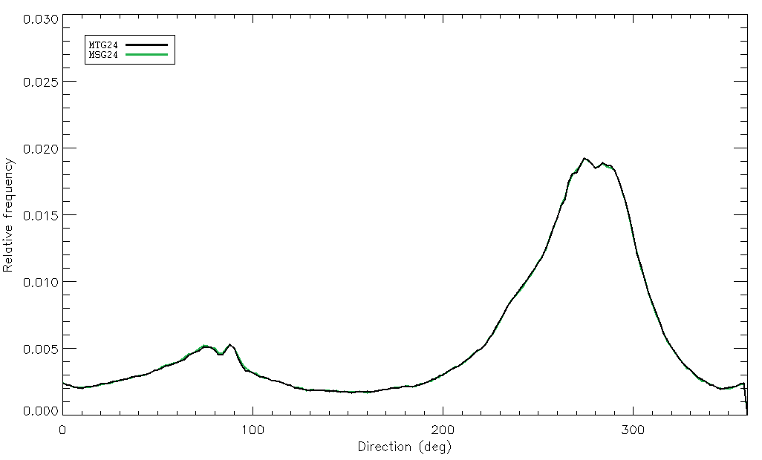
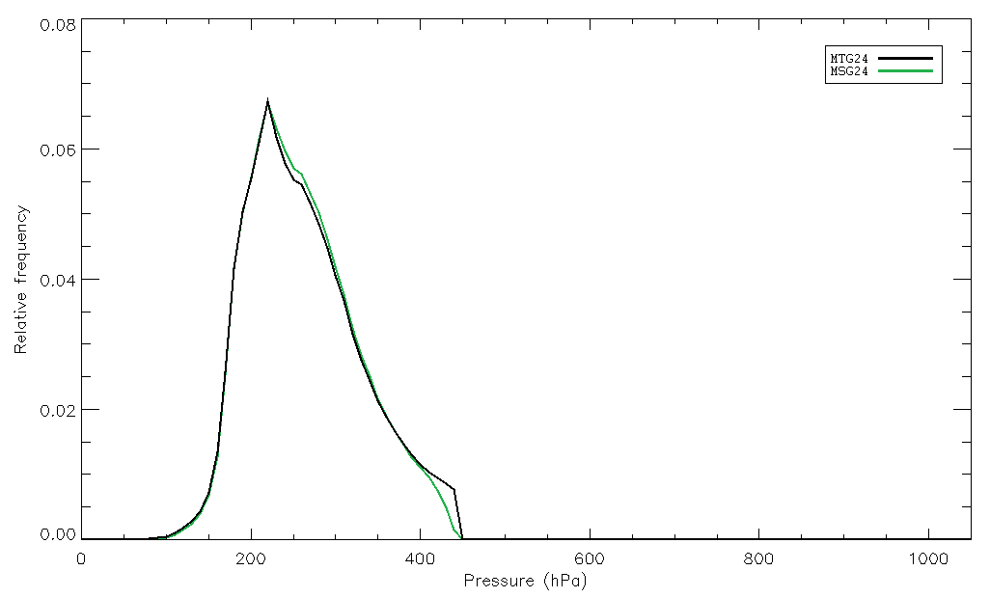
Comparison of the MSG and MTG-FCI algorithms Normalised AMV histograms – WV 6.2 µm (cloudy)
Histograms are almost identical.
MSG AMVs marginally faster (fewer mid-level AMVs).
Direction distribution identical.
MSG AMVs marginally higher (fewer mid-level AMVs).

Slide 11
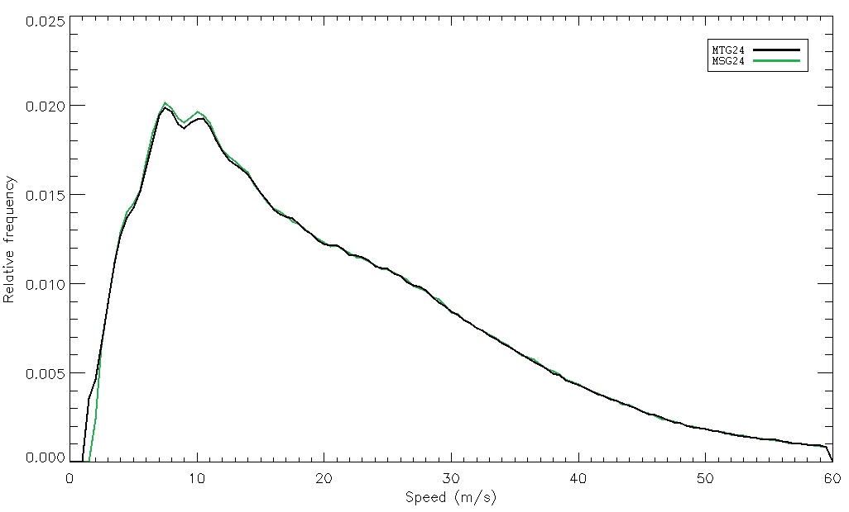
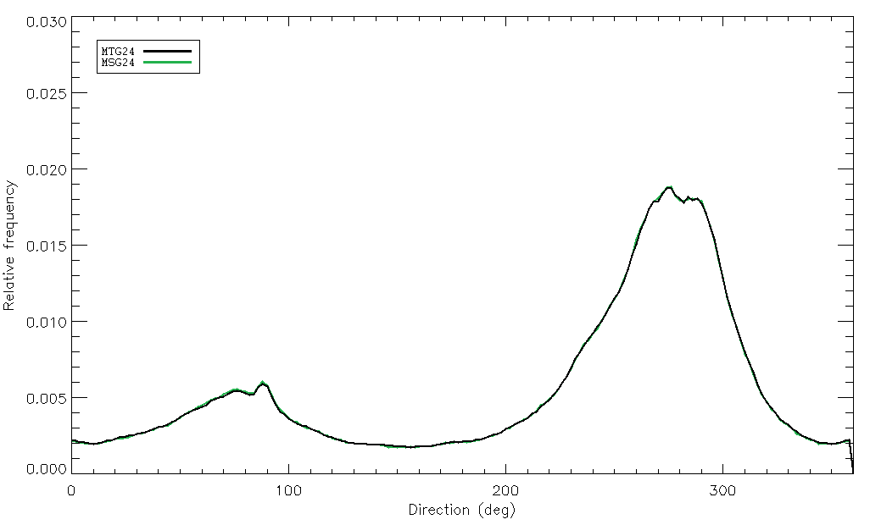
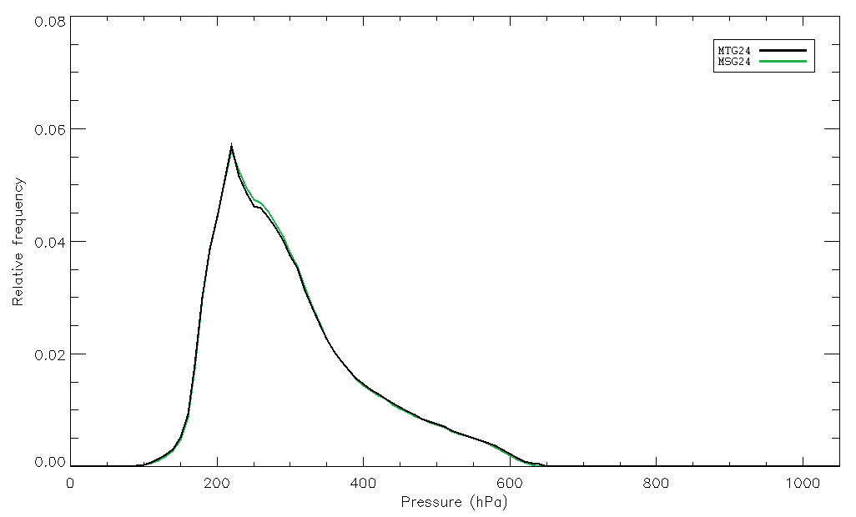
Comparison of the MSG and MTG-FCI algorithms Normalised AMV histograms – WV 7.3 µm (cloudy)
Histograms are almost identical.
MSG AMVs marginally faster (fewer mid-level AMVs).
Direction distribution identical.
MSG AMVs marginally higher (fewer mid-level AMVs).

Slide 12
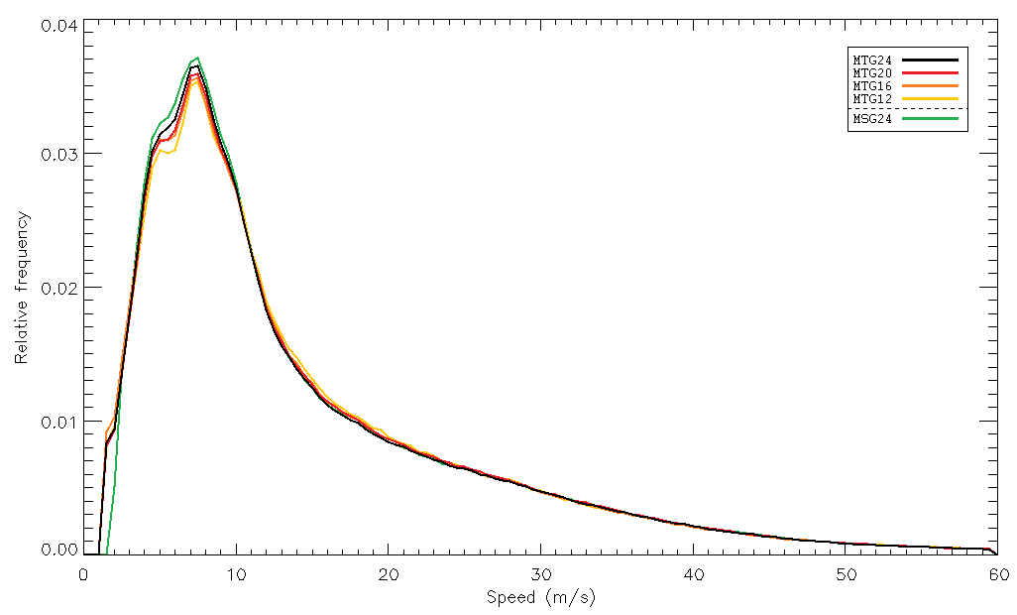
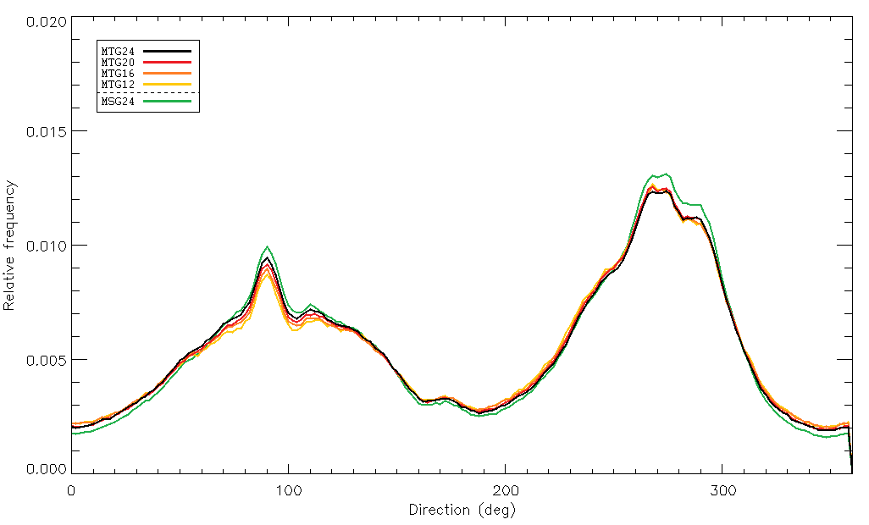
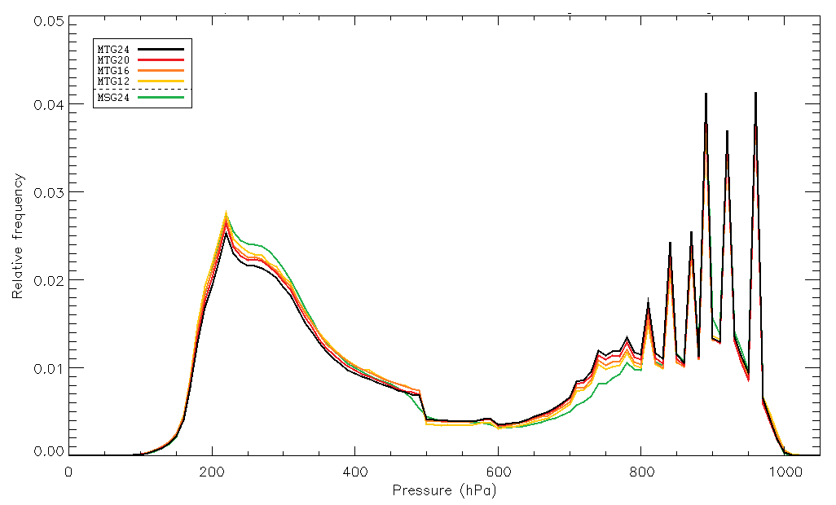
Comparison of the MSG and MTG-FCI algorithms Normalised AMV histograms – IR 10.8 µm
Histograms are very similar.
MSG AMVs slightly faster (fewer mid- and low-level AMVs).
Directions vary slightly due to MSG averaging.
MSG AMVs slightly higher (fewer mid- and low-level AMVs).

Slide 13
Comparison of the MSG and MTG-FCI algorithms Average speed bias and NRMS against forecast – VIS 0.2 µm
 | Speed bias – MSG 24
 | GLO | NH | TR | SH
all | 0.39 | 1.22 | 0.75 | –2.90
high | –0.04 | 2.29 | 0.29 | –5.97
mid | 0.01 | 0.55 | 0.25 | –3.26
low | 0.12 | –0.15 | 0.73 | –1.52
 | Speed bias – MTG 24
 | GLO | NH | TR | SH
all | 0.29 | 1.13 | 0.75 | –3.22
high | –0.14 | 2.17 | 0.20 | –6.02
mid | –0.10 | 0.44 | 0.42 | –3.38
low | 0.04 | –0.37 | 0.85 | –1.70
 | NRMS – MSG 24
 | GLO | NH | TR | SH
all | 0.47 | 0.49 | 0.48 | 0.39
high | 0.43 | 0.44 | 0.52 | 0.33
mid | 0.52 | 0.56 | 0.55 | 0.40
low | 0.39 | 0.48 | 0.37 | 0.41
 | NRMS – MTG 24
 | GLO | NH | TR | SH
all | 0.46 | 0.48 | 0.47 | 0.39
high | 0.43 | 0.44 | 0.51 | 0.33
mid | 0.51 | 0.55 | 0.53 | 0.41
low | 0.39 | 0.45 | 0.37 | 0.41

Slide 14
Comparison of the MSG and MTG-FCI algorithms Average speed bias and NRMS against forecast – WV 6.2 µm
 | Speed bias – MSG 24
 | GLO | NH | TR | SH
all | 0.48 | 3.36 | 1.69 | –2.82
high | 0.40 | 3.38 | 1.67 | –3.15
mid | 2.31 | 3.19 | 3.44 | 1.67
low | – | – | – | –
 | Speed bias – MTG 24
 | GLO | NH | TR | SH
all | –0.40 | 1.92 | 0.97 | –2.03
high | –1.64 | 1.13 | 0.45 | –3.79
mid | 2.46 | 2.74 | 2.75 | 2.26
low | – | – | – | –
 | NRMS – MSG 24
 | GLO | NH | TR | SH
all | 0.38 | 0.43 | 0.50 | 0.28
high | 0.38 | 0.43 | 0.50 | 0.27
mid | 0.39 | 0.54 | 0.63 | 0.30
low | – | – | – | –
 | NRMS – MTG 24
 | GLO | NH | TR | SH
all | 0.39 | 0.52 | 0.55 | 0.31
high | 0.36 | 0.48 | 0.50 | 0.28
mid | 0.48 | 0.62 | 0.69 | 0.37
low | – | – | – | –

Slide 15
Comparison of the MSG and MTG-FCI algorithms Average speed bias and NRMS against forecast – WV 7.3 µm
 | Speed bias – MSG 24
 | GLO | NH | TR | SH
all | –0.20 | 2.22 | 1.09 | –3.22
high | –0.41 | 2.41 | 1.18 | –4.36
mid | 0.89 | 1.55 | 0.80 | 0.64
low | – | – | – | –
 | Speed bias – MTG 24
 | GLO | NH | TR | SH
all | –1.67 | 0.39 | 0.11 | –3.29
high | –2.43 | 0.38 | 0.03 | –4.71
mid | 0.24 | 0.30 | 0.42 | 0.25
low | – | – | – | –
 | NRMS – MSG 24
 | GLO | NH | TR | SH
all | 0.40 | 0.46 | 0.51 | 0.30
high | 0.39 | 0.44 | 0.50 | 0.30
mid | 0.43 | 0.58 | 0.57 | 0.32
low | – | – | – | –
 | NRMS – MTG 24
 | GLO | NH | TR | SH
all | 0.39 | 0.52 | 0.53 | 0.31
high | 0.37 | 0.48 | 0.50 | 0.30
mid | 0.45 | 0.63 | 0.62 | 0.35
low | – | – | – | –

Slide 16
Comparison of the MSG and MTG-FCI algorithms Average speed bias and NRMS against forecast – IR 10.8 µm
 | Speed bias – MSG 24
 | GLO | NH | TR | SH
all | –0.81 | 1.46 | 0.24 | –3.76
high | –1.22 | 2.28 | 0.10 | –5.67
mid | –0.38 | 0.79 | 0.30 | –2.02
low | –0.40 | –0.25 | 0.42 | –1.83
 | Speed bias – MTG 24
 | GLO | NH | TR | SH
all | –0.87 | 1.61 | 0.25 | –3.89
high | –1.22 | 2.25 | 0.08 | –5.63
mid | –0.19 | 1.08 | 0.48 | –1.91
low | –0.53 | –0.31 | 0.47 | –2.05
 | NRMS – MSG 24
 | GLO | NH | TR | SH
all | 0.43 | 0.47 | 0.47 | 0.35
high | 0.39 | 0.43 | 0.46 | 0.32
mid | 0.46 | 0.57 | 0.56 | 0.35
low | 0.38 | 0.49 | 0.36 | 0.37
 | NRMS – MTG 24
 | GLO | NH | TR | SH
all | 0.42 | 0.46 | 0.47 | 0.34
high | 0.39 | 0.42 | 0.45 | 0.30
mid | 0.46 | 0.55 | 0.56 | 0.33
low | 0.38 | 0.46 | 0.36 | 0.35

Slide 17
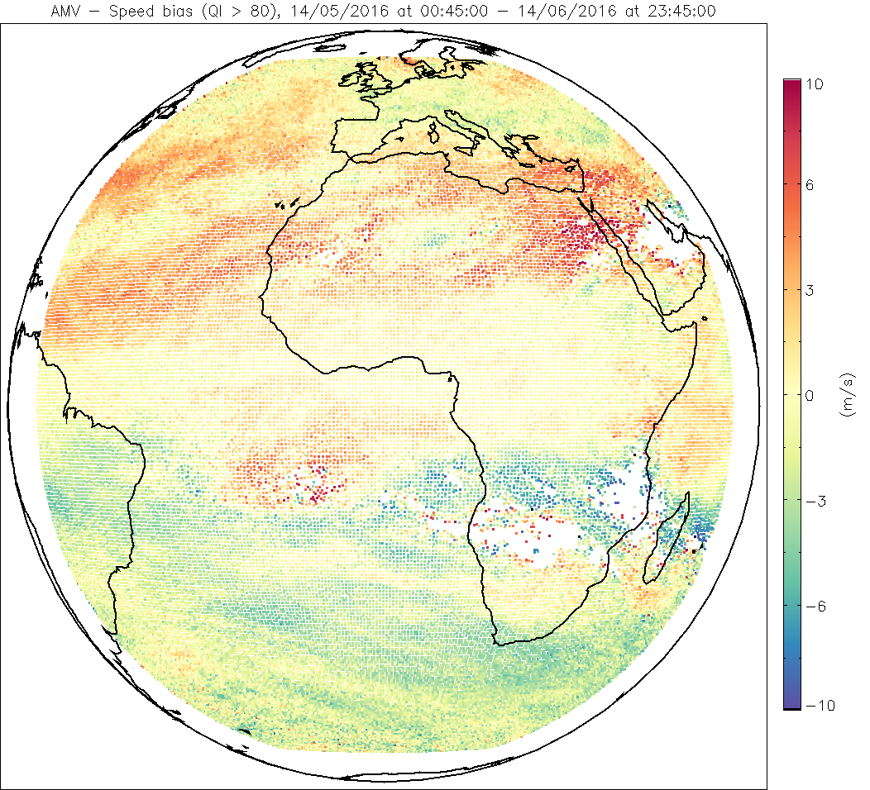
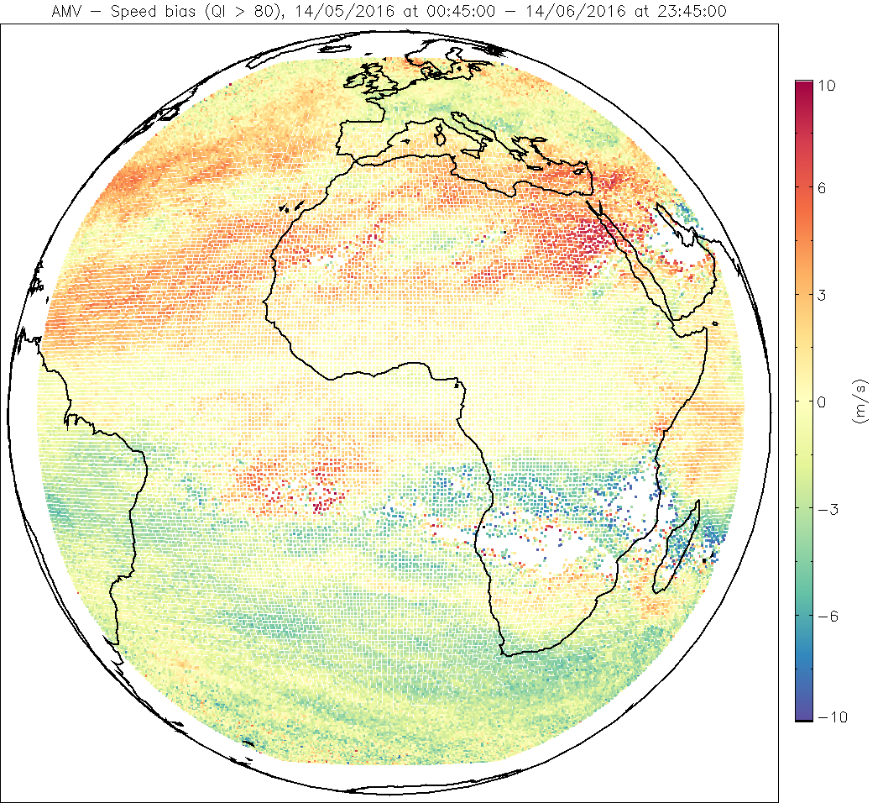
Comparison of the MSG and MTG-FCI algorithms Accumulated AMV speed bias against forecast – IR 10.8 µm, high levels
MSG 24
MTG 24

Slide 18
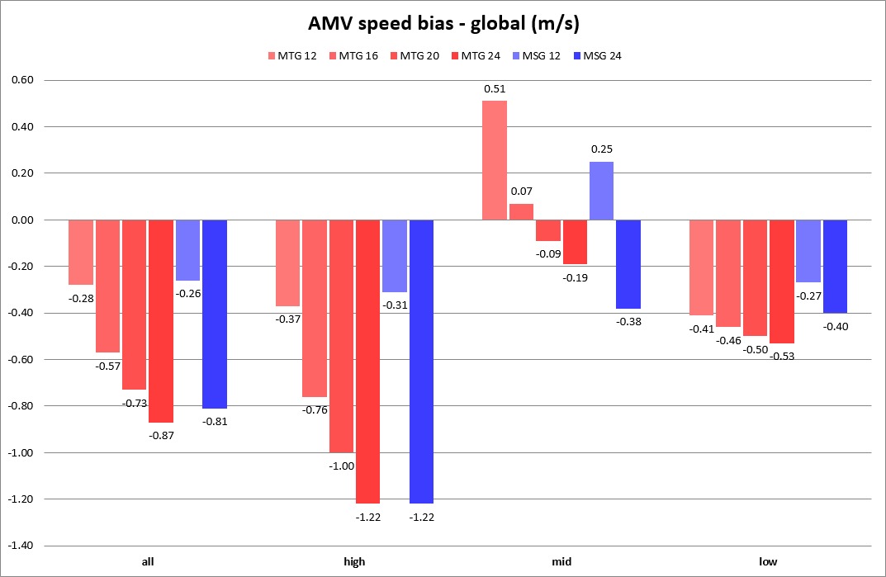
Comparison of the MSG and MTG-FCI algorithms AMV speed bias against forecast – IR 10.8 µm, global
AMVs too fast
AMVs too slow

Slide 19
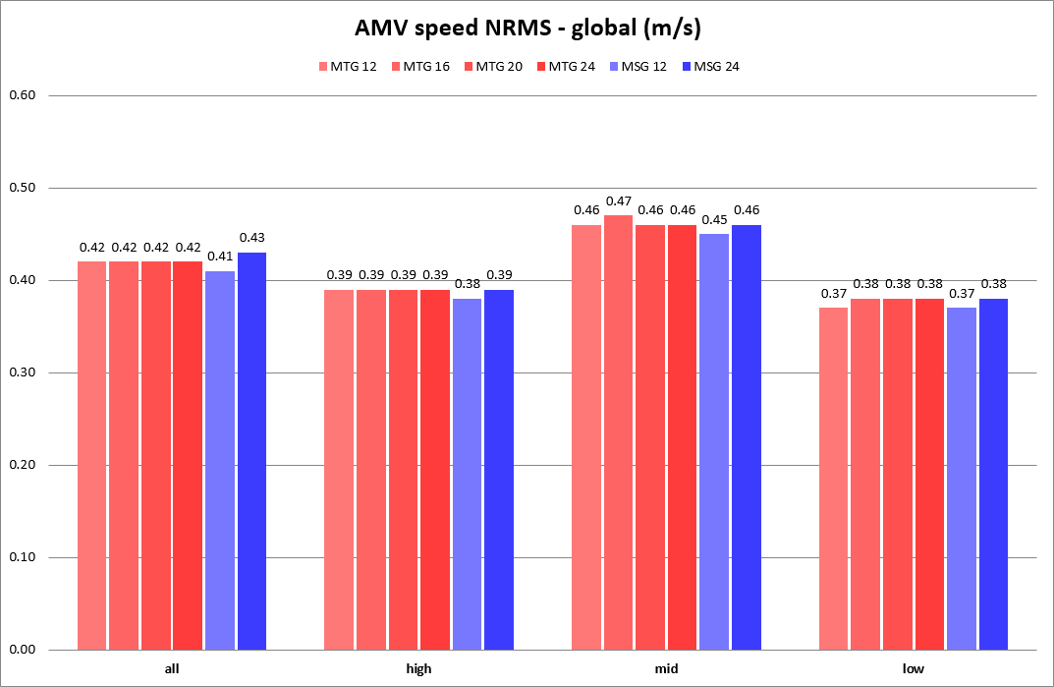
Comparison of the MSG and MTG-FCI algorithms AMV speed NRMS against forecast – IR 10.8 µm, global

Slide 20
Comparison of the MSG and MTG-FCI algorithms Conclusions
More AMVs for MTG than for MSG in general (especially for channels VIS 0.2 µm and IR 10.8 µm).
Normalised AMV histograms very similar for all channels, with slightly faster and higher AMVs for MSG for channels VIS 0.2 µm and IR 10.8 µm (fewer mid- and low-level AMVs).
AMV speed bias and NRMS against forecast very similar for both algorithms, for all levels and geographical areas.
VIS 0.2 µm and IR 10.8 µm: largest differences for mid-level and low-level AMVs (more AMVs for MTG than for MSG).
WV 6.2 µm and WV 7.3 µm: significant improvement for all levels in the northern hemisphere and tropical areas.
For channel IR 10.8 µm, the larger the target box size, the slower the AMVs and, thus, the larger the speed bias (in absolute value).
All in all, there seems to be no significant advantage in the averaging of intermediate products, as currently done for MSG.

Slide 21
Summary
The MTG-FCI AMV prototype
Comparison of the MSG and MTG-FCI algorithms
Results of the MTG-FCI algorithm with Himawari-8 data
Estimation of AMV speed and direction errors
Future work

Slide 22
Results of the MTG-FCI algorithm with Himawari-8 data Datasets
Available datasets:
JMA data from 24/08/2015;
JMA data from 17/03/2016 – 21/03/2016;
KMA data from 19/08/2015;
3rd AMV Intercomparison Study data (using ACHA cloud-top product).
Results from JMA data on 24/08/2015 partially available.
Results from JMA data on 19/03/2016 partially available. Full five-day period still to be processed.
Results from KMA data still to be processed.
Results from 3rd AMV Intercomparison Study fully available.

Slide 23
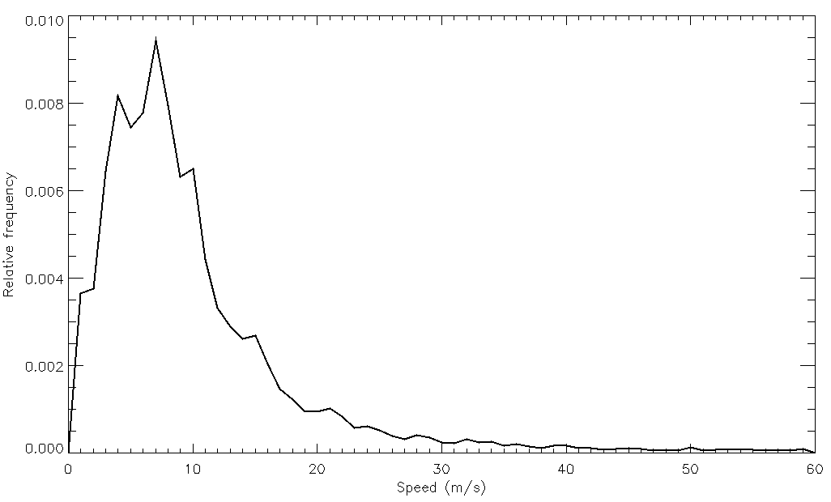
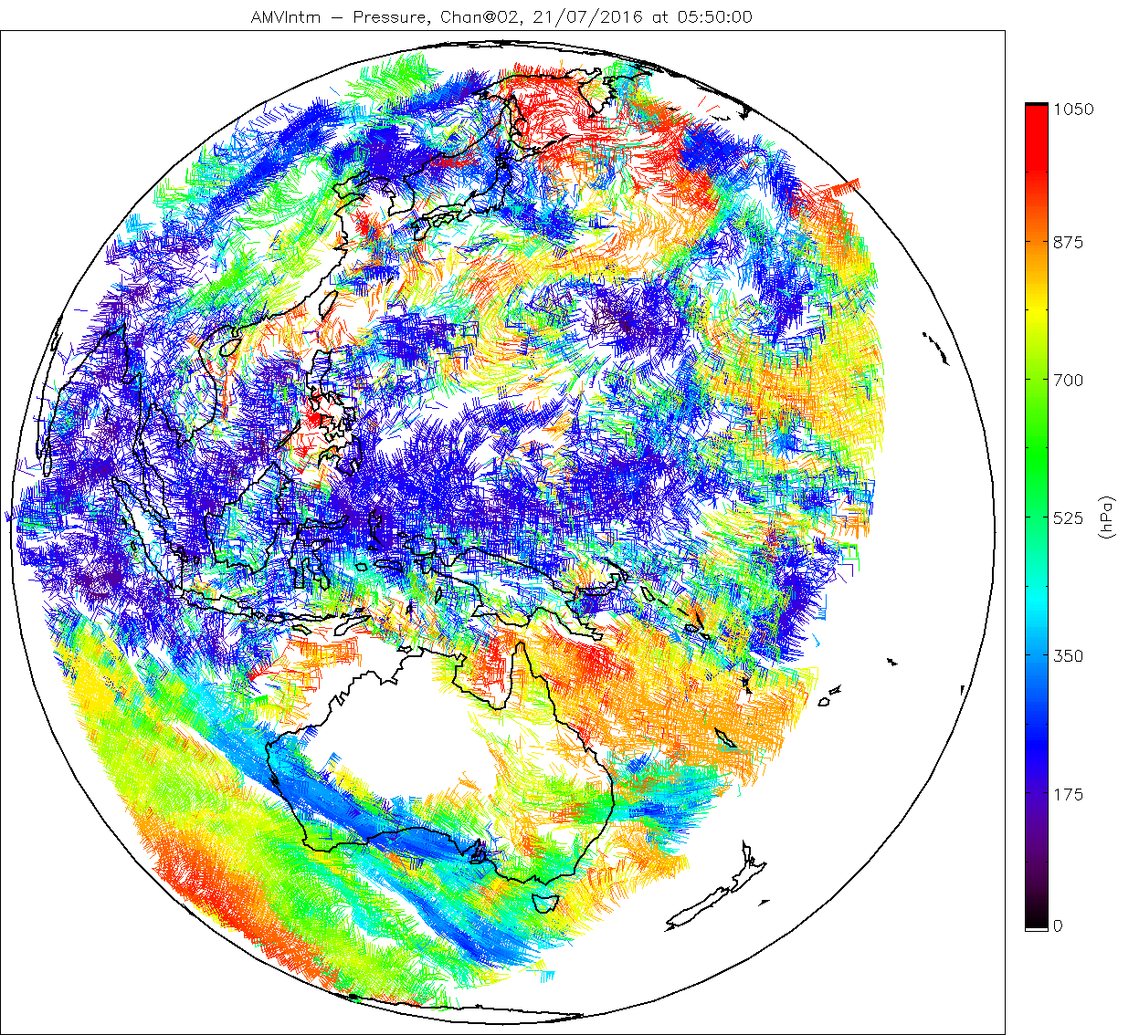
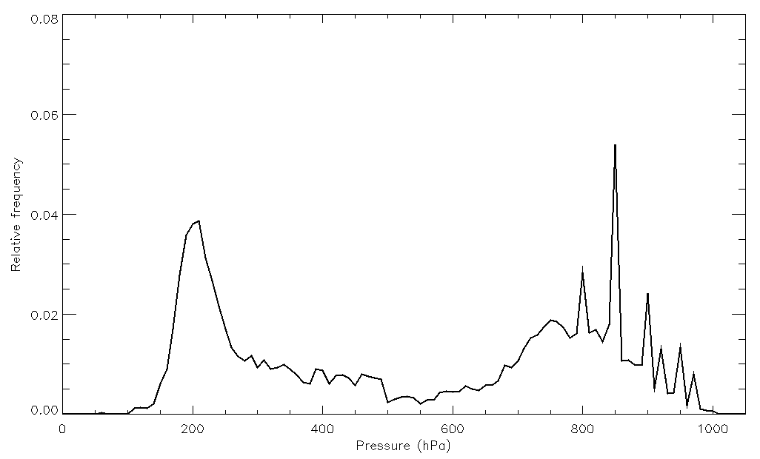
Results of the MTG-FCI algorithm with Himawari-8 data 3rd AMV Intercomparison Study results – VIS 0.6 µm (05:50 UTC)

Slide 24
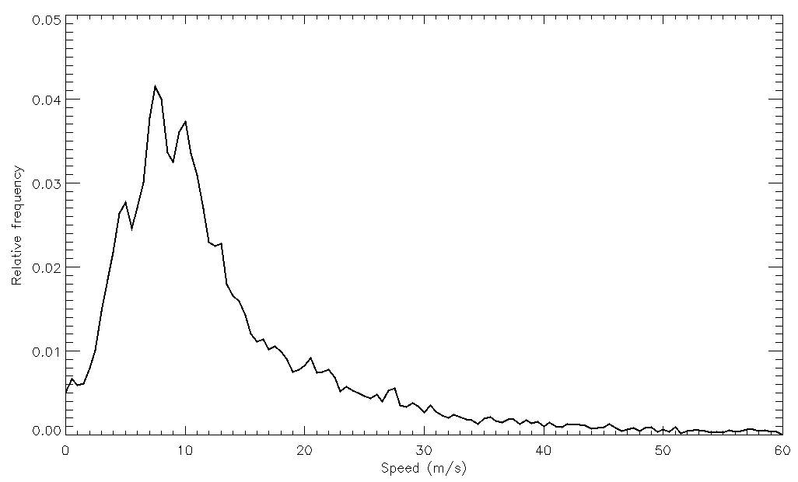
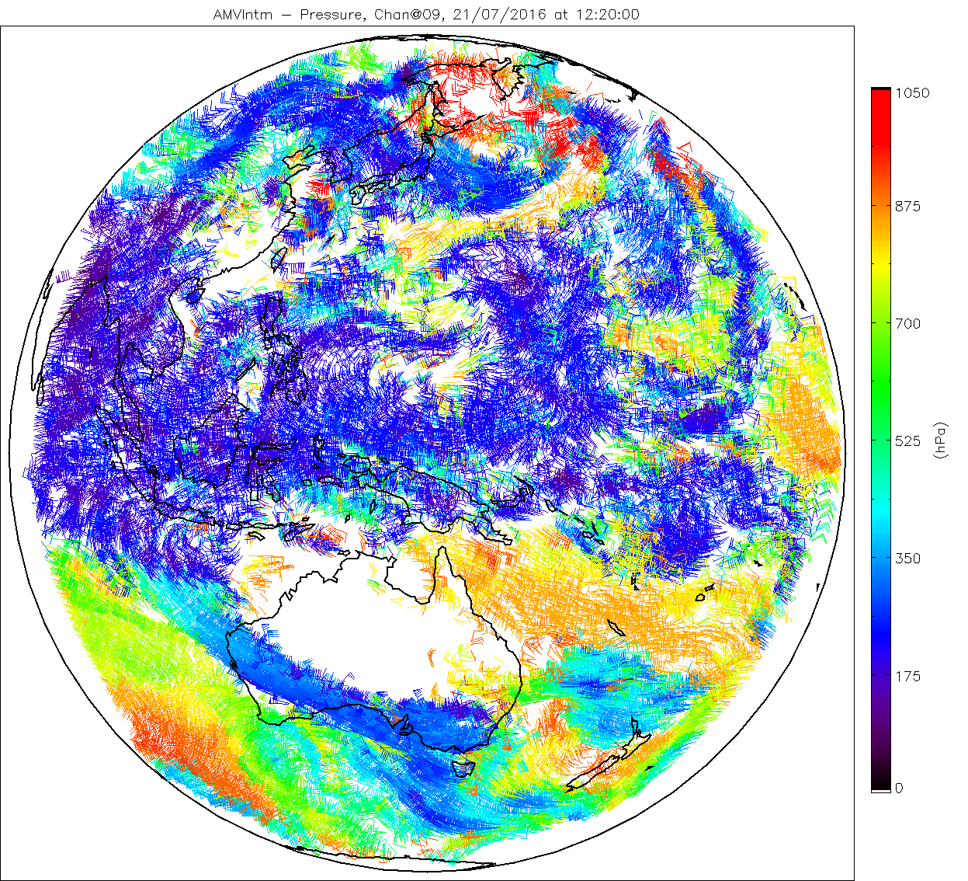
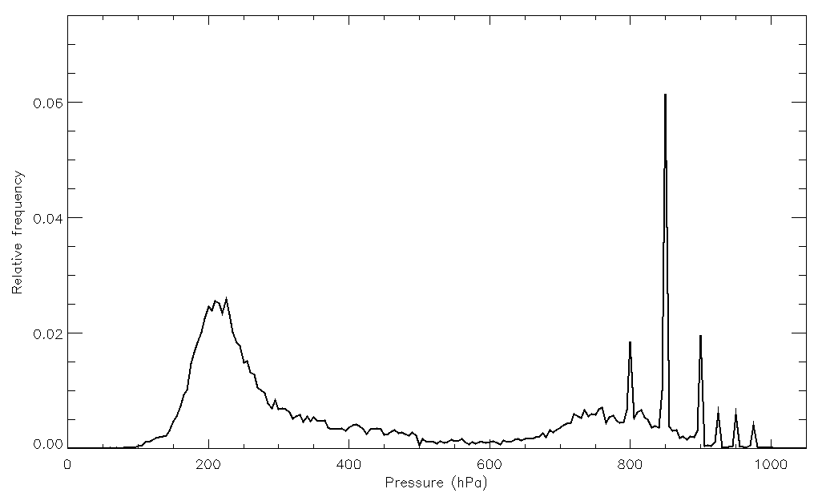
Results of the MTG-FCI algorithm with Himawari-8 data 3rd AMV Intercomparison Study results – IR 10.4 µm (12:20 UTC)

Slide 25
Results of the MTG-FCI algorithm with Himawari-8 data Further information
See poster entitled “AMV INTER-COMPARISON BETWEEN GK-2A AND MTG ALGORITHM USING HIMAWARI8/AHI DATA”, by Soomin Oh, Byung-il Lee, Régis Borde, Manuel Carranza, Sung-Rae Chung and Seongkyun Baek.
See “NWC SAF WINDS INTERCOMPARISON STUDY REPORT: 2018”, by David Santek, Rich Dworak, Steve Wanzong, Katherine Winiecki, Sharon Nebuda, Javier García-Pereda, Régis Borde and Manuel Carranza.

Slide 26
Summary
The MTG-FCI AMV prototype
Comparison of the MSG and MTG-FCI algorithms
Results of the MTG-FCI algorithm with Himawari-8 data
Estimation of AMV speed and direction errors
Future work

Slide 27
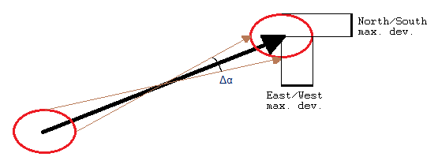
Estimation of AMV speed and direction errors
The MSG Level 1.5 Image Trailer contains information on the relative accuracy (in pixels) between consecutive images:
North/South maximum deviation (per channel);
East/West maximum deviation (per channel);
Magnitude maximum deviation (per channel).
This can be used to derive AMV speed and direction errors, converting first the pixel values into latitude and longitude values.

Slide 28
Summary
The MTG-FCI AMV prototype
Comparison of the MSG and MTG-FCI algorithms
Results of the MTG-FCI algorithm with Himawari-8 data
Estimation of AMV speed and direction errors
Future work

Slide 29
Future work
Adoption of new AMV BUFR format for all satellites.
MTG:
Comparison of MSG and MTG heights with radiosonde observations.
Verification of MTG-FCI prototype with reference code (L2PF).
Scientific validation of MTG-FCI prototype using Himawari-8 data.
MSG:
Investigation of OCA heights at low levels.
Use of cloud microphysics from OCA to improve the height assignment.
Comparison of CLA/OCA heights with radiosonde observations.
Derivation of AMV speed and direction errors from image errors.
Improvement of WV clear-sky AMVs: test using 50% coldest pixels and 100% clear-sky pixels.
Himawari-8:
Generation of results from five-day JMA dataset.
Generation of results from KMA dataset.

Slide 30
Thank you!
Questions?

Slide 31
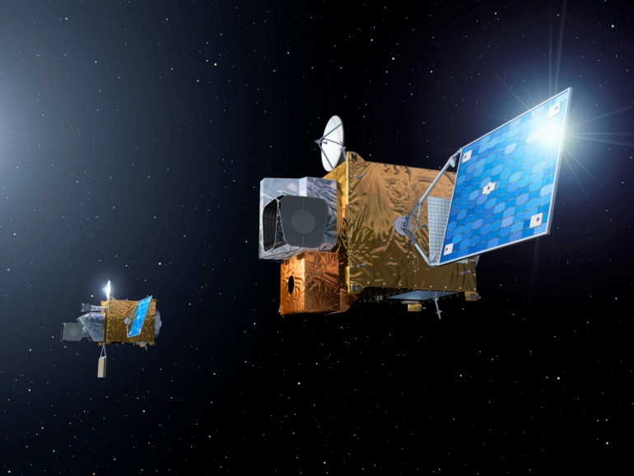
The MTG-FCI AMV prototype Meteosat Third Generation (MTG) programme concept
Twin satellite concept, based on 3-axis stabilized platforms.
Four imaging satellites (MTG-I) (20 years operational)
Two sounding satellites (MTG-S) (15.5 years operational)
MTG-I payload:
Flexible Combined Imager (FCI)
Lightning Imager (LI)
Data Collection System (DCS)
MTG-S payload:
Infrared Sounder (IRS)
Ultra-violet, Visible and Near-Infrared Sounder (UVN)

Slide 32
The MTG-FCI AMV prototype The Flexible Combined Imager (FCI)
Continuation of the very successful SEVIRI on board MSG.
Additional channels with better spatial, temporal and radiometric resolution, compared to MSG.
Full Disk Scan (FDS), with a basic repeat cycle of 10 minutes.
European Regional Rapid Scan (RRS), which covers one quarter of the full disk with a repeat cycle of 2.5 min.
Eight channels in the solar spectral domain (0.4 µm to 2.1 µm), with 1 km resolution.
Eight channels in the thermal spectral domain (3.8 µm to 13.3 µm), with 2 km resolution.

Slide 33
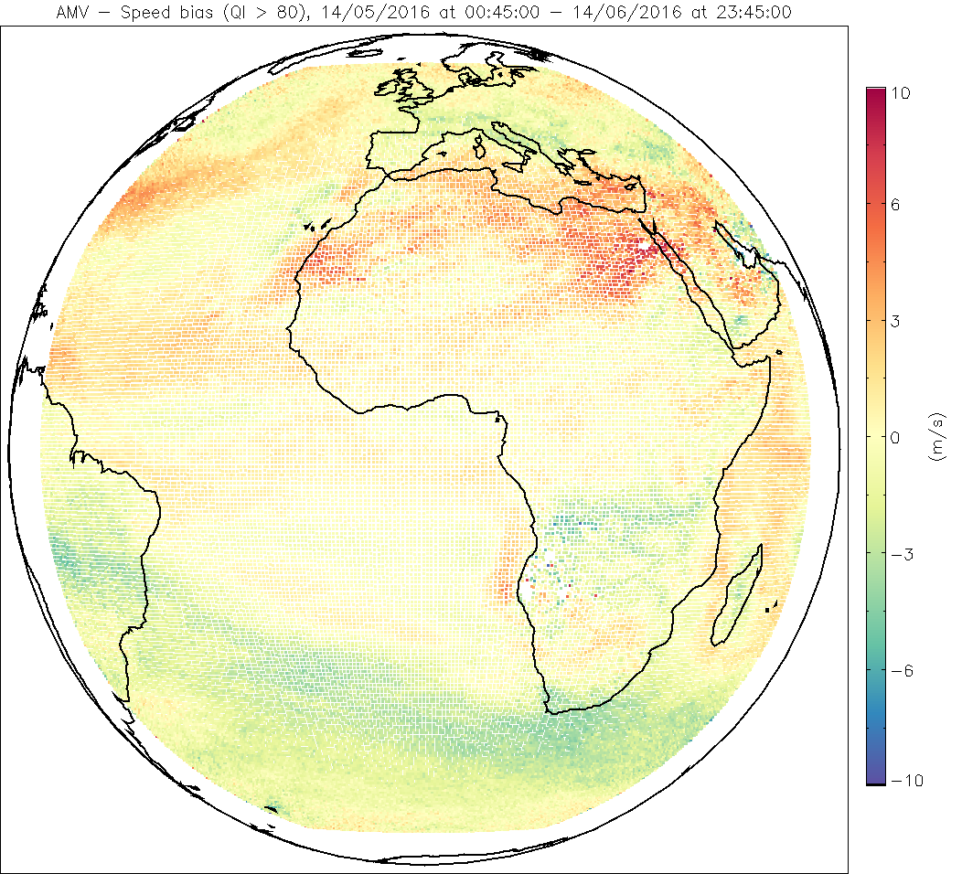
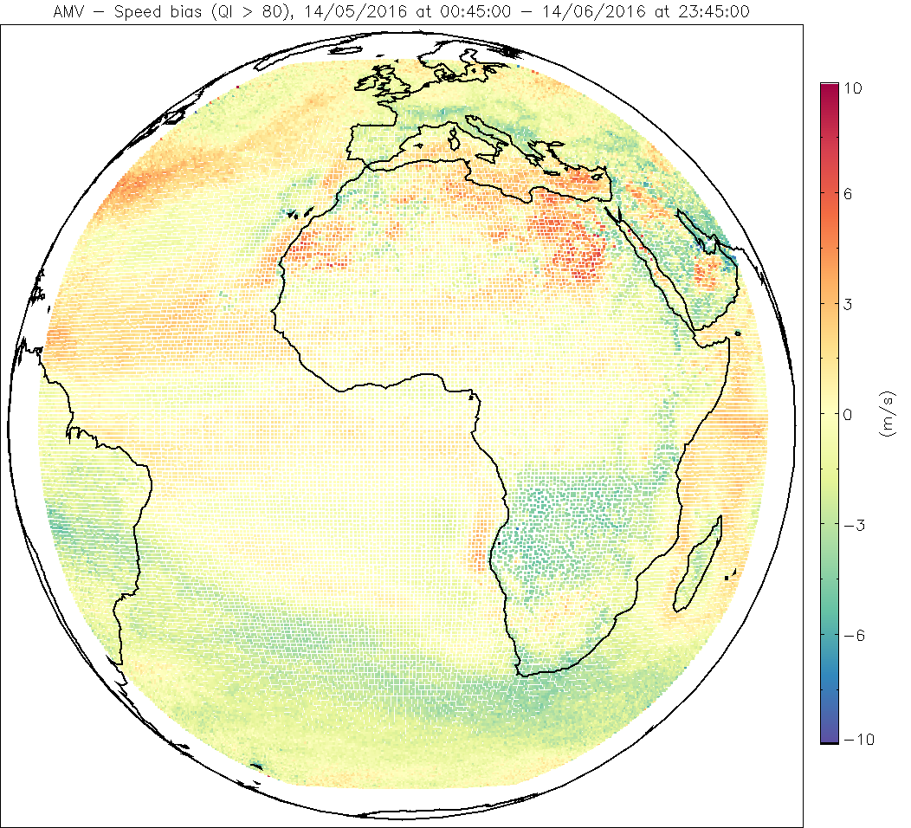
Comparison of the MSG and MTG-FCI algorithms Accumulated AMV speed bias against forecast – IR 10.8 µm, all AMVs
MSG 24
MTG 24

Slide 34
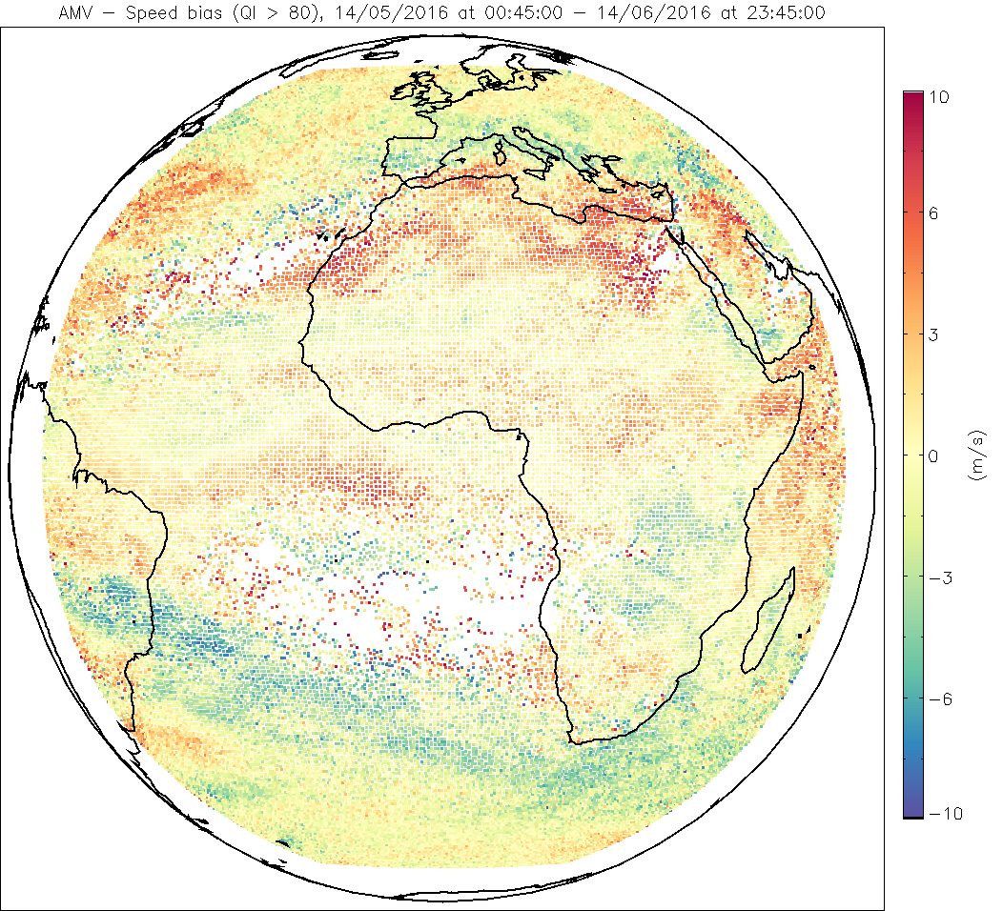
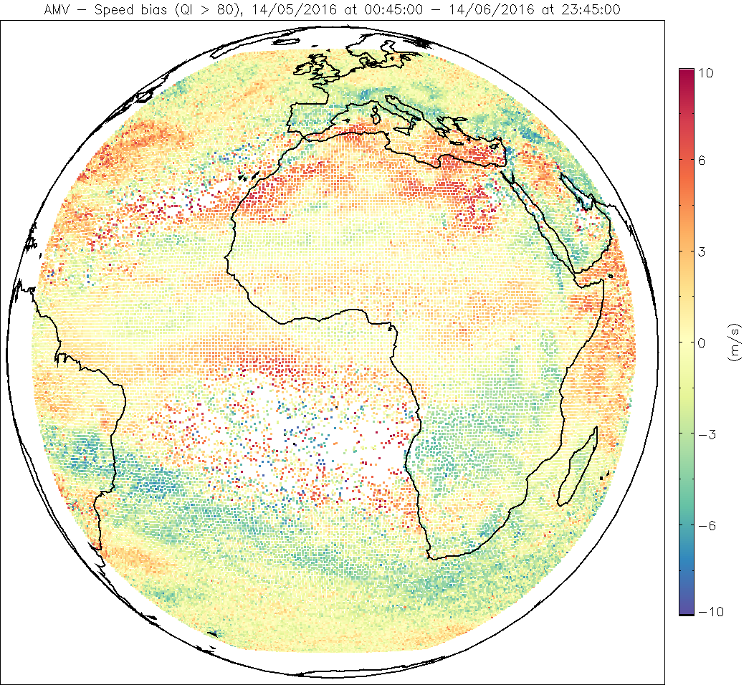
Comparison of the MSG and MTG-FCI algorithms Accumulated AMV speed bias against forecast – IR 10.8 µm, mid levels
MSG 24
MTG 24

Slide 35
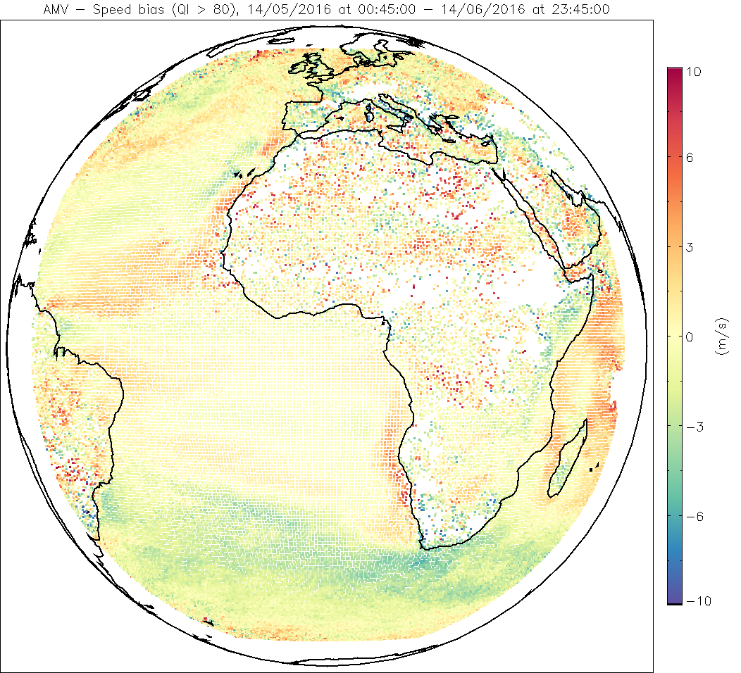
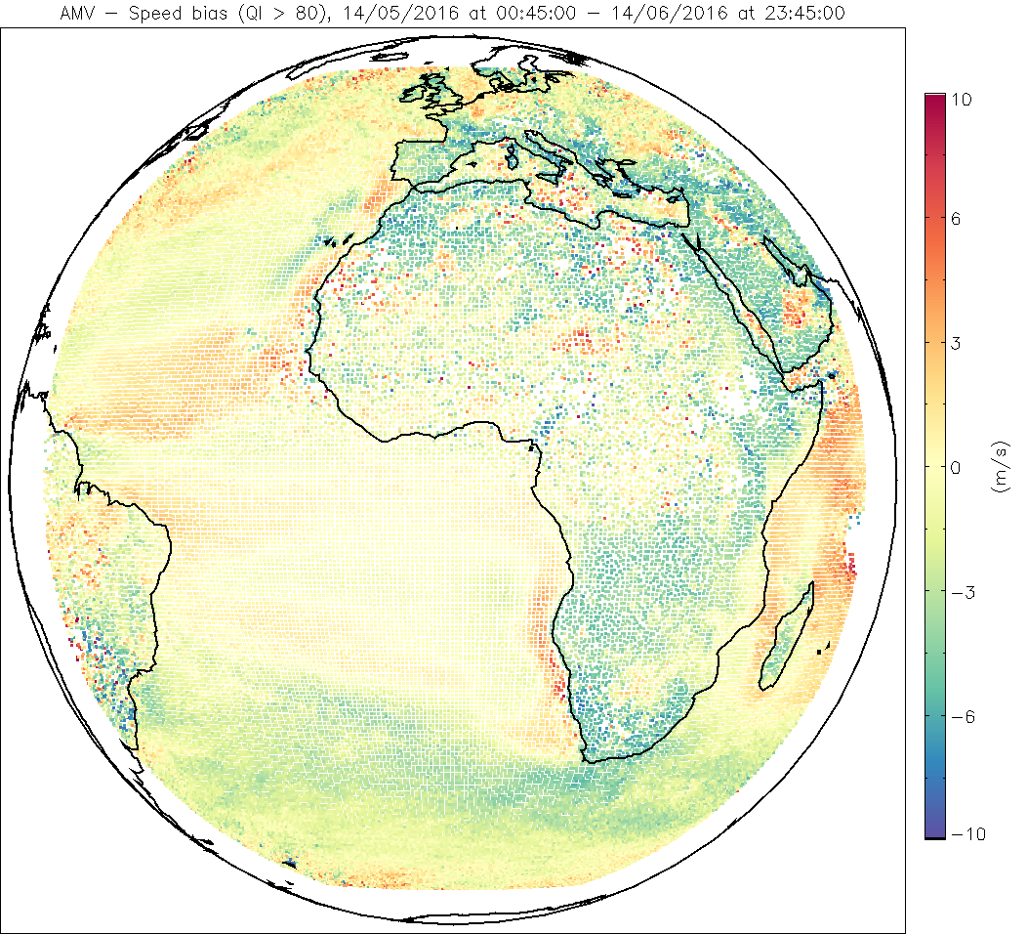
Comparison of the MSG and MTG-FCI algorithms Accumulated AMV speed bias against forecast – IR 10.8 µm, low levels
MSG 24
MTG 24

Slide 36
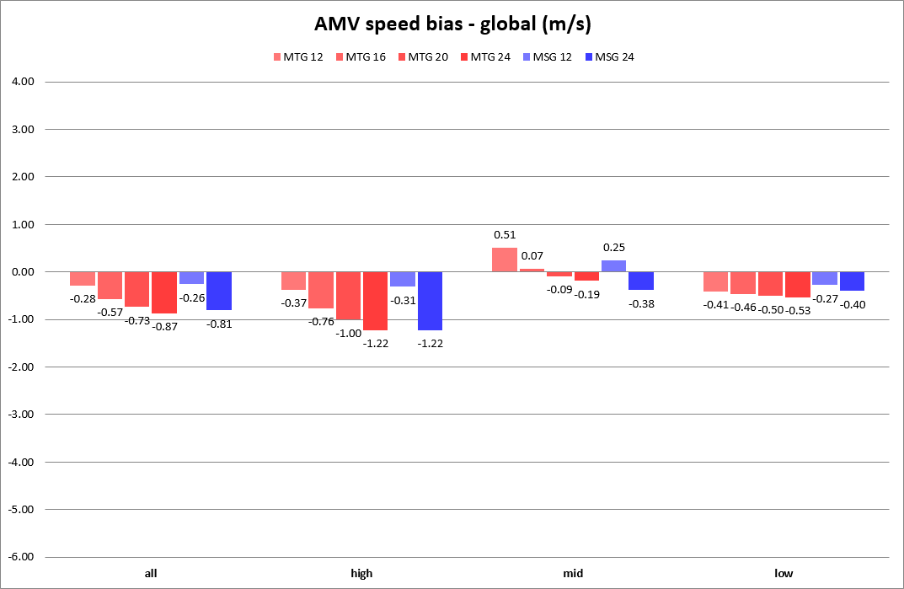
Comparison of the MSG and MTG-FCI algorithms AMV speed bias against forecast – IR 10.8 µm, global

Slide 37
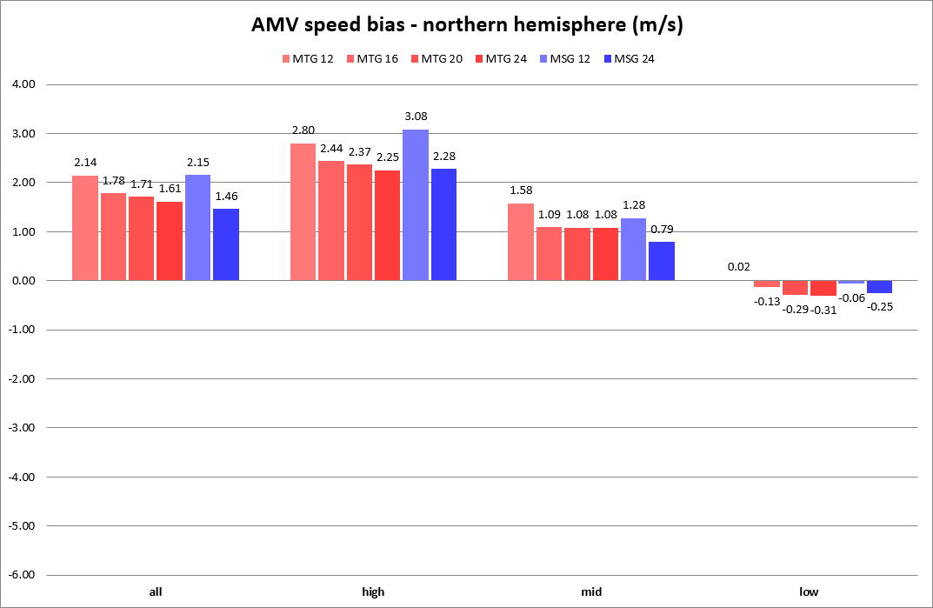
Comparison of the MSG and MTG-FCI algorithms AMV speed bias against forecast – IR 10.8 µm, northern hemisphere

Slide 38
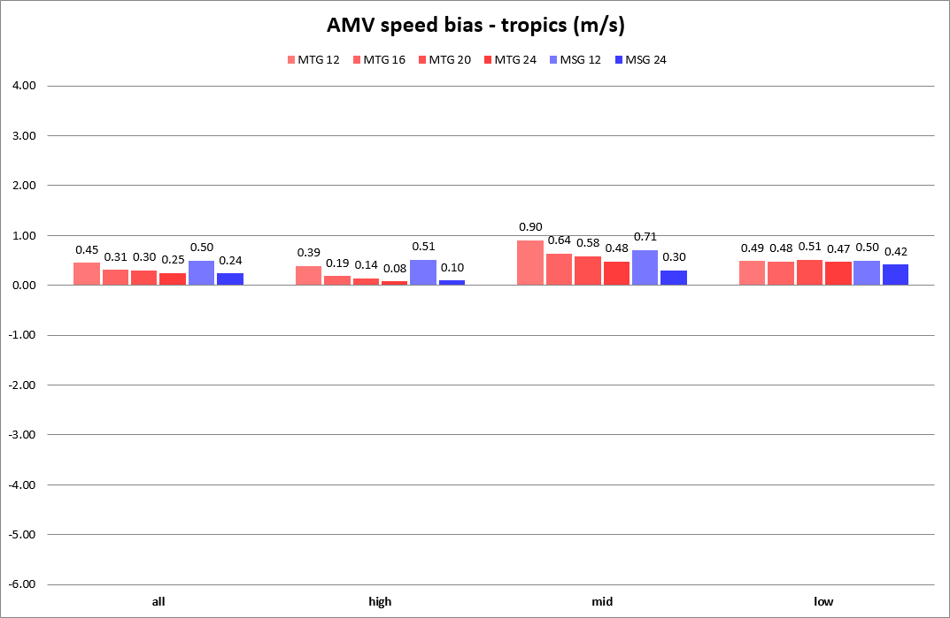
Comparison of the MSG and MTG-FCI algorithms AMV speed bias against forecast – IR 10.8 µm, tropics

Slide 39
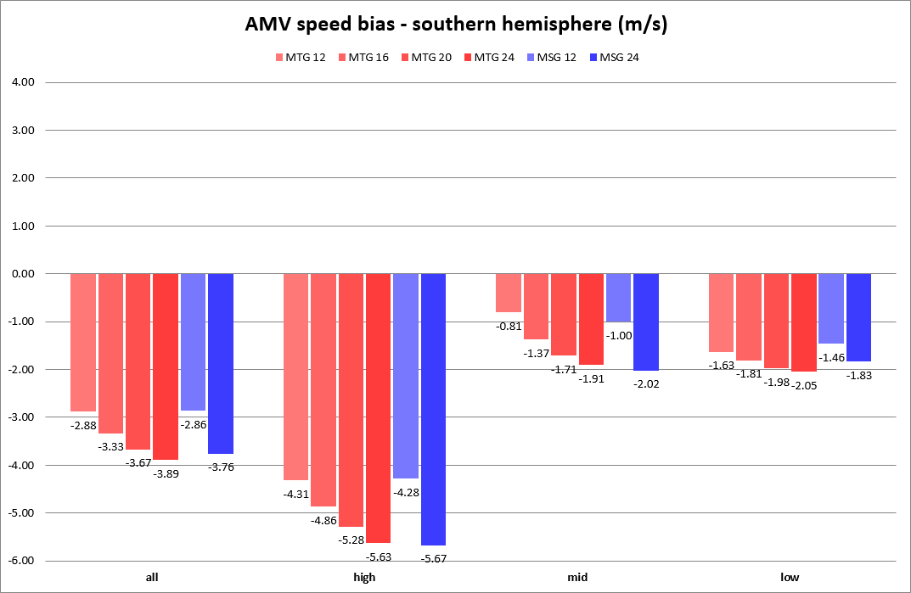
Comparison of the MSG and MTG-FCI algorithms AMV speed bias against forecast – IR 10.8 µm, southern hemisphere

Slide 40
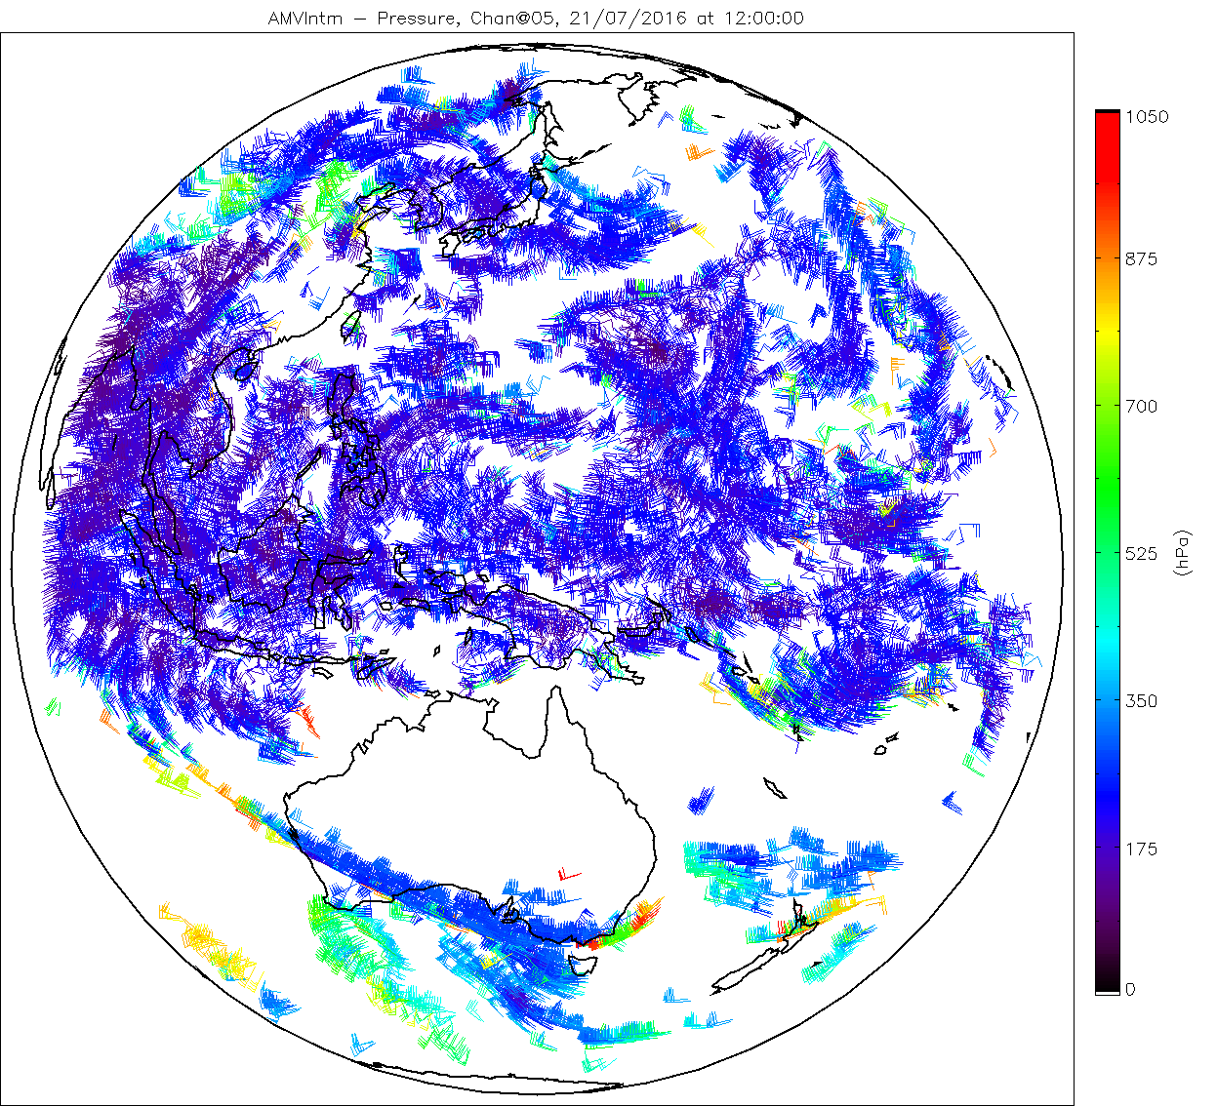
Results of the MTG-FCI algorithm with Himawari-8 data 3rd AMV Intercomparison Study results – WV 6.2 µm (12:00 UTC)

