Slide 1
Current status of GK-2A AMV algorithm in NMSC/KMA
23 April 2018
Soo Min Oh, Byung-il Lee, Sung-Rae Chung, Seonkyun Baek
NMSC/KMA
국가기상위성센터
National Meteorological Satellite Center
Notes:
예 안녕하십니까.
대기운동벡터 산출 알고리즘 개발을 맡고 있는
국가기상위성센터의 오수민입니다.
바로 발표 시작 하겠습니다.

Slide 2
Contents
Status of COMS AMV
Geo-KOMPSAT-2A(GK-2A) Programs
GK-2A AMV algorithm
Target selection
Target tracking
Height assignment
Quality control
Results
Summary

Slide 3
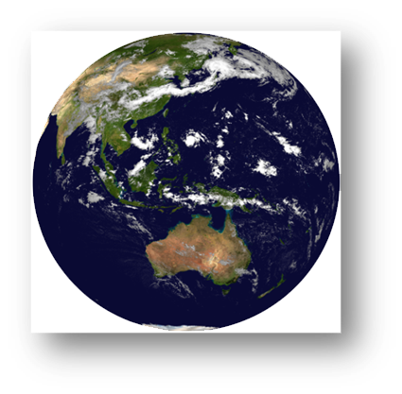
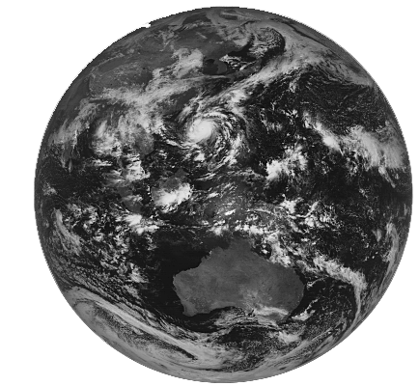
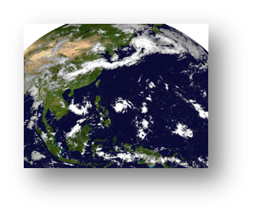
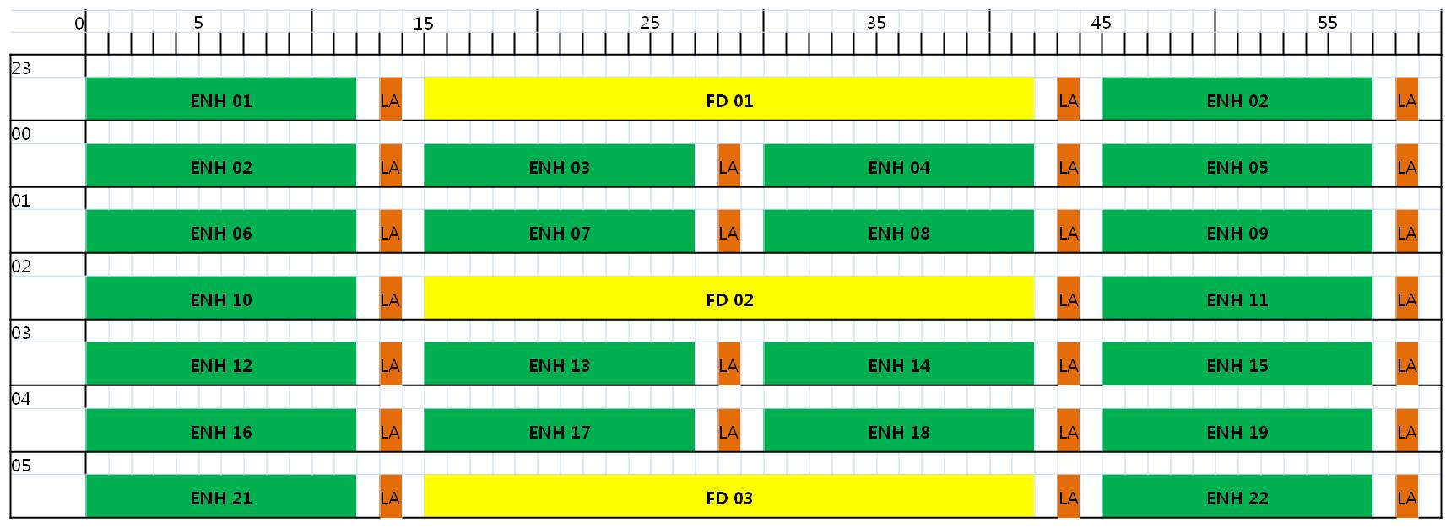
Status of COMS AMV
Observation Schedule
ENH
FD
LA
- AMV’s are produced
every 1 hour
(but not regularly)
- using 3 consecutive
15 min interval
ENH observations
- disseminate by GTS
★
★
★
★
★
★

Slide 4
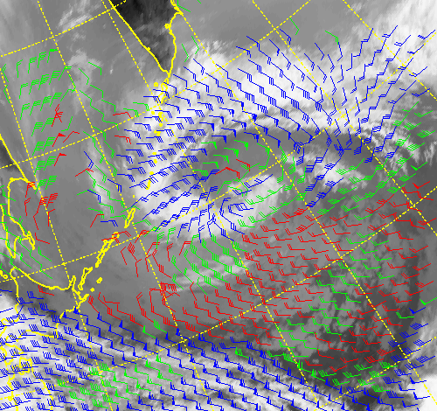
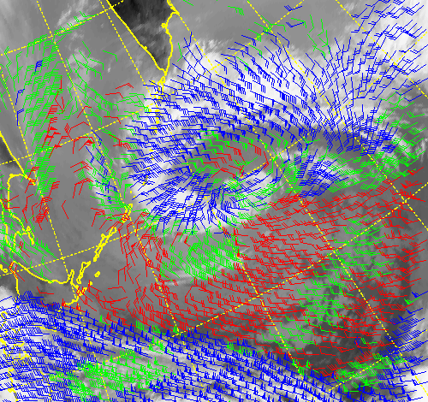
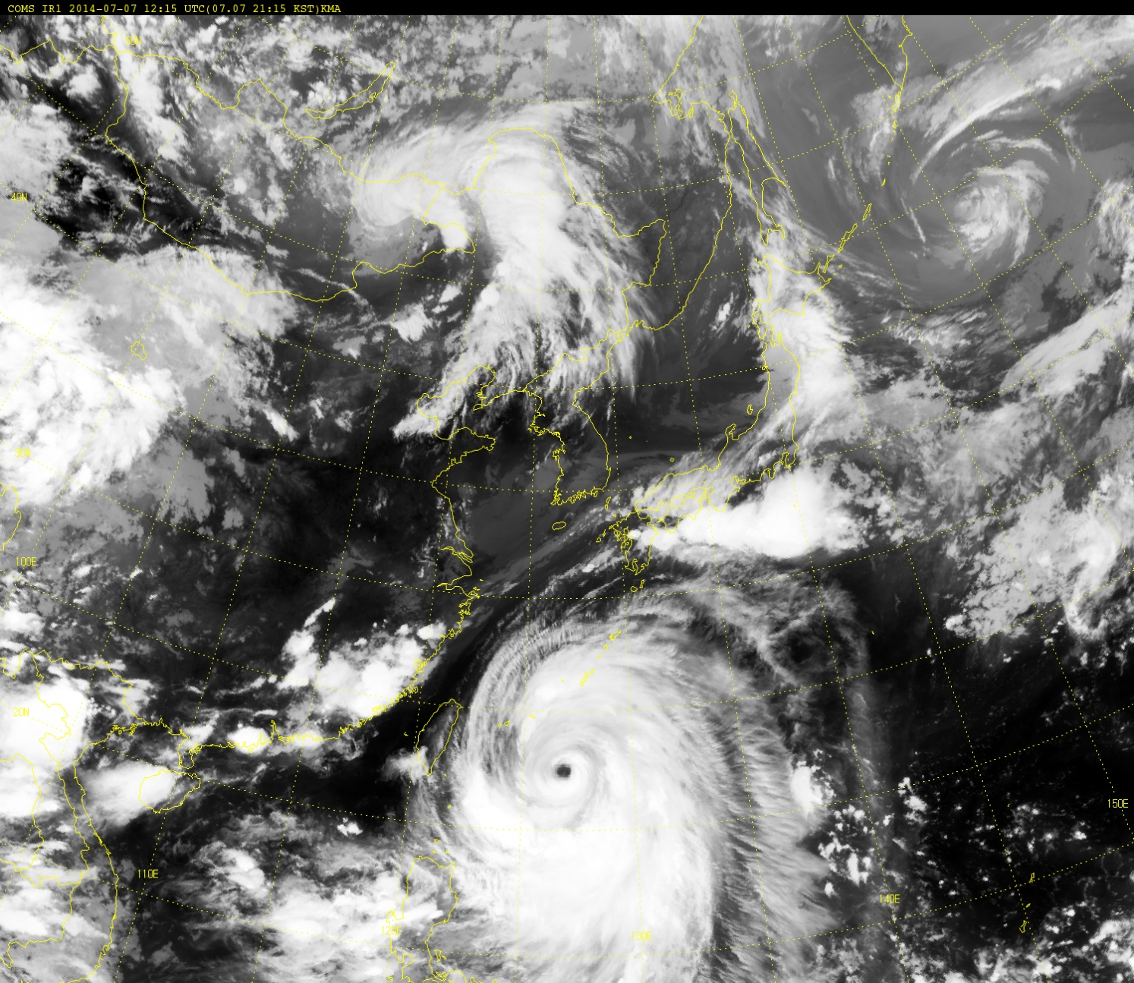
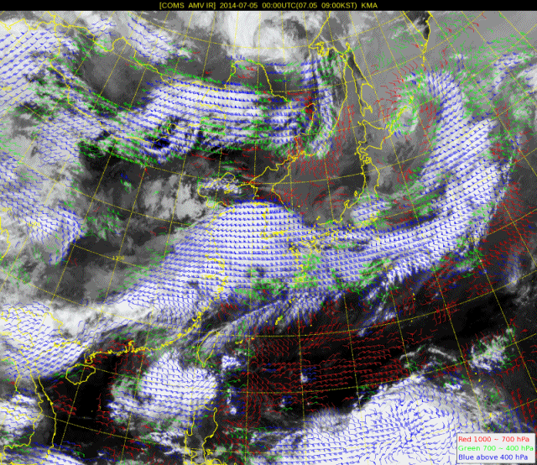
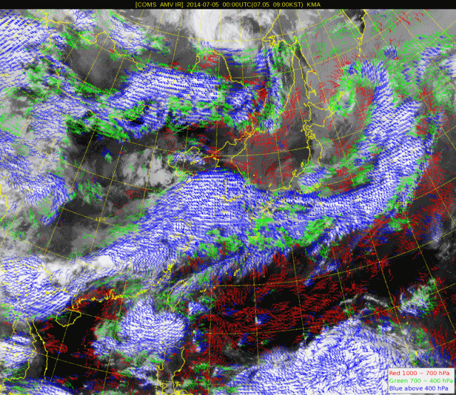
Status of COMS AMV
AMV T24(Operation)
AMV T16(Tested)
Target size : 24x24 (96Ⅹ96km) ➔ 16x16 (56Ⅹ56km)
Target selection : Regular (REG) ➔ Optimal target selection
Target interval : 12 pixels ➔ 8 pixels
AMV24
AMV16
AMV24
AMV16

Slide 5
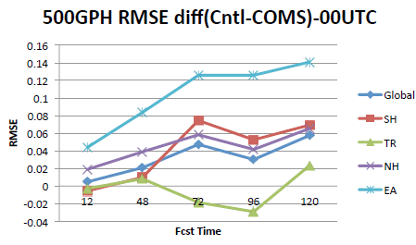
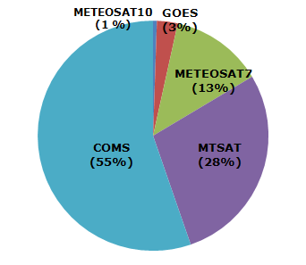
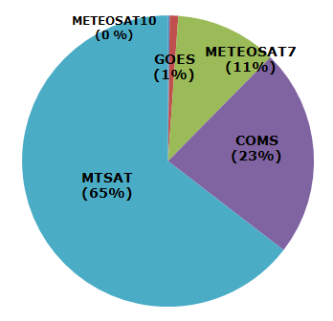
Status of COMS AMV
Accuracy of COMS AMV (April 1 - 24, 2016)
Assimilate(24x24, VIS, IR, WV) in KMA global system since Dec. 2011. Positive impact especially in East Asia [NWP Center]
Sonde(IR) | All level |  | High level |  | Middle level |  | Low level
 | T24 | T16 | T24 | T16 | T24 | T16 | T24 | T16
Number | 37940 | 76507 | 33601 | 67665 | 3190 | 6216 | 1149 | 2626
MVD | 5.62 | 5.75 | 5.80 | 5.57 | 4.71 | 4.77 | 3.02 | 2.98
RMSVD | 6.73 | 6.69 | 6.91 | 6.86 | 5.60 | 5.71 | 3.60 | 3.57
BIAS | -1.74 | -1.23 | -1.88 | -1.34 | -0.83 | -0.50 | -0.23 | -0.17
RMSE | 5.27 | 5.14 | 5.41 | 5.27 | 4.50 | 4.51 | 2.54 | 2.57
FSO of Satwind data in East Asia
<September~ October in 2011>
<Winter & Summer in 2013>

Slide 6
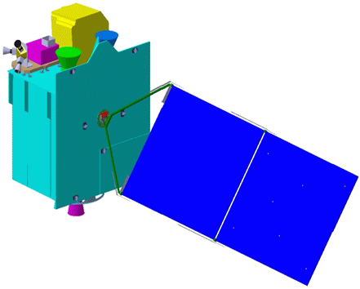
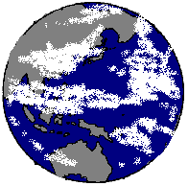
Geo-KOMPSAT-2A Programs
KMA plans to launch the next Korean geostationary meteorological satellite GEO-KOMPSAT-2A (GK-2A) in Nov. 2018
GK-2A for the next generation Meteorological Imager and SWx monitoring
GK-2B for the Ocean Color(GOCI2) and Atmospheric Trace Gas(GEMS) monitoring
NMSC/KMA
Meteorological Sensor
Space weather Sensor
Geo-KOMPSAT-2A
Geo-KOMPSAT-2B
Ocean /
Environmental Sensor
2012 ~ 2018
(7 years development)
Ground Segment
Data Processing System

Slide 7
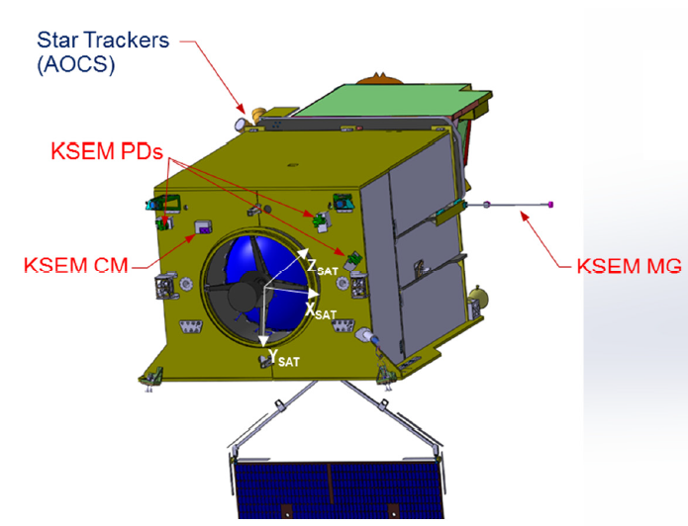
Payloads for Geo-KOMPSAT-2A
AMI (Advanced Meteorological Imager)
Center wavelength (μm)
AMI (Resolution) |  | ABI | AHI
1 blue | 0.47 (1km) | 0.47 | 0.46
2 green | 0.511 (1km) |  | 0.51
3 red | 0.64 (0.5km) | 0.64 | 0.64
4 | 0.856 (1km) | 0.865 | 0.86
5 | 1.38 (2km) | 1.378
6 | 1.61 (2km) | 1.61 | 1.6
 |  | 2.25 | 2.3
7 | 3.830 (2km) | 3.90 | 3.9
8 | 6.241 (2km) | 6.185 | 6.2
9 | 6.952 (2km) | 6.95 | 7.0
10 | 7.344 (2km) | 7.34 | 7.3
11 | 8.592 (2km) | 8.50 | 8.6
12 | 9.625 (2km) | 9.61 | 9.6
13 | 10.403 (2lkm) | 10.35 | 10.4
14 | 11.212 (2km) | 11.2 | 11.2
15 | 12.364 (2km) | 12.3 | 12.3
16 | 13.31 (2km) | 13.3 | 13.3
<Space weather Sensor>
KSEM(Korea Space wEather Monitor)
PD : Particle Detector
MG : Magnetometer
CM : Charging Monitor
vs. AHI : addition : 1.38 μm (NIR), subtraction 2.3 μm (NIR)
- 1.38 μm : favorable for cirrus cloud detection, cloud type and amount
- 2.3 μm : favorable for Land/cloud Properties

Slide 8
52 Meteorological Products
23 Primary Products & 29 Secondary Products
Scene & Surface Analysis (13) | Cloud & Precipitation (14) | Aerosol & Radiation (14) | Atmospheric condition & Aviation (11)
Cloud detection | Cloud Top Temperature | Aerosol Detection | Atmospheric Motion Vector
Snow Cover | Cloud Top Pressure | Aerosol Optical Depth | Vertical Temperature Profile
Sea Ice Cover | Cloud Top Height | Asian Dust Detection | Vertical Moisture Profile
Fog | Cloud Type | Asian Dust Optical Depth | Stability Index
Sea Surface Temperature | Cloud Phase | Aerosol Particle Size | Total Precipitable Water
Land Surface Temperature | Cloud Amount | Volcanic Ash Detection and Height | Tropopause Folding Turbulence
Surface Emissivity | Cloud Optical Depth | Visibility | Total Ozone
Surface Albedo | Cloud Effective Radius | Radiances | SO₂ Detection
Fire Detection | Cloud Liquid Water Path | Downward SW Radiation (SFC) | Convective Initiation
Vegetation Index | Cloud Ice Water Path | Reflected SW Radiation (TOA) | Overshooting Top Detection
Vegetation Green Fraction | Cloud Layer/Height | Absorbed SW Radiation (SFC) | Aircraft Icing
Snow Depth | Rainfall Rate | Upward LW Radiation (TOA)
Ocean Current | Rainfall Potential | Downward LW Radiation (SFC)
 | Probability of Rainfall | Upward LW Radiation (SFC)

Slide 9
GK-2A AMV algorithm
Specification and flow chart
GK-2A AMV start
 | GK-2A AMV
Channels | VIS(03), SWIR(07), IR(13, 14), WV(08, 09, 10)
Input L1b images | 3 images (proxy: Himawari8/AHI)
Time interval | Normal scan(FD) |  | 10 minute
 | Rapid scan |  | 2 minute
Model / RTM | UM N768/rttov 11.2
Target box size | Cloudy target | VIS : 32by32 SWIR : 16by16 IR : 16by16 WV : 16by16
 | Clear-air target | WV : 16by16
Target selection | Optimal (Statistic)
Grid step size | Same with target box size
Search box size | Cloudy target | VIS : 185by185 SWIR : 54by54 IR : 54by54 WV : 54by54
 | Clear-air target | WV : 54by54
Center of search area | Regular
Target tracking | CC
Height assignment | Cloudy target | 1. CCC 2. EBBT(Cloud base correction) 3. IR/WV rationing 4. CO2 slicing (+Inversion layer correction)
 | Clear-air target | 1. NTC 2. NTCC
Quality control | QI, EE
VIS, SWIR, IRW
IRWV
Target selection
(Optimal method)
Target selection
(Optimal method)
Cloudy target HA
1. CCC
2. EBBT(CBC)&IR/WV
3. EBBT(CBC)
4. IR/WV
5. CO2 slicing
Clear-air target HA
1. NTC&NTCC
2. NTC
3. NTCC
Inversion layer correction
Tracking
(Cross correlation coefficient)
Quality Control
1. Quality indicator
2. Expected error
Final output

Slide 10
Step1: Target selection
Optimal target selection
Cloud Target: 03, 07, 08, 09, 10, 13, 14 (Using cloud mask)
Clear Target: 08, 09, 10
$${STD}_{m,n}=\sqrt{\frac{1}{9}\sum_{i=−1}^{1}{\sum_{j=−1}^{1}{{({BT}_{m+i,n+j}−{\overline{BT}}_{m,n})}^{2}}}}$$

Slide 11
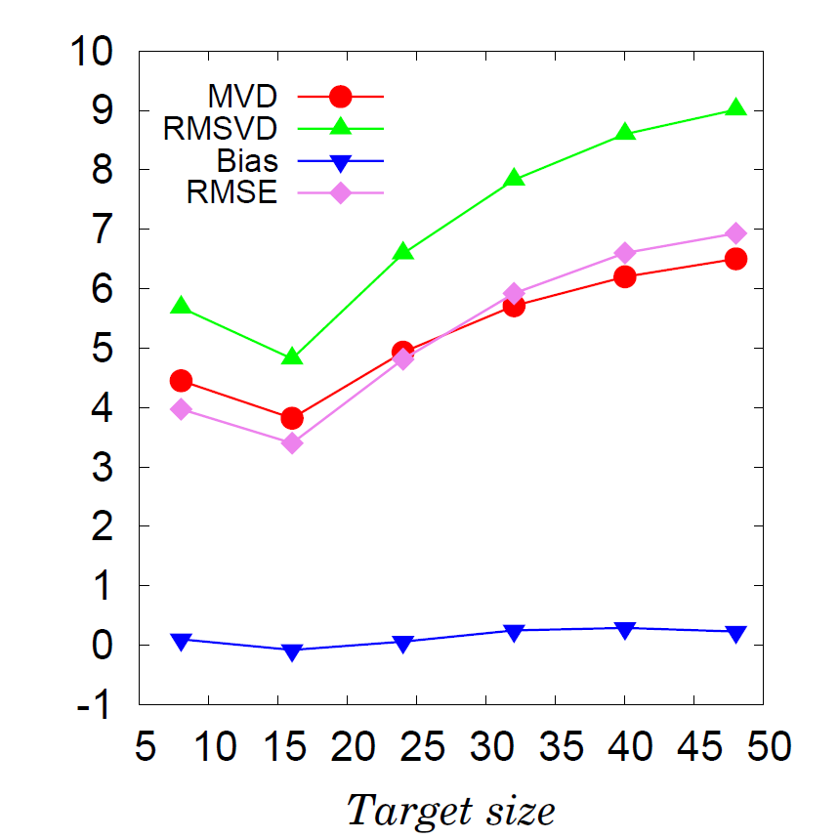
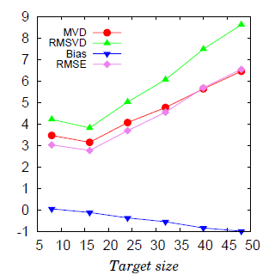
Step1: Target(search) size and temporal gap
Preliminary Results for GK-2A
[P10: Sensitivity Tests]
Periods | 2016.07.21. 00:00 ~23:00 (UTC)
Channel | Ch. 13 cloudy target, Ch. 08 clear target
Time interval | 10 minute
Target(Search) box size | 8(46), 16(54), 24(62), 32(70), 40(78), 48(86)
Ch13 cloudy
Ch08 clear
With NWP
With NWP

Slide 12
Step2: Target tracking
Cross Correlation Coefficient
49x49 pixels
16x16 pixels
$$t_{0}$$
$$∆\vec{r}$$
$$t_{0}+∆t$$
Caluated vector : $\vec{v}=\frac{\vec{r}}{∆t}$
$$t_{0}$$
$${CC}_{m,n}=\frac{1}{N_{x}N_{y}}\sum_{i=1}^{N_{x}}{\sum_{j=1}^{N_{y}}{\left(\frac{a_{m+i,n+j}−{\overline{a}}_{m,n}}{{\left(σ_{a}\right)}_{m,n}}\frac{b_{i,j}−\overline{b}}{σ_{b}}\right)}}$$
$a_{i,j} :BT value in ith row and jth column of N_{x} by N_{y} target box in search area at time t_{0}+∆t$.
$\overline{a} :Average of a_{i,j}$.
$σ_{a} :Standard deviation of a_{i,j}$.
$b_{i,j} :BT value in ith row and jth column of N_{x} by N_{y} target at time t_{0}$.
$\overline{b} :Average of b_{i,j}$.
$σ_{b} :Standard deviation of b_{i,j}$.
$N_{x}, N_{y} :Size of target box$.

Slide 13
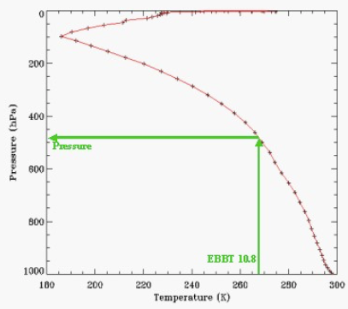
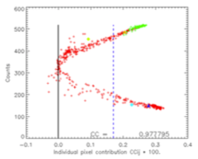
Step3: Height assignment(Cloud Target)
Cloud Target: 4 methods + 2 combinations
EBBT
Equivalent Blackbody Temperature
Opaque Clouds
NWP Temp. Profile
+ RTM simulation
Coldest 15% temp.
: Dominant motion
level of targets
IR/WV Intercept
Semi-transparent Clouds Optically Thin Clouds (e.g., cirrus)
WV and IR (window) TBB ratio
Pressure
EBBT
CO₂ Slicing Method
Similar to IR/WV intercept, but use CO₂ channel
CCC
Cross-Correlation Contribution
Every Cloud
Depends on CTP

Slide 14
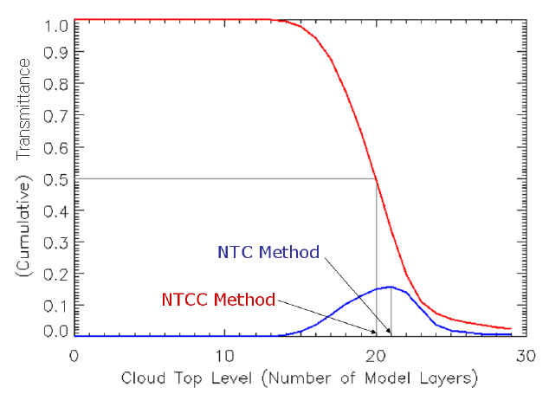
Step3: Height assignment(Clear Target)
Clear Target: 2 methods ➔ chose higher one
NTC & NTCC methods. (Transmittance profile by channel.)
H(km)
Transmittance(WV)
*NTC: Normalized total contribution
*NTCC: Normalized total cumulative contribution

Slide 15
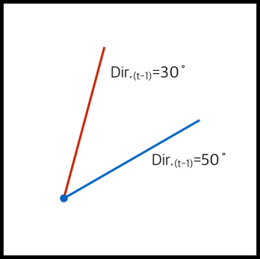
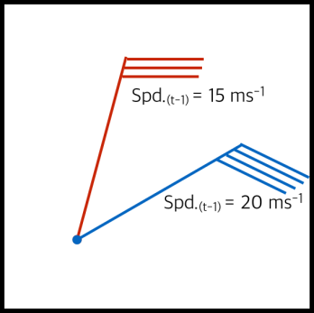
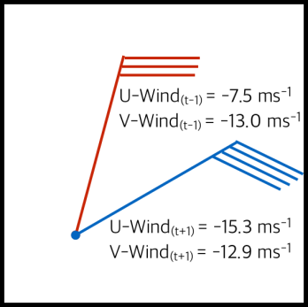
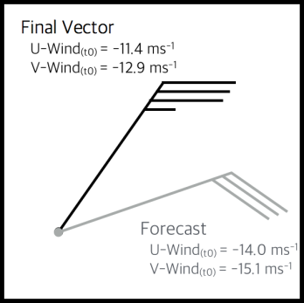
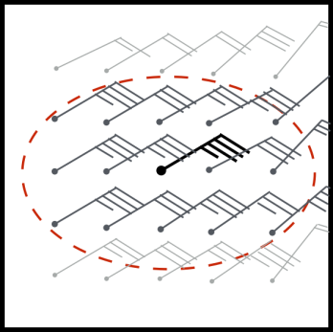
Step4: Quality Control
Quality Indicator (QI)
Calculation Procedure: Calculated using weighted averaged of 5 consistencies
1. Temporal Direction Consistency 2. Temporal Speed Consistency
3. Temporal Vector Consistency 4. Forecast Consistency
5. Local Vector Consistency
Direction Test
$Φ_{dir.}=1−{\left[\tanh\left\{\frac{Diff.(Dir.)}{coeff.A ∙ \exp\left(\frac{−{Spd.}_{avg}}{coeff.B}\right) + coeff.C ∙ {Spd.}_{avg}+coeff.D}\right\}\right]}^{coeff.E}$
Others
$Φ_{other}=1−{\left[\tanh\left\{\frac{Diff.}{MAX\left(coeff.A ∙ {Spd.}_{avg}, coeff.B\right) + coeff.C}\right\}\right]}^{coeff.D}$

Slide 16
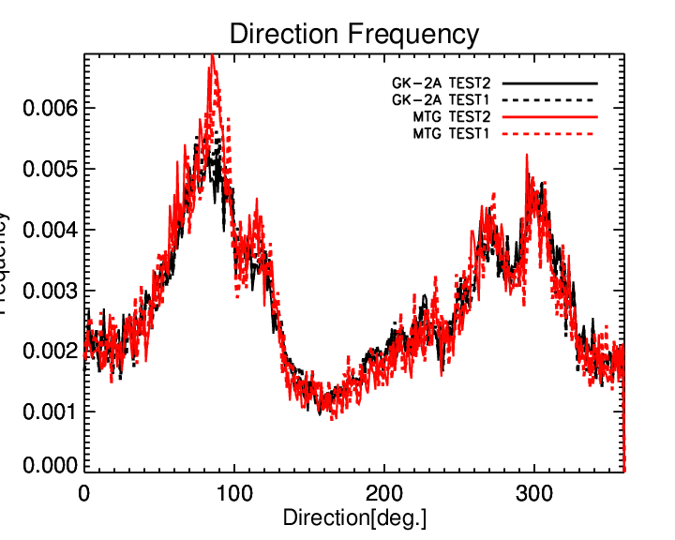
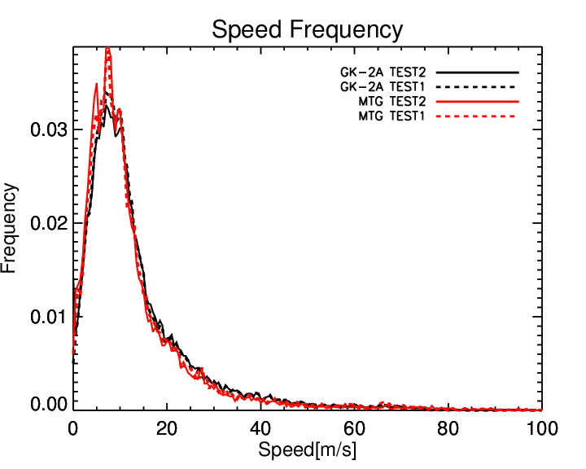
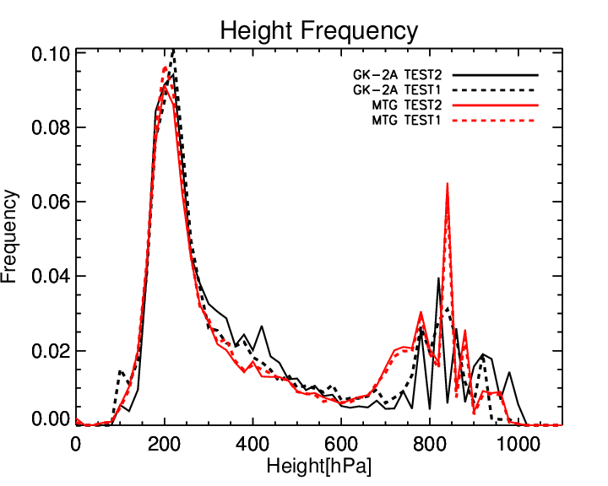
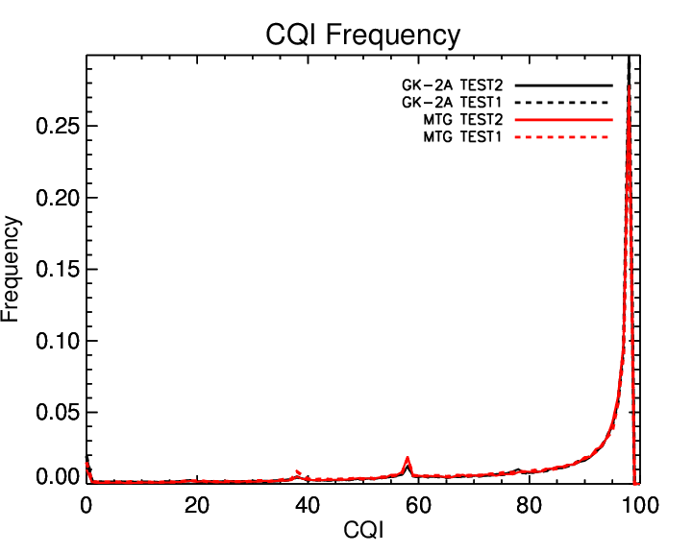
Results: Cloudy target for 10.4㎛
Validation: 4 HA methods + 2 combinations
2016. 7. 1. ~ 7. 7. (All level(1000~100 hPa))
Inter-comparison with MTG algorithm [P9: Inter-comparison results]
Ch13 (10.4) | GK-2A(Himawari-8) |  | Goes-R(Meteossat-8)
Period | 2016.7.1.~7.7. |  | Aug 2006 | Feb 2007
HA method | EBBT&IR/WV | EBBT & CO2 | GOES-R/ABI Cloud Height Algorithm (ACHA) products
Count | 17702 | 17345 | 13987 | 15286
MVD | 4.71 | 5.05 | 4.51 | 5.21
RMSVD | 5.71 | 6.14 | - | -
Bias | -0.67 | -1.09 | 0.24 | -0.54
RMSE | 4.35 | 4.64 | 5.78 | 6.61
Ch13 (10.4) | GK-2A |  | MTG
QI>80 | > 80 |  | > 80
Reference | NWP | Sonde | NWP | Sonde
Count | 44145 | 1028 | 45580 | 1035
Bias | -0.34 | -1.32 | -0.18 | -0.80
RMSE | 4.74 | 5.92 | 4.70 | 5.91
NBias | -0.023 | -0.071 | -0.012 | -0.045
NRMSE | 0.316 | 0.316 | 0.323 | 0.330
[Jaime Daniels, et al., GOES-R ATBD(2012)]
[Inter-comparison with MTG AMV]

Slide 17
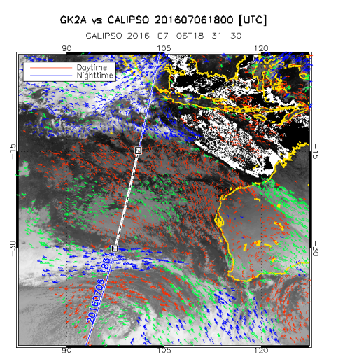
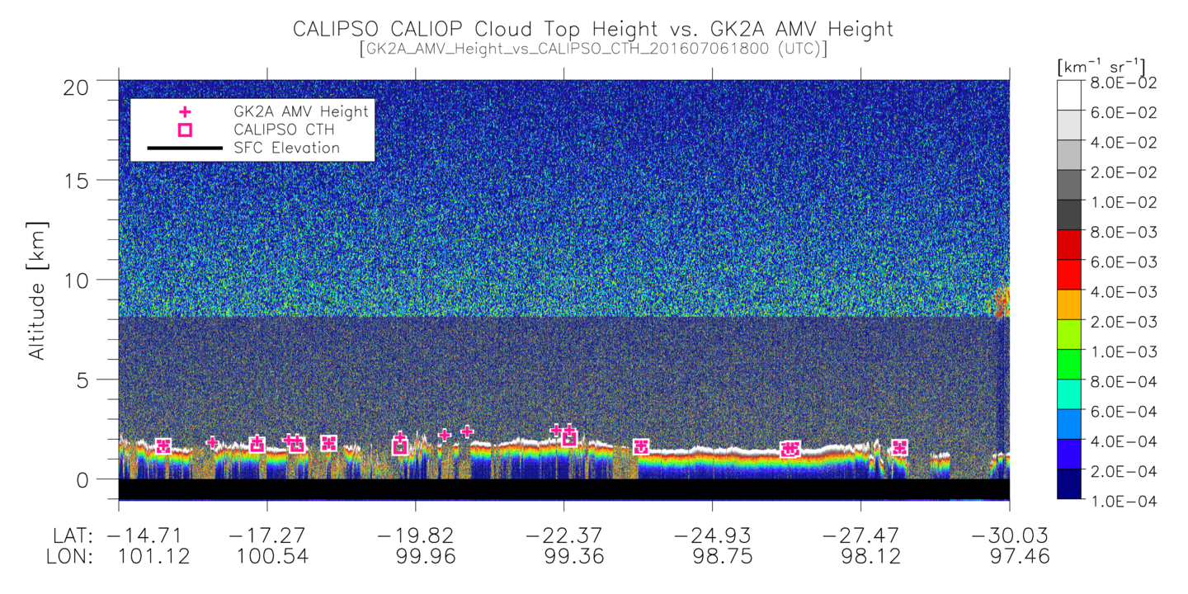
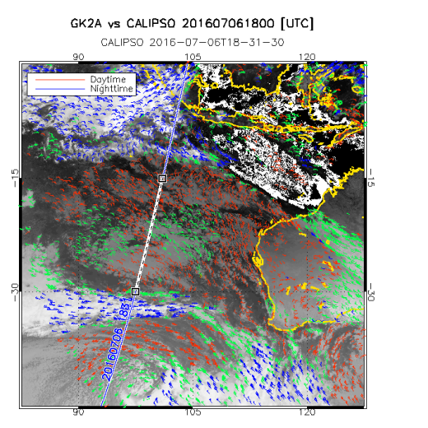
AMV height assignment methods
Optically THICK LOW cloud case
EBBT + IR/WV Intercept
EBBT + CO2 Slicing

Slide 18
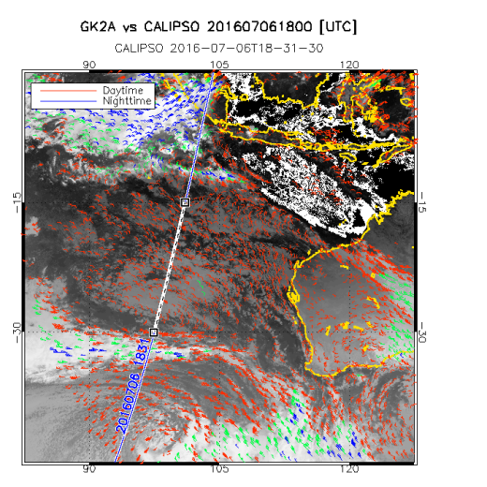
AMV height assignment methods
Optically THICK LOW cloud case
CCC Method

Slide 19
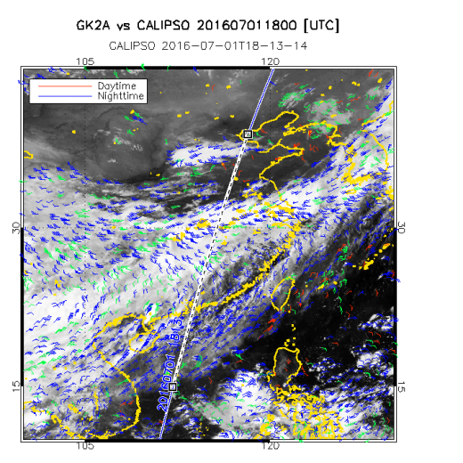
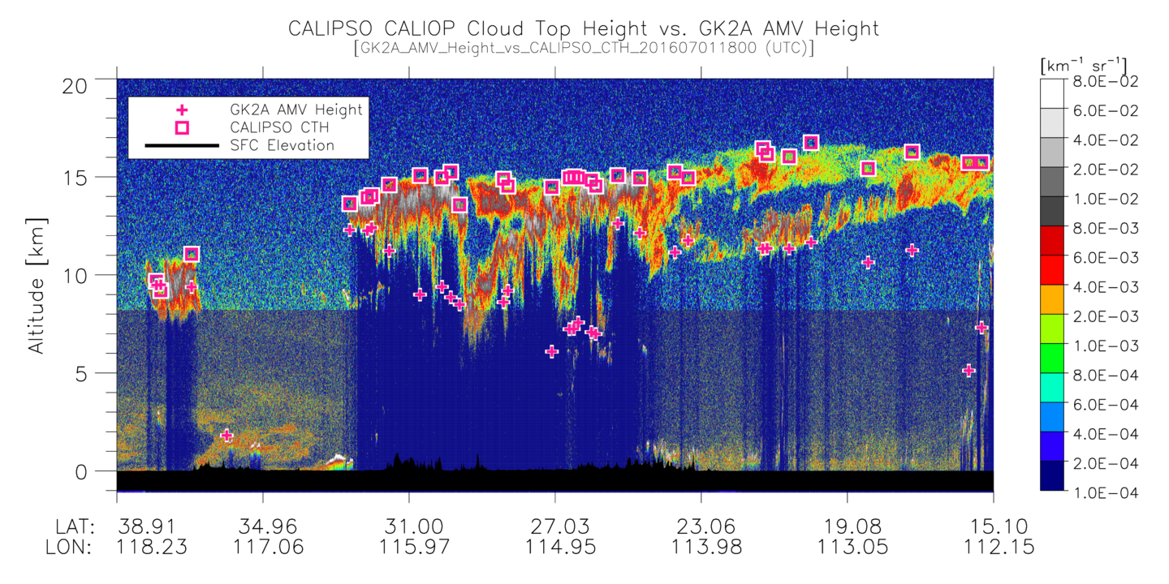
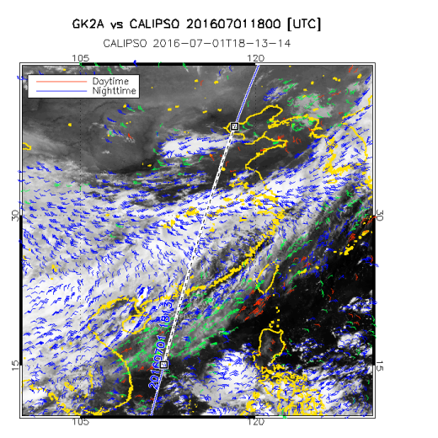
AMV height assignment methods
Optically THIN HIGH cloud case
EBBT + IR/WV Intercept
EBBT + IR/WV Intercept
EBBT + IR/WV Intercept
CALIOP CTH
AMV Height
EBBT + CO2 Slicing
EBBT + CO2 Slicing
EBBT + CO2 Slicing
CALIOP CTH
AMV Height

Slide 20
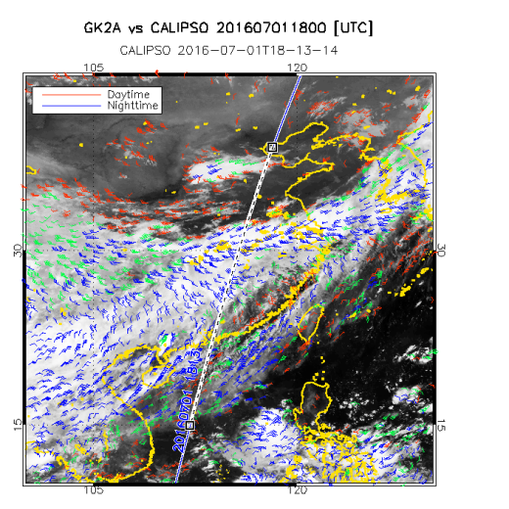
AMV height assignment methods
Optically THIN HIGH cloud case
CCC Method
CALIOP CTH
AMV Height

Slide 21
Summary
We have developed Atmosphere Motion Vector for GK-2A/AMI using Himawari8/AHI as proxy data.
Target size(Search size) : 16Ⅹ16 (54Ⅹ54)
Height Assignment : EBBT+IR/WV intercept
The result is comparable with other institute
The accuracy is better than COMS one
Need to validate with long term data
Related Posters
P7: Quality Control(Quality Index and Expect Error)
P9: AMV Inter-comparison with EUMETSAT
P10: Sensitivity Tests for target size and HA methods
P11: Impact assessment

Slide 22
Thank you!!!

