Slide 1
NWCSAF/High Resolution Winds AMV Software Version 2018
24th April 2018
Fourteenth International Winds Workshop
Jeju, Korea
Javier García-Pereda
NWCSAF/AEMET
Madrid, Spain
(jgarciap@aemet.es)

Slide 2
Index
I. NWCSAF/HRW current status
II. NWCSAF/HRW v2018
III. NWCSAF/HRW later up to 2022
IV. Other activities involving NWCSAF/HRW
V. NWCSAF/High Resolution Winds as
“Stand alone AMV calculation software”
2

Slide 3
NWCSAF/HRW current status
EUMETSAT’s Satellite Application Facility on Support to Nowcasting (NWCSAF)
develops and distributes to Meteorological Services and Researchers
NWCSAF/GEO Software Package.
This software provides its users the calculation locally and in near real time of
a total of 15 meteorological products:
Clouds Precipitation Convection
Humidity and Stability Dynamics Conceptual models
Among them:
High Resolution Winds (HRW):
High density sets of Atmospheric Motion Vectors (AMVs)
and Trajectories for near real time applications
3

Slide 4
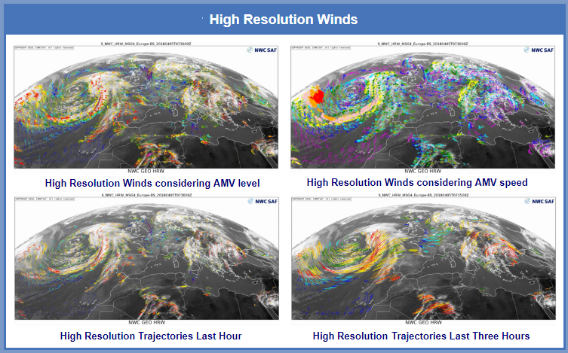
NWCSAF/HRW current status
Currently operational version of High Resolution Winds is v2016
(released in November 2016; shown in previous Winds Workshop).
Example of NWCSAF/HRW v2016 outputs at www.nwcsaf.org webpage
for 05 April 2018, 0730Z, Meteosat 11, European & North Atlantic region
4

Slide 5
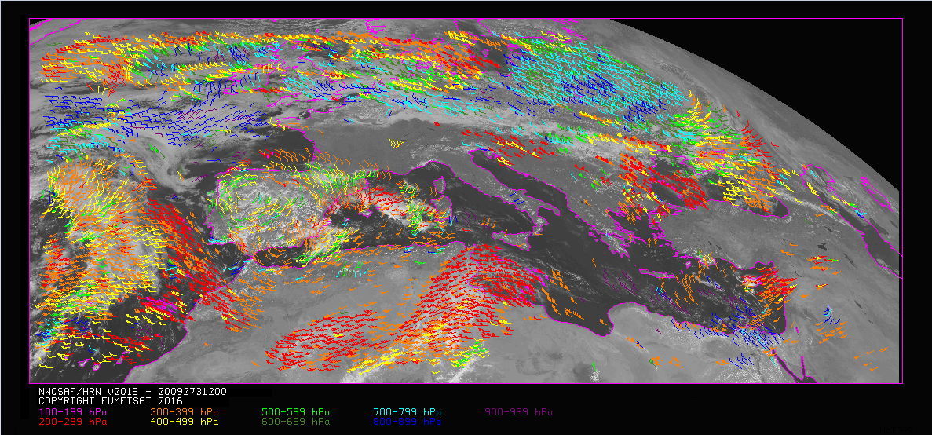
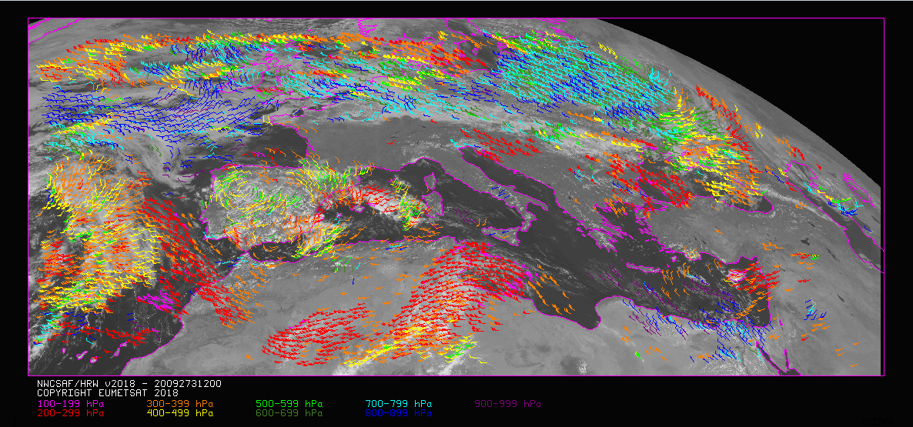
NWCSAF/HRW v2018: Main improvements
NWCSAF/High Resolution Winds v2018
is now being prepared for release in Autumn 2018.
Main improvements for NWCSAF/HRW v2018:
1. More AMVs at low levels:
> Requirement from users.
> Defined reducing to a half
the separation of
Very low & Low cloud tracers.
> Comparing this example of
HRW v2016 (up), v2018 (down)
for 30 Sept. 2009 at 1200Z:
> Higher density of
low level AMVs (blue colours) is clear
clear in many locations.
5

Slide 6
NWCSAF/HRW v2018: Main improvements
Comparing AMV statistics against Radiosounding winds for HRW v2016/v2018:
(MSG-2 satellite, Europe & Mediterranean region, July 09-June 10):
> There is an absolute increase of Low level AMVs,
and a relative increase of Low level AMVs (from 14% to a 23%)
between HRW v2016 and v2018.
> The process is a bit slower: total number of AMVs reduces a bit (a 24%).
> Considering the validation statistics:
- Basically the same for the three layers, with a slight reduction in the NBIAS.
6

Slide 7
NWCSAF/HRW v2018: Main improvements
2. Adaptation of HRW algorithm to Himawari-8/9 satellite series:
> AMVs extracted from:
- 0.6 μm Visible channel (0.5 km resolution).
- 0.8 μm Visible channel (1.0 km resolution).
- 11.2 μm Infrared channel (2.0 km resolution).
- 6.2 μm, 6.9 μm, 7.3 μm Water vapour channels (2.0 km resolution).
> All processes for AMV extraction equivalent to those for MSG,
using “CCC method with Microphysics correction” as height assignment.
> A retuning of the “Microphysics correction” has been done for Himawari,
due to differences in the NWCSAF/Cloud products
for MSG and Himawari.
7

Slide 8
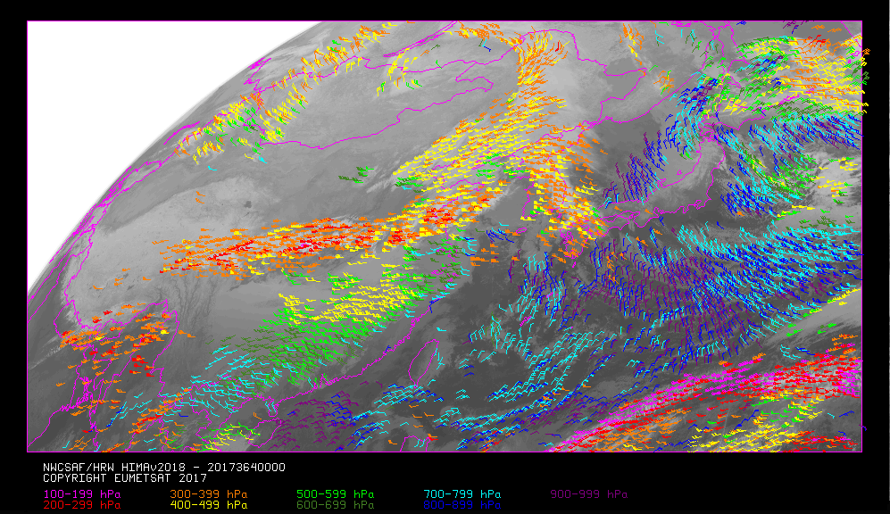
NWCSAF/HRW v2018: Main improvements
Example of NWCSAF/HRW v2018 AMVs for Himawari-8
30 December 2017, 0000Z, China-Korea-Japan region
8

Slide 9
NWCSAF/HRW v2018: Main improvements
Considering AMV Validation against Radiosounding winds for Himawari
(Himawari-8 satellite, China-Korea-Japan region, Nov 2017-Feb 2018):
and comparing against the commented AMV Validation for MSG:
> There is a significant improvement of all validation parameters
(NBIAS reduces to zero; NMVD/NRMSVD reduces a 15%-30%)
at high and medium layers.
> There is a slight worsening of all validation parameters
(NBIAS increases a 30%; NMVD/NRMSVD increase a 5%) at low layer.
9

Slide 10
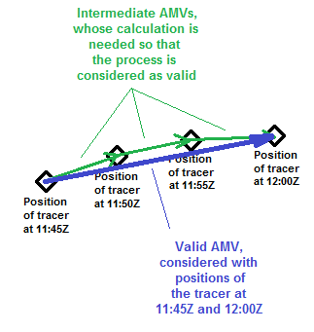
NWCSAF/HRW v2018: Main improvements
3. Option for a “Mixed scanning processing”
considering short and long time intervals (with Rapid scan and Nominal scan):
> Small intervals of time
between the initial and final image
increase the amount of AMVs and
the quality of the tracking process,
due to the smaller changes in the tracers.
> But this way, problems occur with
the calculation of the displacement,
due to the spatial resolution of the images
(often, displacement smaller than a pixel).
> The situation is much better:
- Verifying the tracking process with “short time intervals”
(f.ex. 5 min. for MSG – 2.5 min. for Himawari)
- Calculating the displacement of the AMVs with “long time intervals”
(f.ex. 15 min. for MSG – 10 min. for Himawari).
10

Slide 11
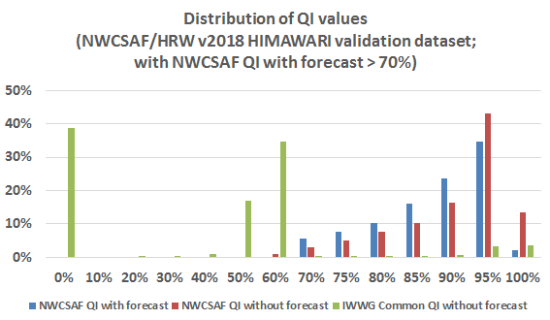
NWCSAF/HRW v2018: Main improvements
4. Inclusion of the “IWWG Common Quality Control module”
as additional parameter in the HRW outputs.
> Three Quality indices are so provided for each AMV:
- HRW Quality index with forecast.
- HRW Quality index without forecast.
- IWWG Common Quality index without forecast.
> The current “AMV Intercomparison”
(to be shown next Thursday)
shows this parameter has a real skill
to increase the homogeneity between
AMVs from different centres.
However, use it with care:
- Its value distribution is limited!
11

Slide 12
NWCSAF/HRW v2018: Main improvements
5. Autovalidation of the calculated AMVs during the running of HRW algorithm:
> NWP model forecast/analysis winds at AMV level/best fit level as reference.
(NWP analysis winds generally not available for real time tasks).
> This information can be very useful for real time processing of HRW data.
> Statistics defined by configuration for
whole AMV dataset, the different layers, the different satellite channels.
> Example of statistics shown in the HRW log file for each slot of
HRW algorithm (Himawari satellite, against NWP analysis winds):
HRWDATE:20171102T000000Z NWPCONF:ANA *** AMV:BAS CHA:TOTAL LAY:ALL *** NC: 20052 SPD[M/S]:22.290 NBIAS:+0.066 NMVD:0.198 NRMSVD:0.250
HRWDATE:20171102T000000Z NWPCONF:ANA *** AMV:BASCLEAR CHA:TOTAL LAY:ALL *** NC: 1952 SPD[M/S]:23.901 NBIAS:-0.042 NMVD:0.220 NRMSVD:0.267
HRWDATE:20171102T000000Z NWPCONF:ANA *** AMV:BASCLOUD CHA:VIS06 LAY:ALL *** NC: 483 SPD[M/S]:23.689 NBIAS:+0.053 NMVD:0.164 NRMSVD:0.203
HRWDATE:20171102T000000Z NWPCONF:ANA *** AMV:BASCLOUD CHA:VIS08 LAY:ALL *** NC: 1285 SPD[M/S]:16.443 NBIAS:+0.096 NMVD:0.211 NRMSVD:0.268
HRWDATE:20171102T000000Z NWPCONF:ANA *** AMV:BASCLOUD CHA:IR112 LAY:ALL *** NC: 5490 SPD[M/S]:18.687 NBIAS:+0.074 NMVD:0.211 NRMSVD:0.267
HRWDATE:20171102T000000Z NWPCONF:ANA *** AMV:BASCLOUD CHA:WV062 LAY:ALL *** NC: 2241 SPD[M/S]:27.804 NBIAS:+0.077 NMVD:0.169 NRMSVD:0.214
HRWDATE:20171102T000000Z NWPCONF:ANA *** AMV:BASCLOUD CHA:WV069 LAY:ALL *** NC: 3648 SPD[M/S]:24.710 NBIAS:+0.087 NMVD:0.195 NRMSVD:0.248
HRWDATE:20171102T000000Z NWPCONF:ANA *** AMV:BASCLOUD CHA:WV073 LAY:ALL *** NC: 4953 SPD[M/S]:22.750 NBIAS:+0.078 NMVD:0.196 NRMSVD:0.245
> Corresponding information on “NWP wind at AMV level/best fit level”
is also stored in HRW outputs for further processing of HRW statistics.
12

Slide 13
NWCSAF/HRW v2018: Main improvements
6. Parallax correction in the position and displacement of the AMV:
> Consequences more formal than real:
(General reduction of the speed of the AMV;
reduction smaller than a 3% always; smaller than a 1% in 99% of cases).
7. Simplification in the HRW running files:
> Reduction in the number of default HRW configuration files
to one per satellite series only.
13

Slide 14
NWCSAF/HRW v2018: Main improvements
To be developed this summer, for release also in Autumn 2018:
8. Implementation of the “New IWWG AMV BUFR” output:
> The HRW output is configured by the NWCSAF user.
> Up to four output options can be defined in parallel
for the same running of HRW algorithm.
> This way, the user of HRW v2018 will decide very easily
when to change its HRW output to the “New IWWG AMV BUFR” format.
9. Parallelization of HRW code:
> Processing times of HRW algorithm increase visibly,
especially with the new “very high resolution satellite channels”.
> The parallelization will allow to reduce processing times,
if the user has the corresponding computer resources.
> The process will be done considering the largest reductions
in the processing times with the least changes in HRW code.
14

Slide 15
NWCSAF/HRW v2018: Main improvements
To be developed later, for release in the first half of 2019
10. Adaptation of HRW algorithm to GOES-R/S satellite series:
> Adaptation to be very similar to the one for Himawari,
using equivalent satellite channels
(VIS06, VIS08, WV062, WV070, WV074, IR112).
> Release after full AMV validation.
> This way, NWCSAF/HRW will be able in 2019 to
run operationally for the first time all around the planet Earth
with 5 geostationary satellites:
- 2 MSGs over Europe/Africa and West Asia.
- Himawari over East Asia.
- GOES-R and -S over the Americas.
15

Slide 16
NWCSAF/HRW later up to 2022
For the period 2019-2022 next activity will be the main objective:
Version “day 1” for MTG-Imager first satellite (in 2021-2022):
➔ The experience of HRW algorithm
with Himawari and GOES-R/S satellites
will be very helpful for this adaptation.
➔ Currently, main difficulties expected to be related to:
- The optimal use for AMV extraction of high resolution visible channels
(good AMV densities, optimization of time processing,…)
- The improvement of AMVs at low levels.
16

Slide 17
NWCSAF/HRW later up to 2022
About the extension of HRW algorithm to other options with GEO satellites:
- Extension to other GEO satellites,…
- Integration of other methods developed for other AMV algorithms,...
Specific resources are at this moment not allocated for that up to 2022.
- Suggestion of collaboration with other institutions
to integrate these options inside HRW algorithm.
Financiation of tasks posible
through NWCSAF Visiting Scientist Activities!
17

Slide 18
NWCSAF/HRW later up to 2022
Several suggestions have been received for the extention of HRW algorithm
to polar satellites (inside parallel NWCSAF/PPS software package).
➔ User requirements evolve for
a quick calculation of polar AMVs in hourly cyclings.
This adaptation would be reasonable:
➔ Both HRW-GEO and HRW-PPS would be based
on NWCSAF/Clouds, with similar outputs.
➔ For maintenance reasons, it would be important
there would be an only HRW code, integrated in both software packages.
This is now not in NWCSAF plan,
but this could be changed if interest is shown by the IWWG!
An analysis of this is currently done inside NWCSAF Project Team.
18

Slide 19
Other activities involving NWCSAF/HRW
NWCSAF will also develop a specific
NWCSAF/GEO-S software package
for “IRS – Infrared Sounder Instrument”
on board MTG-Sounder satellites (≥ 2023).
NWCSAF/GEO-S software package to include “wind retrieval”
in a version for “day 2”.
19

Slide 20
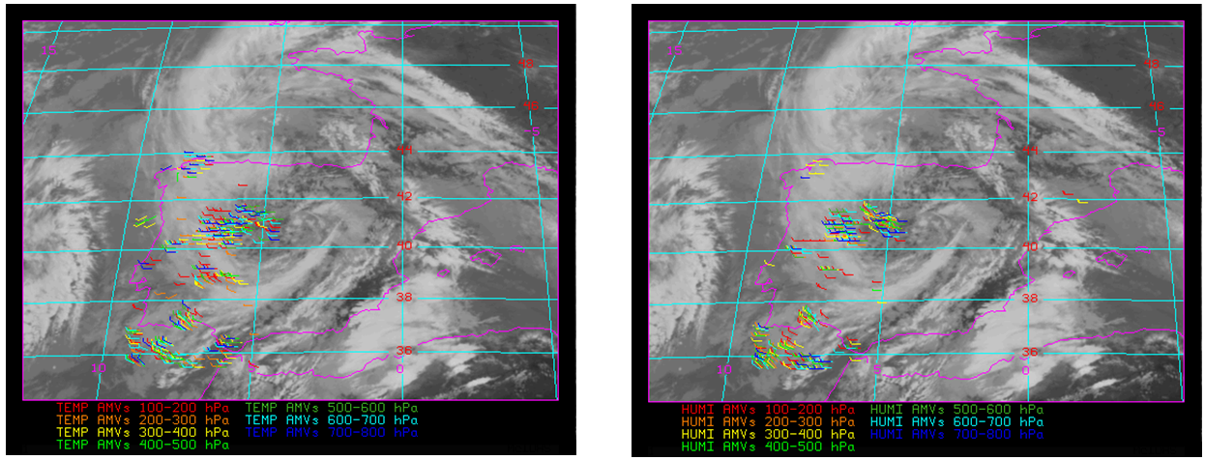
Other activities involving NWCSAF/HRW
About the retrieval of Winds with MTG-Sounder data
- A study was done in 2017 considering proxy data (from IASI) for
MTG-Sounder L2 vertical temperature and moisture profiles
➔ It is possible to extract AMVs from these Temperature/Humidity fields,
at medium and low levels (400-1000 hPa).
➔ It is much more difficult to obtain representative AMVs at high levels
due to the low values of specific humidity, and
difficulties to define good gradients and trackable features at those levels.
Example for the
Iberian Peninsula
(6 May 2016, 12:00Z)
- Left: Temp.field
- Right: Hum.field
20

Slide 21
Other activities involving NWCSAF/HRW
About the retrieval of Winds with MTG-Sounder data
➔ There is a real option to obtain AMV profiles in some locations
(i.e., AMVs at all high, medium and low layers),
giving the option to calculate wind shear in these locations.
➔ But the horizontal density of AMV profiles is clearly not homogeneous
(but this is a general property of AMVs which never denied their usability!)
Example for the
vicinity of Lisbon
(6 May 2016, 12:00Z)
- Left: Temp.field
- Right: Hum.field
21

Slide 22
Other activities involving NWCSAF/HRW
About the retrieval of Winds with MTG-Sounder data
➔ These data would provide additional meteorological information,
useful for analysis and forecasting,
beyond the one provided by AMVs calculated with satellite images.
➔ But they would be complementary information,
and would not substitute AMVs calculated with satellite images
(or wind data/profiles obtained with other schemes
like “Optical flow” by Olivier Hautecoeur/EUMETSAT
or Miguel Ángel Martínez/NWCSAF).
22

Slide 23
HRW as “Stand alone AMV calculation software”
Due to its characteristics and its ease to be obtained/understood/run locally,
NWCSAF/HRW was proposed at previous “International Winds Workshops”
as “Stand alone AMV calculation software”
available for all AMV researchers and users.
Its good validation results by independent studies:
- 2014 AMV intercomparison with MSG
- 2017 AMV intercomparison with Himawari
should be enough to convince any researchers about the use of HRW algorithm.
For any questions/suggestions please contact me here at any moment or at:
Javier García Pereda
jgarciap@aemet.es
www.nwcsaf.org
23

