Slide 1
A study of the AMV correlation surface
Mary Forsythe, Graeme Kelly, Javier Garcia Pereda
IWW14, 24/04/2018

Slide 2
Talk Outline
Motivation
Polar data
High resolution data
Global data
Early examples
How can we use the information?
© Crown copyright Met Office

Slide 3
Motivation

Slide 4
How are AMVs produced?
Initial corrections (image navigation etc.)
Tracking
Infrared Imagery
Search Area
80 x 80 pixels centred on target box
Target Box / Tracer
e.g. 24 x 24 pixels
pixel – 3 km
new location determined by best match of individual pixel counts of target with all possible locations of target in search area.
T
T + 15 min
Normally repeat from image 2-> 3 to give a second vector for quality control
3. Assign a height to the derived vector – moving towards use of optimal estimation - not always easy!

Slide 5
In recent years……
For traditional AMV production from geostationary satellites - height assignment thought to be the dominant source of error – less focus given to tracking step.
But….

Slide 6
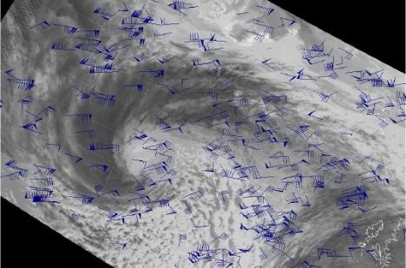
First challenge - polar winds
Greg Dew’s talk IWW10 Feb 2010
Image interval longer at ~100 min
Target size 28x28
Lots of noise in vector field due to longer image interval
Conclude: need first guess to guide tracking for polar winds

Slide 7
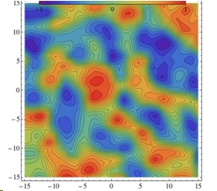
Second challenge – high resolution winds
Kazuki Shimoji’s talk IWW12 Jun 2014
Aim to generate winds more representative of local flow - move to smaller target box sizes
Target size 5x5
More noise, multiple peaks in correlation surface

Slide 8
Third challenge – smoother cloud features
NWP SAF – 4th analysis report – James Cotton, 2010
Example in jet region
1) 22 June 2) 29 June
Differences in texture of the two features may be affecting success of tracking step.
Feature exhibiting large slow bias
Narrow jet core
Smooth linear features aligned parallel to direction of wind
Feature with fairly neutral bias
Much wider
Less regular - more contrast details perpendicular to flow
Mean MetO background
O-B speed bias

Slide 9
Early examples

Slide 10
Plotting the correlation surfaces
Javier Garcia Pereda provided a modified version of HRW v2016 (applicable with NWCSAF v2016 only) which includes the correlation matrices for each AMV.
This is running in test mode at the Met Office and Graeme Kelly has put together some code to plot the correlation matrices for winds within the UKV domain.

Slide 11
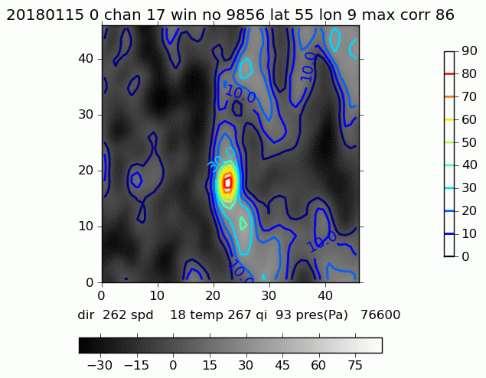
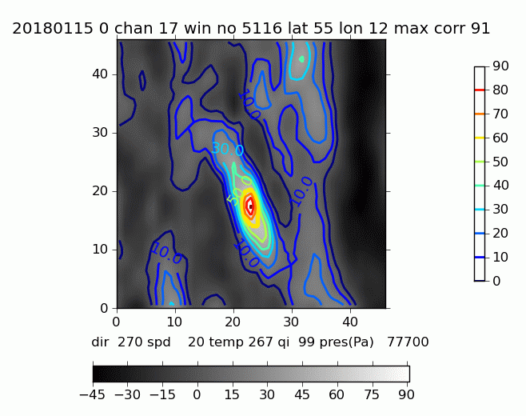
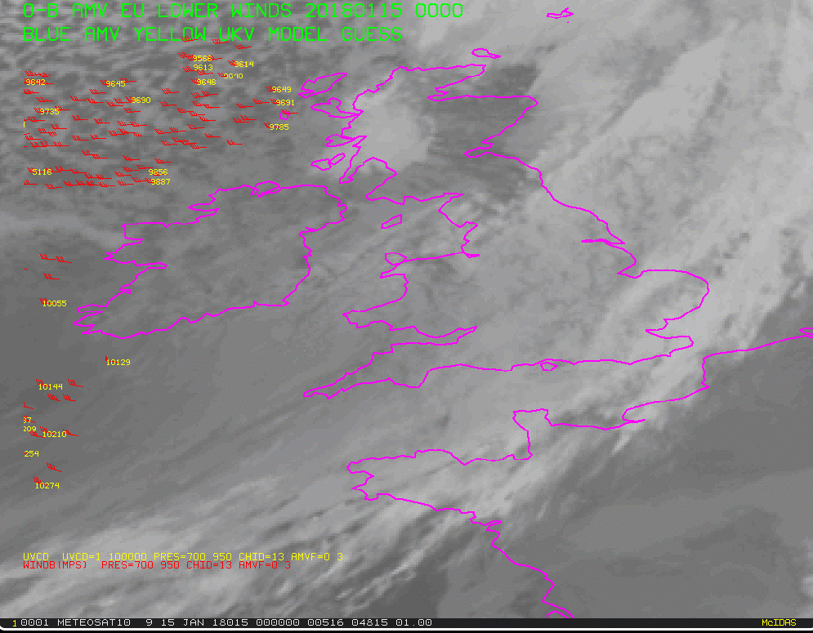
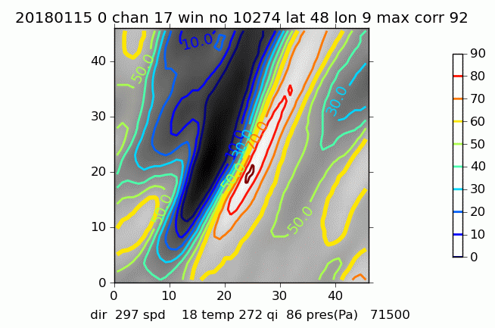
Low level examples
At low level generally see cleaner correlation surfaces.
Correlation surface better constrained in area with more cloud texture

Slide 12
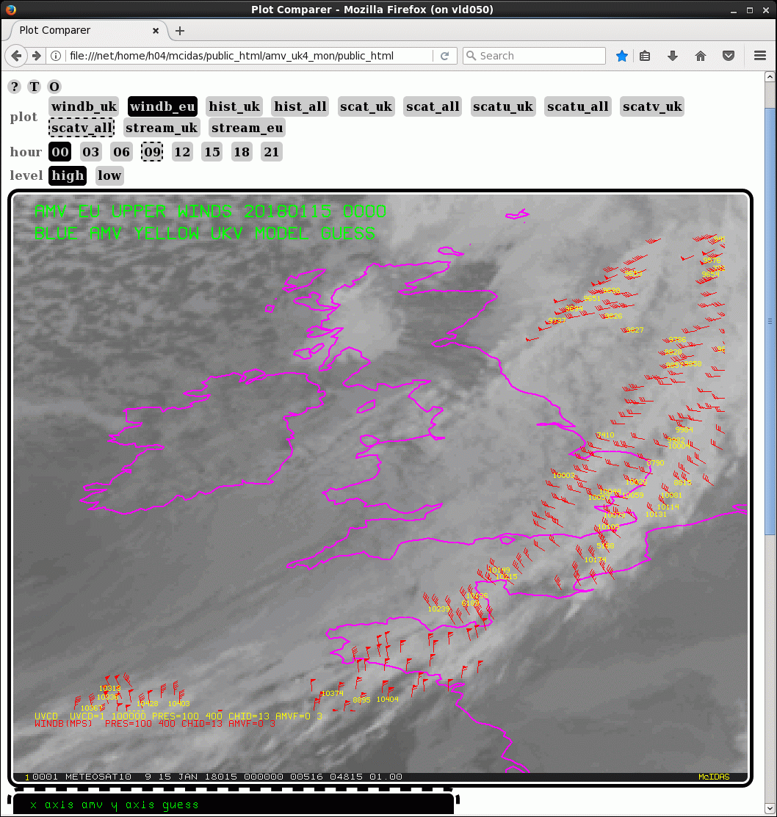
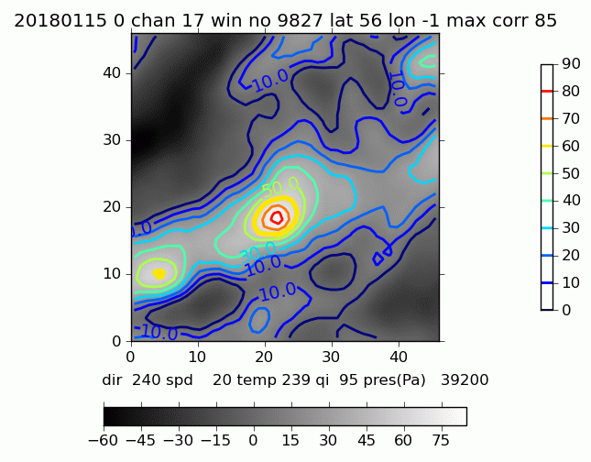
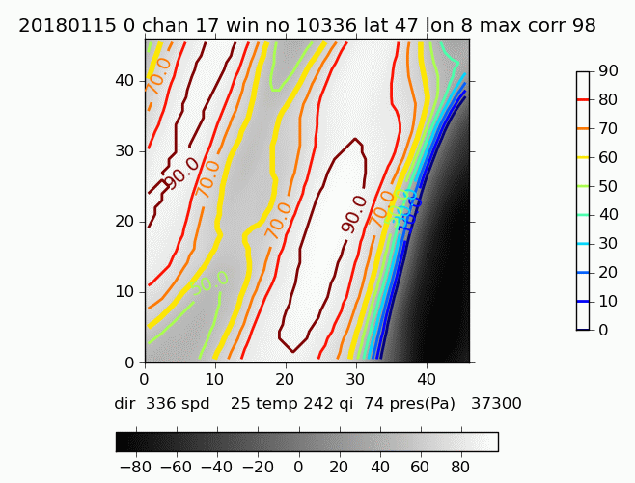
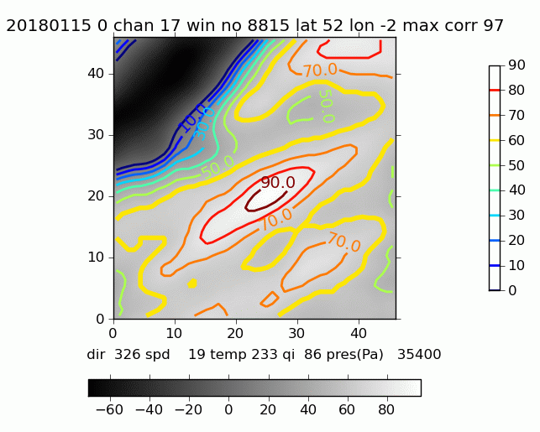
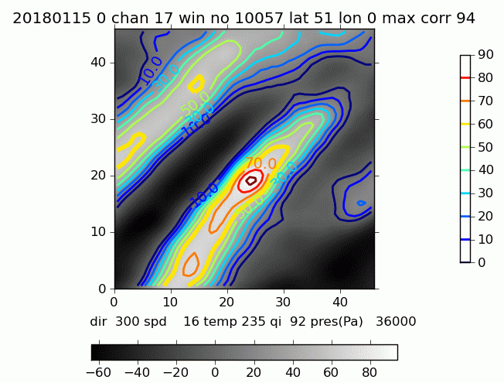
High level examples
At higher level – correlation surfaces can look quite messy!

Slide 13
How can we use the information?

Slide 14
Filtering to remove the poorly constrained cases
If correlation outside of a set region around the maximum correlation value exceeds a fraction of the maximum correlation – this test should remove cases with multiple maxima or broad maxima

Slide 15
Estimating tracking errors
Could attempt to fit an ellipse to the peak correlation structure – could provide estimates of error across both axes of the ellipse

Slide 16
NWP AMV observation error schemes
Several NWP centres use an observation error scheme based on the following assumption
Two independent sources of error
Error in vector
Linked to accuracy of tracking step
Error in height
Linked to accuracy of height assignment
More problematic if large vertical wind shear
Total u/v error = √ (u/v Error² + Error in u/v due to error in height²)
For this we need an estimate of:
u and v error (Eu and Ev)
height error (Ep)
Potentially use information from the correlation surface for Eu and Ev
A good specification of the observation error is essential to assimilate in a near-optimal way
See Forsythe & Saunders, IWW9, 2008 for more information

Slide 17
Summary
For many global AMVs – height assignment remains the main source of error
For polar AMVs and high resolution AMVs, the tracking step has proved more problematic due to longer image intervals (polar) or smaller target sizes (high resolution).
There may also be cases where traditional AMVs struggle due to smoother cloud features – in these cases motion often better constrained in one dimension.
There is information in the correlation surfaces that could be used to filter out poorly constrained cases or provide estimates of errors in the tracking step for use in NWP.

Slide 18
Next steps
So far the results have not shown much correlation between poorly constrained correlation surfaces and O-B fit, but we also haven’t seen cases where the AMVs look noisy.
We plan to look at reducing the quality control which might be filtering out the cases of poor tracking. We also plan to look at using smaller target box sizes which we know is more challenging.
We can then look again at whether there is a relationship with O-B fit.
Beyond that can we develop the ideas to provide flags or error estimates?

Slide 19
Spare slides

Slide 20
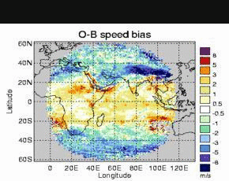
Example 3 High level Jet region slow bias
Meteosat-7 WV Indian Ocean – large slow bias feature
Persist May-Sept (SH Winter)
Example for June 2009
Closely matches location of sub-tropical Jet around 20-30S
Feature varies throughout June but not always coinciding with fastest wind speeds e.g.
O-B speed bias June 2009
Mean MetO 250 hPa analysis wind speed
Mean MetO background
O-B speed bias

Slide 21
Example 3 High level Jet region slow bias
Case Study 1) 22 June 2009, 00UTC
Jets
Slow bias
MetO model background wind speed
O-B speed bias
Both sub-tropical Jet and Polar Jet show fast model wind speeds (>70 m/s) for AMVs (WV) associated with large slow biases

Slide 22
Example 3 High level Jet region slow bias
Case Study 2) 29 June 2009, 00UTC
Jet
MetO model background wind speed
O-B speed bias
Jet to SE Madagascar shows fast wind speeds, but AMVs in this case with neutral (or even slightly fast) bias.
Why large slow biases associated with very fast winds in some cases and not others?

