Slide 1

Status of MISR Stereo Motion Vectors and
Assessment using MODIS, MSG, & CATS lidar
Kevin J. Mueller¹
¹Jet Propulsion Laboratory, California Institute of Technology, Pasadena, CA

Slide 2
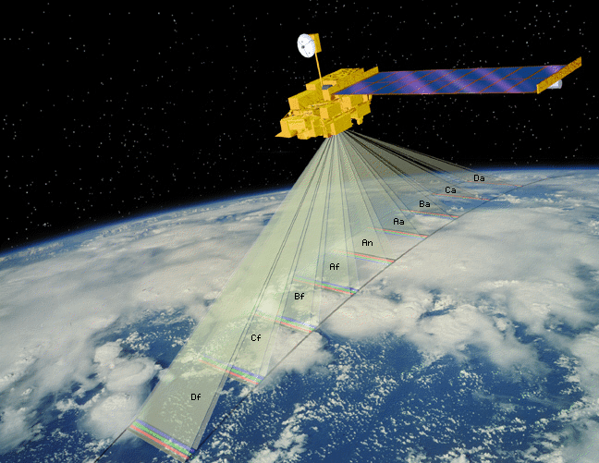
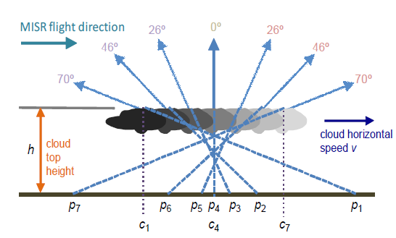
Multi-angle Imaging SpectroRadiometer
MISR instrument
Mission Lifetime
  1999 -> 2018+ 2026
  Orbit change in 2022
Swath Width ~ 380 km
9 Camera View Angles
  0º (Nadir)
  ±26.1º, ± 45.6º
  ±60.0º, ± 70.5º
  7 minute overpass
B, G, R, & NIR Bands
Spatial Resolution
  275 m for Nadir and Red Band
  1100 m all else
Up
Cross-track
Along-track
∆t ~ 7 minutes
Cross-track
Along-track
MISR Wind Products
Stereo Motion Vectors (SMV)
  Geometric height obtained from parallax
  Retrieved from redundant forward and aft camera triplets
  Time interval ∆t = 200 seconds
  Gridded resolution ∆x = 17.6 km
Height-resolved cross-track cloud motions:
  Geometric height obtained from parallax
  Retrieved from redundant forward and aft camera pairs
  Time interval ∆t = 46 seconds
  Gridded resolution ∆x = 1.1 km

Slide 3
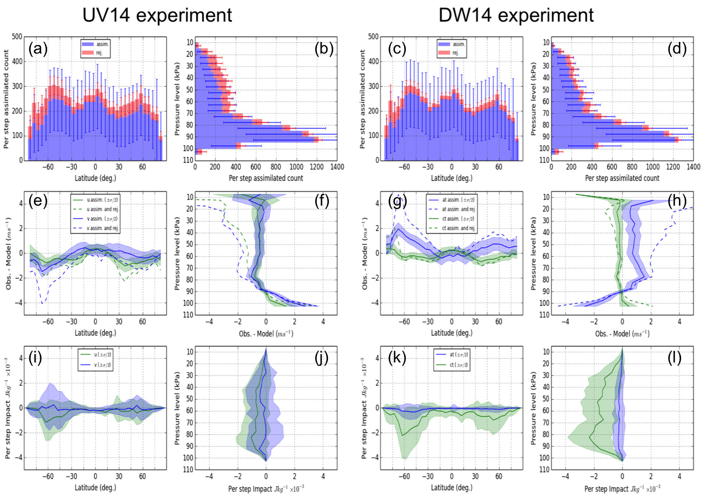
MISR Stereo Motion Vectors status
  Forecast benefit in GMAO GEOS-5 model shown
    Mueller et al. 2017, MWR
    GMAO following up by incorporating code into operational GEOS5-FP
      Testing in progress after updating code from paper to current GEOS5 revision
  Two years of NWPSAF monitoring show well constrained error
    NWPSAF AMV Analysis reports show 2 caveats:
      occasional orbits with poor georegistration have systematic bias and degraded forecast benefit
  MISR SMV will benefit from major upstream revisions to Level 1 software
    New DEM and revised camera model will benefit georegistration
    MISR SMV are highly sensitive to georegistration- see above

Slide 4
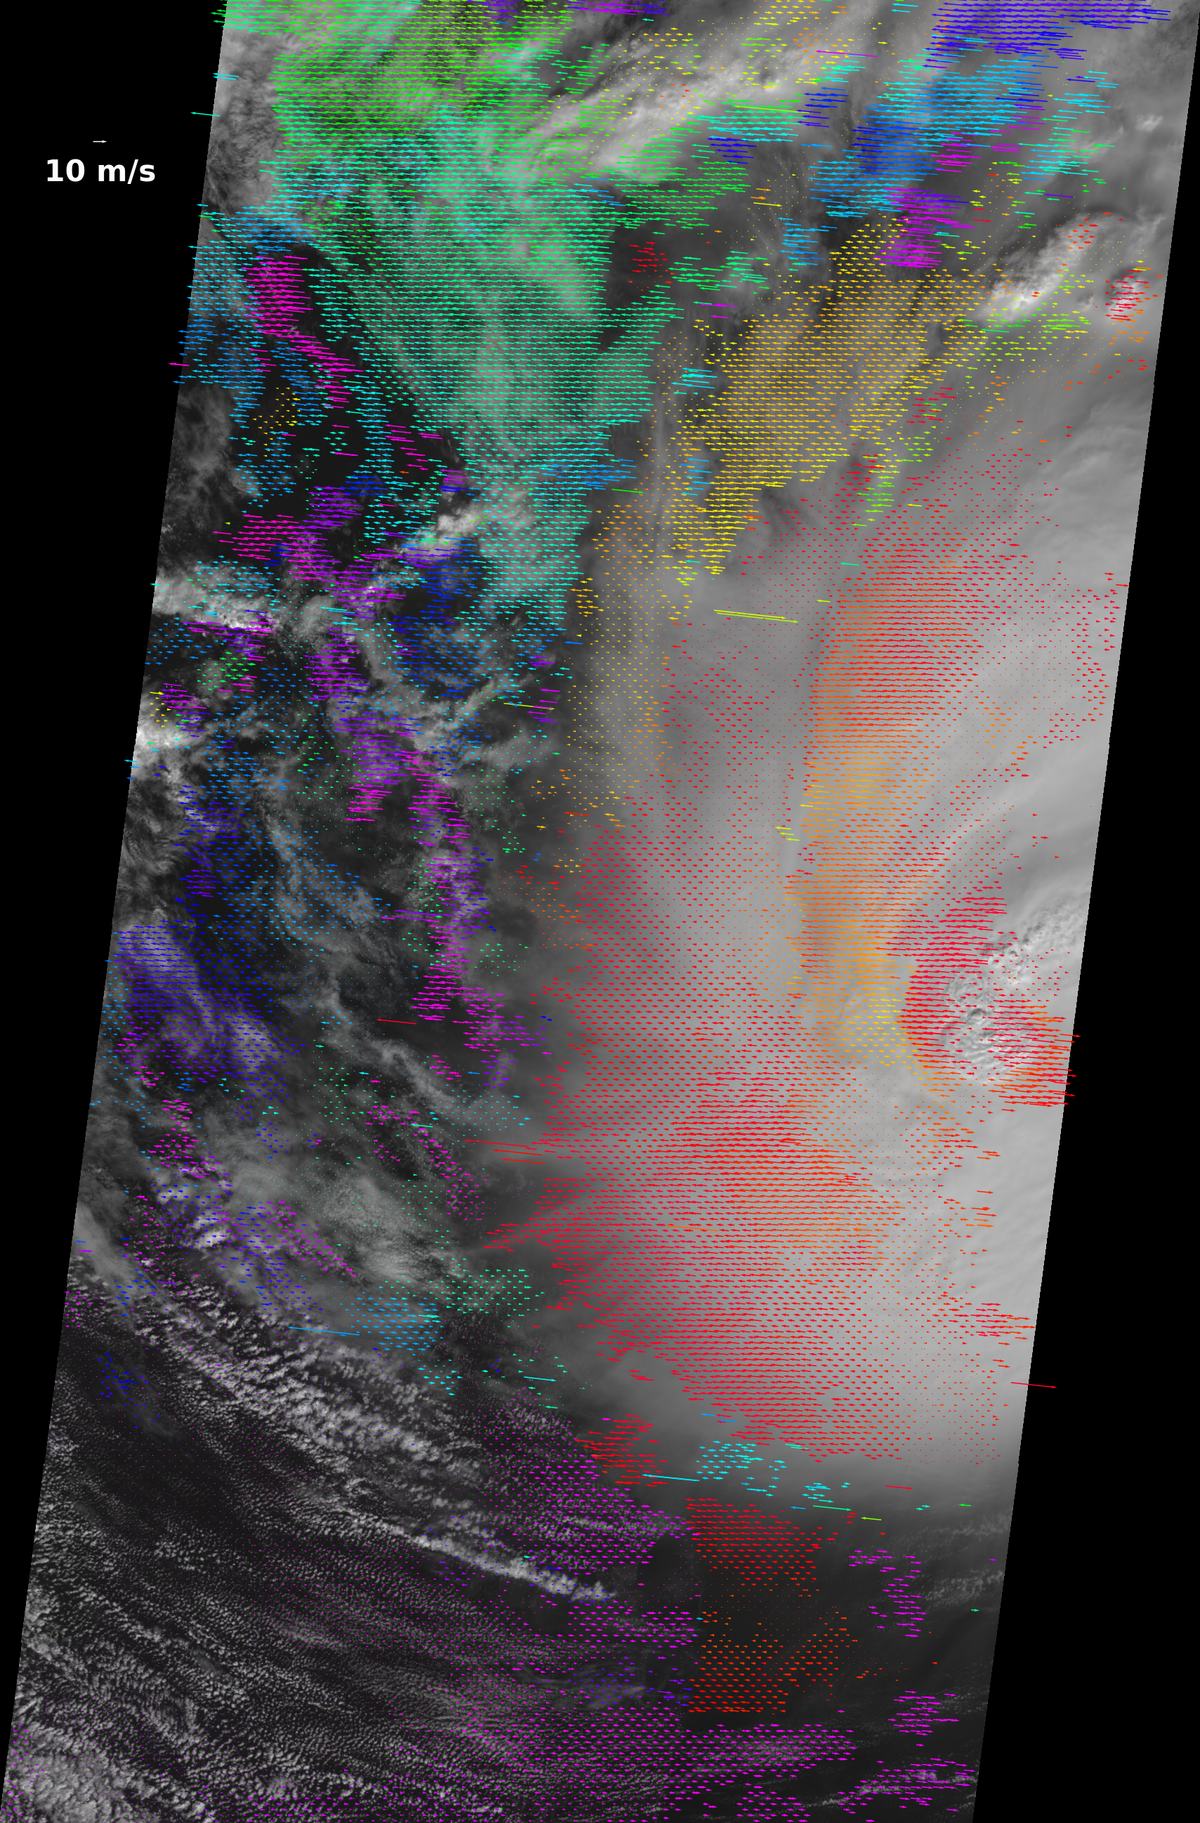
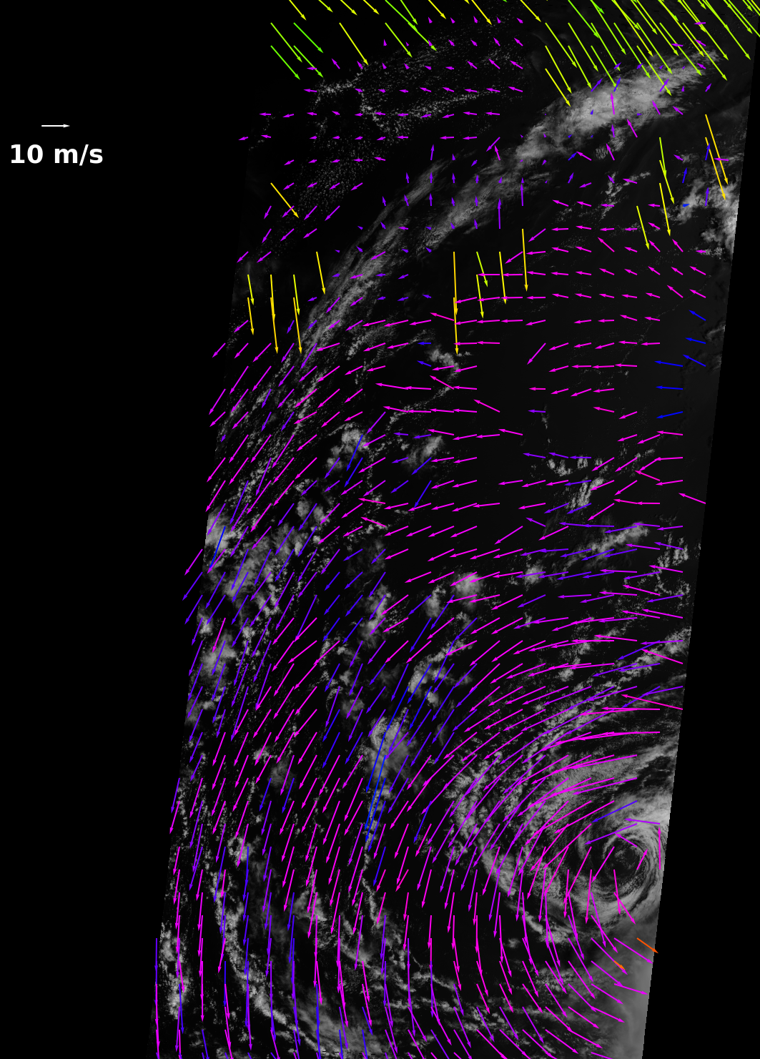
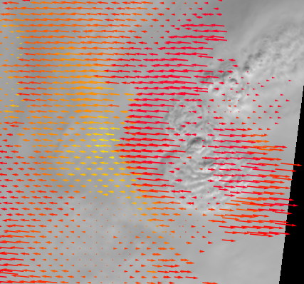

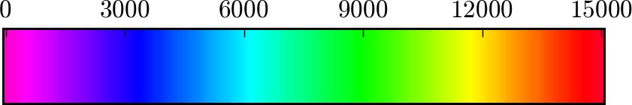
Example MISR Wind Product Retrievals
Height resolved cross-track cloud motion (1.1 km resolution)
(Hurricane Ida)
Height resolved cloud motion vectors (17.6 km resolution)
(Hurricane Francis)
Height (meters)

Slide 5
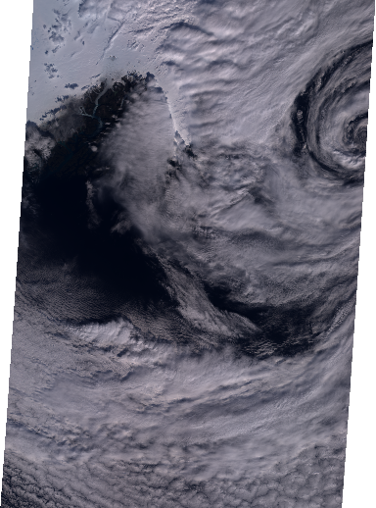
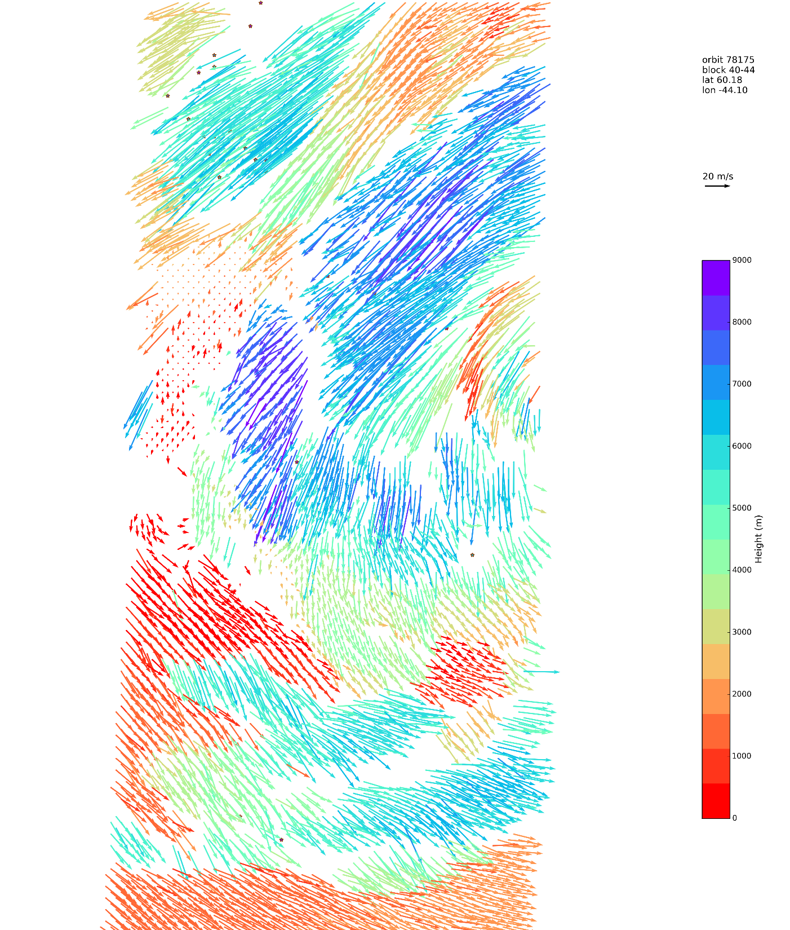
Research retrieval: 4.4 km resolution
Speed 20 m/s
9000
6000
Height (m)
3000
0

Slide 6
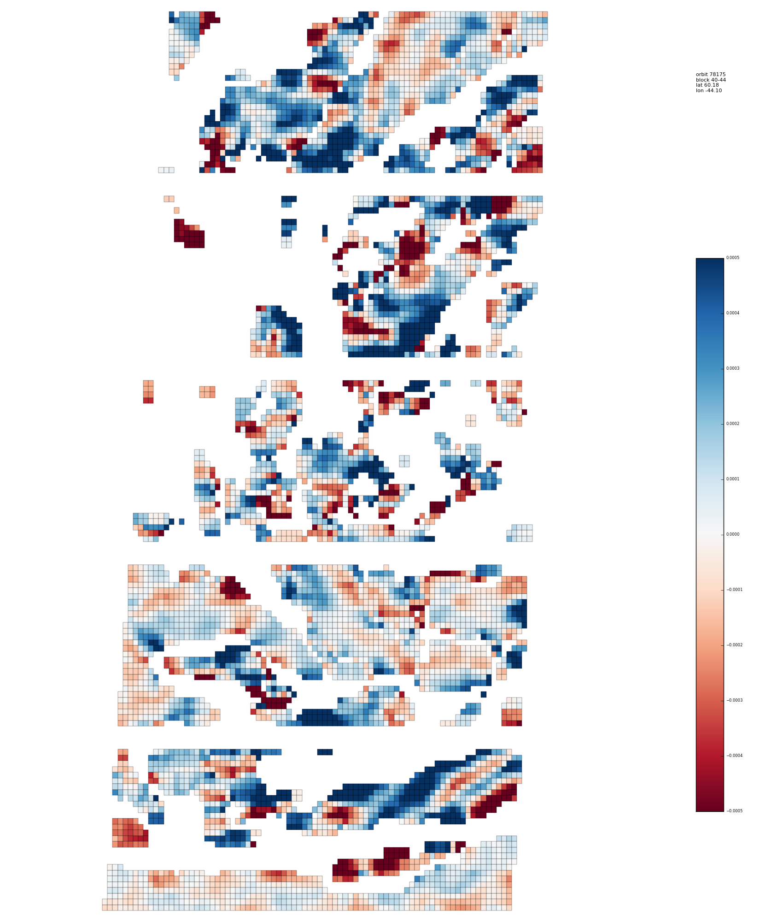
Prototype: divergence @ 4.4 km
0.4
0.2
Divergence
(s⁻¹ ×10⁻³)
0
-0.2
-0.4

Slide 7
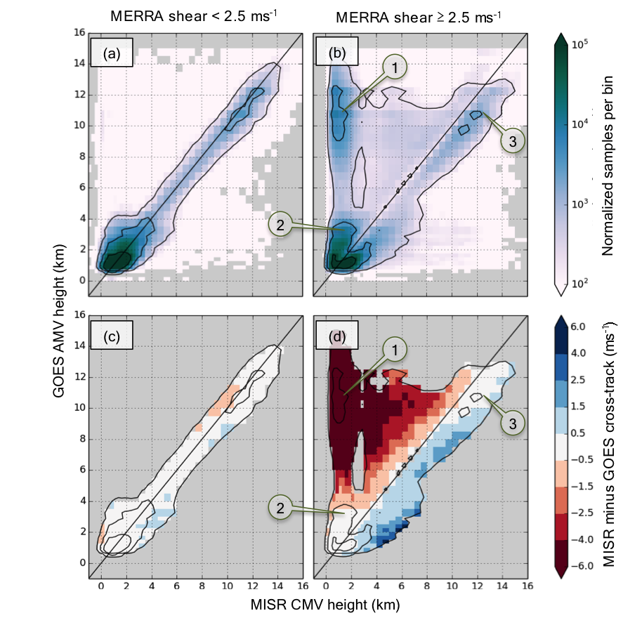
Questions from past SMV assessment
Comparison of MISR with GOES AMV (2003-2008)
  Mueller et al., 2017 JAMC
  MISR and GOES wind tracking agree well
    3.2 m s⁻¹ VRMS (VIS channel)
    1.6 m s⁻¹ RMS cross-track
  Except for…
    (2) Low heights (< 4 km):
      Heights uncorrelated
      MISR often 2 km below GOES
    (3) High heights (> 8 km)
      MISR often 1 km above GOES
Can analysis be corroborated / expanded with “truth” data for heights?
Notes:
Spend time explaining (1), (2), and (3)

Slide 8
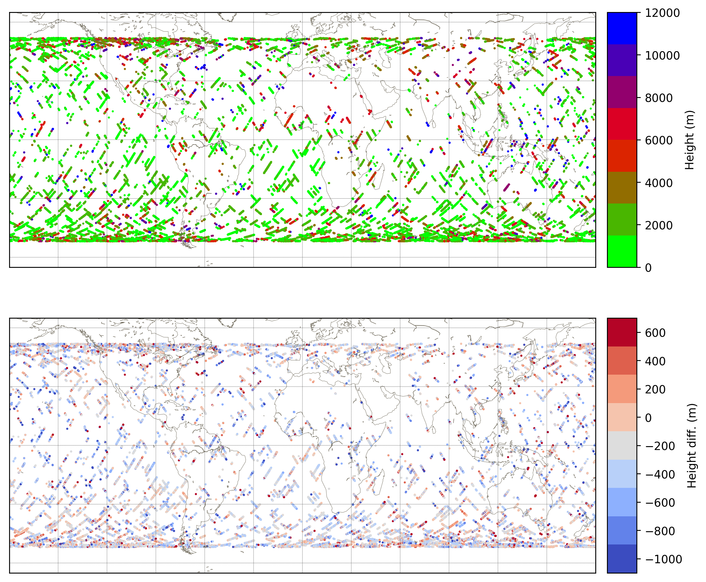
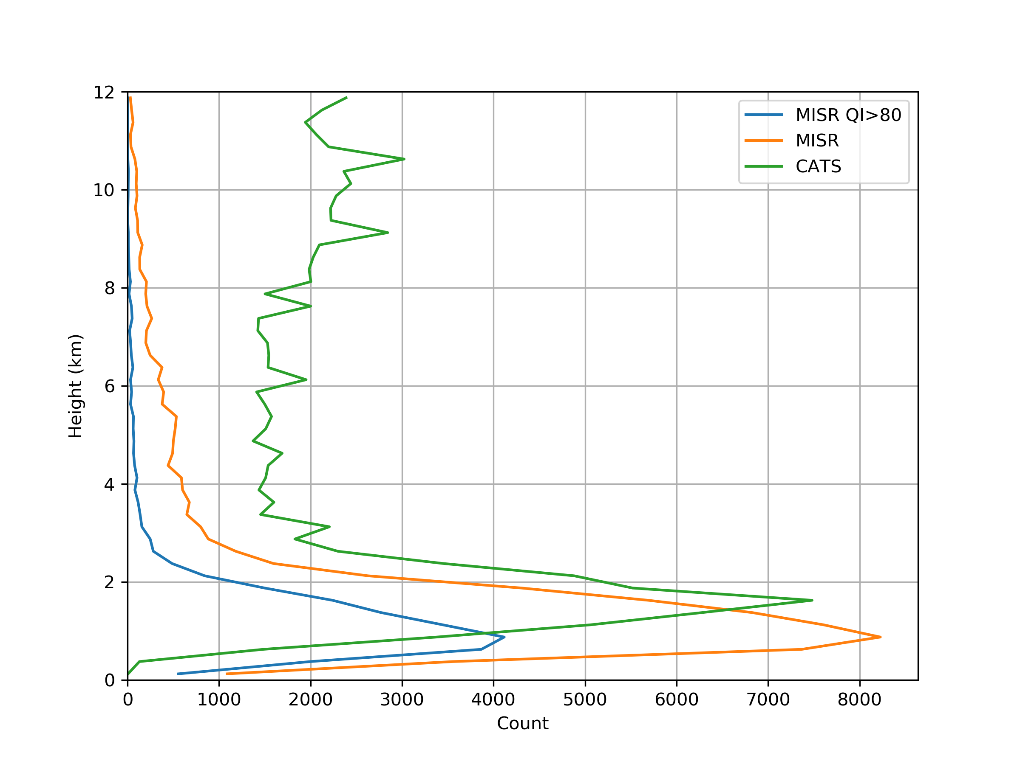
MISR SMV height validation with CATS
10s of thousands of well distributed spatial coincidences within 5 minutes, 2015-2017
Latitude range 52° S. to 52° N
Coincidences with poor MISR orbit registration have been excluded
Locations and heights (m) of coincidences
Height distribution of collocations

Slide 9
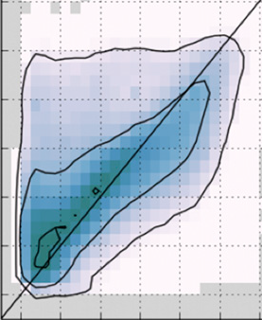
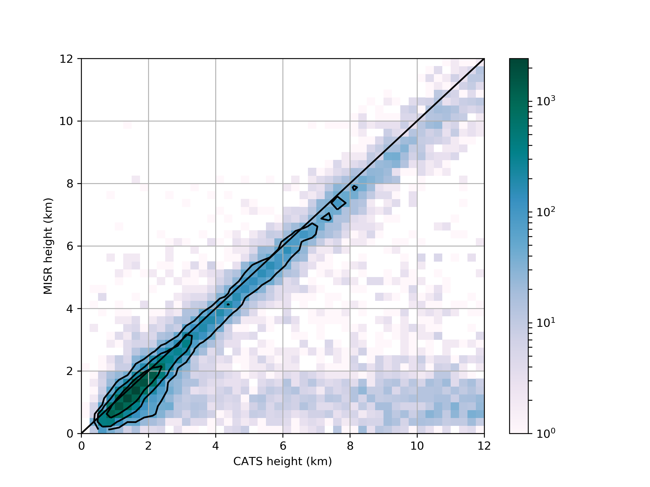
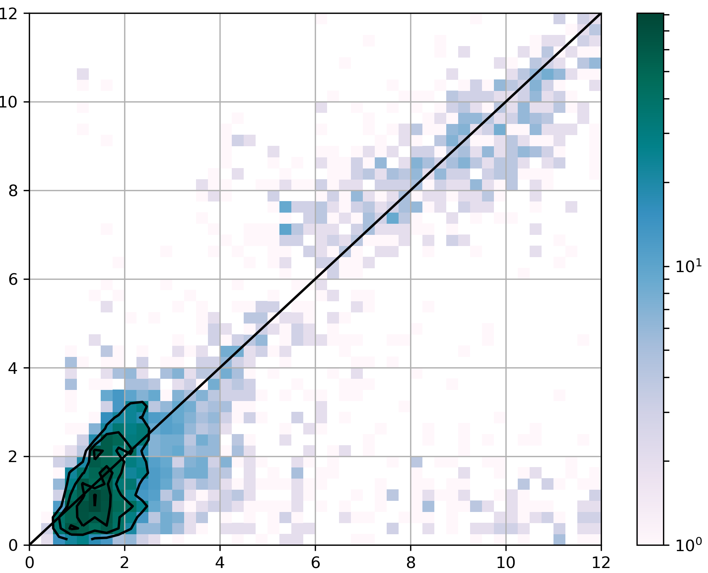
Lidar heights compare favorably with SMV heights
MISR vs. GOES height
Directly comparable measurements yield low noise
  RMS 300 m
MISR vs. CATS height
MODIS vs. CATS height
MISR height (km)
MODIS height (km)
CATS height (km)
CATS height (km)

Slide 10
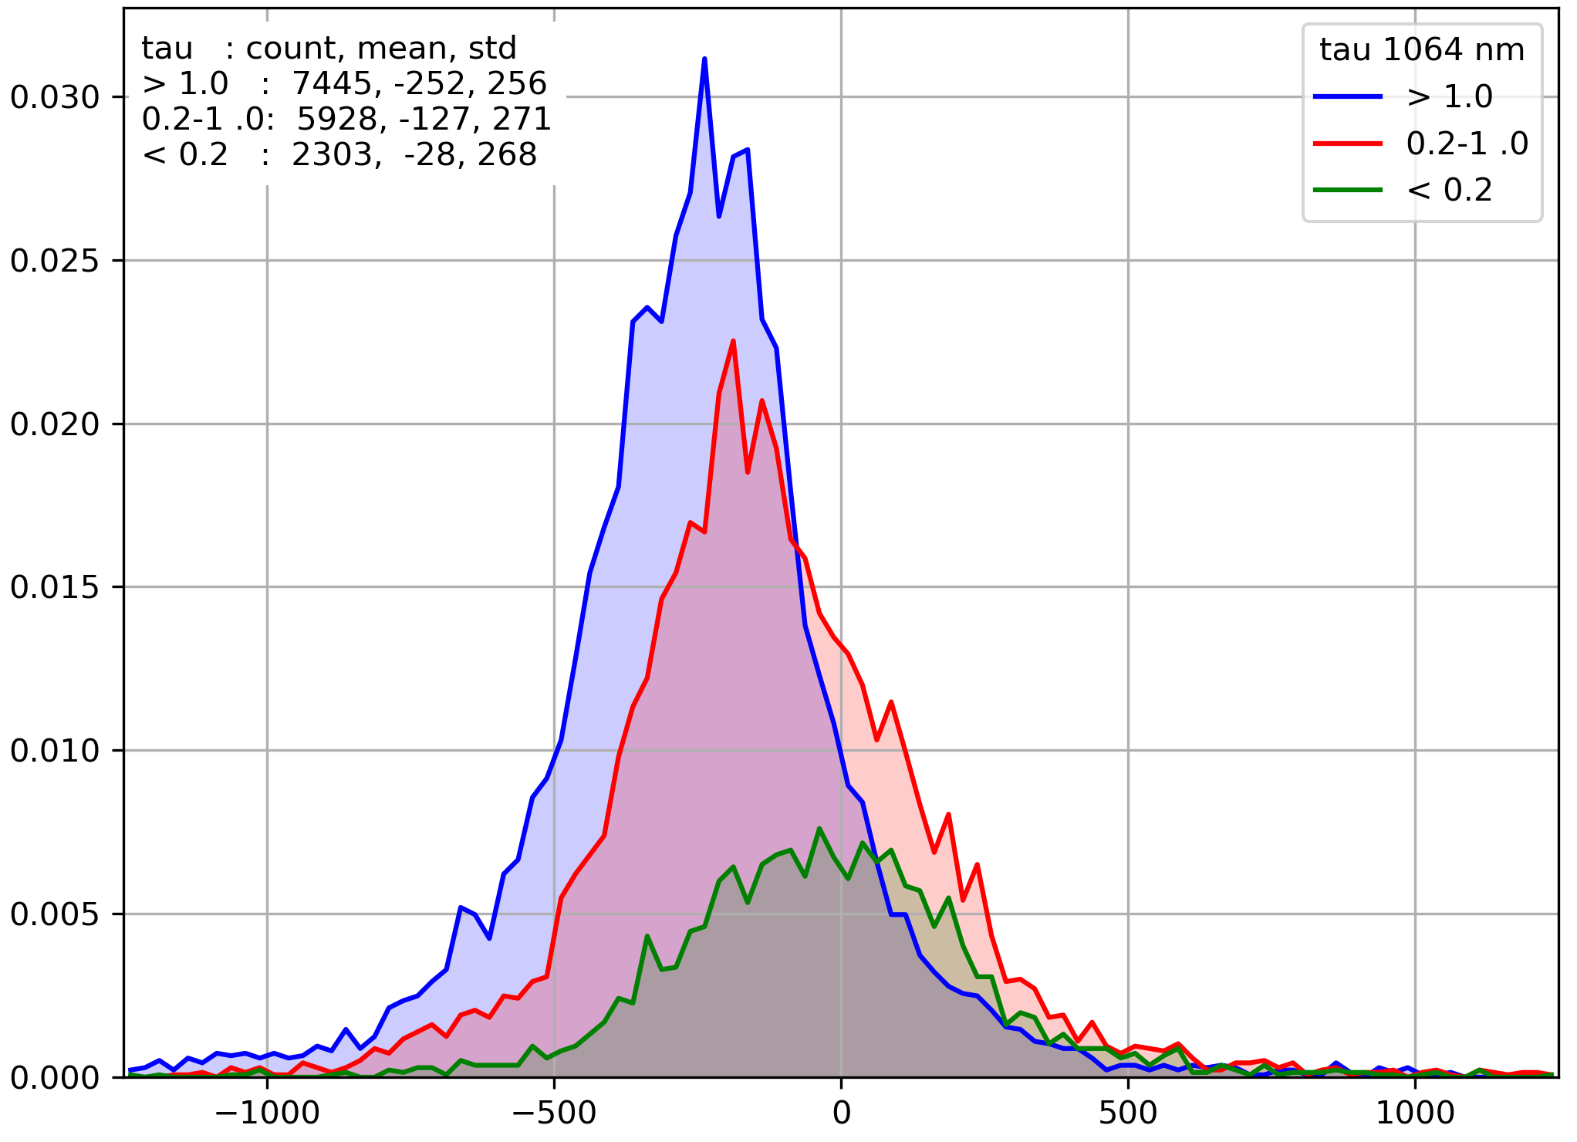
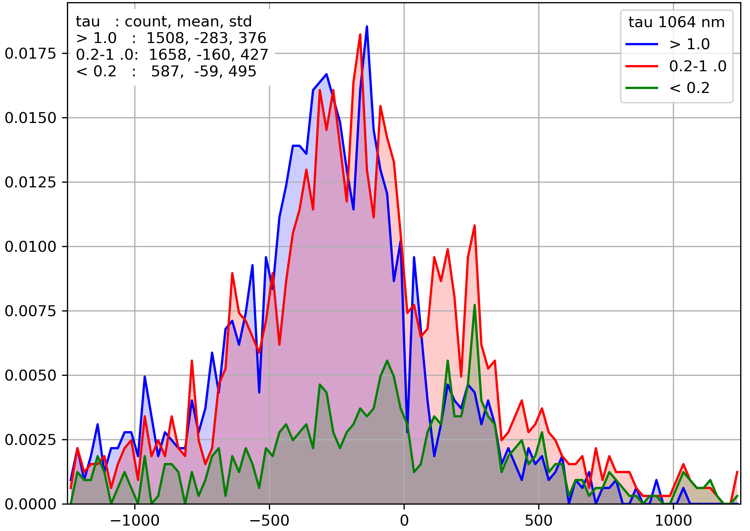
MISR stereo prefers optically thick, water clouds (possible bias in other clouds)
Ice & indeterminate phase, bias
Ice and unkown phase clouds have double the height variance relative to CATS
  Liquid phase σ = 260 m, ice & unknown phase σ = 500 m
With decreasing optical depth, height “bias” relative to CATS increases from -250 m to -30 m
Would these patterns hold for along-track variance and bias?
Liquid phase, bias as function of tau (at 1064 nm)
Ice & unknown phase, bias as function of tau
Frequency
MISR height minus CATS height (m)
MISR height minus CATS height (m)

Slide 11
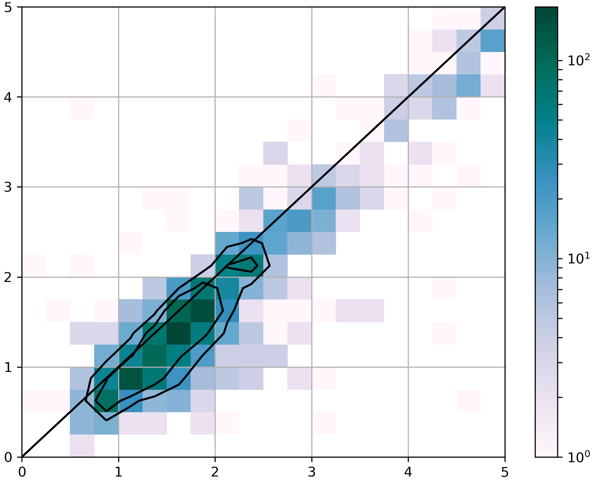
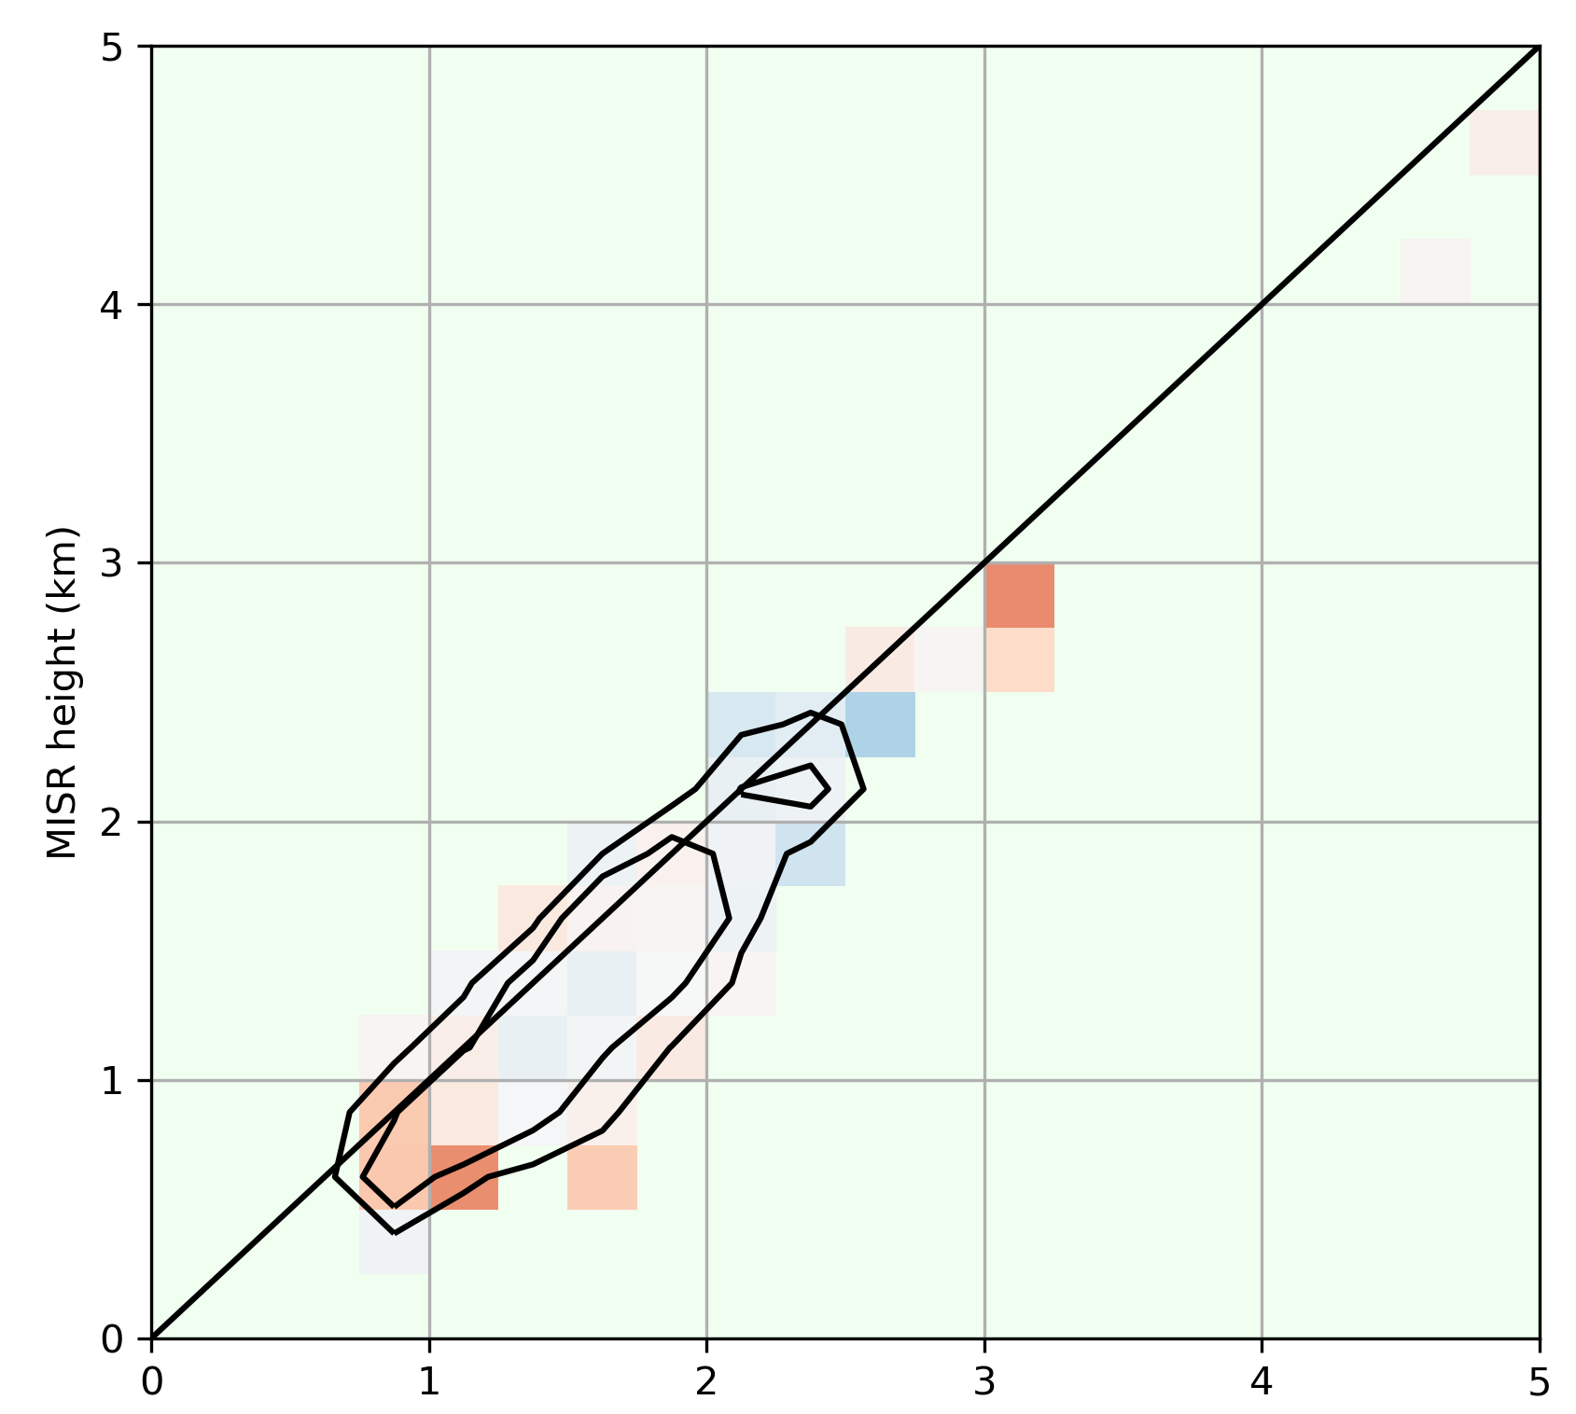
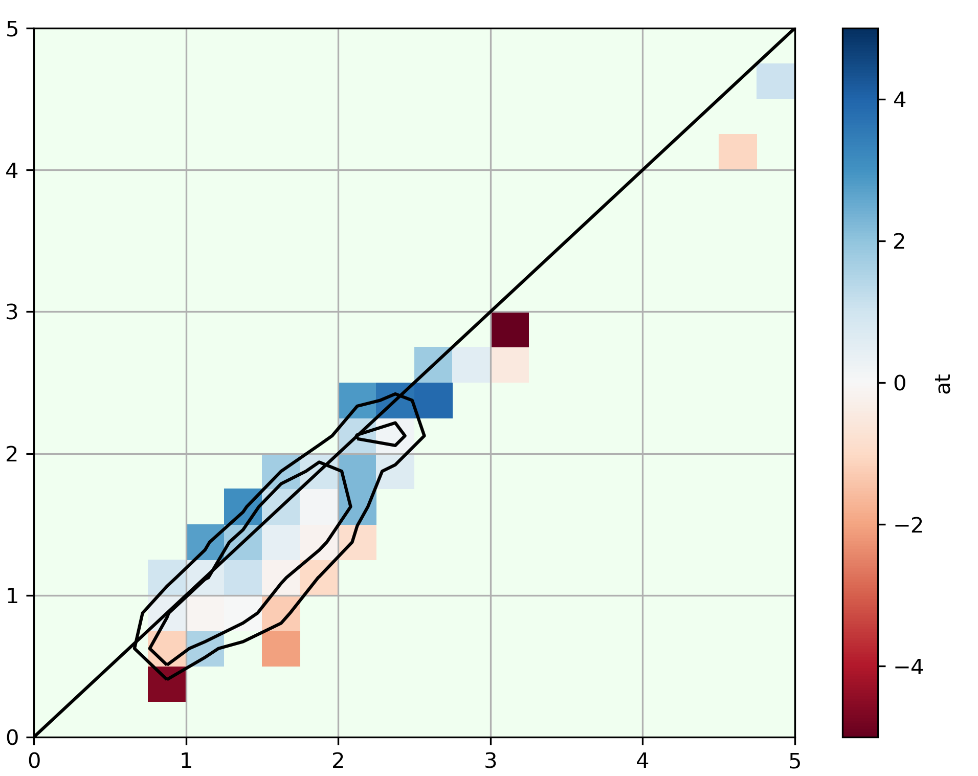
Additionally collocated MSG AMV shows SMV along-track bias may follows height bias
Pattern of SMV along-track bias vs. MSG AMV follows that of SMV vs. CATS height
  Positive/negative along-track bias at positive/negative fringes of height distribution which
For low clouds:
  height σ=600 m, along-track σ=3.5 m/s, cross-track σ=2.5 m/s
5
5
5
5
Frequency
MISR cross-track bias
MISR along-track bias
MISR Height (km)
Wind Component (m/s)
0
0
0
0
-5
0
5
0
5
0
5
CATS Height (km)
CATS Height (km)
CATS Height (km)
CATS Height

Slide 12
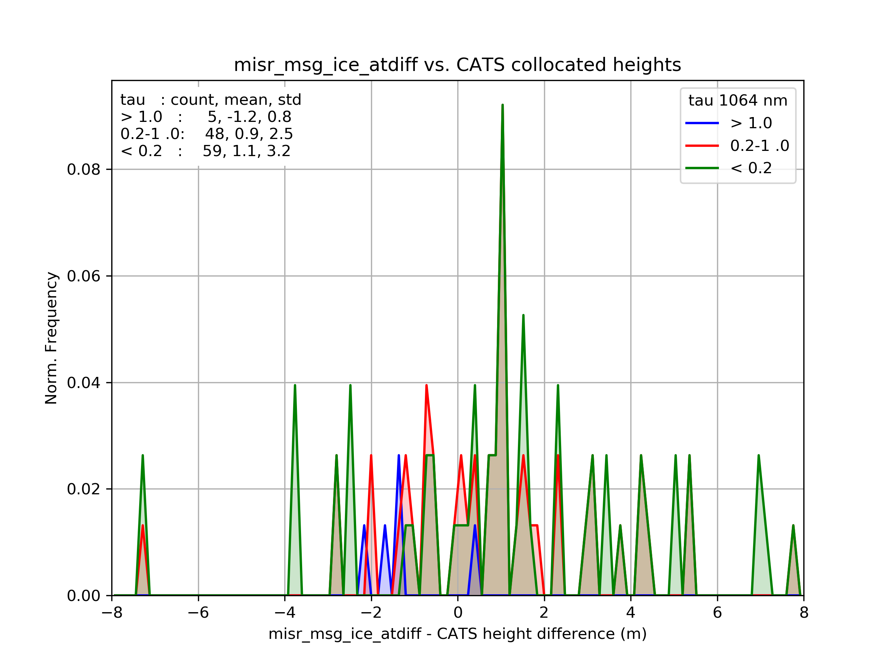
Low optical depth ice clouds (cirrus?) produce along-track biased retrievals
The fringes of the prior distribution show the source of bias to be ice in prior distribution

Slide 13
Conclusions and follow up work
Ice clouds are a source of positive along-track bias in MISR SMVs, and may be the dominant source
Can a scheme for flagging ice clouds be used to improve robustness of MISR SMVs

