Slide 1
Intercomparison of the different AVHRR winds products at Eumetsat
Olivier Hautecoeur (Exostaff)
Regis Borde (Eumetsat)

Slide 2
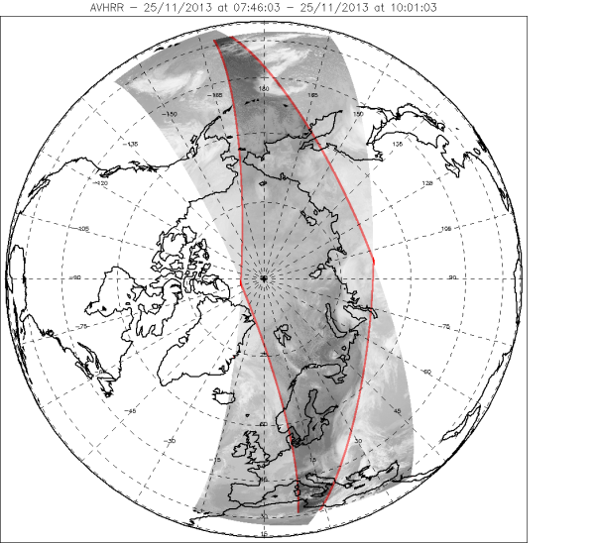
The 3 AVHRR winds precessing modes
« Single mode »
Using two successive orbit paths of one Metop satellite
Time difference between two images is ~101 minutes.

Slide 3
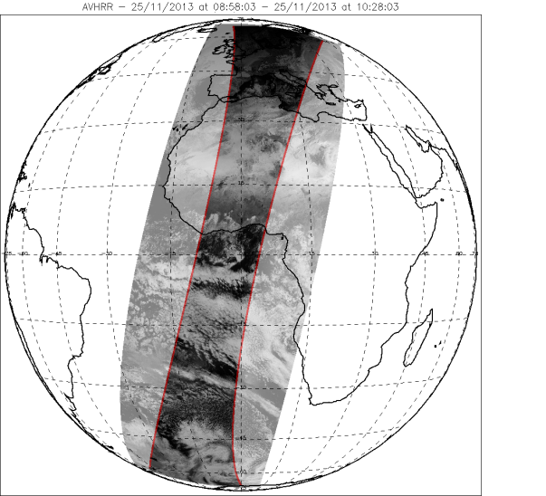
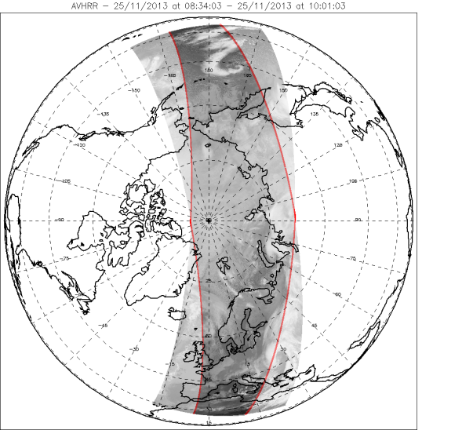
The 3 AVHRR winds precessing modes
« Dual mode »
Using two successive orbit paths of two different Metop satellites
Time difference between two images is ~50 minutes.
Extended coverage
Global product

Slide 4
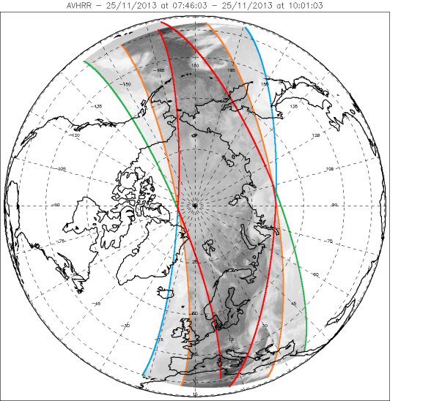
The 3 AVHRR winds precessing modes
« Triplet mode »
Using three successive orbit paths from two Metop satellites
Time difference between two images is ~50 minutes.
Same coverage as legacy product with additional consistency check

Slide 5
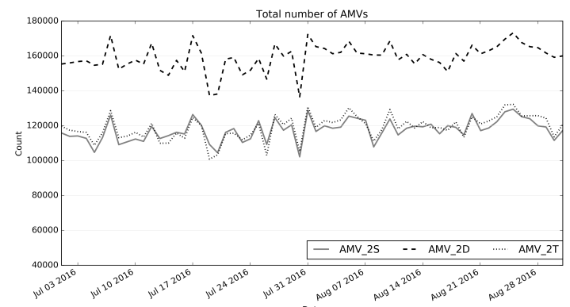
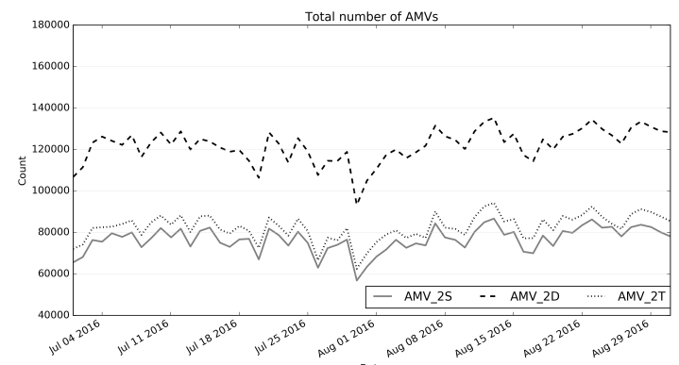
Total number of winds
Statistics computed poleward 50° (for North and South regions)
Only the overlap matters

Slide 6
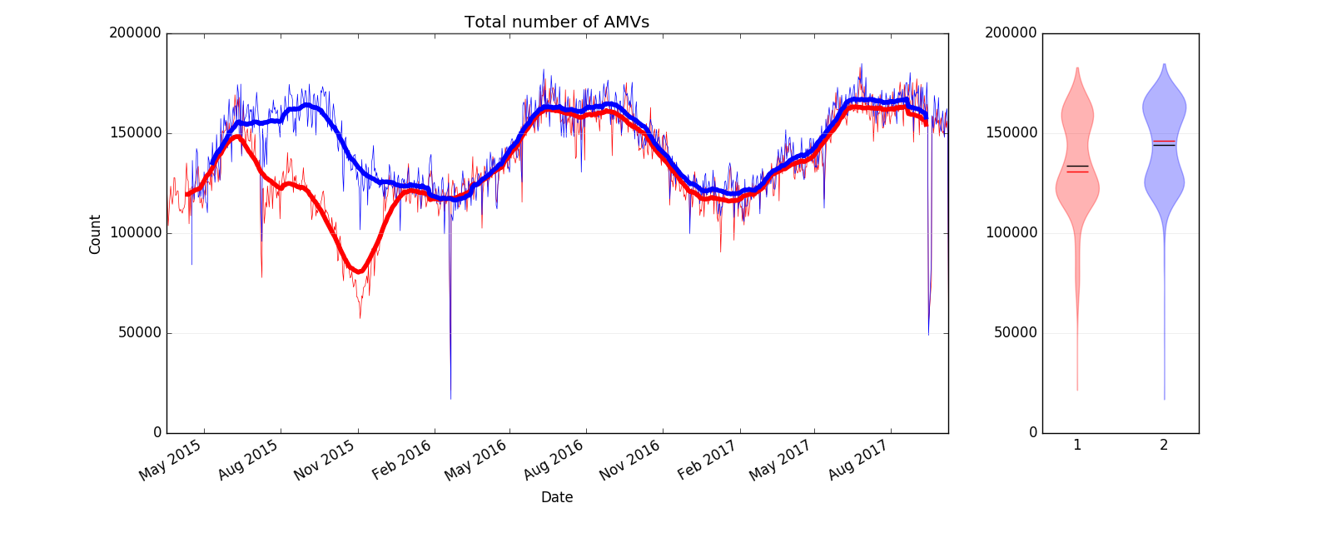
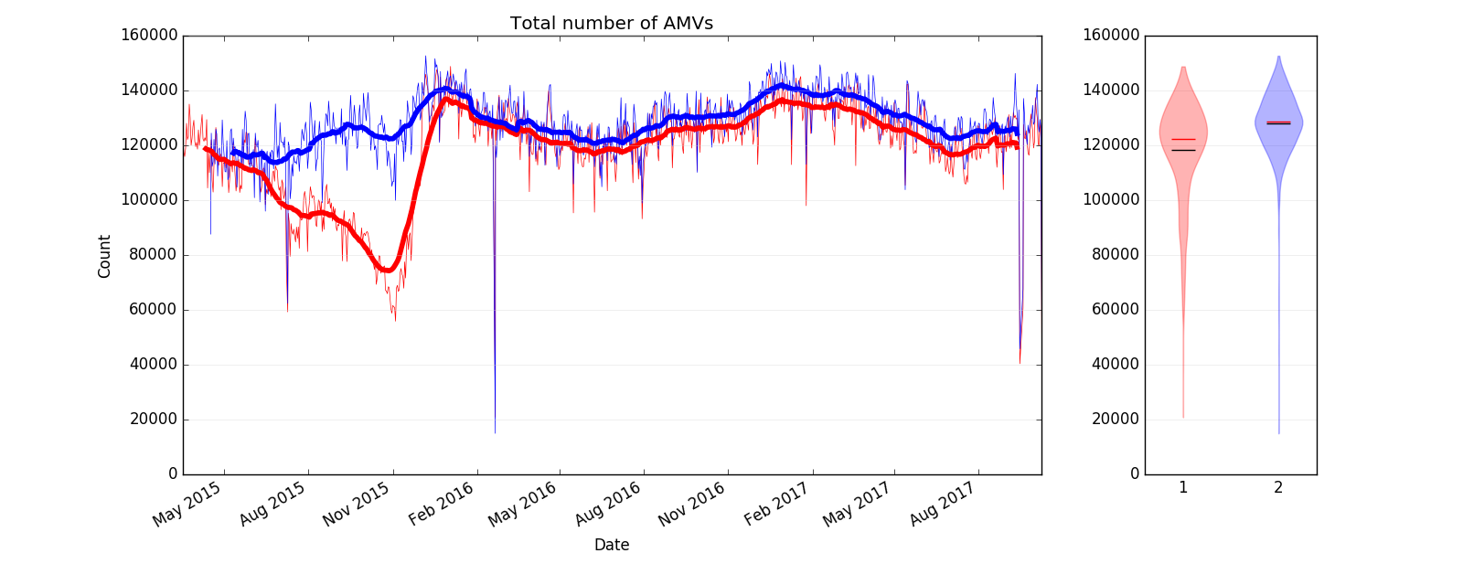
Number of winds: Seasonal effect (AVHR_AMV_2D)
Northern
Hemisphere
Southern
Hemisphere

Slide 7
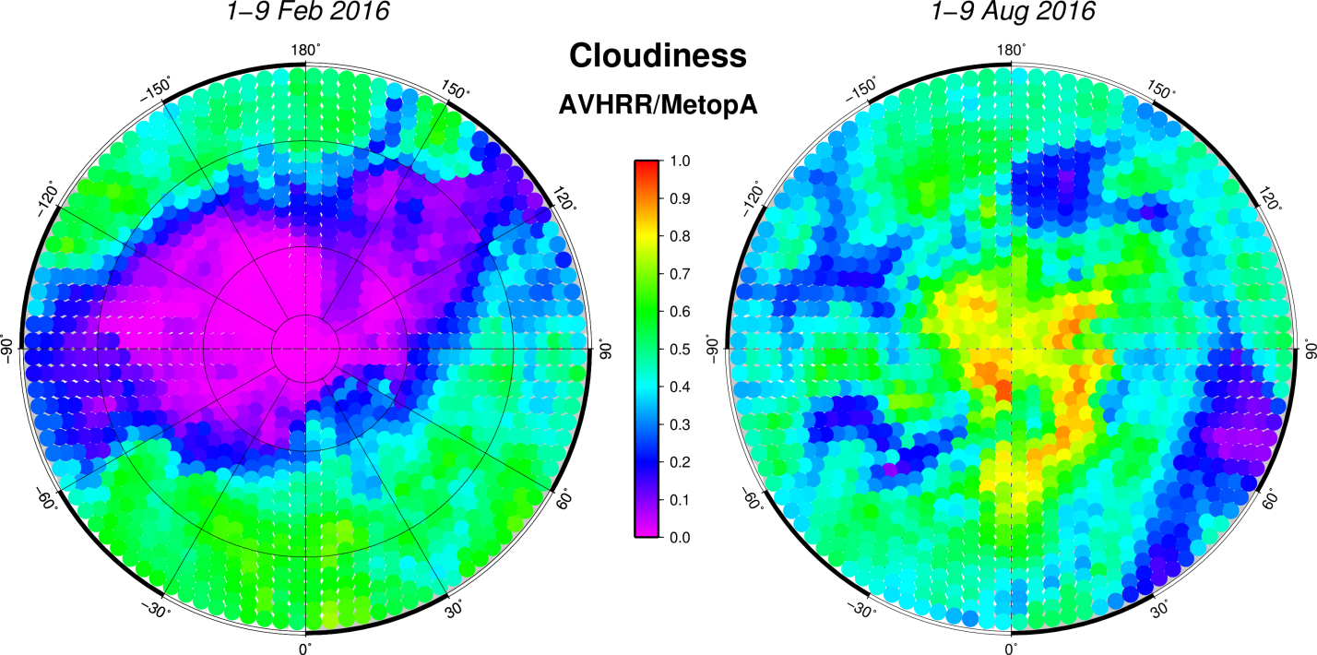
Number of winds: Cloudiness effect

Slide 8
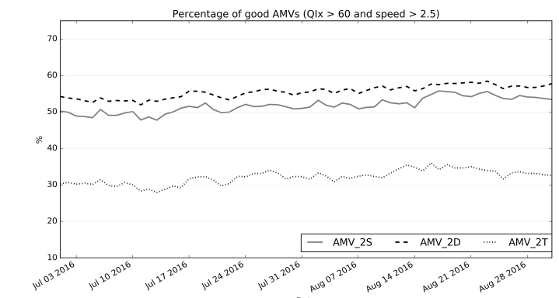
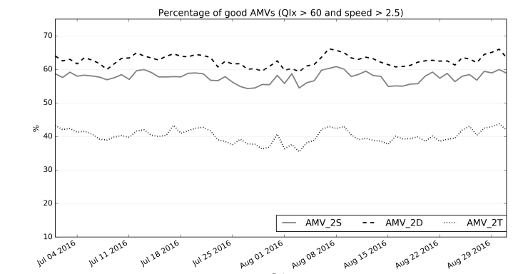
Quality screening (QIx > 60)
Reducing the time difference increases the similarity between the images, and so the QI
Adding a third image constrains the selection

Slide 9
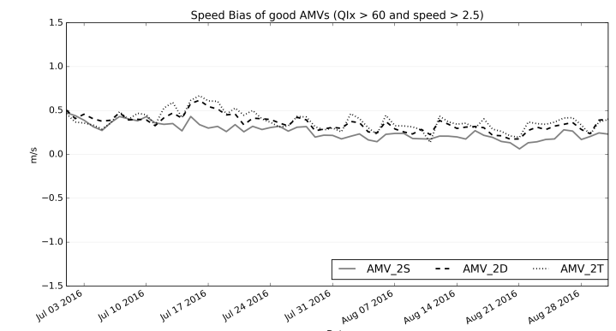
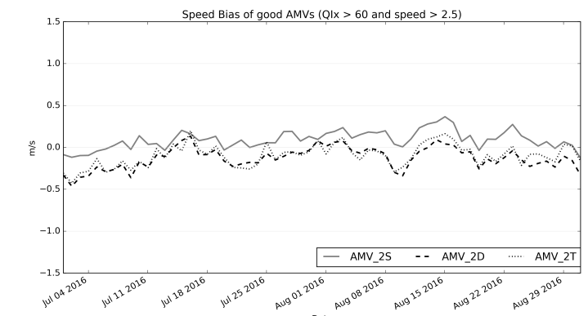
Forecast Speed Bias
AMV global and triplet share the same output

Slide 10
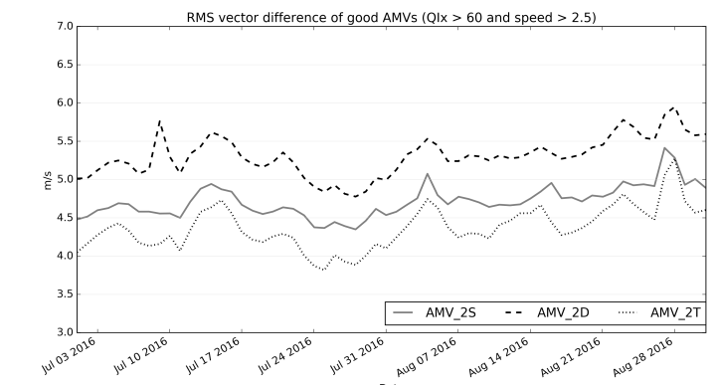
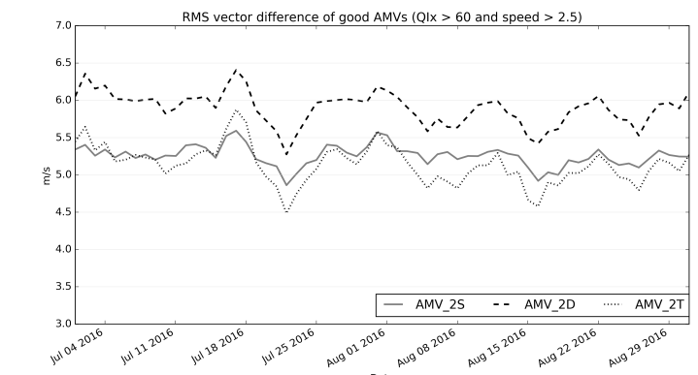
RMSVD against forecast
Effect of the third image in the quality screening

Slide 11
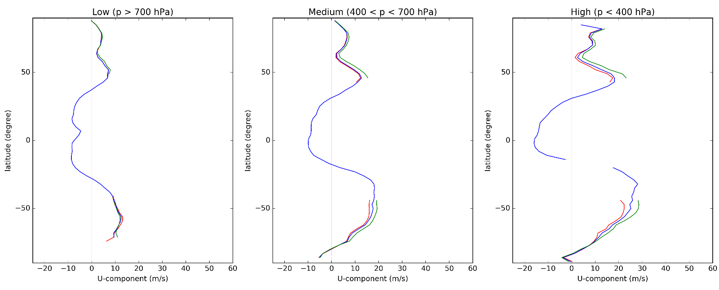
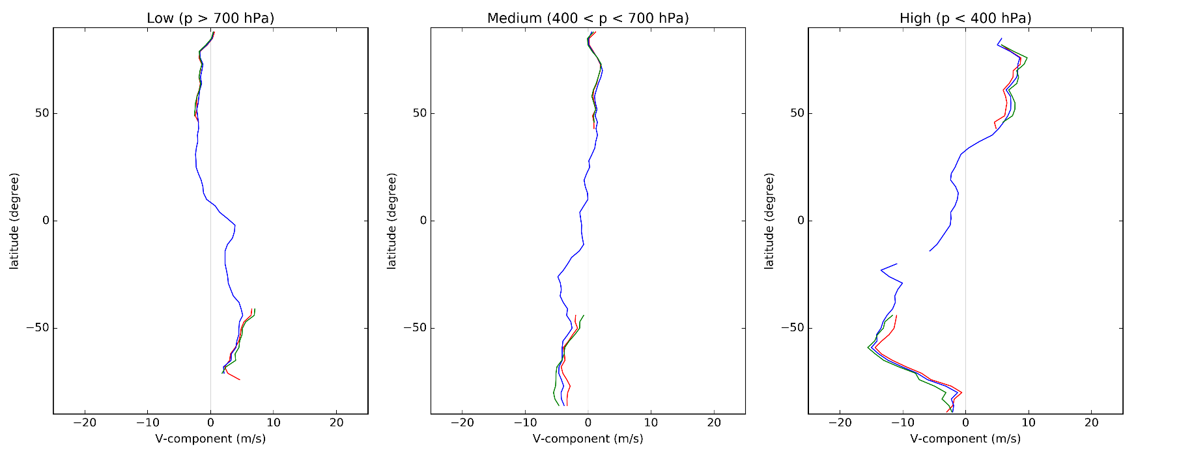
AVHRR Statistics (July 2017)

Slide 12
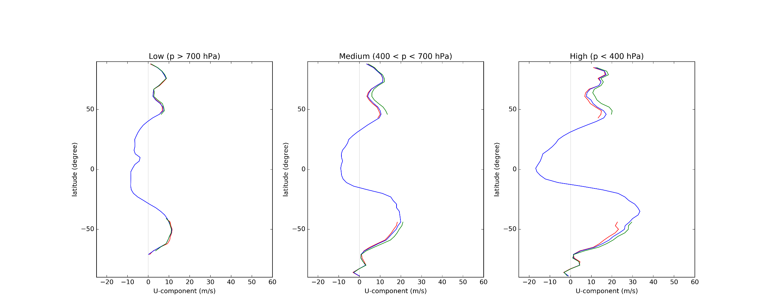
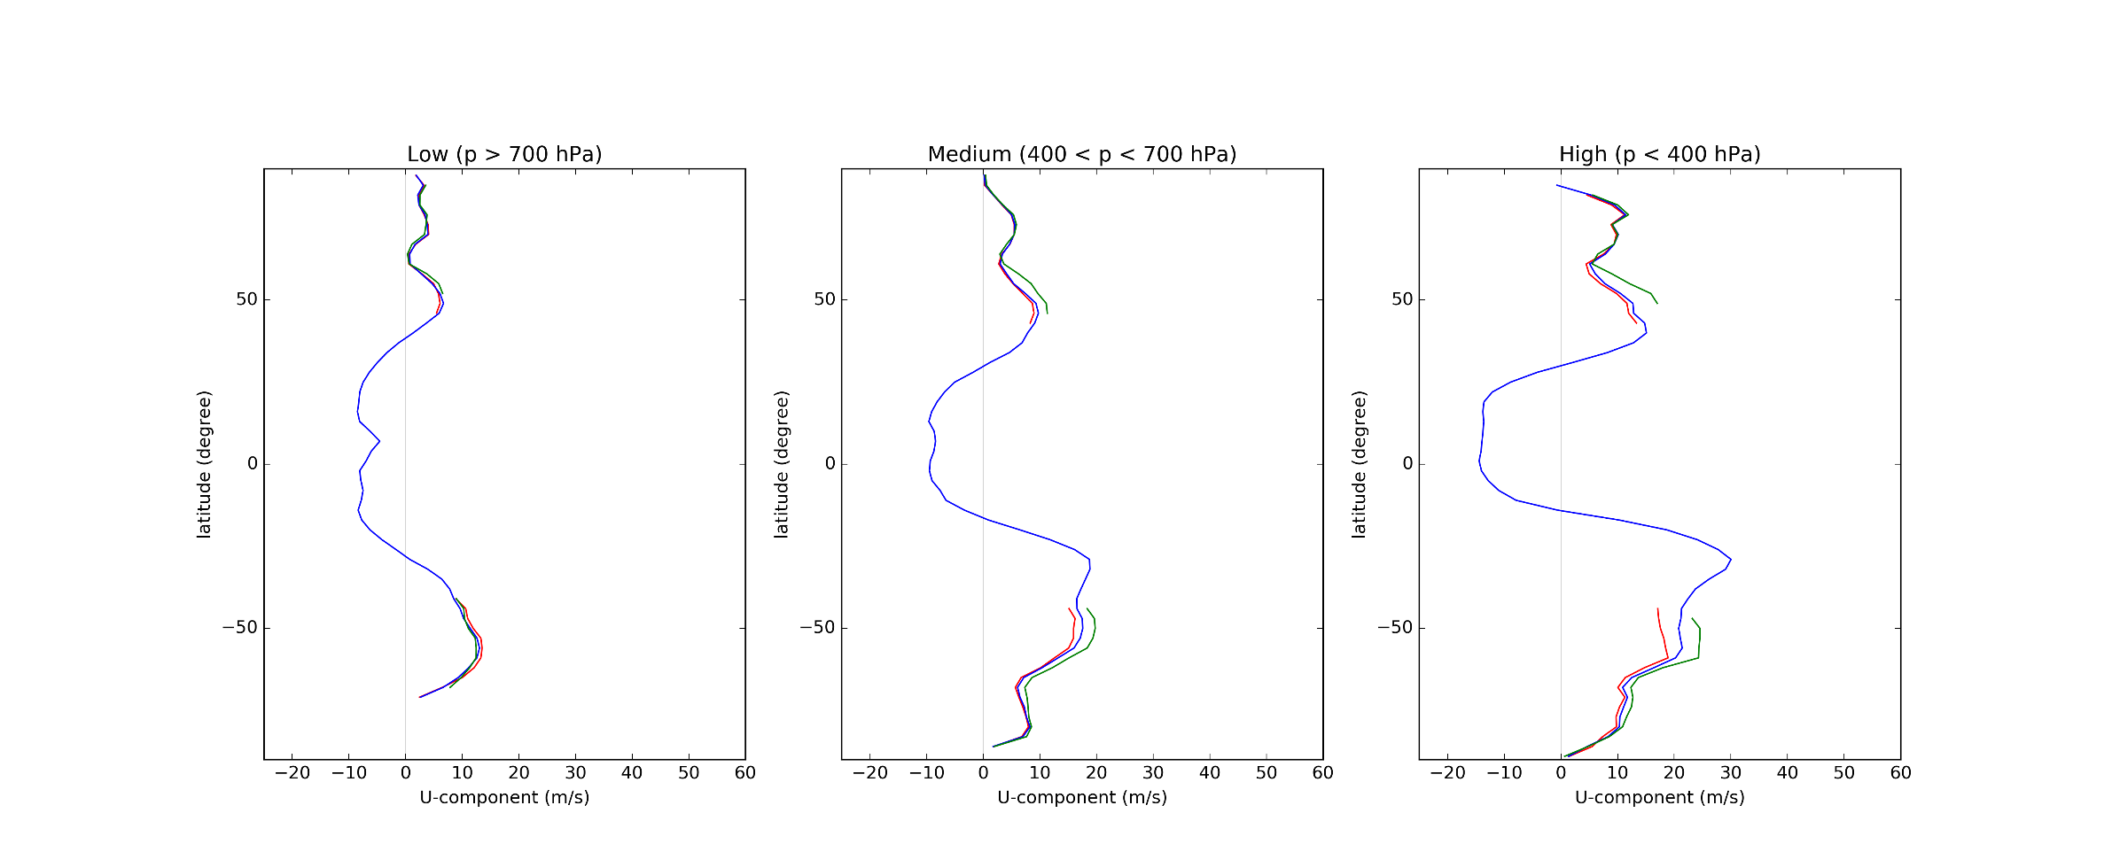
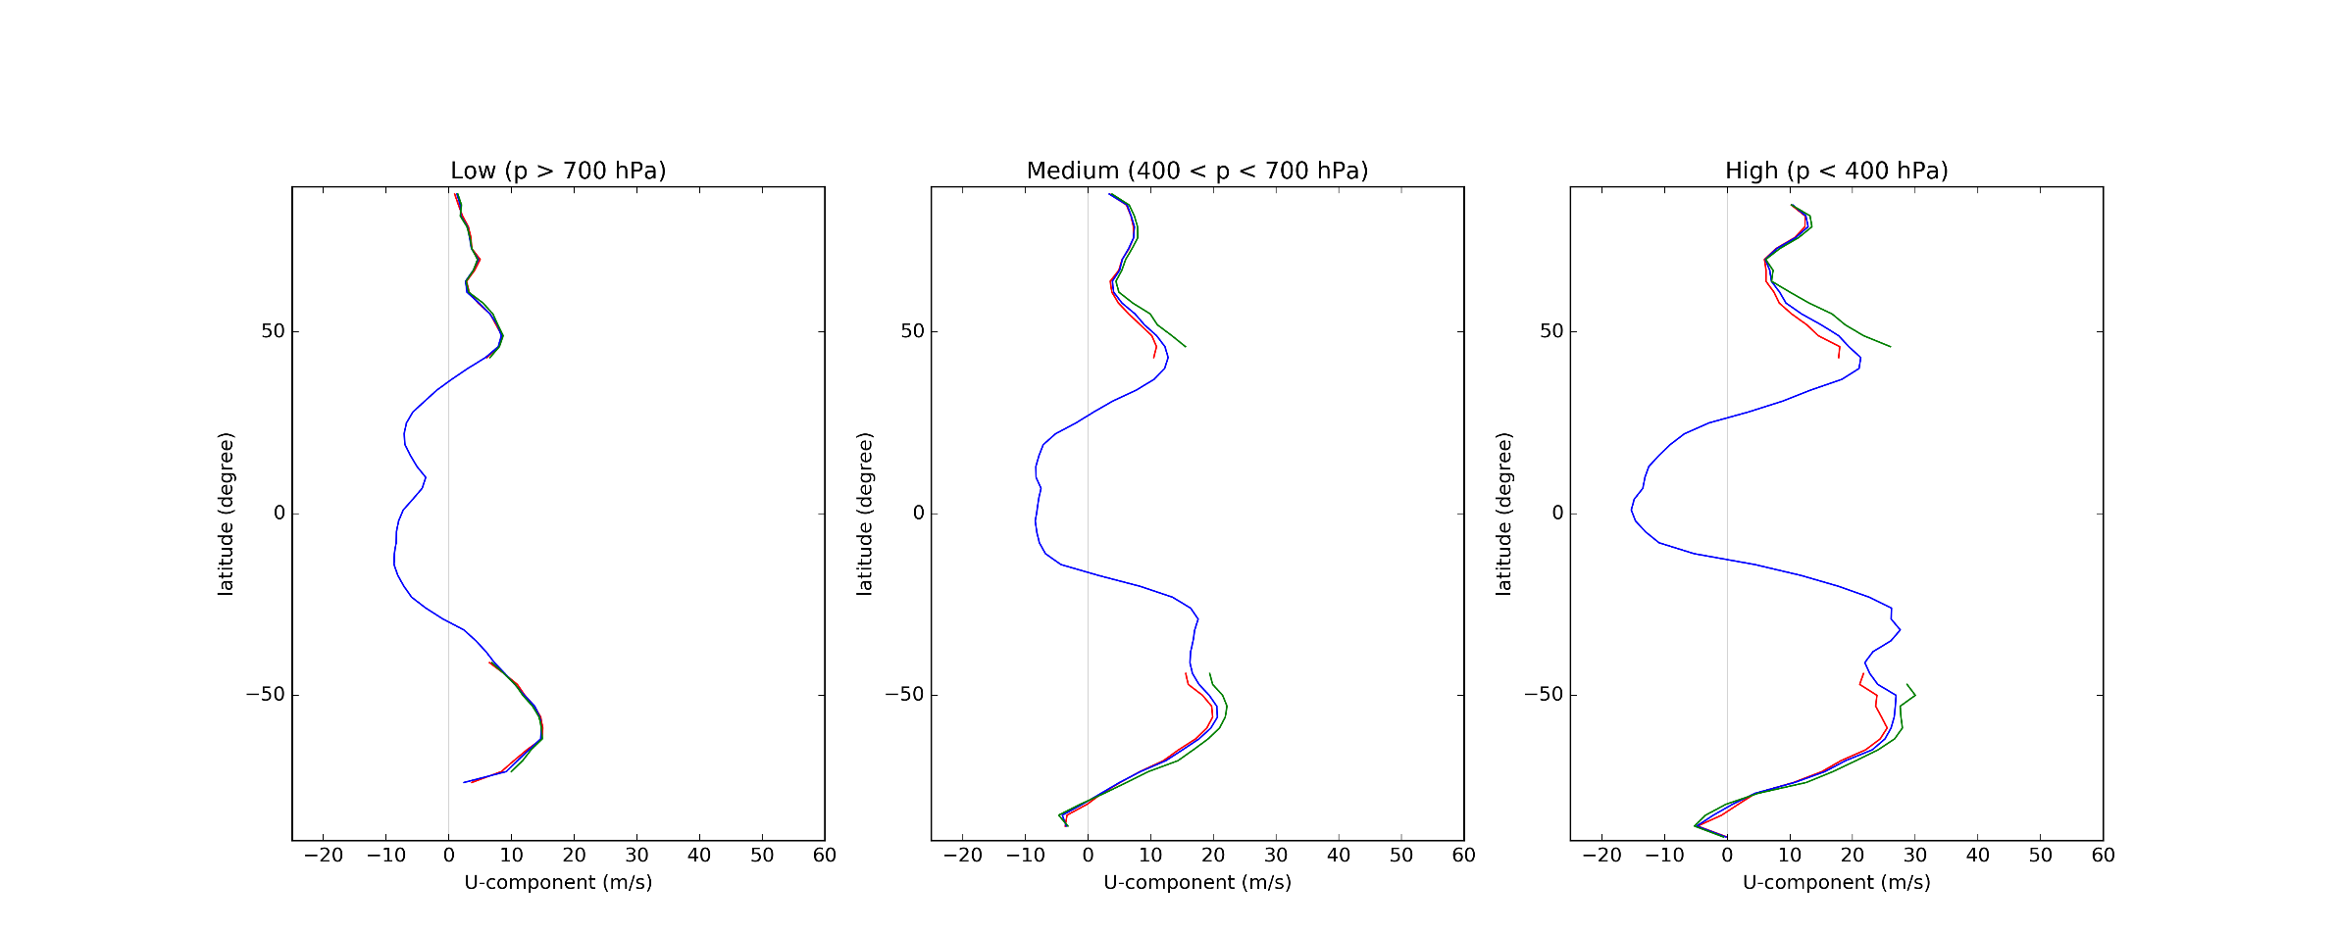
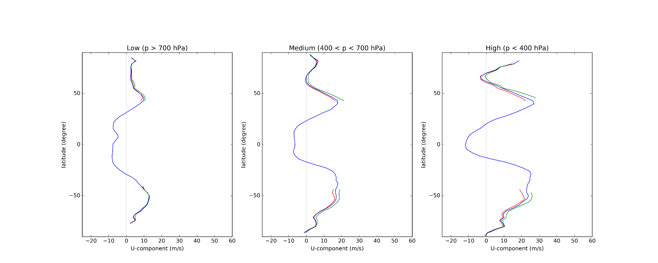
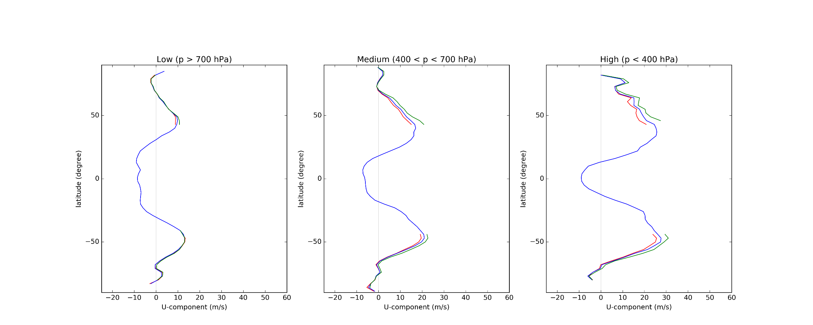
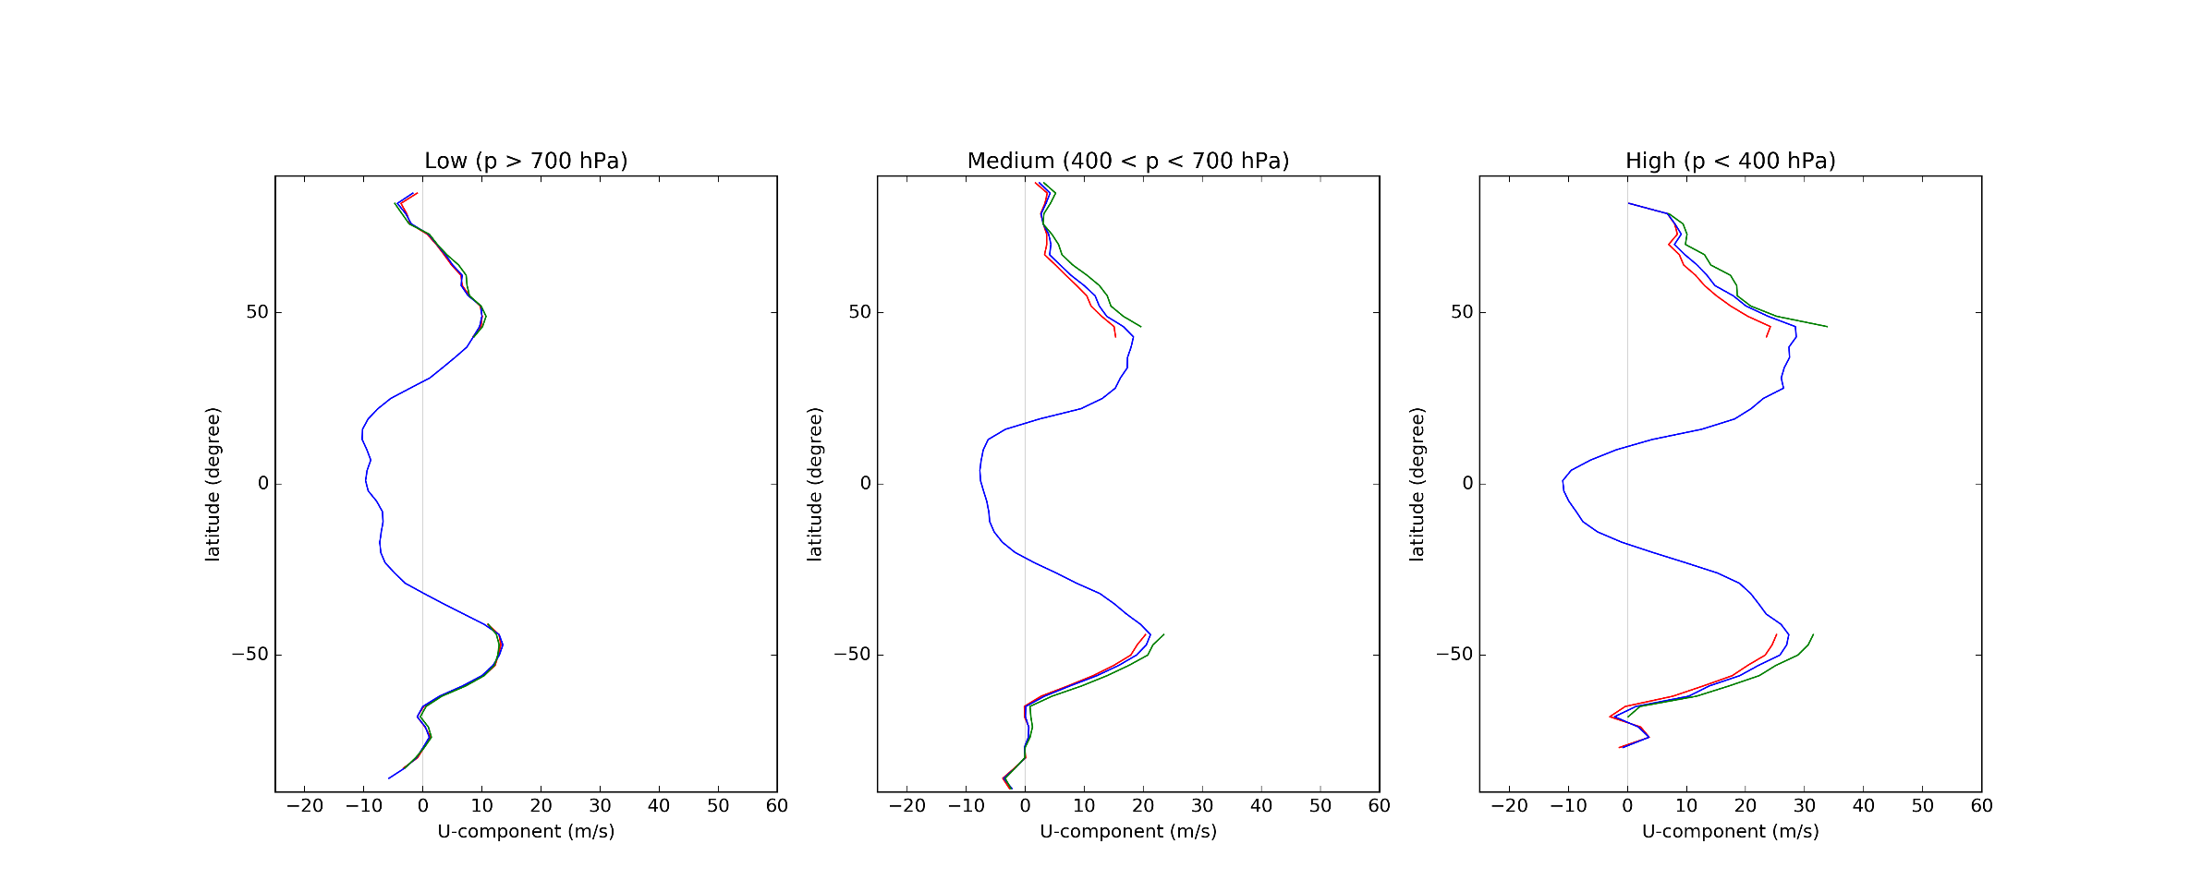
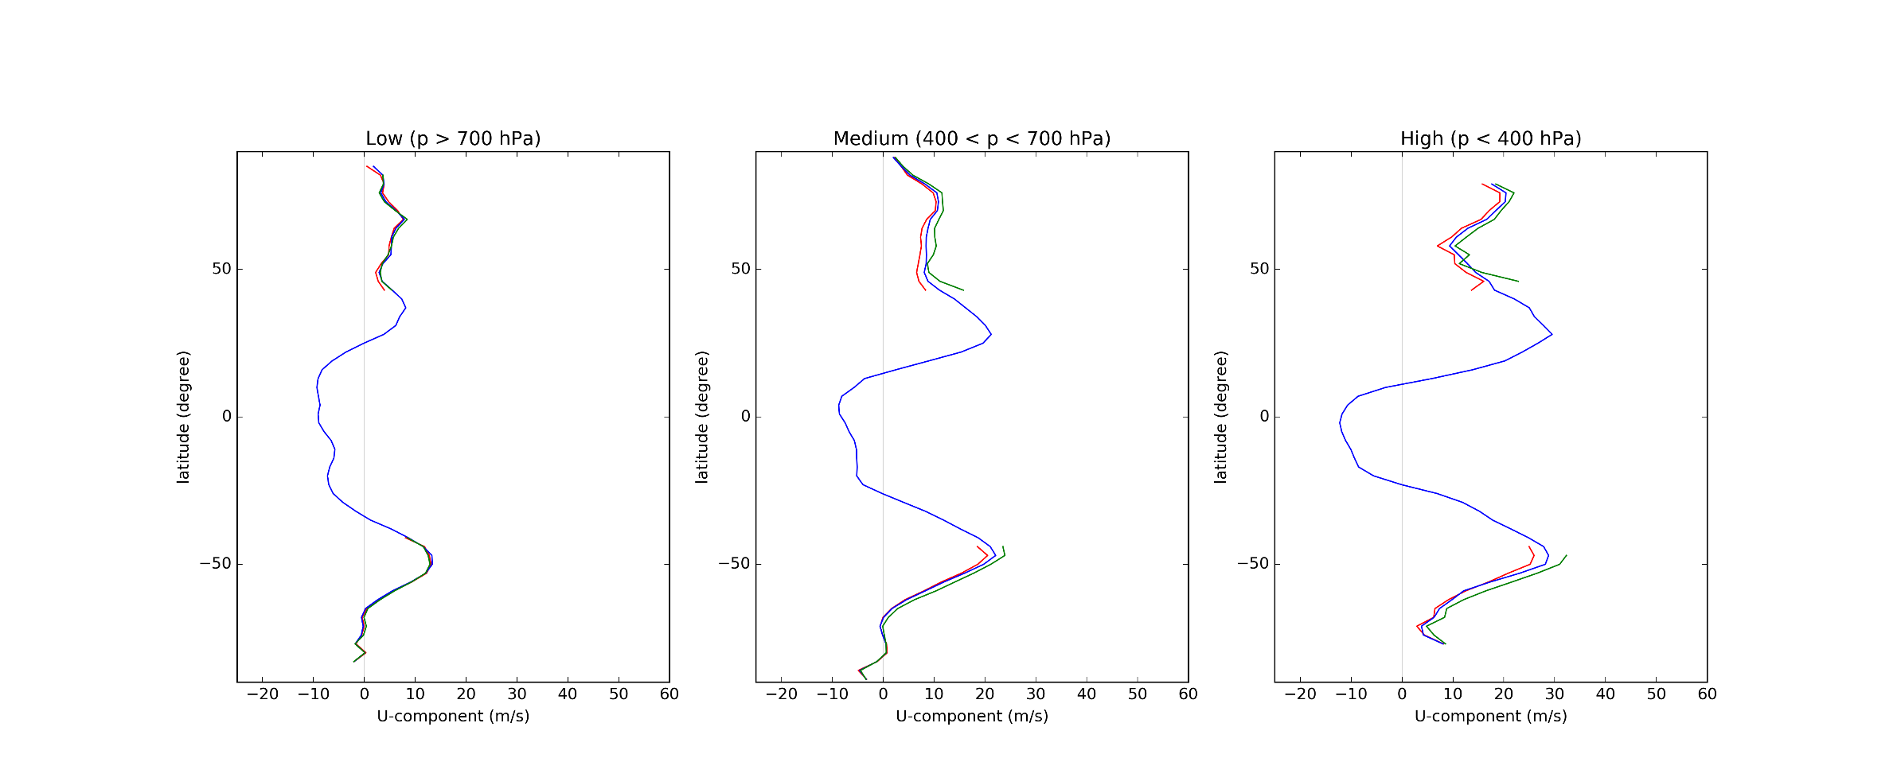
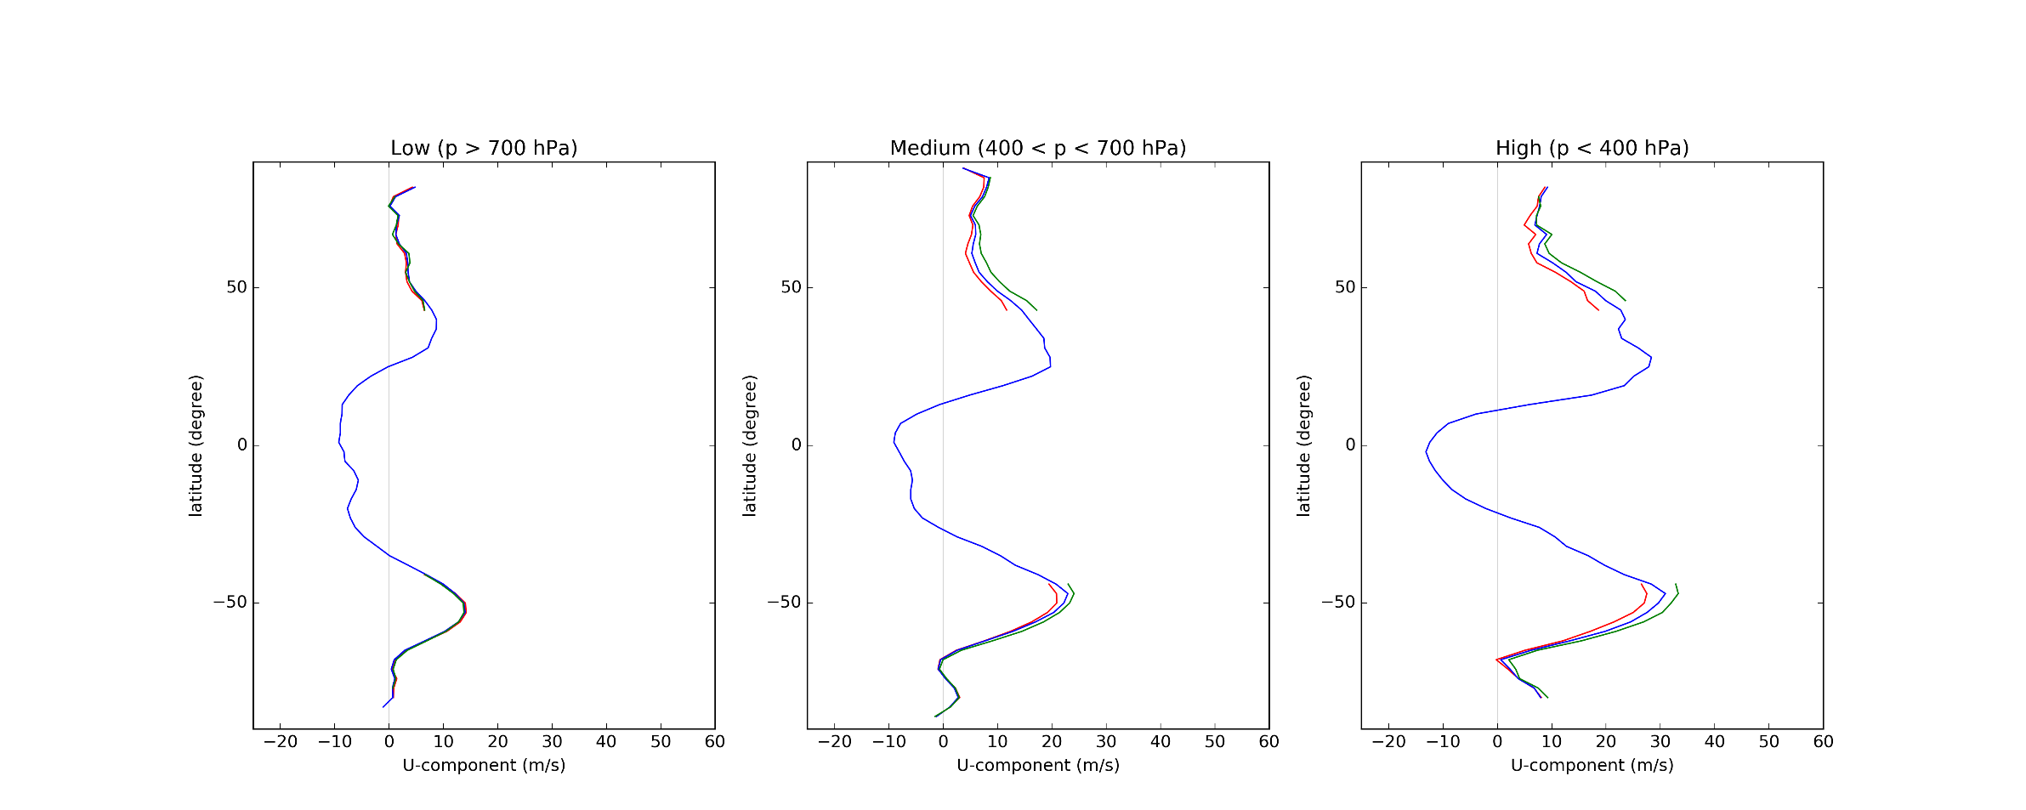
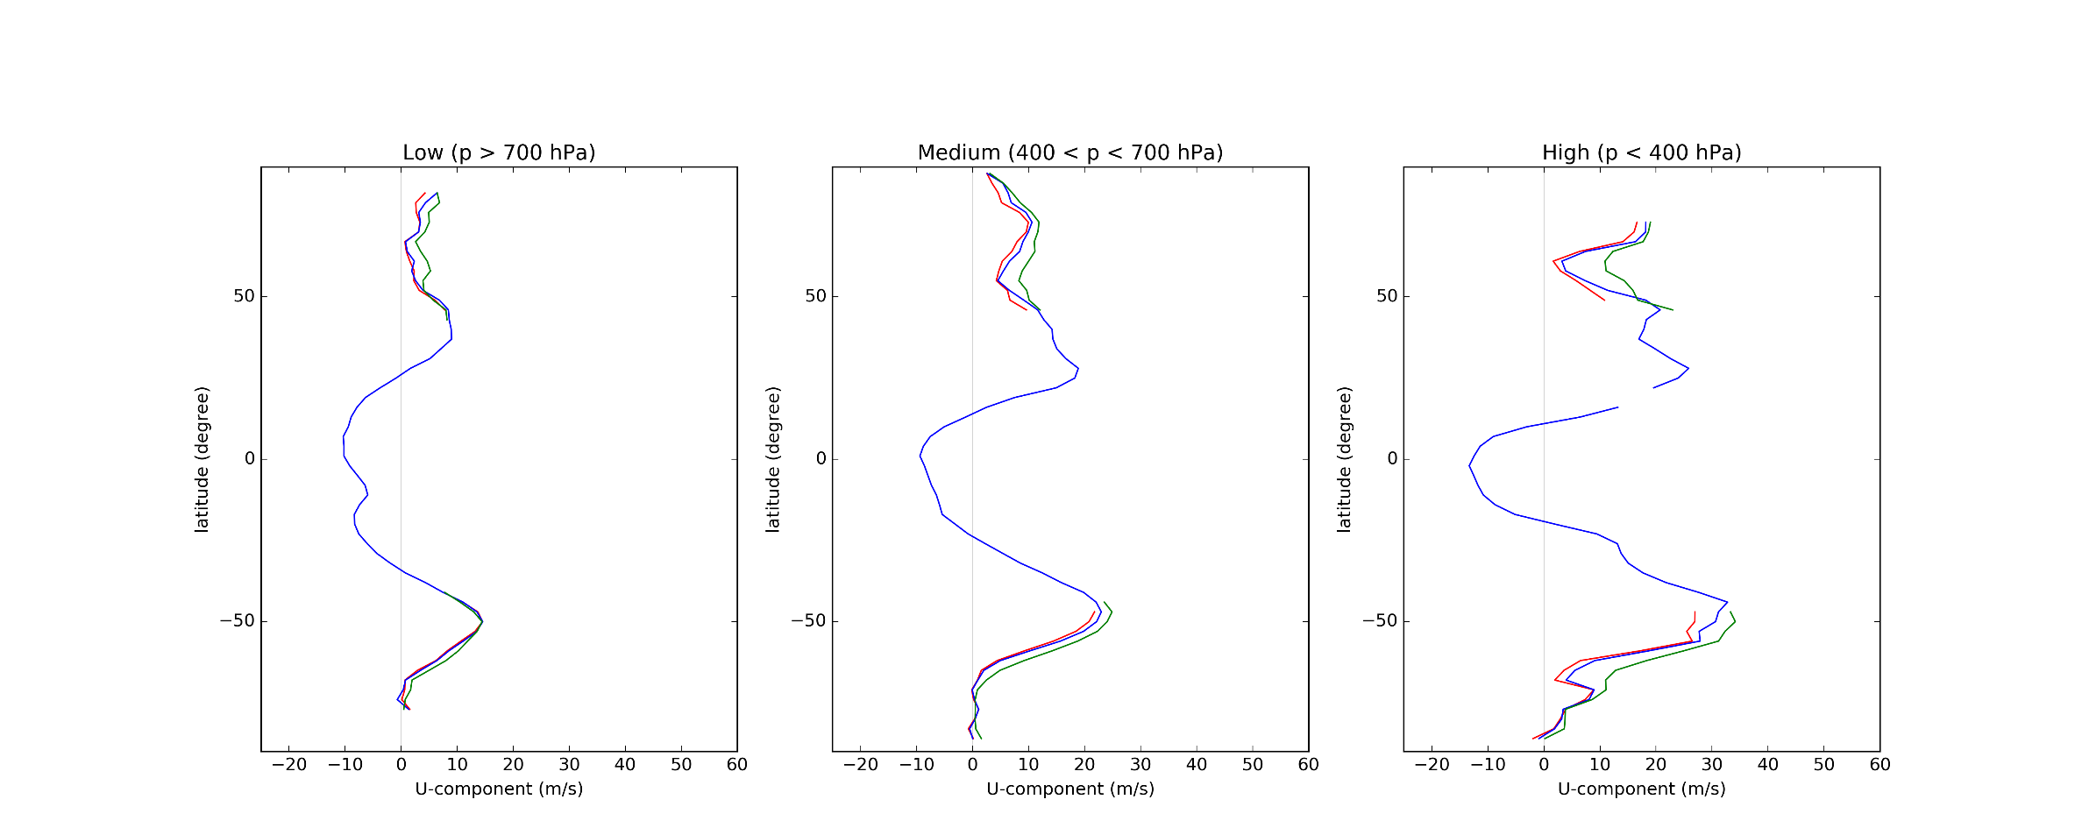
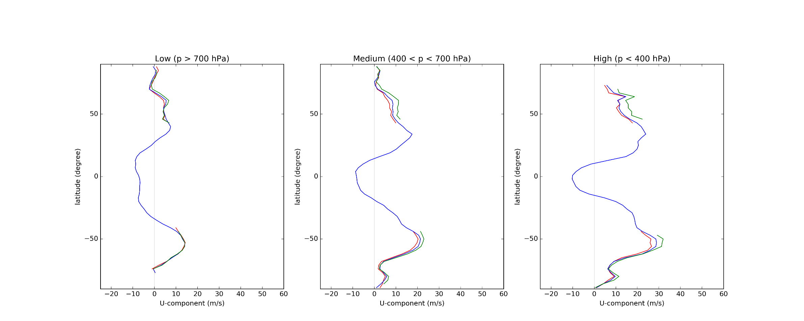
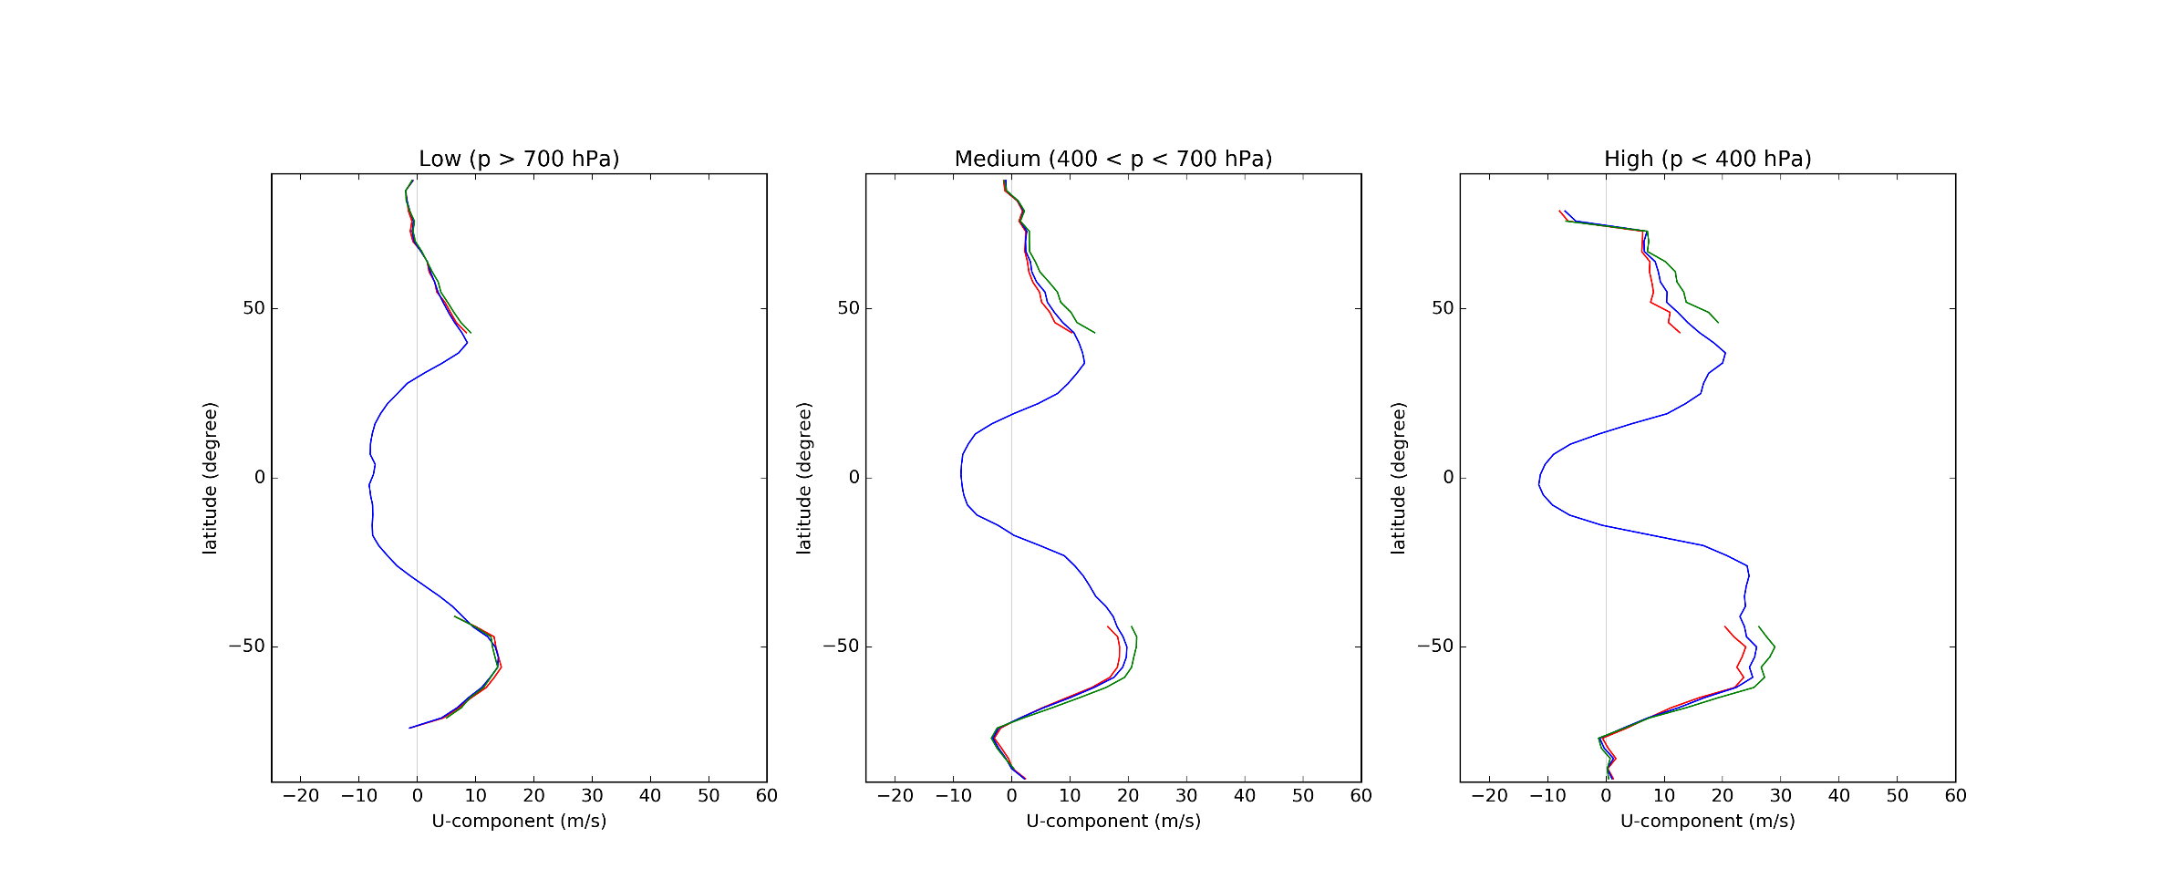
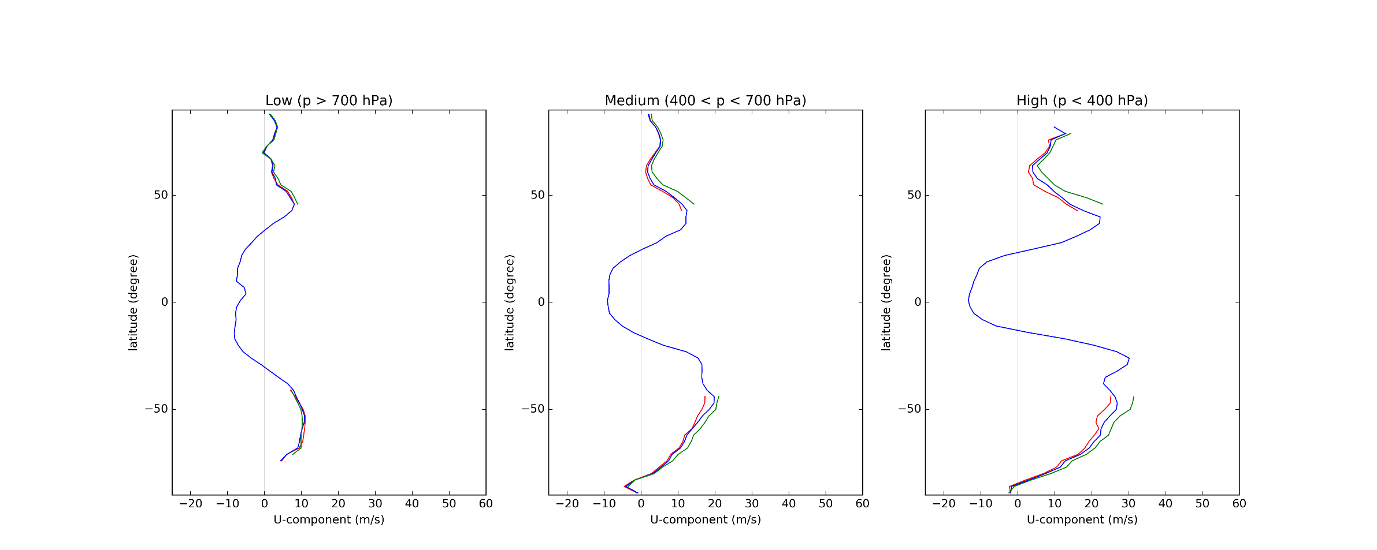
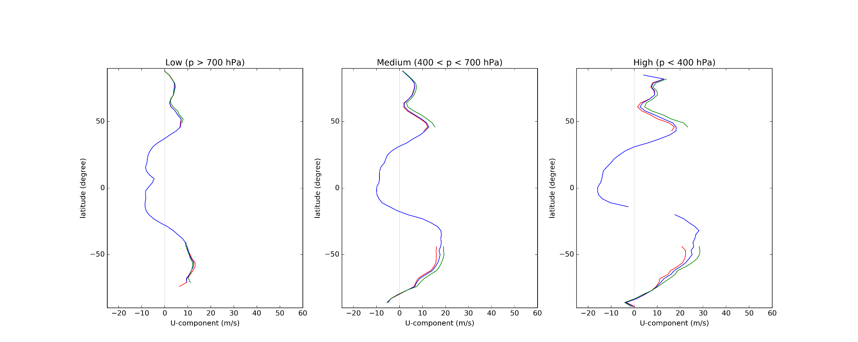
AVHRR Statistics (July 2016 - July 2017)

Slide 13
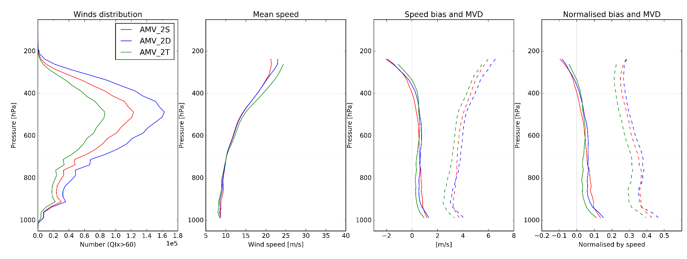
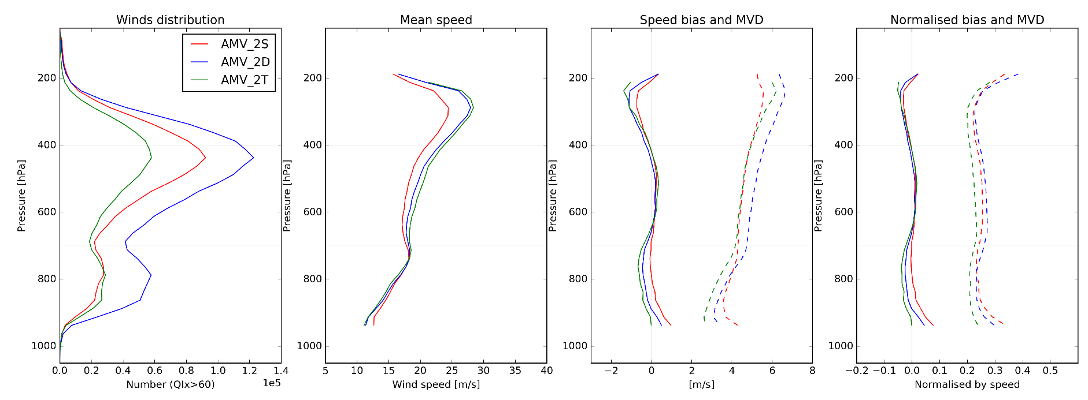
AVHRR Statistics (July 2017)
Northern
Hemisphere
Southern
Hemisphere

Slide 14
Quality comparison
Northern Hemisphere
February 2016
 | AMV_2S |  |  |  | AMV_2D |  |  |  | AMV_2T
 | Number | Speed (m/s) | Bias (m/s) | MVD (m/s) | Number | Speed (m/s) | Bias (m/s) | MVD (m/s) | Number | Speed (m/s) | Bias (m/s) | MVD (m/s)
All | 1035829 | 15.8 | 0.42 | 4.44 | 1551715 | 16.73 | 0.31 | 4.88 | 583998 | 16.1 | 0.33 | 3.92
Low | 22% | 11.41 | 0.61 | 3.79 | 24% | 11.52 | 0.45 | 3.64 | 28% | 10.81 | 0.26 | 2.81
Mid | 65% | 15.73 | 0.57 | 4.46 | 62% | 16.56 | 0.53 | 5.02 | 59% | 16.52 | 0.56 | 4.14
High | 13% | 24.2 | -0.74 | 5.51 | 13% | 26.94 | -0.97 | 6.46 | 13% | 25.86 | -0.6 | 5.43

Slide 15
Quality comparison
Southern Hemisphere
February 2016
 | AMV_2S |  |  |  | AMV_2D |  |  |  | AMV_2T
 | Number | Speed (m/s) | Bias (m/s) | MVD (m/s) | Number | Speed (m/s) | Bias (m/s) | MVD (m/s) | Number | Speed (m/s) | Bias (m/s) | MVD (m/s)
All | 1302232 | 15.64 | 0.1 | 4.14 | 2092956 | 17.21 | -0.05 | 4.51 | 1008402 | 16.39 | -0.0 | 3.75
Low | 26% | 12.88 | 0.36 | 3.46 | 28% | 13.37 | 0.08 | 3.38 | 32% | 12.83 | -0.04 | 2.86
Mid | 64% | 14.9 | 0.19 | 4.19 | 60% | 16.52 | 0.09 | 4.64 | 58% | 15.93 | 0.14 | 3.89
High | 10% | 27.06 | -1.12 | 5.51 | 11% | 30.43 | -1.17 | 6.63 | 10% | 30.59 | -0.76 | 5.82

Slide 16
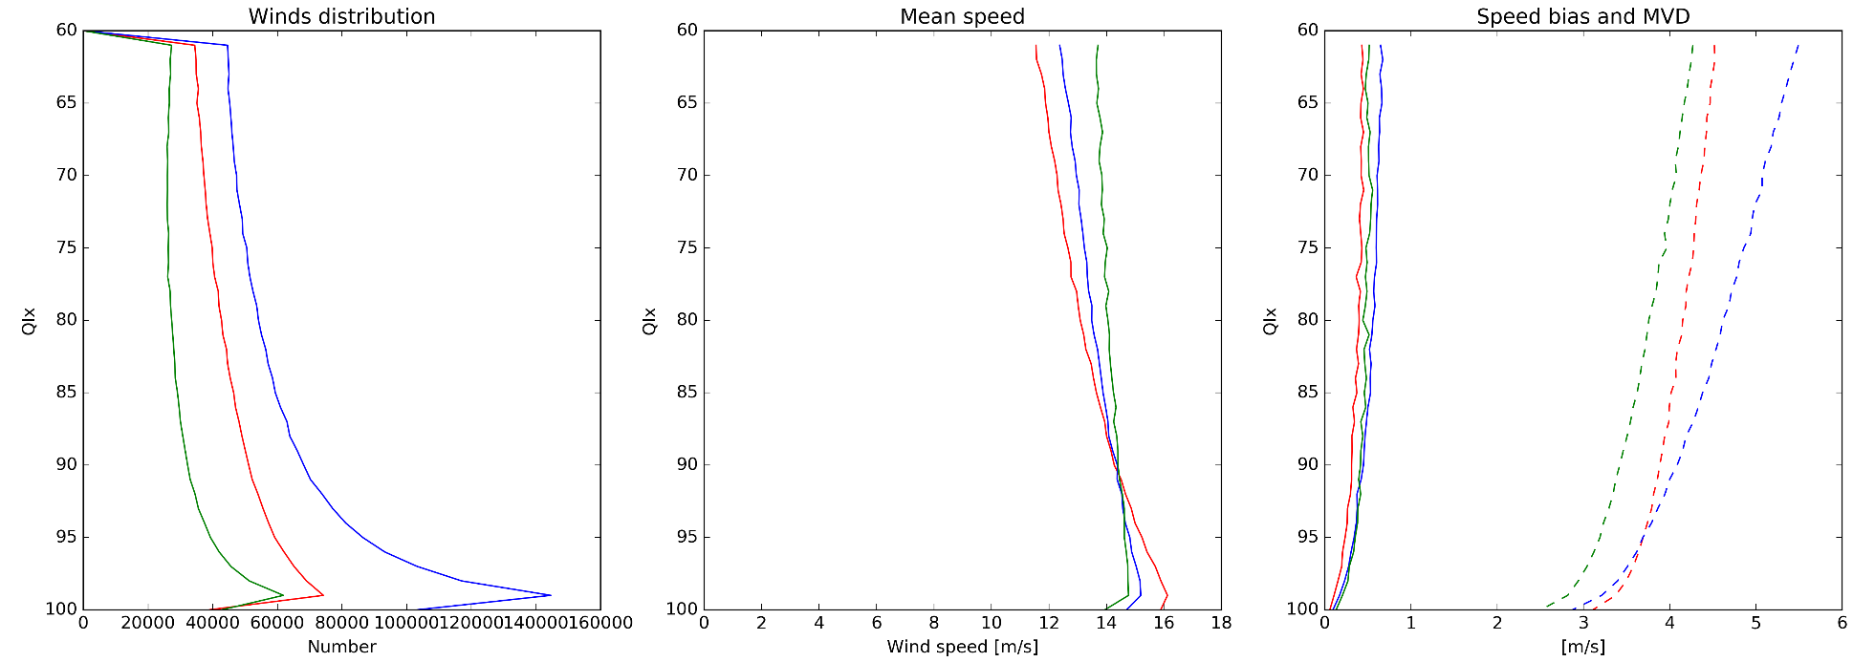
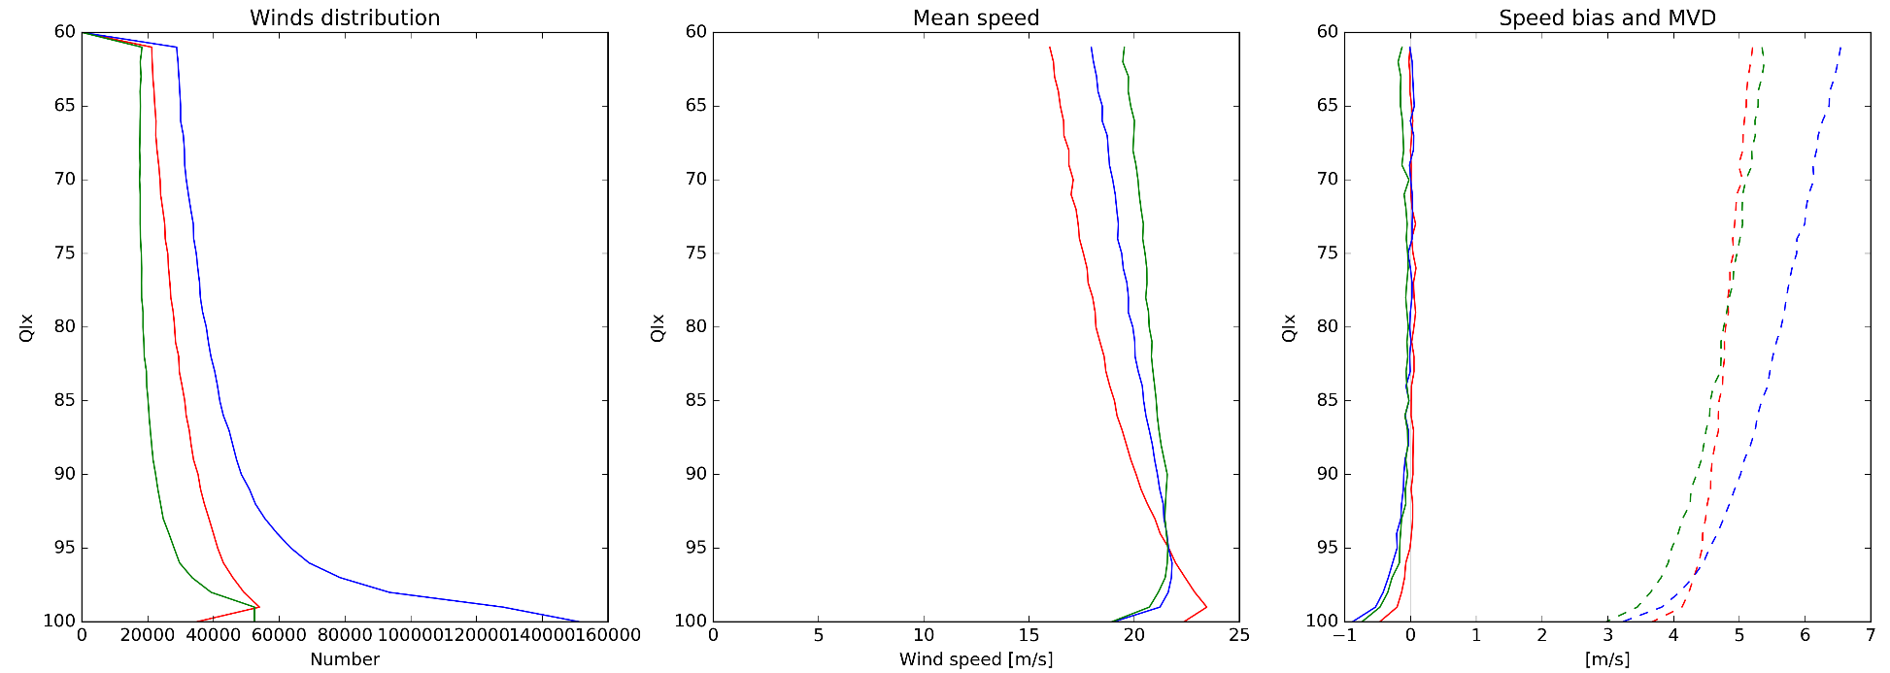
AVHRR Statistics (July 2017)
Northern
Hemisphere
Southern
Hemisphere

Slide 17
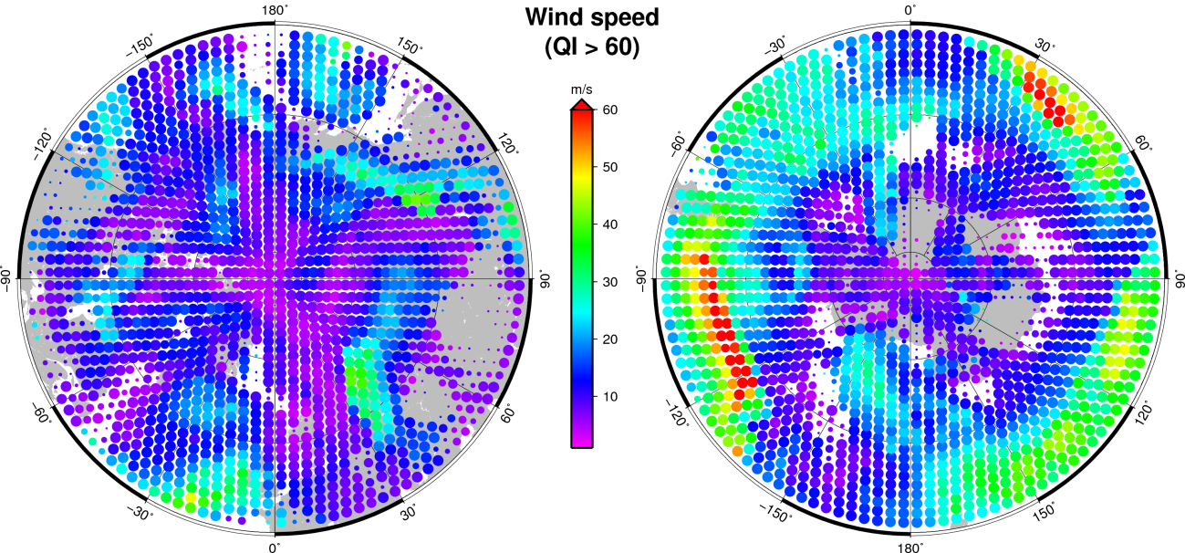
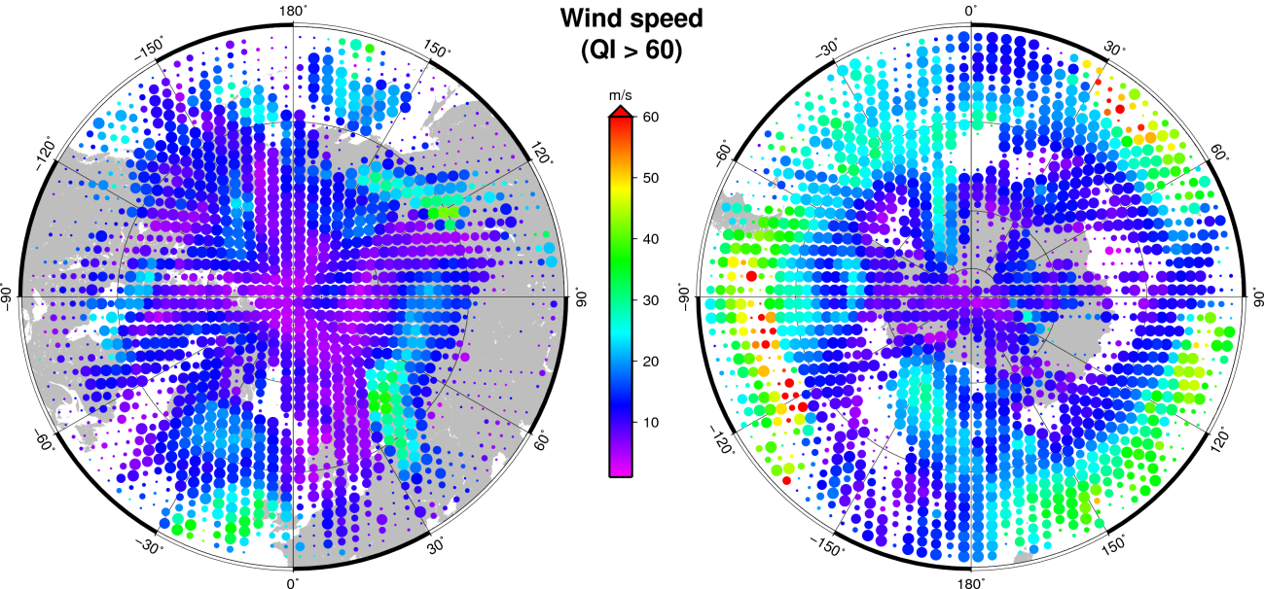
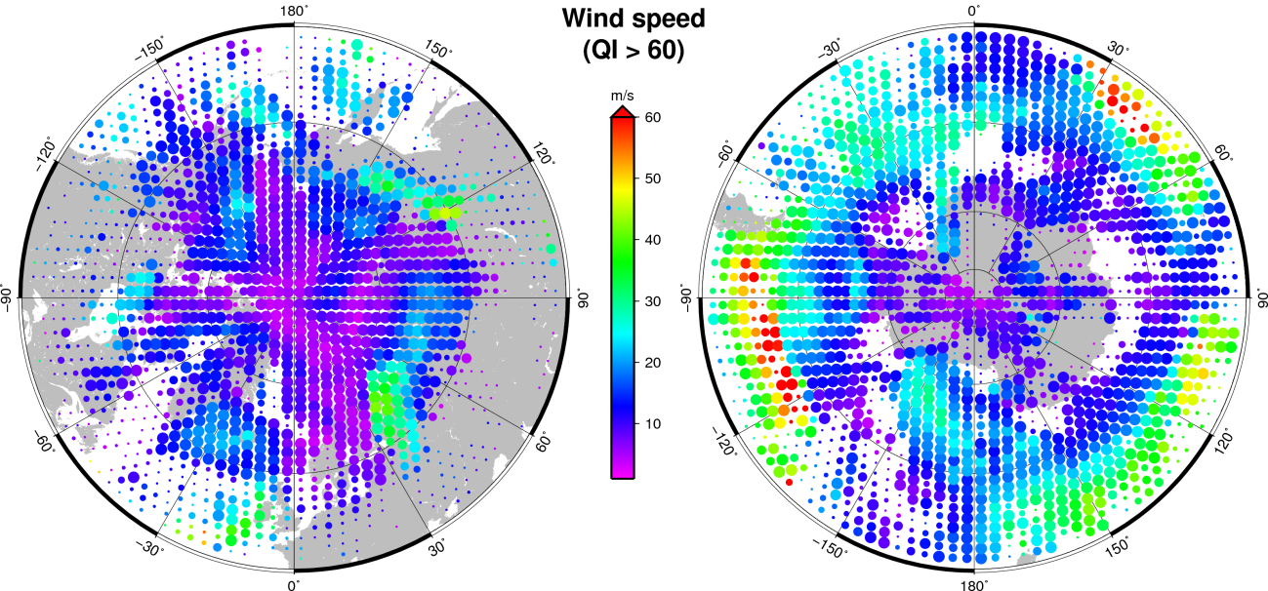
Coverage and mean speed
AVHR_AMV_2T
27 June 2015
AVHR_AMV_02
27 June 2015
AVHR_AMV_2D
27 June 2015

Slide 18
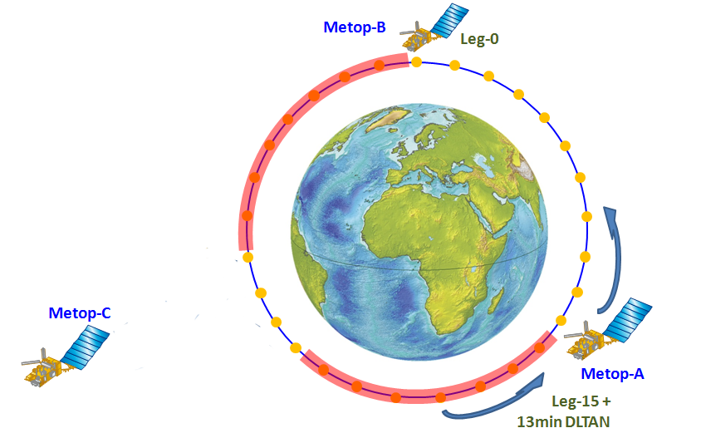
Metop-A, Metop-B, Metop-C Phasing
Metop-C injection Leg 10
LST 9:30 (desc. node)
Leg-10

Slide 19

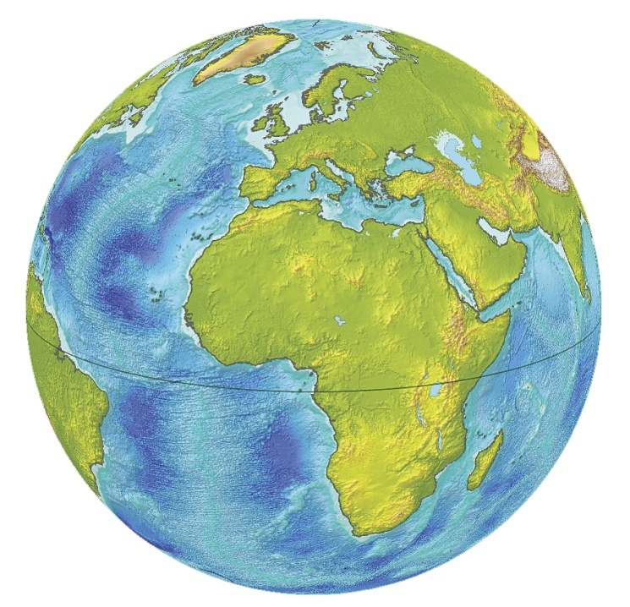
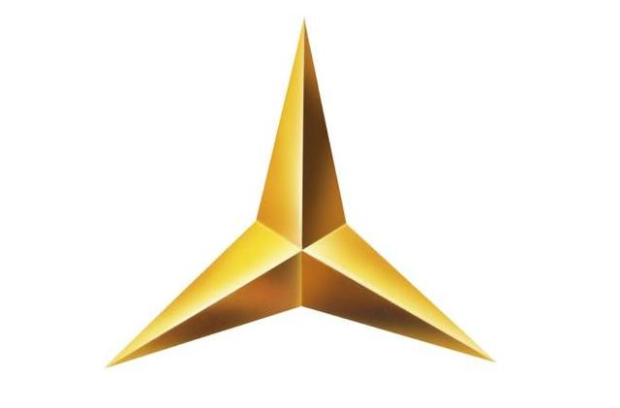
Phasing of 3 Metops: Trident or Tristar
Trident configuration
Tristar configuration
Metop-B
TRIDENT
Metop-A
Metop-C
Metop-B
Metop-A
Metop-C
TRI-STAR

Slide 20
The high-latitude winds v2019
Metop-A·B·C operational and processed
  Single, Dual and possible Triple platforms products
  Not all combinations are suitable
Implementation of the new BUFR sequence
  Mandatory to distinguish the product!
Tristar configuration should provide the best ever configuration for LEO winds
  But it is a temporary (Between 6-9 months…. to 2 years)
Since EPS/AVHRR + EPS-SG/VII dual operation will be very difficult to implement (due to operational ground segment contraints), Sentinel 3A-3B/SLSTR dual operation will be implemented and will secure the EUMETSAT Winds production over high latitude regions (poleward 45-50°)

Slide 21

감사합니다.

