Slide 1
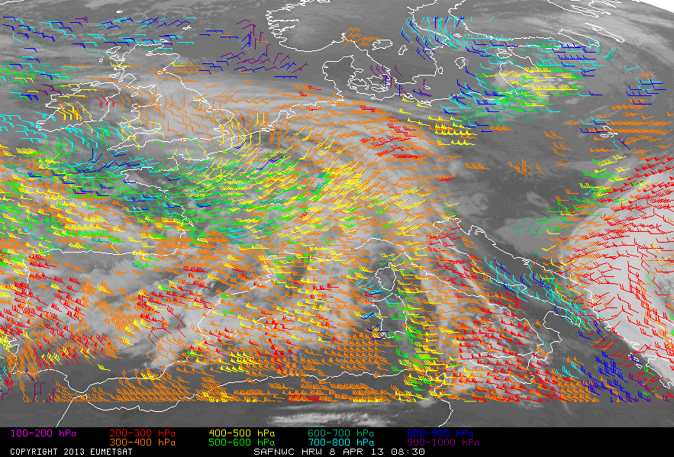
Which AMVs for which model?
Chairs: Mary Forsythe, Roger Randriamampianina
IWW14, 24 April 2018

Slide 2
Thanks to
Regis Borde, EUMETSAT
James Cotton, Met Office
Javier Garcia-Pereda, NWC SAF
Graeme Kelly, Met Office
Kenichi Nonaka, JMA
Ad Stoffelen, KNMI
Chris Velden, CIMSS
For contributing material and thoughts on this topic

Slide 3
Motivation
NWP requirements
Considerations for AMV production

Slide 4
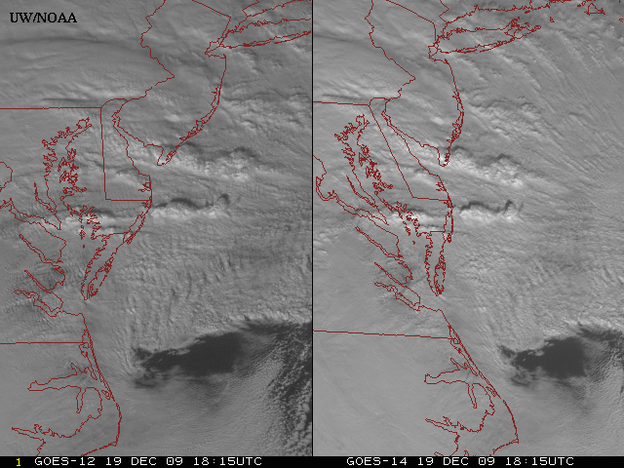
Motivation
Most current AMV products capture broad-scale to synoptic-scale flow.
Can see information available on smaller scales in the imagery.
Spatial and temporal resolution improving e.g. Himawari-8. GOES-16, MTG
Can we derive more useful AMV information for nowcasting or assimilation in high resolution models? Particularly to help with forecasting high impact weather events.
GOES-12
GOES-14
Visible data from the GOES-14 NOAA Science Test – 1 min imagery, from Jaime Daniels, NESDIS

Slide 5
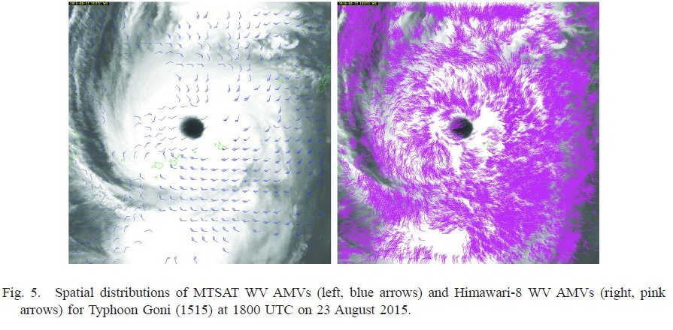
Motivation
Oyama et al., 2018, JMSJ

Slide 6
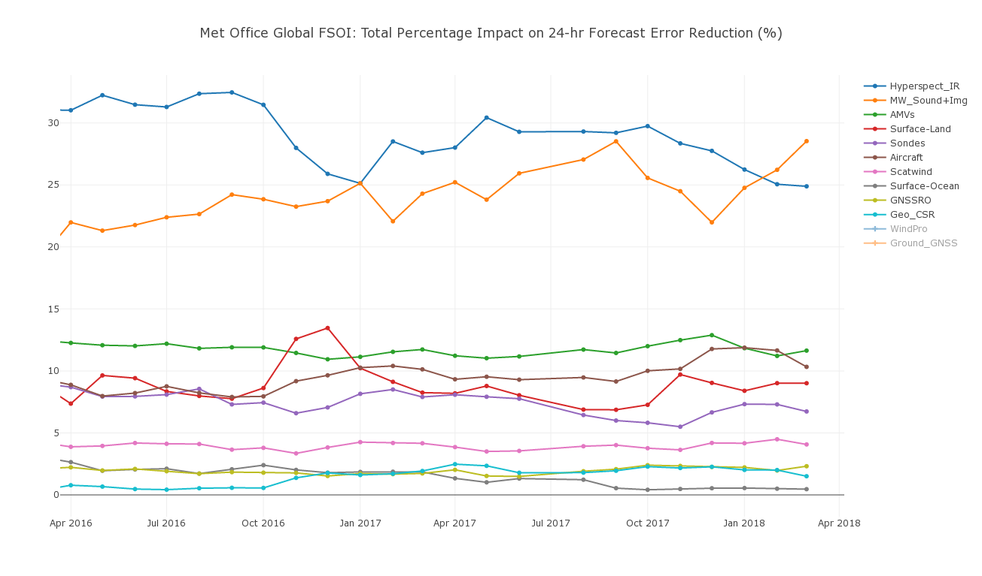
Motivation
AMVs are an important part of the observing system for global NWP – see in FSOI and data denial studies
James Cotton, Met Office

Slide 7
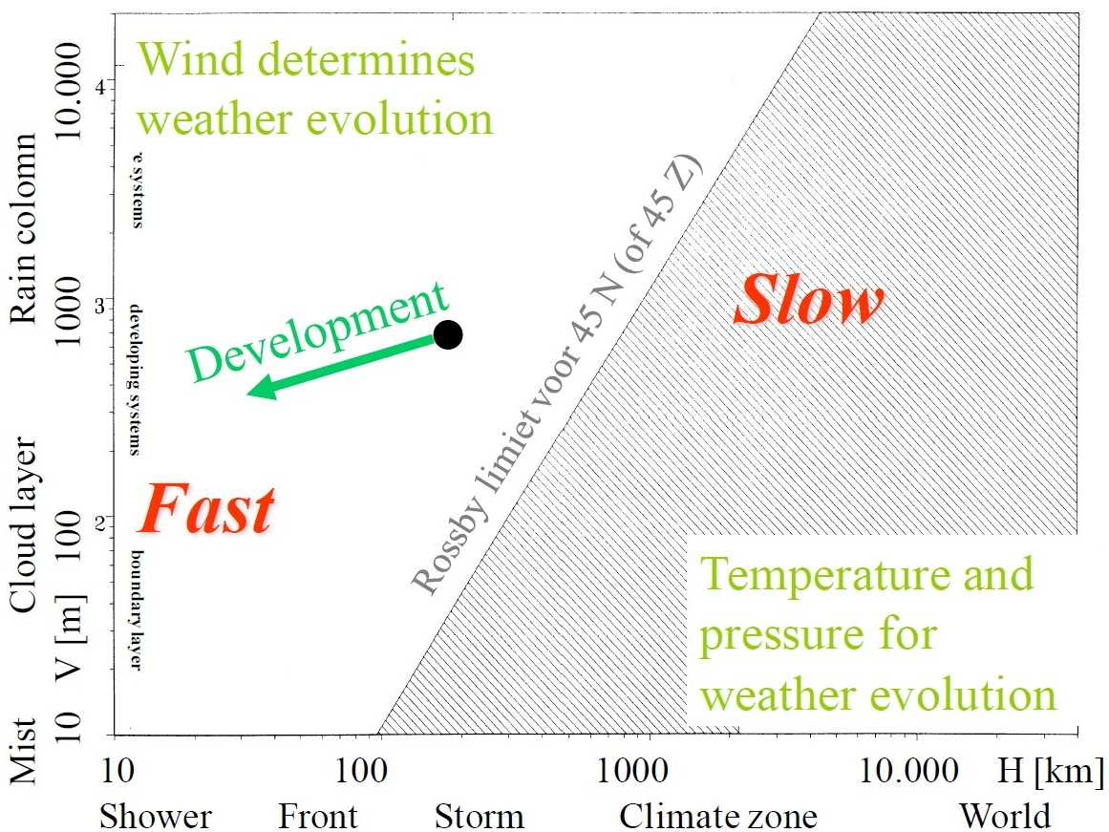
Motivation
We also know wind information is increasingly important as move to higher resolution to capture and initialize small-amplitude, fast-evolving and mesoscale dynamical structures.
Divergent part of the wind is no longer considered “noise”, it is the needed “signal”
In NWP smaller scales tend to change fast and represent only modest energy conversion. The 4D quantity and coverage of observations to initialise and evolve these scales is a daunting challenge. Inadequate coverage could compromise the analysis of the larger scales.
Challenge to improve winds part of the Global Observing System to meet these requirements.
Ad Stoffelen, KNMI

Slide 8
Motivation
NWP requirements
Considerations for AMV production

Slide 9
What are the use cases we need to consider?
Global NWP
Regional NWP
Nowcasting / diagnostic studies?
Are the requirements different?
Ad Stoffelen, KNMI

Slide 10
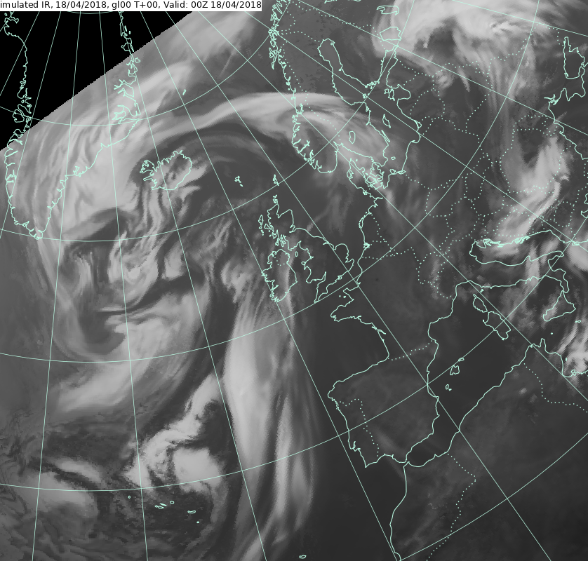
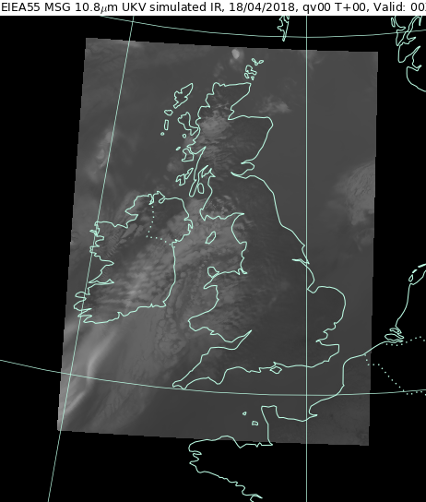
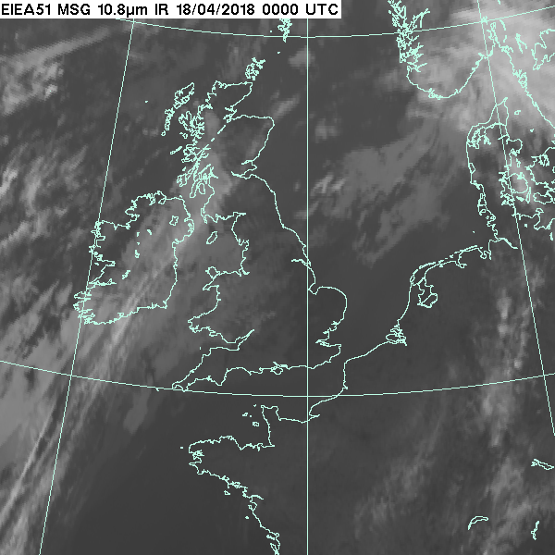
Different models – different requirements?
Met Office Global Model
10 km resolution
Runs every 6 hours
6 hour assimilation window
Met Office UKV Model
1.5 km resolution (over core area)
Runs every hour
1 hour assimilation window
Stricter obs timeliness requirements
Tom Blackmore, Met Office

Slide 11
Effective model resolution
Several studies have looked at effective model resolution - some differences in both the approach and results, but agree it is several times the grid resolution.
Gert-Jan Marseille et al., 2013 (ESA Aeolus study)
Spectral analysis using collocated observations (scatterometer, MODE-S winds) and model background winds.
ECMWF grid resolution = 16 km, effective model resolution of 200-500 km.
Note also that model underestimates vertical shear by a factor of 2-3
Conclude that Aeolus and scatterometer resolutions of 80-100 km may be fairly optimal for global model.
Saleh Abdalla et al., 2012 (ESA Aeolus study)
Calculated kinetic energy spectra using 12 hr forecast fields
ECMWF grid resolution = 16 km, effective model resolution of 100 km, partially below that.
There has been less work done with high resolution regional models….. We expect the effective resolution will be higher, but perhaps not by as much as you might think.

Slide 12
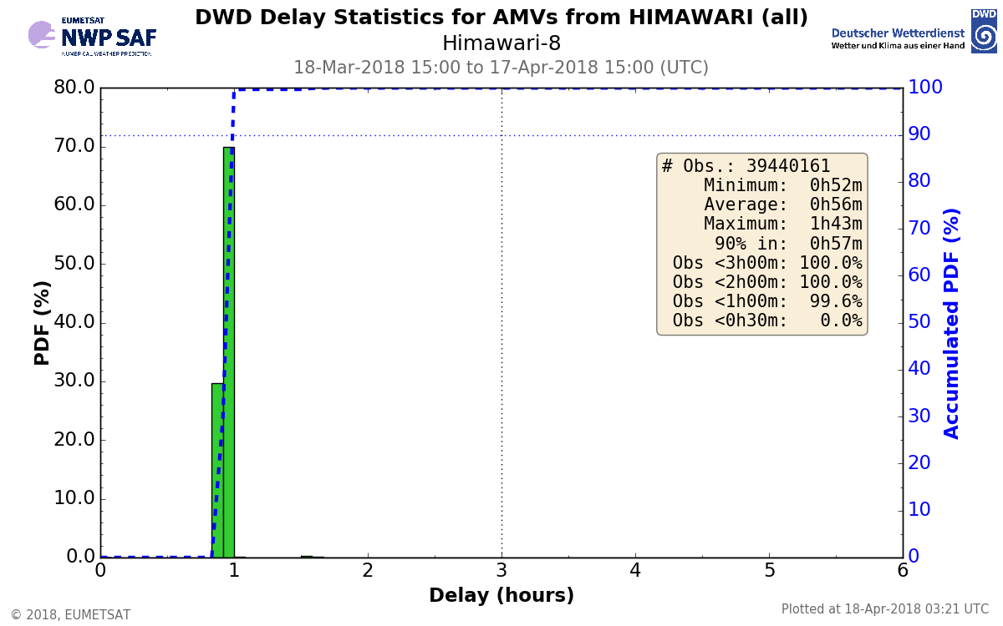
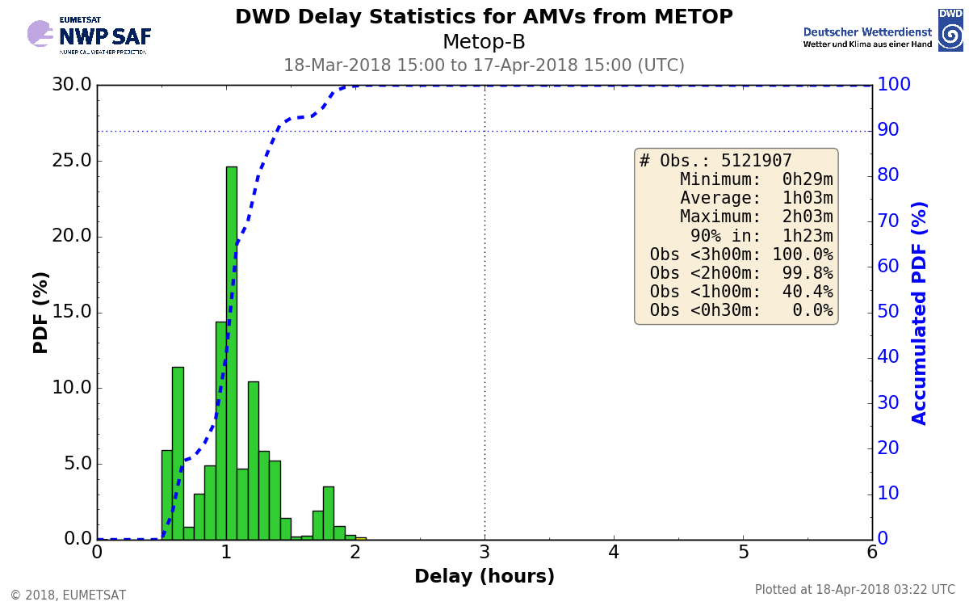
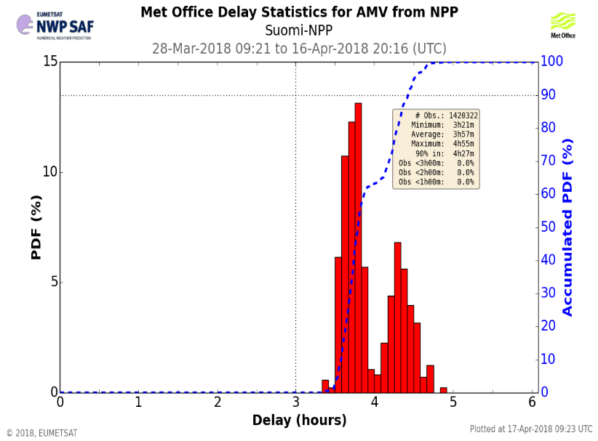
Timeliness requirements
Global models – in some cases use data up to 3-9 hr old (end-start of assimilation window) in update runs, up to 0-5.5 hr old in main forecast runs
Regional models – moving towards hourly cycling with shorter cut-offs - UKV use data up to 15-75 min old
New section on NWP SAF web site showing data coverage plots and data timeliness plots. Initial version available; plans for further development
https://www.nwpsaf.eu/site/monitoring/nrt-availability/
NWP SAF

Slide 13
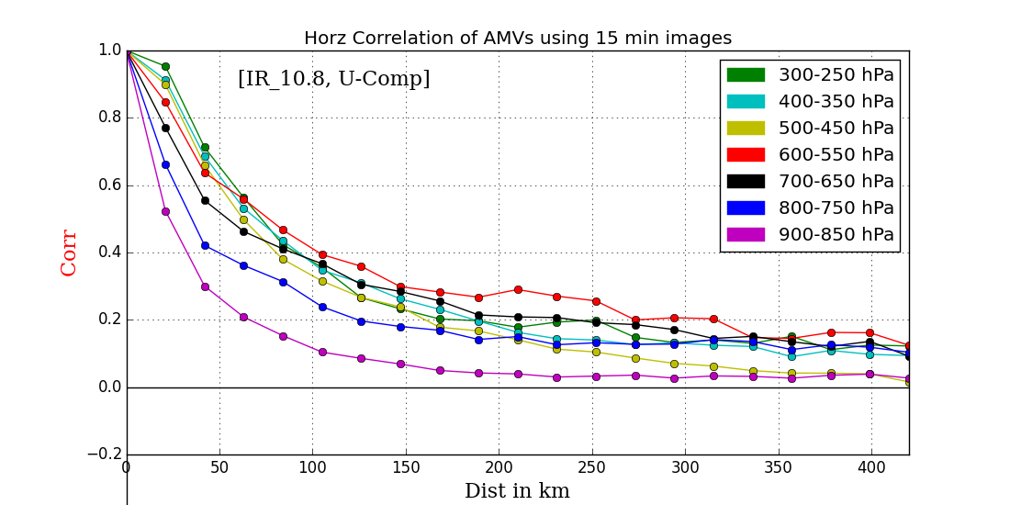
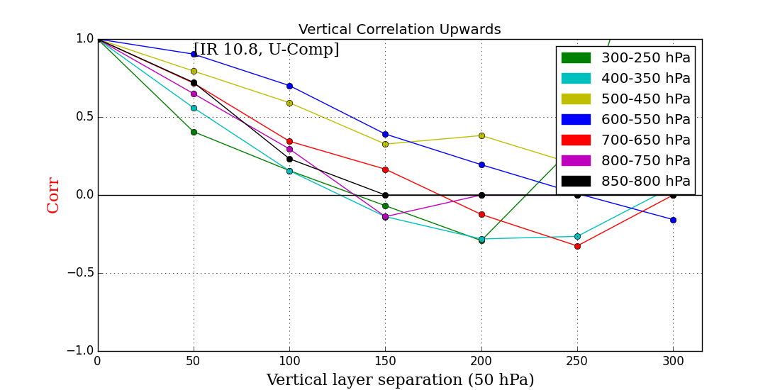
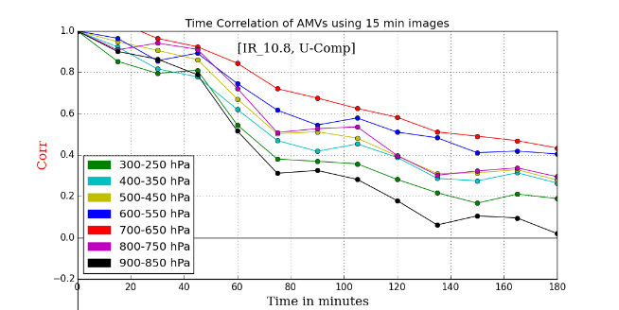
AMV error correlations
UKWINDS (NWC SAF) vs UKV model – Desroziers method, 20 km bin
Horizontal correlations ~140-210 km – low level smallest correlations, mid level highest correlations
Vertical correlations for IR ~150 km
Temporal correlations – some levels not dropped below 0.2 after 3 hrs.
Graeme Kelly, Met Office

Slide 14
Decisions for NWP
We know that
  The AMV data has correlated errors, if we assimilate at too high density we risk overfitting to the data. If we thin too much, we risk losing the mesoscale information of interest
  We could allow for correlated error in the assimilation, this tends to assume a simplified correlation falling off with distance, not clear yet how well this would work.
  If we cannot adequately initialise the smaller turbulent scales we risk compromising the analysis of the larger scales
  Models not able to resolve some of the smaller scale features.
As a result are we better to try to match the scales we think we can adequately initialise and resolve in the models by either super-modding or superobbing the data? This may vary geographically.
Correlated error is often handled by either thinning or superobbing the data and potentially also inflating the errors.
What do we do in more interesting regions including near tropical cyclone – should we attempt to assimilate at higher density in these areas despite the challenges, but assimilating the data at lower density elsewhere to reduce the risks of overfitting the data?

Slide 15
EUMETSAT NWP SAF mesoscale wind data assimilation workshop
Tallinn, Estonia, half a day, during the EUMETSAT Conference 17 to 21 September 2018 – exact date to be confirmed soon
Topics covered include:
Spatial scales observed and the errors in satellite winds
Examples of the spatial scales deterministically modelled, but also the spatial scales which are only realistically modelled and not well initialized.
Spatial representation errors, which often dominate wind measurement observation errors. The pros and cons of thinning, superobbing and “supermodding” will be discussed.
Bias correction
If you want to be kept up-to-date on this workshop, please register at scat@knmi.nl for the workshop.

Slide 16
Motivation
NWP requirements
Considerations for AMV production

Slide 17
How do we optimize the production and the assimilation?
Temporal image interval
Target size
Cross-correlation or optical flow
AMV grid resolution (avoid overlapping targets?)
How often should they be produced
Some other considerations for deriving HR AMVs
More sensitive to satellite image registration errors (but navigation systems are improving).
Cannot resolve slower winds well with shorter image intervals (less of a problem for high resolution visible channels).
Current quality indicators tuned to large-scales - penalize spatially varying, accelerating wind features - need new quality control – could use other information from derivation.

Slide 18
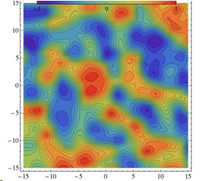
High resolution AMVs – some thoughts
Use smaller targets and shorter imager intervals to derive high resolution AMV datasets reflecting the motion of smaller scale features of the flow.
Tracking – becomes trickier
Example correlation surface with 5x5 pixel targets.
BUT more noise - many peaks ->
Information included in target feature is not enough to determine wind vector accurately
From Kazuki Shimoji’s IWW12 talk
Need to reduce noise
  clustering (e.g. Nested tracking developed at NESDIS)
  use information from correlation surface to filter out poorly constrained cases.
  averaging (see e.g. Shimoji, IWW12)

Slide 19
Beyond NWP - visualisation and nowcasting
Potential use for severe weather e.g.
Tropical cyclone studies - Oyama et al, JMSJ, 2018
Convective weather events – Apke et al., JAMC, 2016
2337 UTC 20 May 2014 example of supercell in central Colorado – associated with hail up to 6-7 cm in diameter
(c) Current 7-min GOES rapid scan mAMVs as compared with (d) 1-min GOES-14 super rapid scan–derived mAMVs with GOES visible imagery.
GOES visible satellite data with equilibrium-level flow-relative SRSOR mAMVs and (left) cloud top divergence and (right) cloud top vorticity
Distinct signal in divergence and vorticity (couplet pattern) for supercell cases – potential for severe weather prediction. But, more work needed to QC the data (problems near cloud edges, cirrus contamination…)

Slide 20
And finally…
We can continue to use the wiki page on IWWG web page to foster collaboration
https://groups.ssec.wisc.edu/groups/iwwg/activities/high-resolution-winds-1/high-resolution-winds

