Slide 1
Migration to a Forecast Independent Quality Indicator and Further QC Changes @ Met Office
James Cotton, Mary Forsythe
IWW14, Jeju City, South Korea.
23-27 April 2018

Slide 2
Motivation
QC essential for NWP: remove data of “bad” quality, also data that cannot be simulated by NWP model
AMVs supplied with Quality Indicator (QI) values
Spatial/temporal consistency
QI1 (with first-guess check against ECMWF, GFS, JMA,..)
QI2 (without first-guess check)
Ideally observations independent from model.. but QI1 used thus far (protect from large HA errors)
1) Migrate from QI1 to QI2 to remove check against (other centres) NWP forecast
2) Update thresholds
Aim

Slide 3
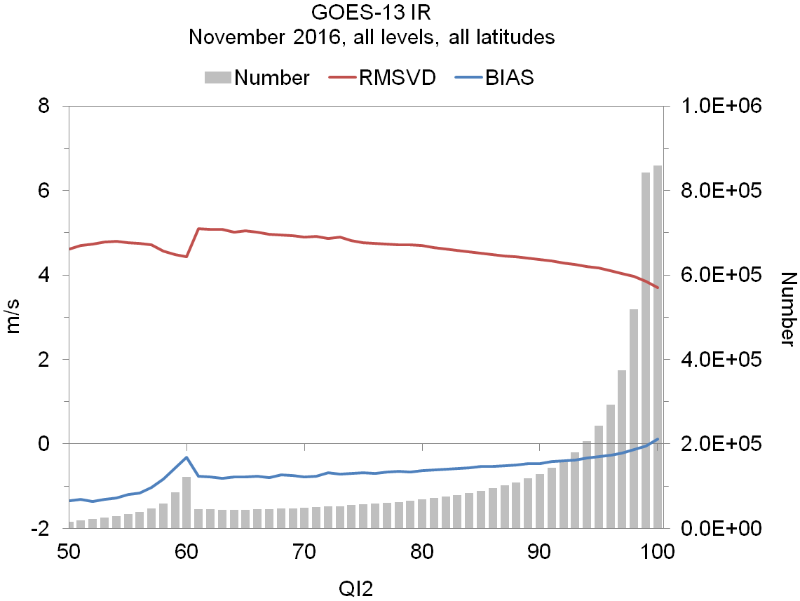
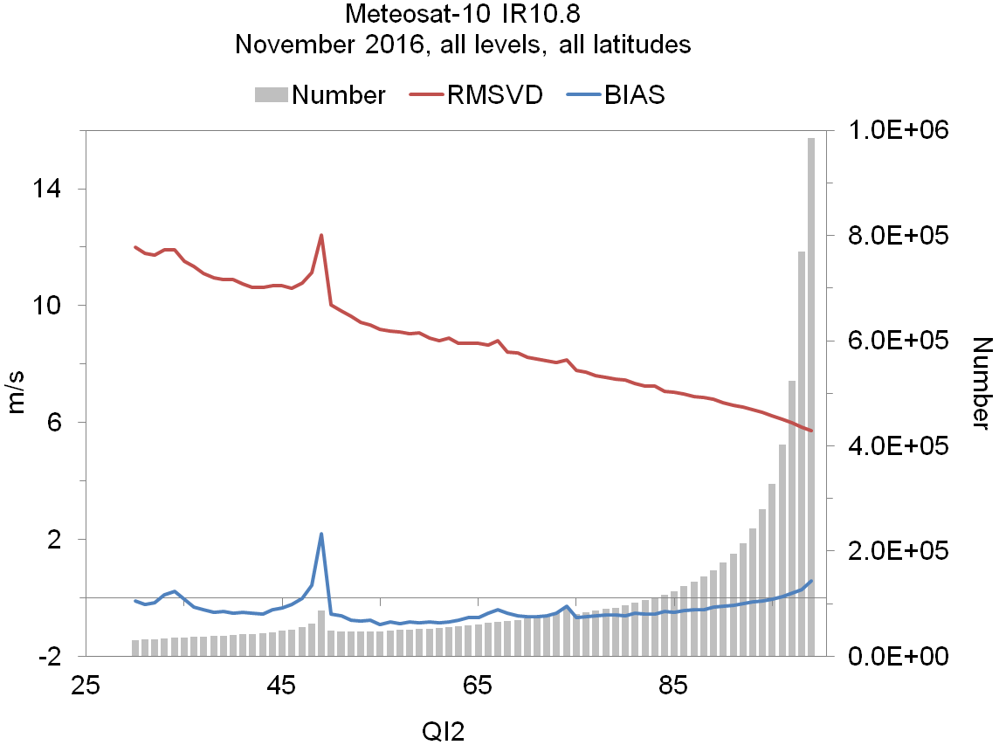
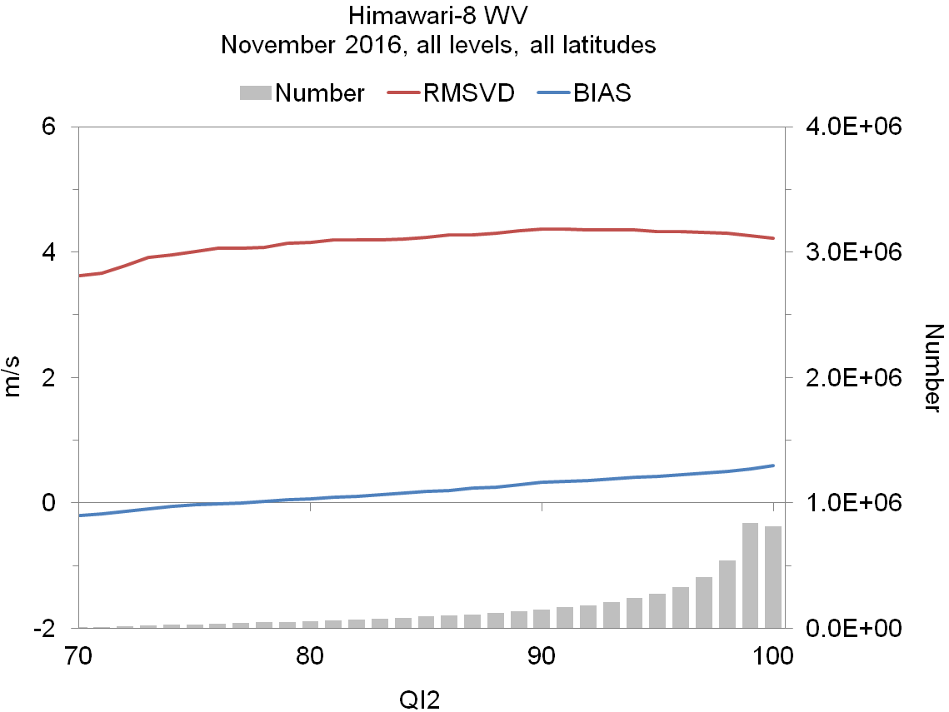
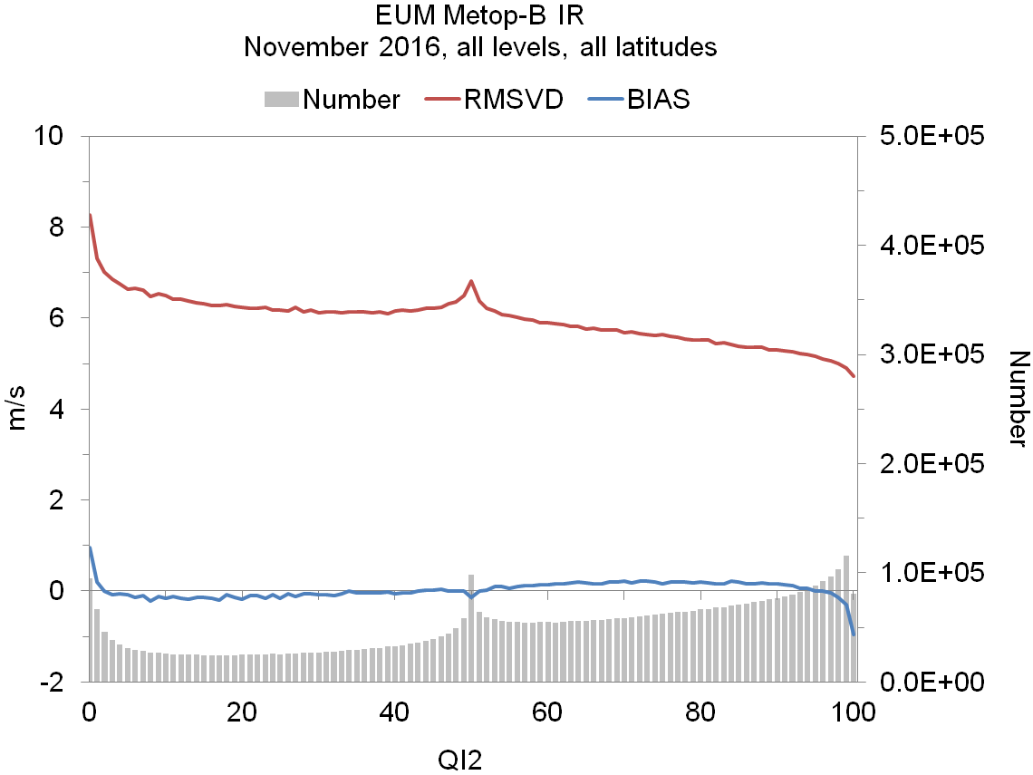
Does QI2 have skill?
GOES-13 IR
Met-10 IR
Him-8 WV
EUM Metop-B
50
30
70
0
Providers have different range of QI disseminated
QI2 has greater proportion (than QI1) with very high QI values
MSG has downward trend in RMSVD, but “spikes”
GOES slight trend for QI > 60, Himawari flat
QI2 less useful at discriminating “bad” data.. But still useful for MSG

Slide 4
Met Office thresholds: before
Satellite | QI | Channel | Extra-tropics (High/Mid/Low) | Tropics
GOES-13/15 | QI1 | IR WV | 85/80/80 80 | 90 90
Meteosat-8/10 | QI1 | IR VIS WV | 85/80/80 65 80 | 90 90 90
Himawari-8 | QI1 |  | 85 | 85
Metop (EUM) | QI1 |  | 80 | -
VIIRS* | QI2 |  | 60 | -
LeoGeo | QI1 |  | 70 | -
Use QI1 for all data, except VIIRS
Vary by channel, latitude band, height level
Very high QI1 threshold in the tropics..
Essentially assimilating ~NWP forecast information

Slide 5
Met Office thresholds: now
Satellite | QI | Channel | Threshold | Active?
GOES-13/15 | QI2 | All | 50 | N
Meteosat-8/10 | “ | “ | 85 | Y
Himawari-8 | “ | “ | 70 | N
Metop | “ | “ | 60 | Y
VIIRS | “ | “ | 60 | Y
Other polar | “ | “ | 60 | Y
Use QI2
Vary only by satellite
GOES and Himawari-8 – just prevent unexpected data with lower QI appearing

Slide 6
Impact experiment – round 1
“Relaxed” thresholds with QI2 allows 20% more AMVs used
Large changes in mean tropical wind field at 850 hPa
Background (T+6) u/v wind fit to AMVs is degraded by ~8%
Allowing larger innovations through
Background fit to other obs is also slightly worse, including ~1% for SEVIRI radiances
Forecast RMSE neutral vs observations, SH/NH 500 hPa height worse vs ECMWF analyses

Slide 7
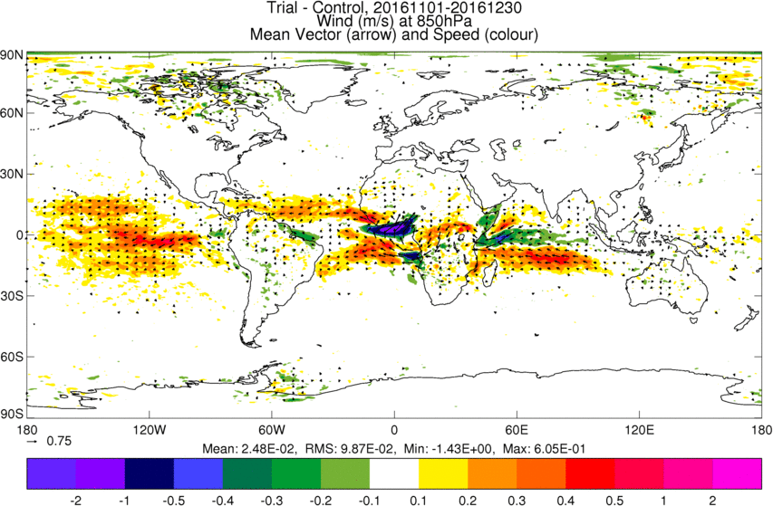
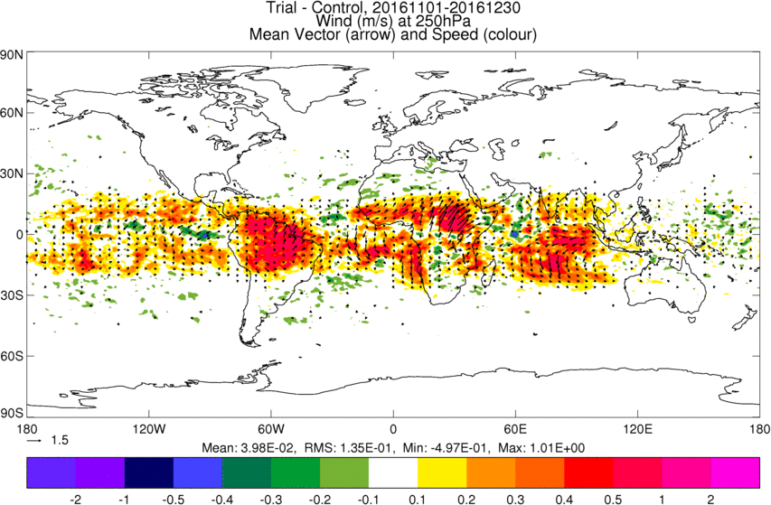
Mean Wind Analyses
Experiment (QI2 “relaxed” thresholds) - Reference (QI1 strict thresholds)
Met-10
Him-8
Wind 850 hPa
Wind 250 hPa
Changes largest for data where QI most useful –MSG , very little change in Himawari region

Slide 8
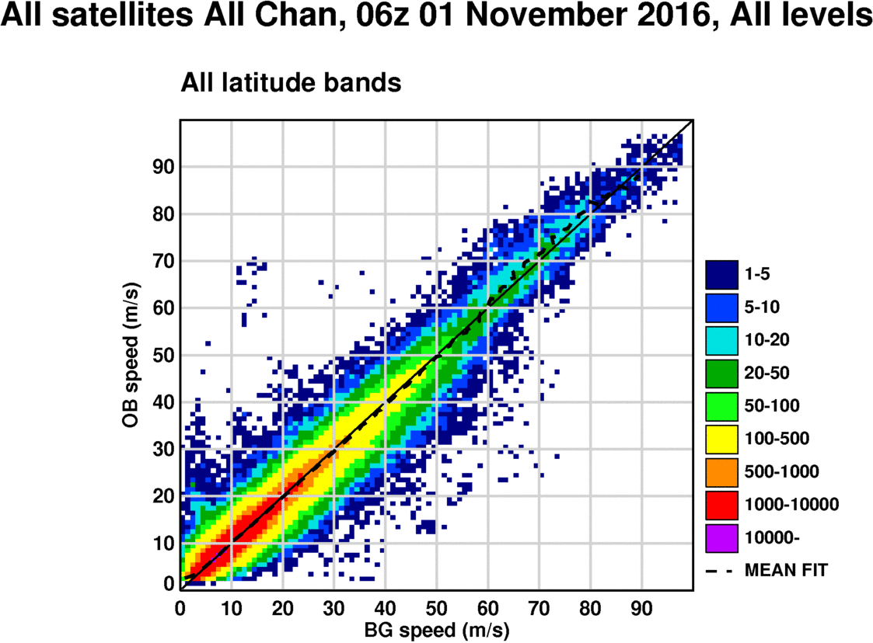
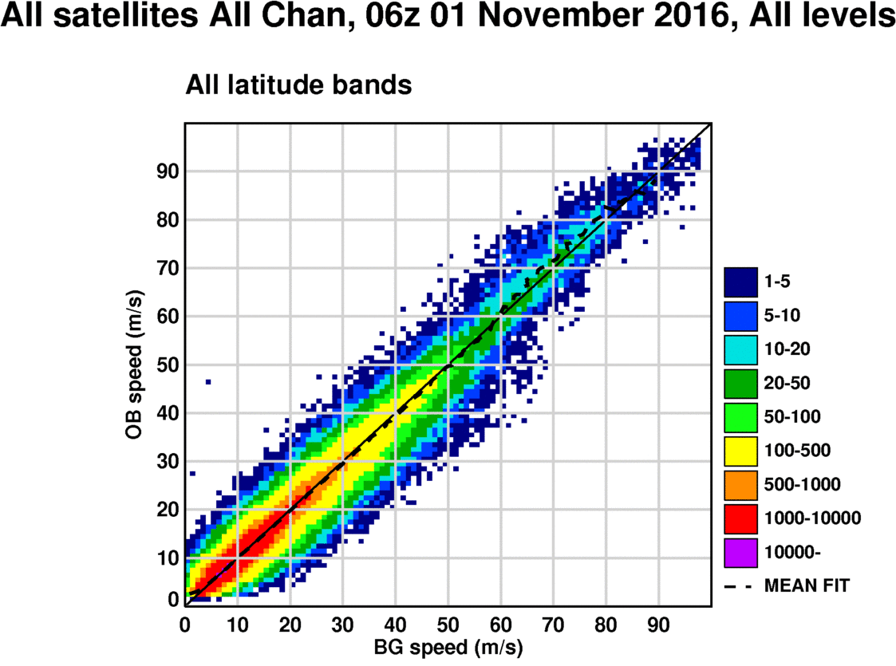
Tighten the background check
Can we ensure the overall quality of AMVs remains similar in migration from QI1 to QI2?
Stricter QI2 thresholds aren’t going to help
Tighten background check against own model.. but we just removed model check via QI1??
Not ideal, but our own model, tuneable, and currently quite relaxed
After QC
+ BgChk

Slide 9
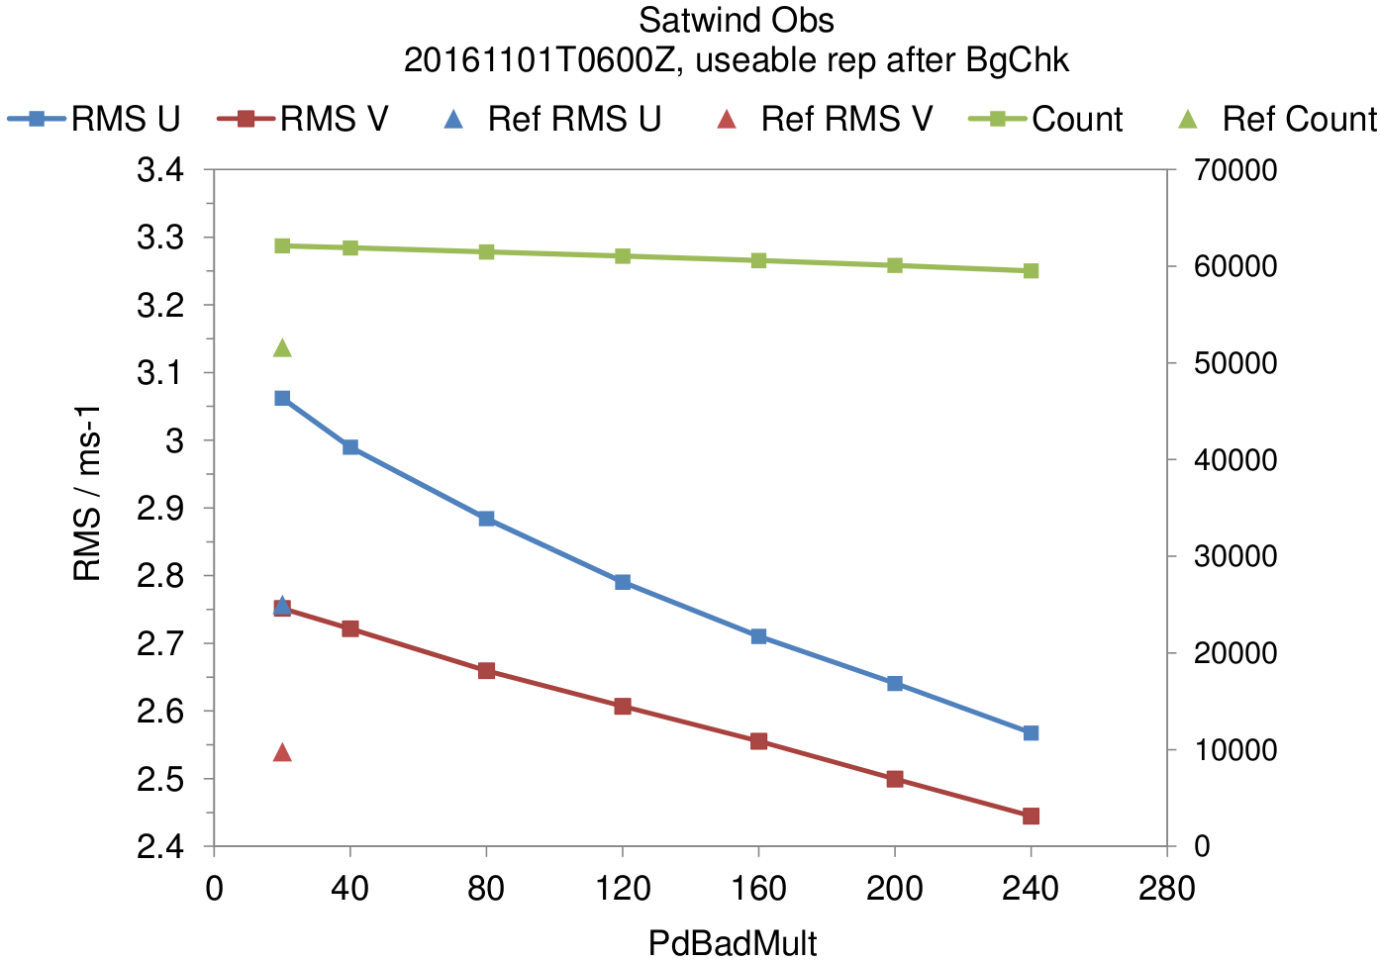
RMS Sensitivity to Background check
Stricter Bg. Check still allows many more AMVs vs QI1
Reference count
Tightening background check efficient way to improve O-B
Reference RMS values
Tighter Bg. Check

Slide 10
Impact experiment – round 2
Relaxed thresholds with QI2, but tighter BgCheck still allows 18-19% more AMVs (vs Ref)
Background u/v wind fit to AMVs is now more similar
Reduced by 2% for u
Increased by 0.5% for v
Background fit to other obs is neutral, except SEVIRI CSR channels 9 and 10 (surface)
QI2 “relaxed” thresholds, tighter Bg. Check vs. Reference

Slide 11
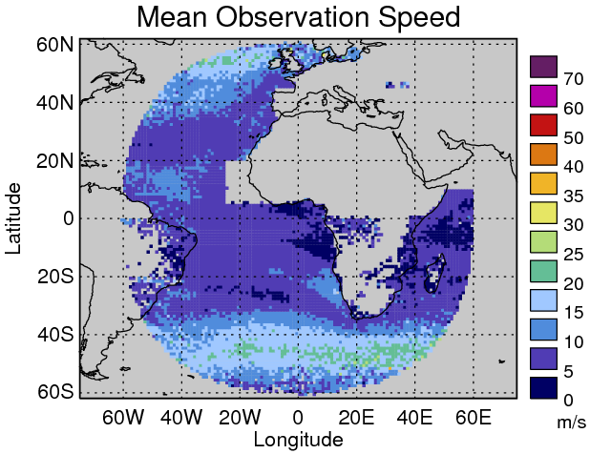
Wind direction O-B
Degradation in SEVIRI-9/10 CSR linked to an increase in assimilated AMV O-B in same areas
Indian Ocean and to the west of Africa near the equator
low wind speed regions (average speed < ~5 m/s)

Slide 12
Wind direction O-B after min. speed
After applying minimum speed check of 4 m/s
(AMV and model speed)

Slide 13
Impact experiment – round 3
Relaxed thresholds with QI2, tighter BgCheck, and slow speed check still allows 11-13% more AMVs (vs Ref)
Background u/v wind fit to AMVs remains similar to round 2
Reduced by 2% for u
Increased by 1.0% for v
Background fit to Geo clear-sky radiance improved (versus experiment without speed check) for GOES, SEVIRI, AHI, but in summer season only..
Forecast RMS errors mostly beneficial, esp. tropical winds 250 hPa

Slide 14
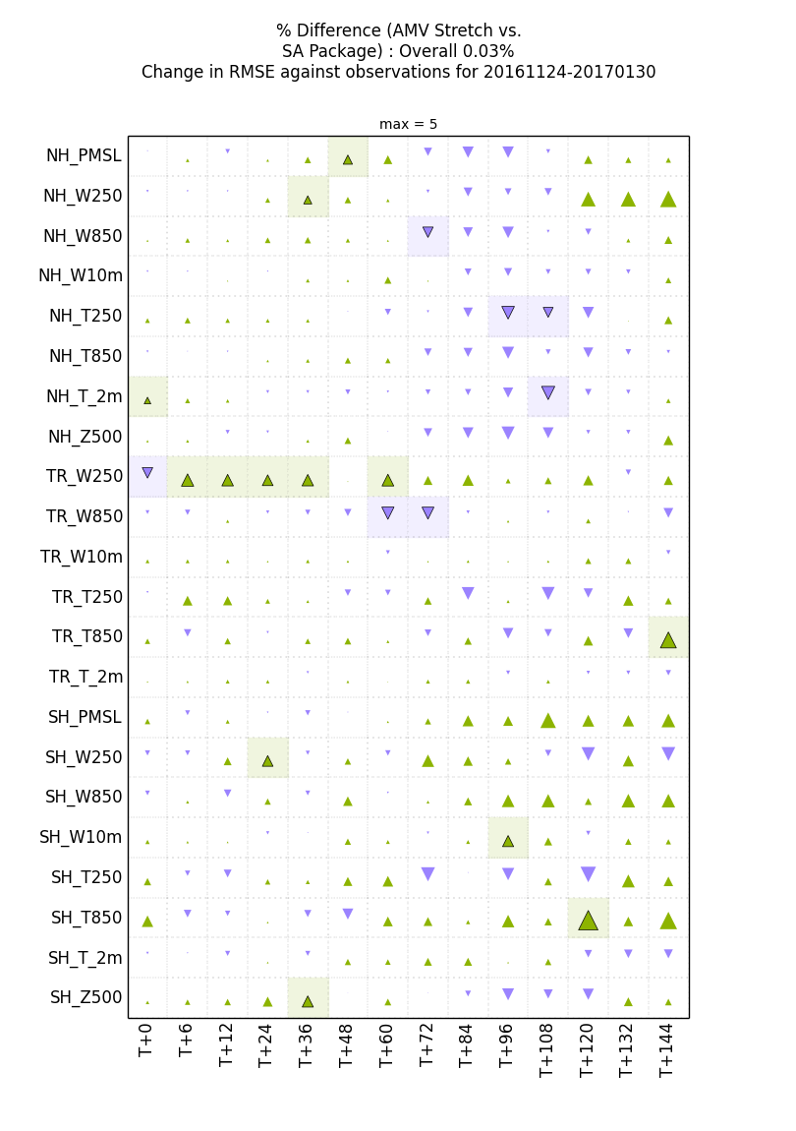
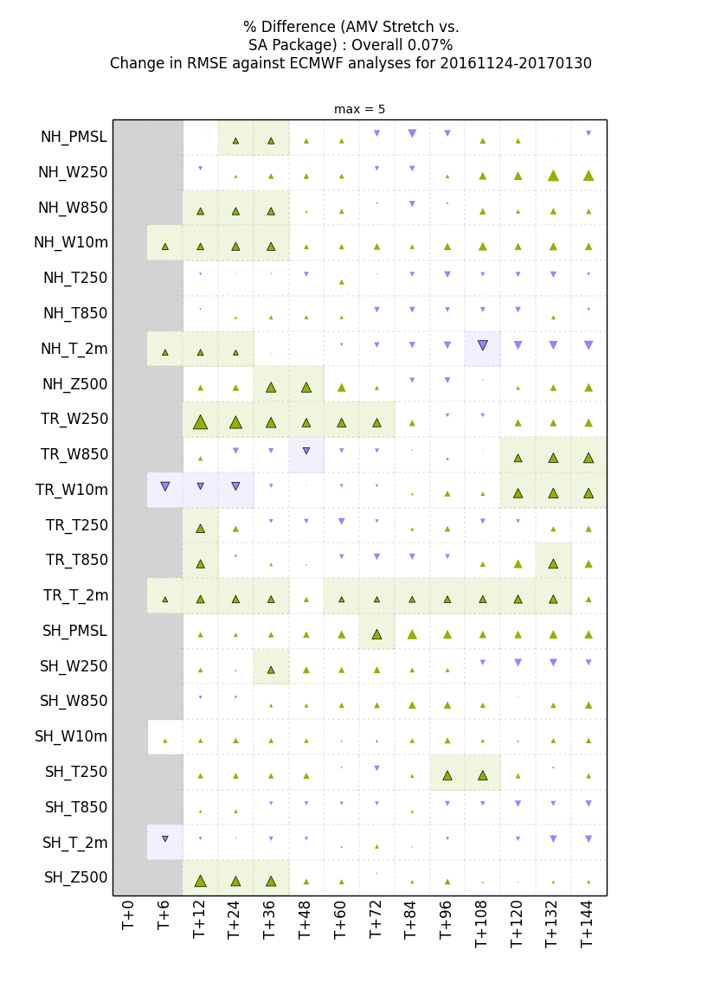
Forecast RMSE: Winter 2016/17
TR W250
# significant impacts
60 positive
13 negative
TR T2m
Truth: Surface, Sonde, Aircraft (W250)
Truth: ECMWF

Slide 15
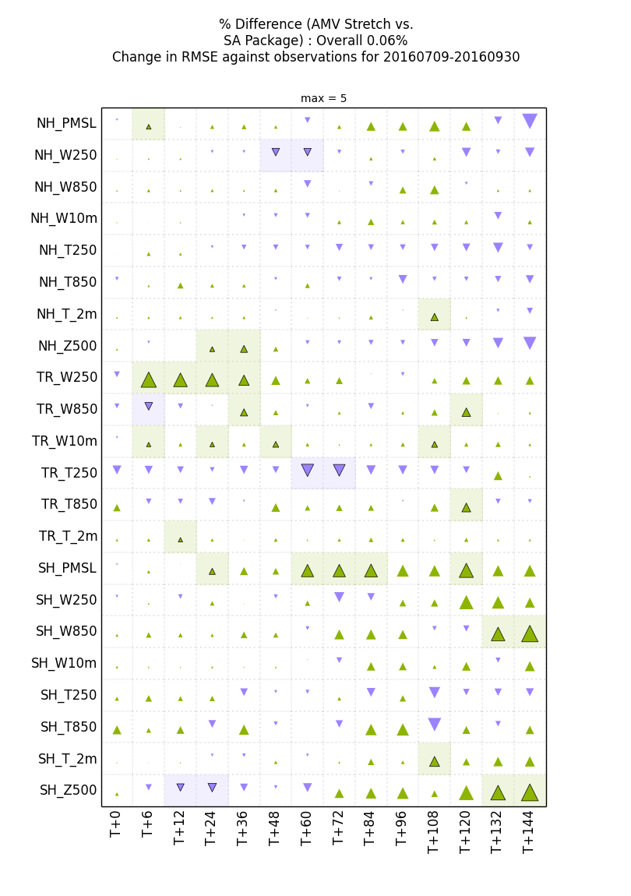
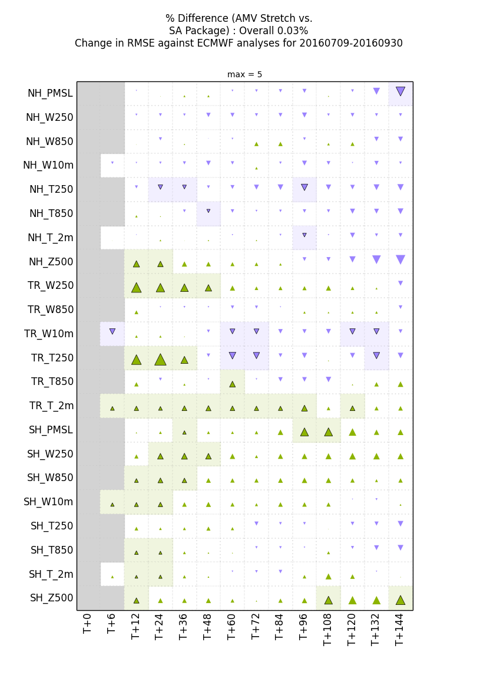
Forecast RMSE: Summer 2016
TR W250
# significant impacts
65 positive
20 negative
TR T2m
Truth: Surface, Sonde, Aircraft (W250)
Truth: ECMWF

Slide 16
Conclusions I
QI2 (without Fc) has little skill in discriminating ‘bad’ data
Revised thresholds are much lower – no filtering applied for GOES and Himawari
Allows much larger volume for assimilation, large change in low level wind analyses in tropics, but results in degraded O-B fit
Needed to tighten check against Met Office background winds – remove small number of observations such that overall AMV O-B remains about the same in going from QI1 to QI2
Found background fit to geostationary radiance (SEVIRI 9/10) still degraded - use minimum wind speed threshold to remove AMV and Bg. speeds < 4 m/s
Forecast RMSE scores mostly beneficial – improvements seen for Winds 250 hPa in Tropics at day 1-2

Slide 17
Conclusions II
Changes operational with OS40, 13 Feb 2018
For now we only have QI to work with, but with “new” AMV Bufr format we will have much more information supplied with the observations E.g. cloud top pressure error, optical thickness, OE cost,..

Slide 18
Thank you for listening
(View from flight between Seoul and Jeju)
www.metoffice.gov.uk © Crown Copyright 2017, Met Office

Slide 19
SEVIRI CSR O-B change vs reference
Without Min Speed Check
With Min Speed Check
Summer
Winter

Slide 20
Bayesian background check
‘Good’ observations with normally distributed errors have Gaussian distribution with unbiased errors and variance V
‘Bad’ observations with gross errors have uniform density, k
Background forecast assumed to have Gaussian errors
Let G denote the presence of gross errors, Ḡ denote the absence of gross errors
The overall probability density of observed value y_{o} given background value y_{b} is
Variance of O-B values (excluding gross errors)

