Slide 1
GOES-16 AMV data evaluation and algorithm assessment
Katie Lean and Niels Bormann
IWW14, Jeju Island, South Korea, 23-27th April 2018
katie.lean@ecmwf.int

Slide 2
Outline
Introduction
Changes in number and data quality using first guess departures
Assimilation experiments
Initial challenges in the tropics
Promising outlook
Next steps and summary

Slide 3
Significant change in processing
Previous operational scheme
“Traditional” methods e.g. CO₂ slicing
Auto-editor: greater NWP dependence and artificial speed up
GOES-16:
Nested tracking
Heights from optimal estimation technique
GOES-16 vs. auto-edited GOES-13/-15 winds
Full disk winds only
Vis
IR
Cloudy WV (6.2µm only)
Initially reprocessed GOES-13/-15 vs. auto-edited winds
Better statistics at expense of NWP independence
Plots taken from NWP SAF monitoring website:
https://nwpsaf.eu/site/monitoring/winds-quality-evaluation/amv/amv-monthly-monitoring/

Slide 4
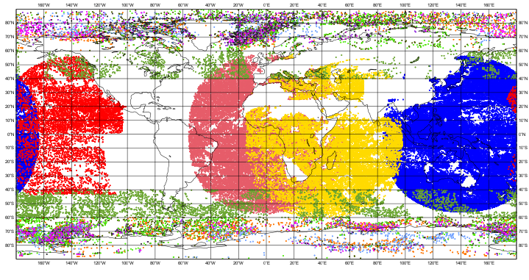
GOES-16 data timeline
10th Nov: News that BUFR are available
16th Nov: FTP set up at ECMWF for GOES-16
30th Nov: satellite drift starts
Sample GOES-16 available
GOES-16 launched
GOES-13 retired in operations 2nd Jan
Nov | Dec | Jan 17 | Feb | Mar | Apr | May | Jun | Jul | Aug | Sep | Oct | Nov | Dec | Jan 18 | Feb | Mar | Apr
Active AMVs 12Z 25th Feb 2018
Regular acquisition of GOES-13/-15 reprocessed (corrected)
Regular acquisition of GOES-16 at final location 15th Dec
GOES-16 monitored 18th Apr

Slide 5
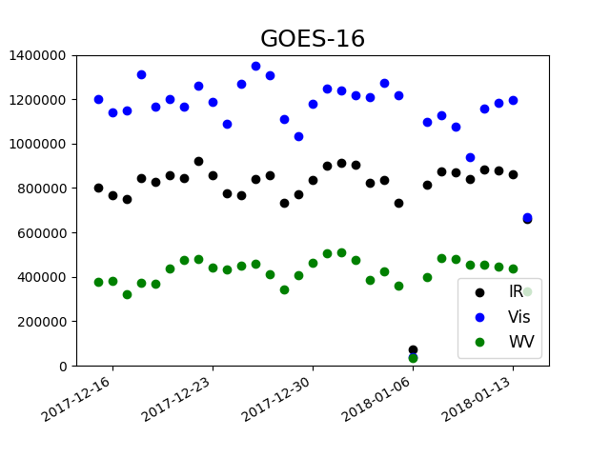
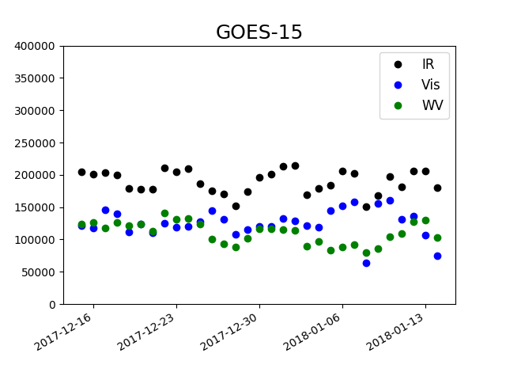
Large increase in AMVs
Full disk AMVs only
No. of AMVs
Algorithm alone ~doubles number (seen from reprocessed GOES-13/-15 data)
Combined with higher resolution on GOES-16 ~doubles number again
Visible channel increases even more
Local winds ~same number as full disk

Slide 6
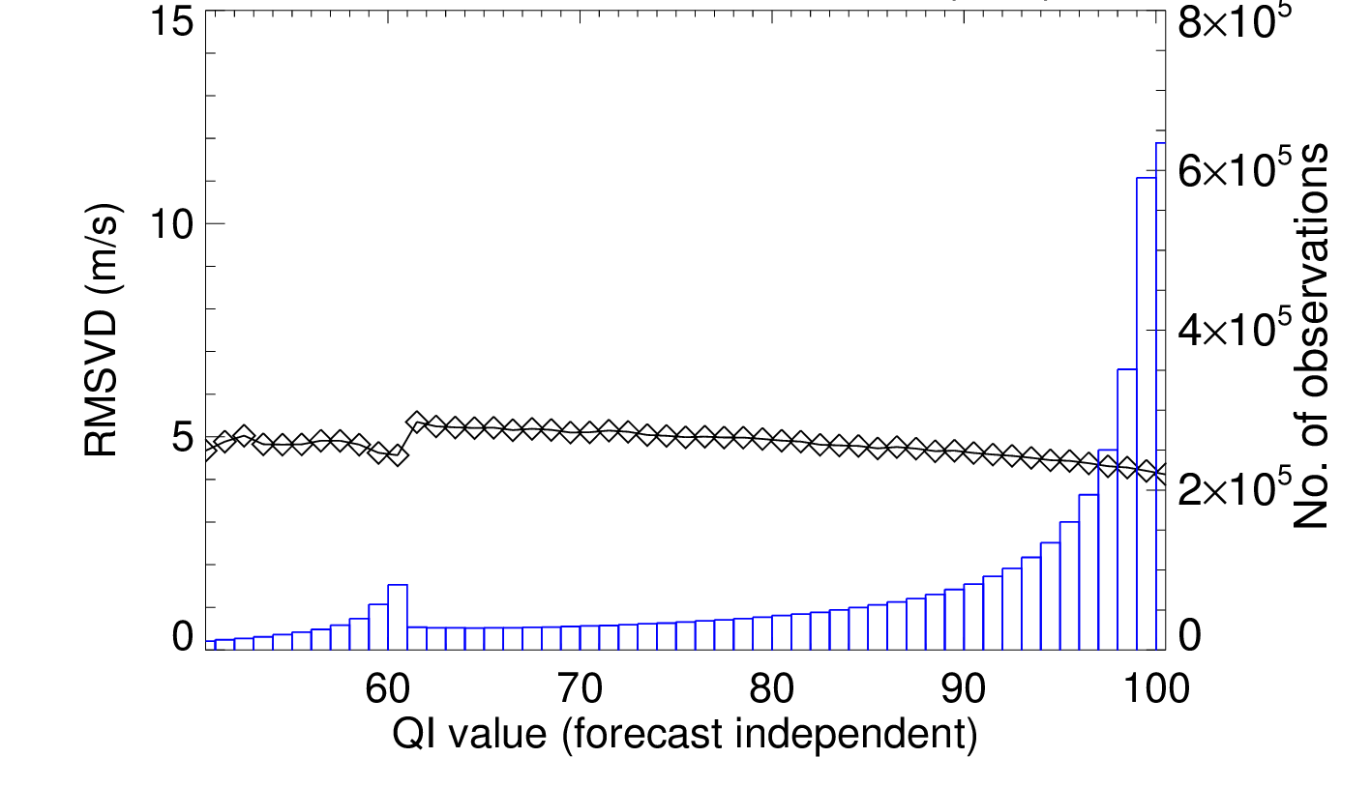
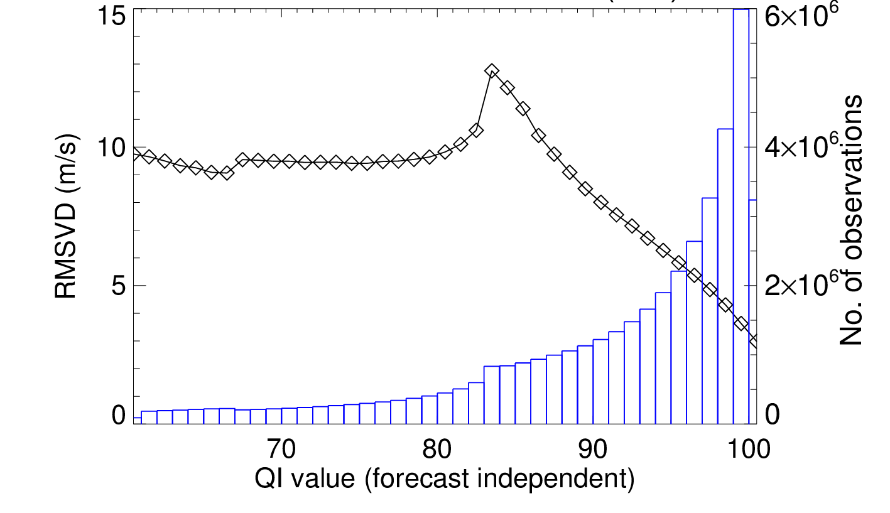
Stronger dependence on forecast independent QI
GOES-13 IR
GOES-16 IR
Stronger dependence – threshold of 90 suggested as compromise no. of AMVs vs. better quality
Little dependence on QI meant no screening used
All data 15th Dec – 8th Jan

Slide 7
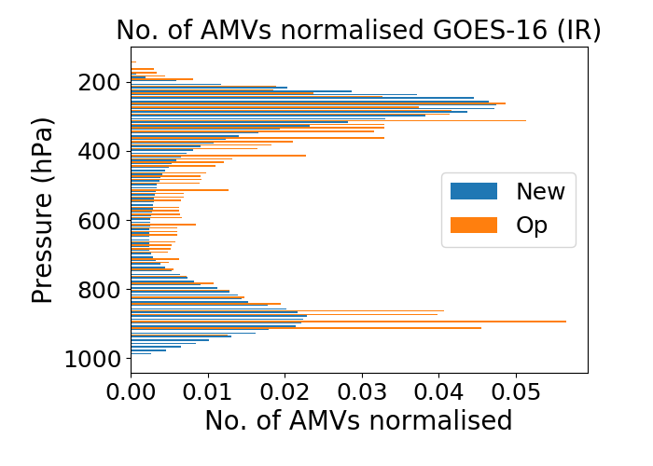
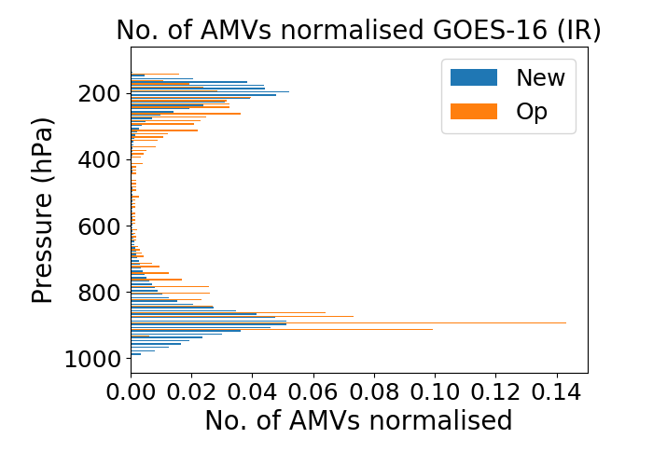
Changes in vertical distribution and characteristics
Normalised No. of AMVs
NH
Fewer mid level AMVs
Concentrated into narrower bands high/low levels
Changes also seen for ‘algorithm only’
GOES-16
GOES-15
TR
15th Dec – 14th Jan QI + first guess screening

Slide 8
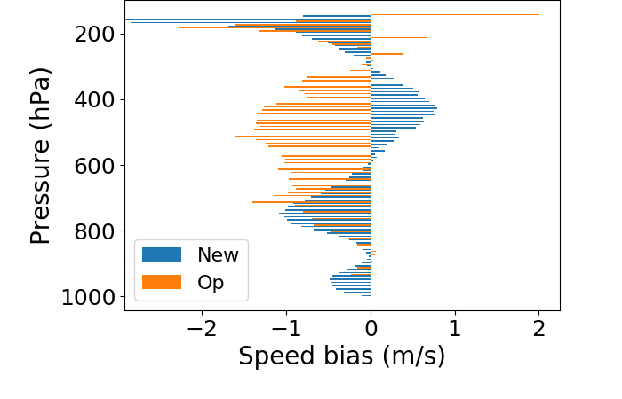
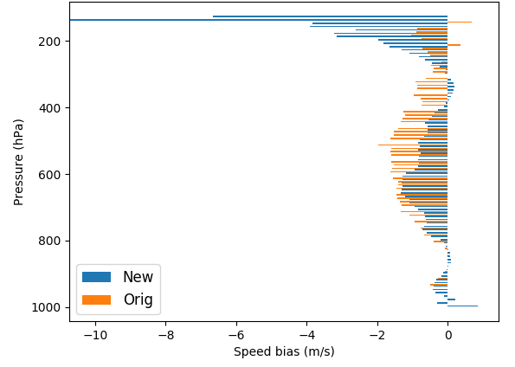
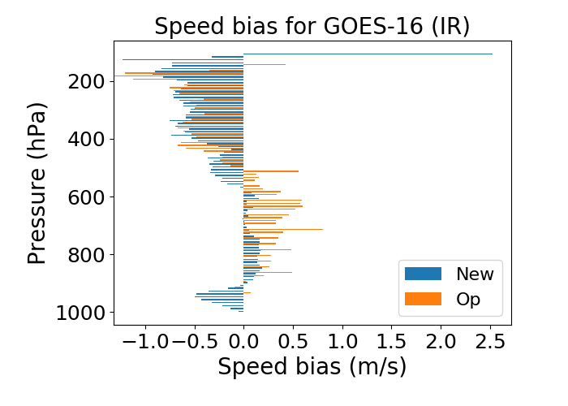
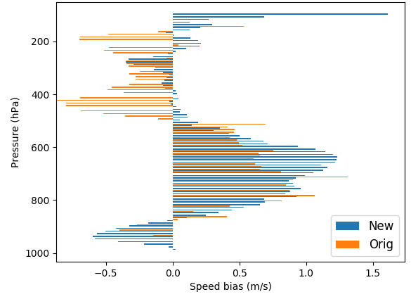
Changes in vertical distribution and characteristics
GOES-13 reprocessed vs. auto-edited (March – April 2017)
Normalised No. of AMVs
Speed bias
High levels in extra tropics start with negative speed bias…
… And show more positive speed bias 300-600hPa
NH
GOES-13 repro
GOES-13 op
In tropics speed bias is negative (similar or more than GOES-15)
For ‘algorithm only’ biases were generally positive/less negative
GOES-16
GOES-15
GOES-13 repro
GOES-13 op
GOES-16
GOES-15
TR
15th Dec – 14th Jan QI + first guess screening

Slide 9
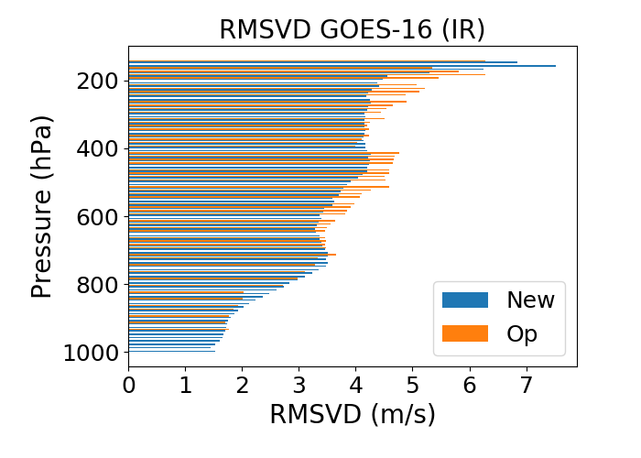
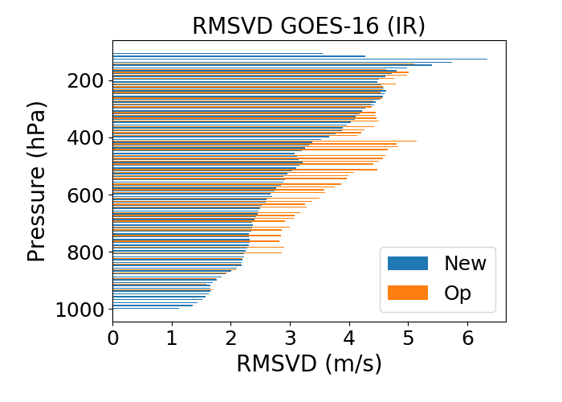
Changes in vertical distribution and characteristics
Normalised No. of AMVs
Speed bias
RMSVD
NH
RMSVD values are similar or smaller than GOES-13/-15
GOES-16
GOES-15
GOES-16
GOES-15
TR
GOES-16
GOES-15
15th Dec – 14th Jan IR, QI + first guess screening

Slide 10
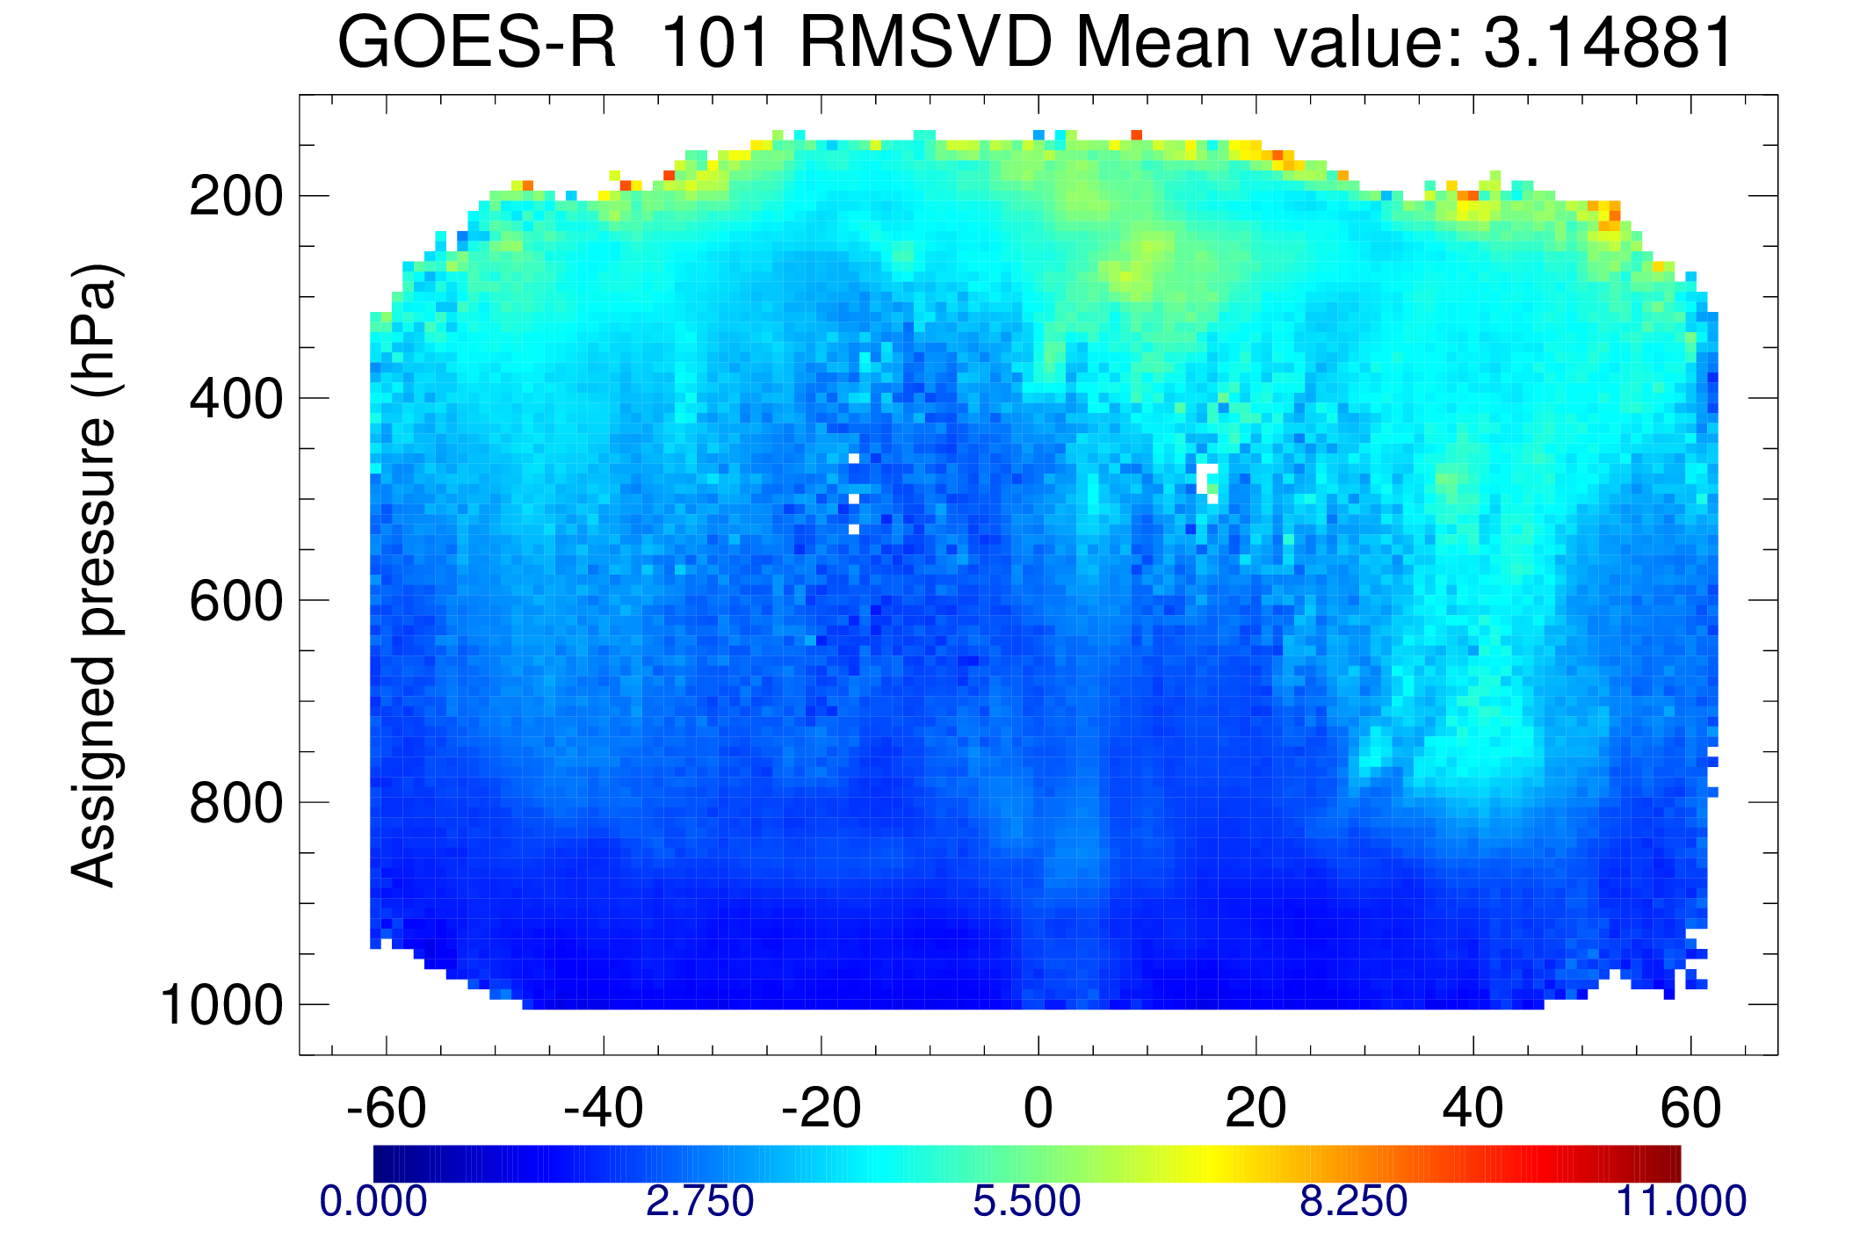
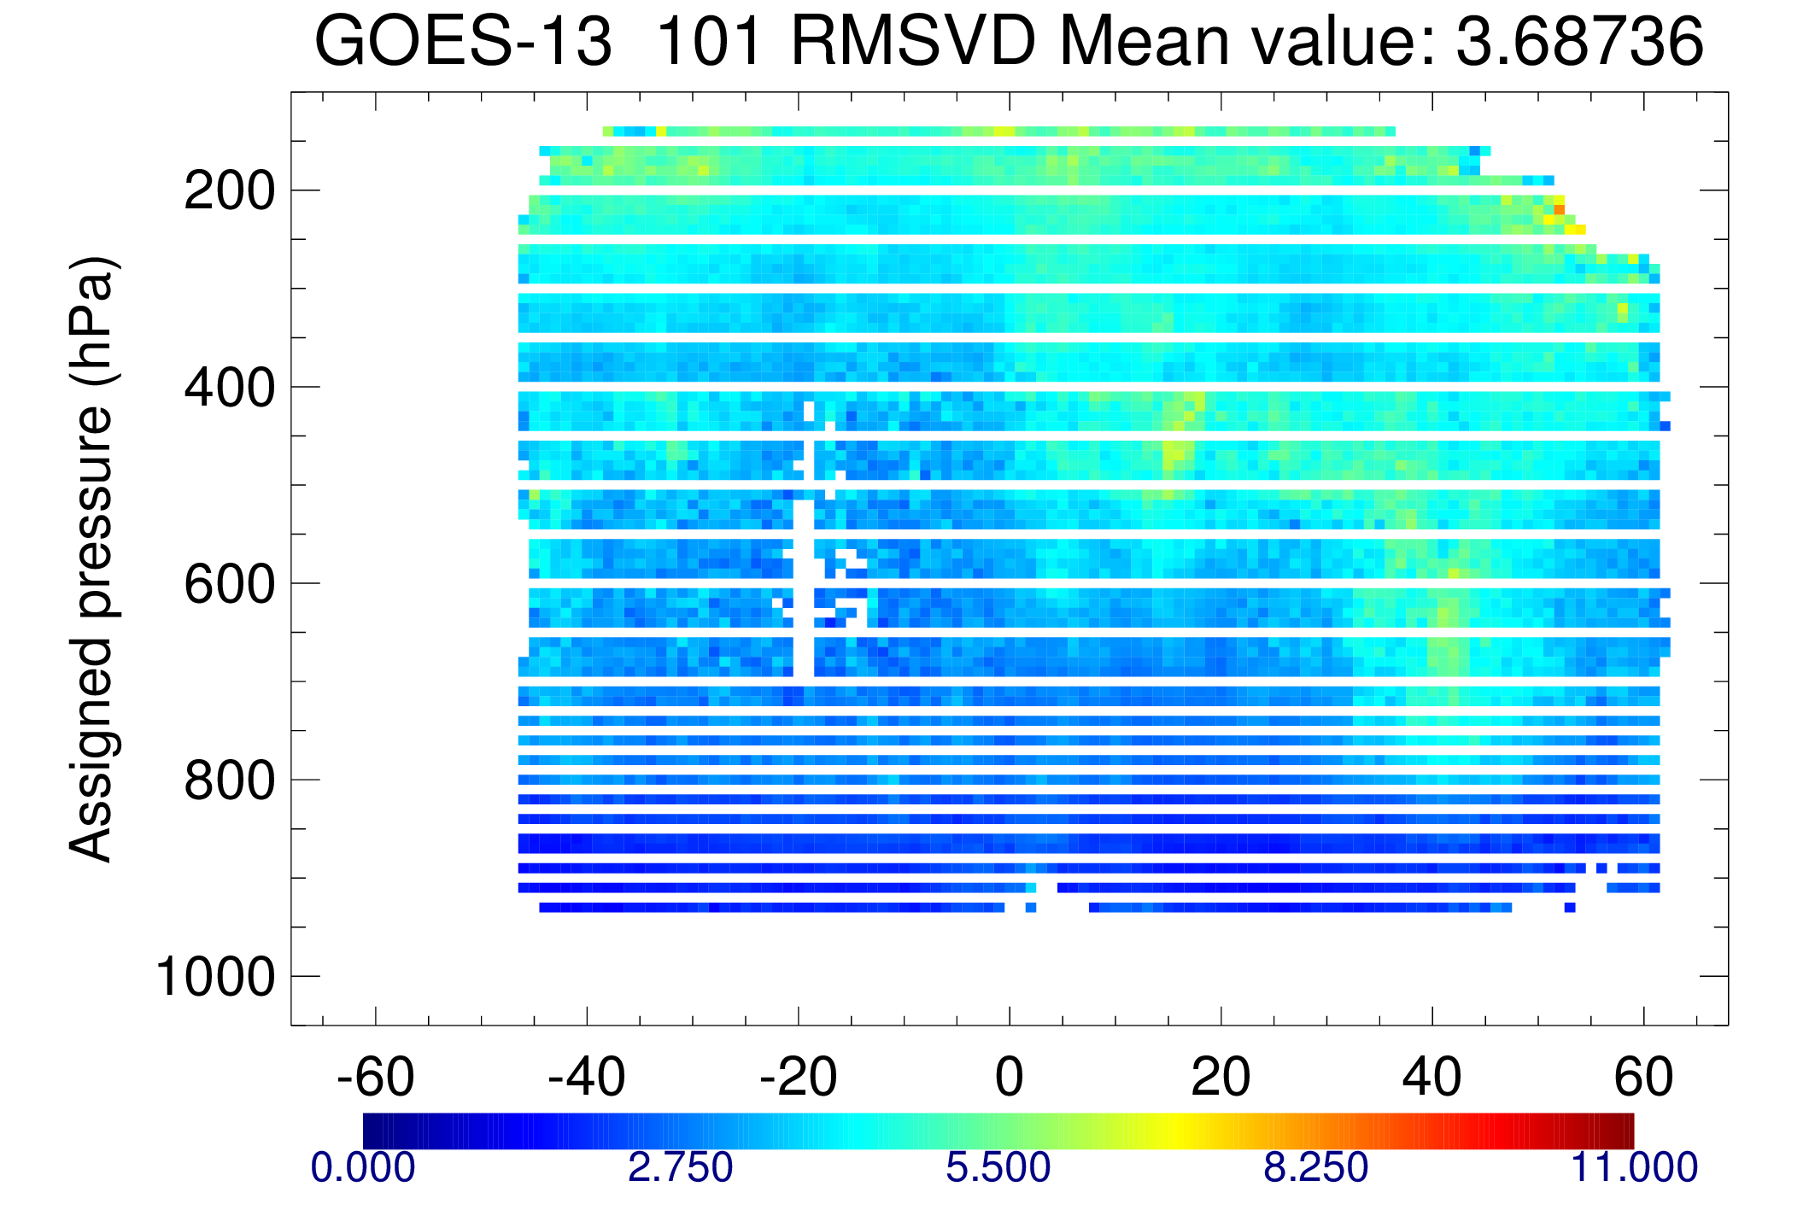
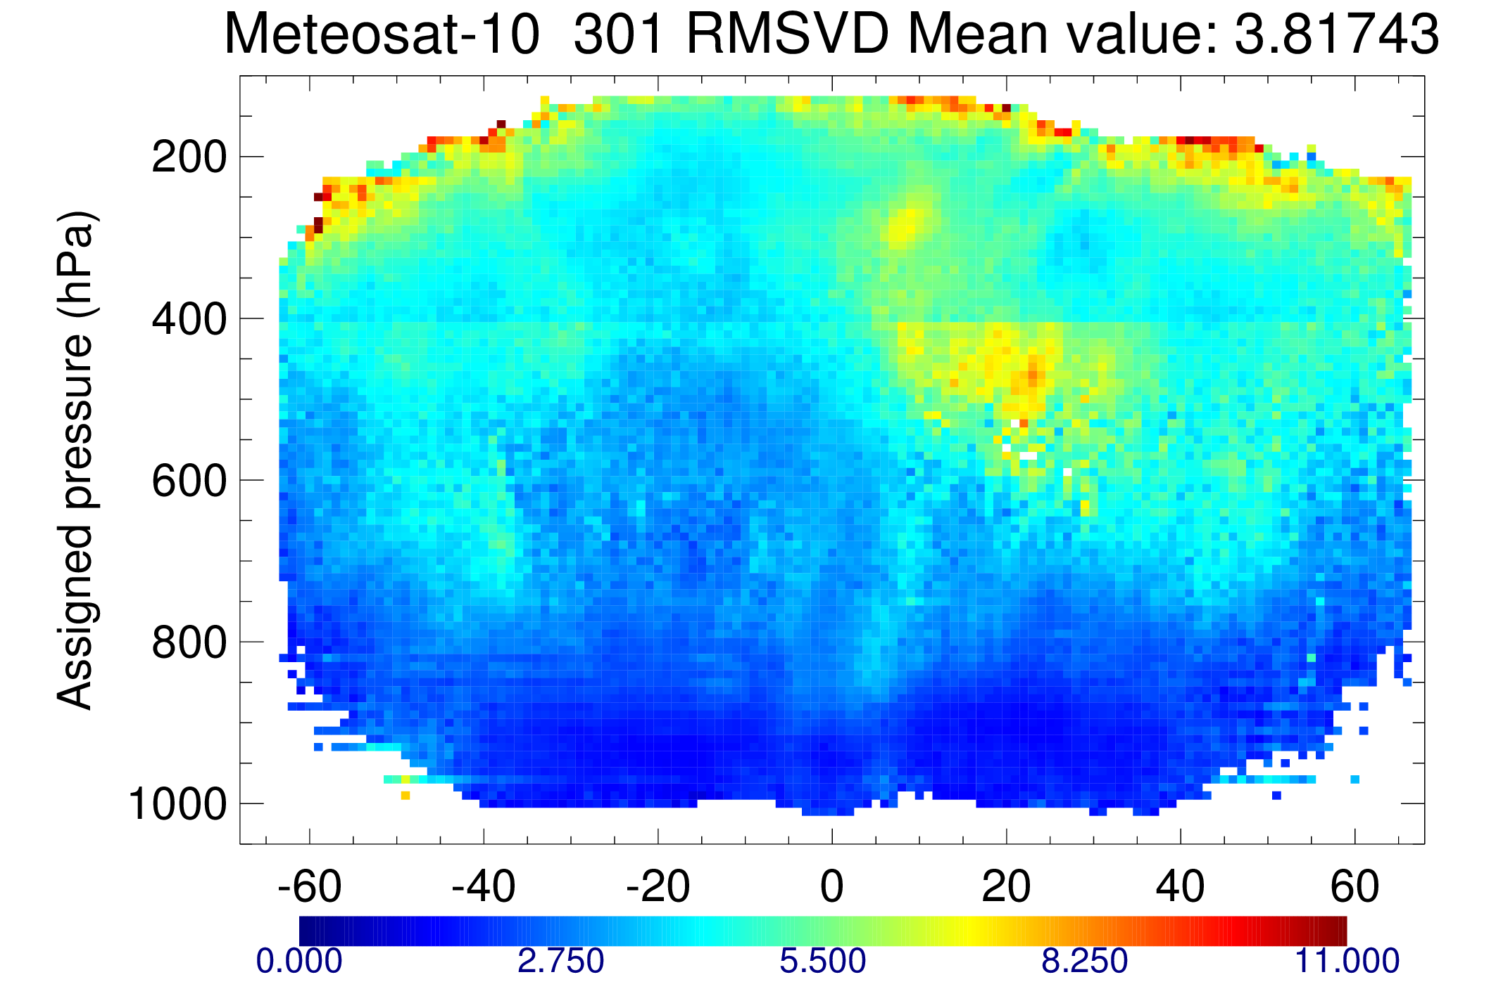
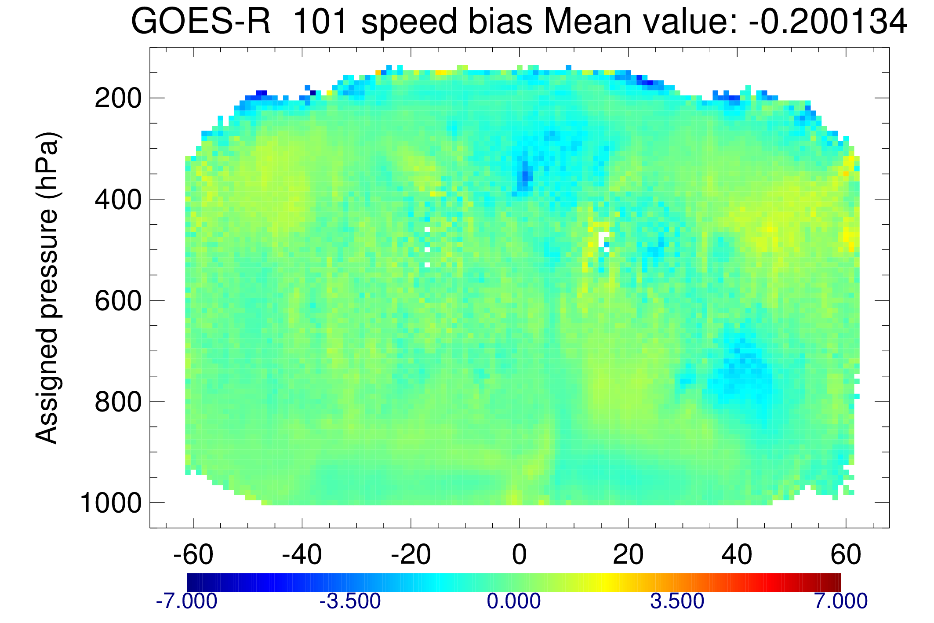
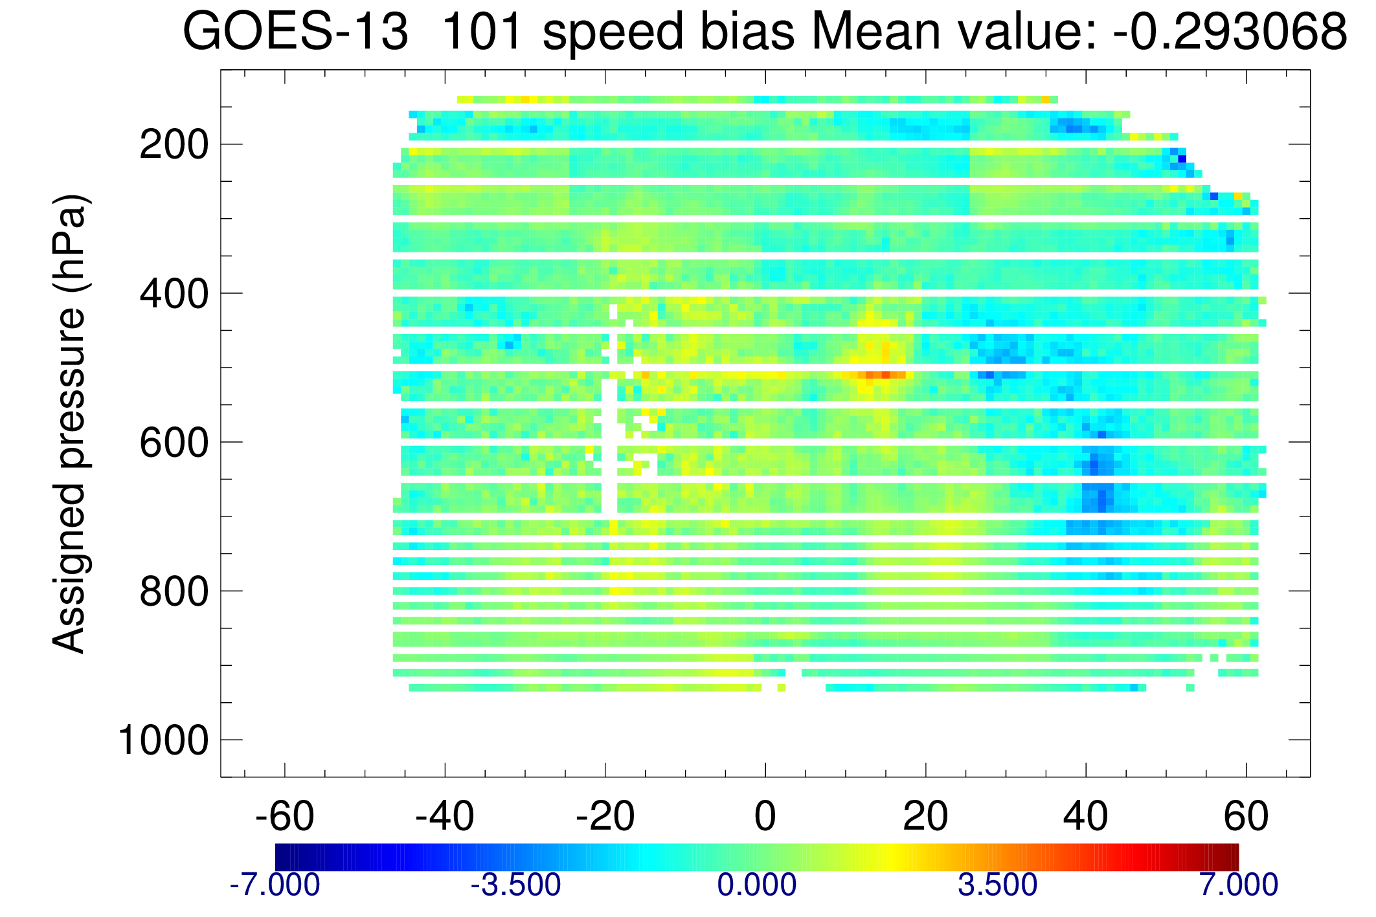
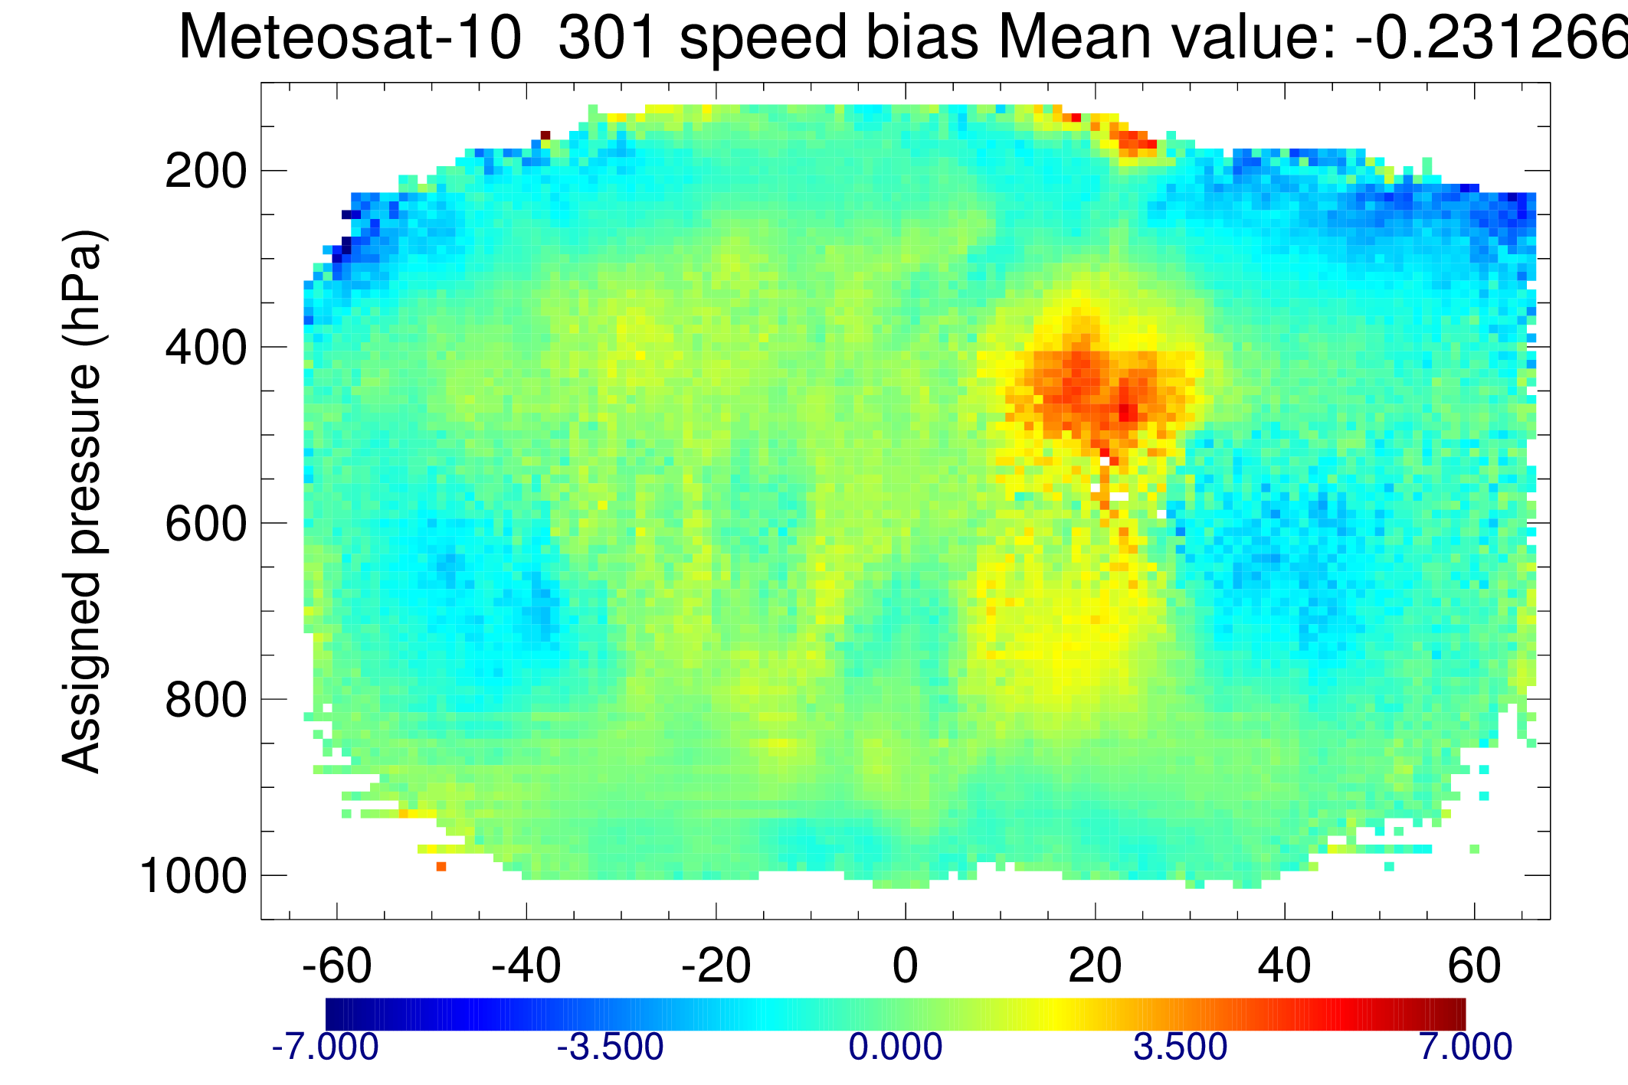
Data quality comparable but change in patterns
GOES-16
GOES-13
Met-10
RMSVD
RMSVD comparable
Speed bias
More positive speed bias in general
(1 month)
(2.5 weeks)
(1 month)
IR after QI and first guess screening

Slide 11
Comparison with adjacent satellites
% Diff RMSVD
Diff |speed bias|
Similar pattern in reprocessed GOES-13
But RMSVD lower in GOES-16 case
High level water vapour winds
After QI and first guess screening
GOES-16 – Met-10
GOES-16 lower RMSVD
GOES-16 higher RMSVD
GOES-16 bias closer to 0
GOES-16 bias further from 0
Mixed changes but GOES-16 has no auto-editor
Larger differences in tropics
GOES-16 – GOES-15

Slide 12
Assimilation experiments: initial channel selections
Control: full observing system except AMVs in GOES-E position
Common criteria – reject GOES-16 AMVs if:
P < 150hPa
QI (forecast independent) < 90
Visible only: P < 700hPa
Low level winds over land
WV removed in extra-tropics P>300hPa
Initial experiments tried a bolder use of data…
…but encountered issues at high levels

Slide 13
Problems at high levels?
Using IR/WV at all pressures in tropics vs. control
Conventional wind
U/V wind, Tropics
In verification vs. own analysis see large increase in analysis increments at 200hPa
Improvement/degradation signals in 200hPa short range forecast treated with caution
But more reliable observations show problem…
High level degradation in fit of conventional wind to model background
Good
Bad
20th Dec 2017 – 10th Mar 2018

Slide 14
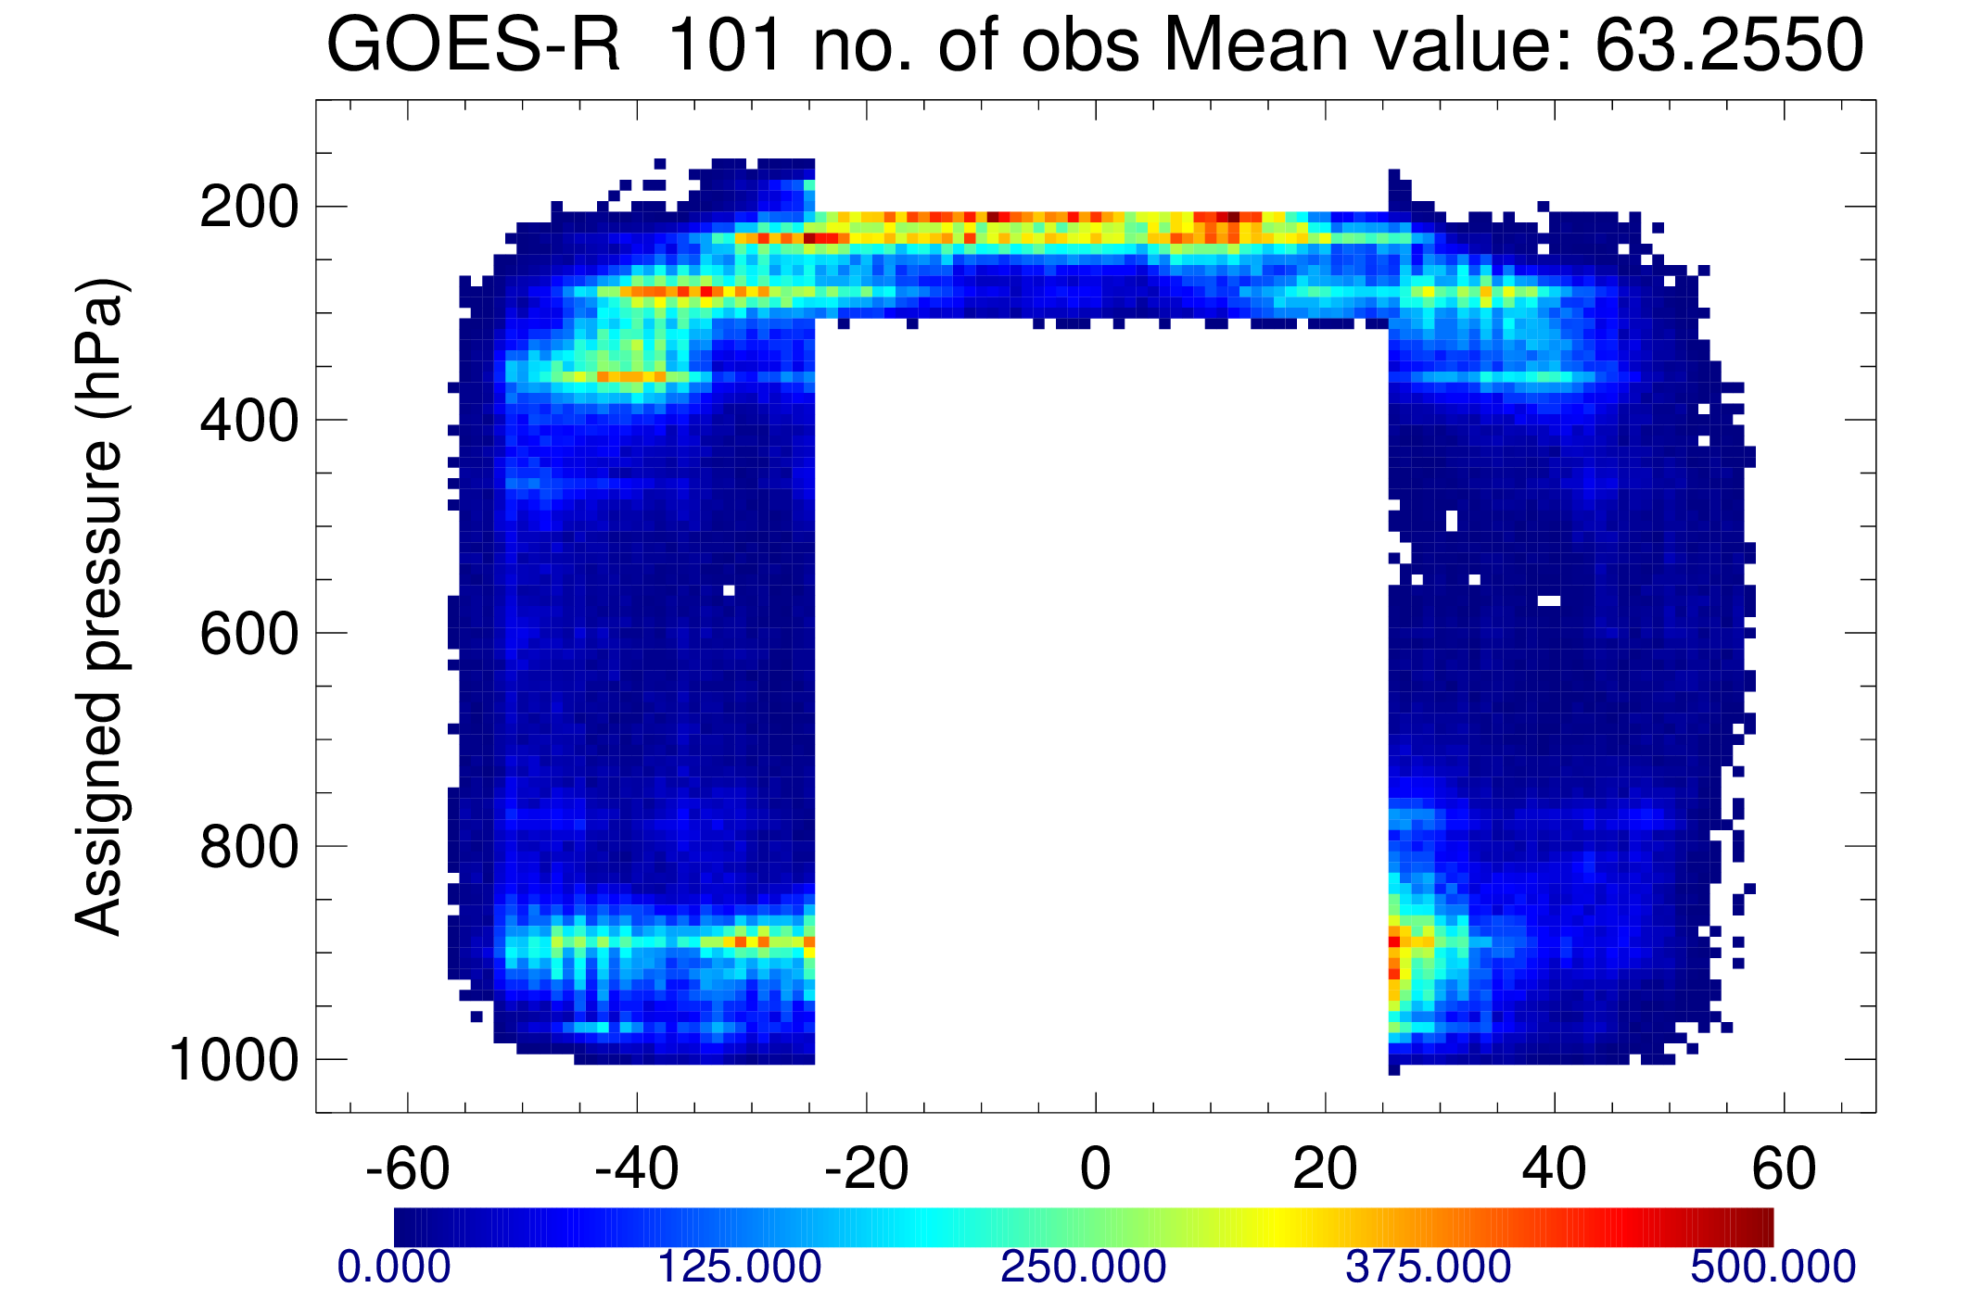
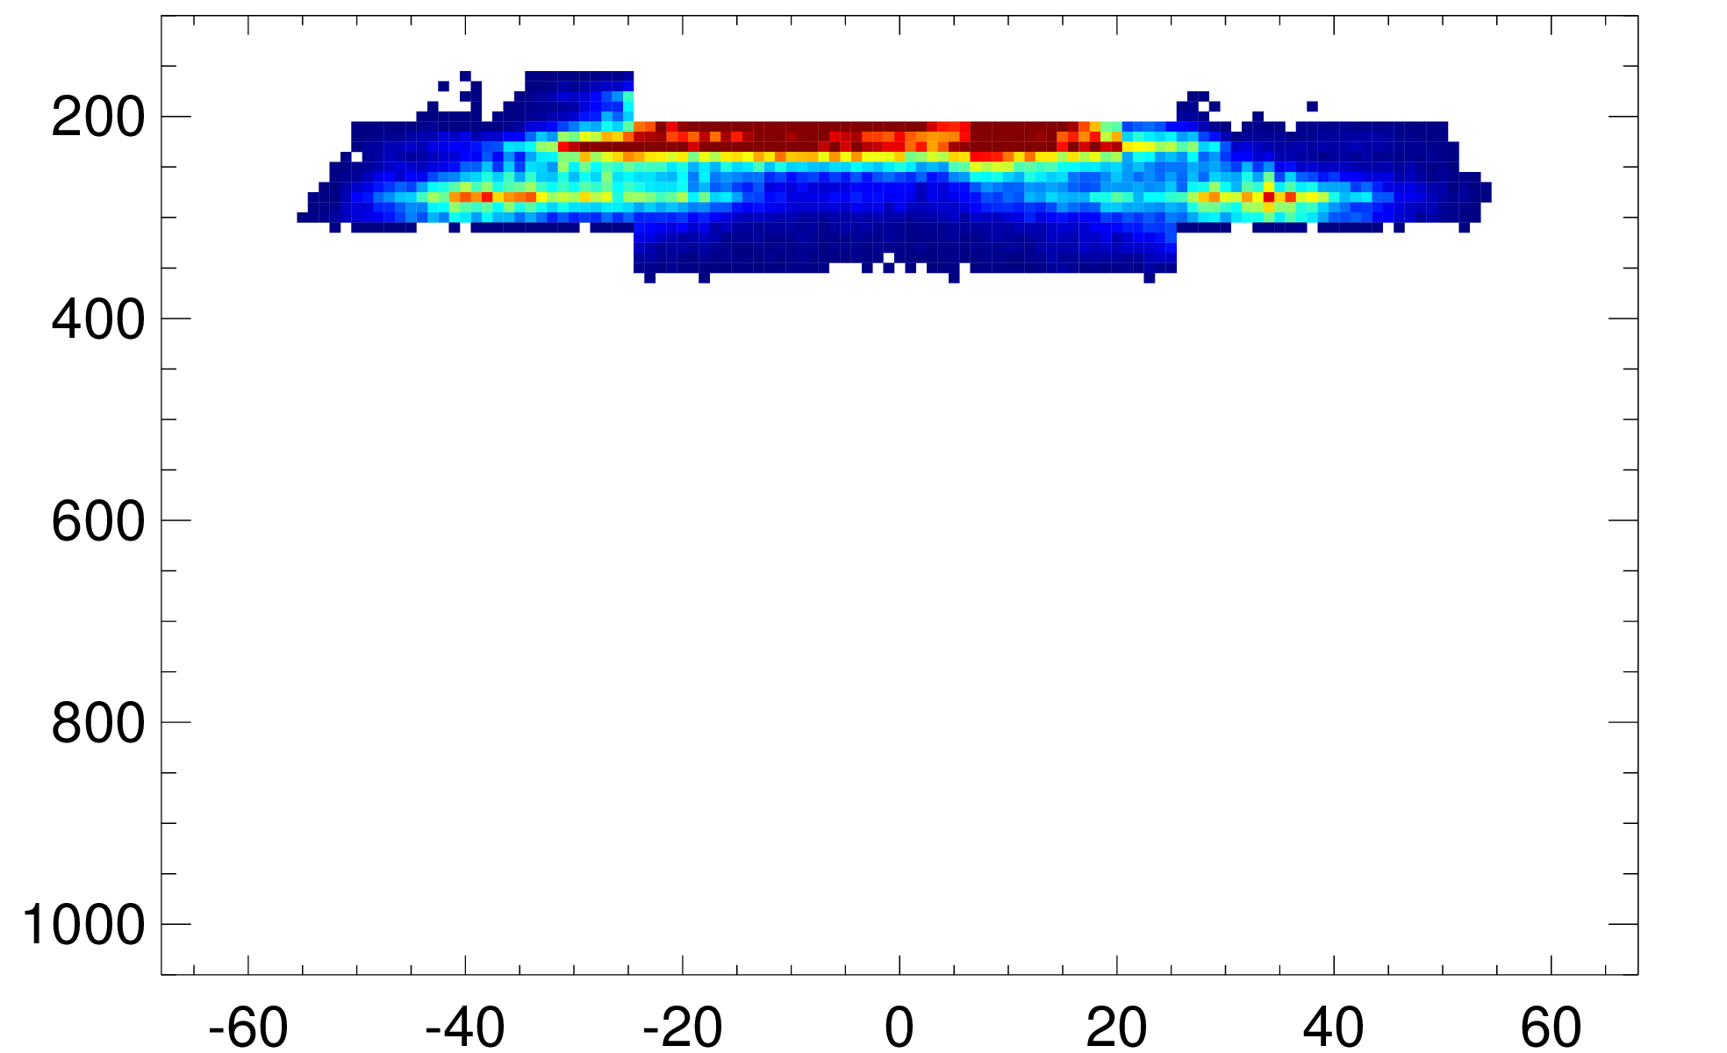
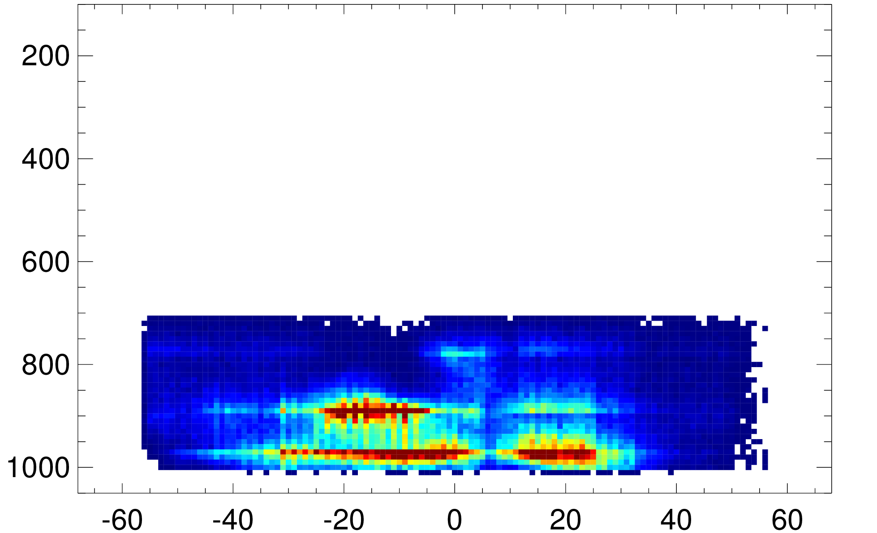
Assimilation experiments: more conservative screening
Tropics traditionally difficult area
For Meteosat/Himawari, screening IR/WV at mid/low levels in tropics necessary
GOES-16 negative impacts at lower pressures (150-200hPa)
Most successful restricted tropics above 200hPa
20th Dec 17 – 2nd Jan 18
No. active global AMVs in tropics
No. active GOES-16 AMVs 20-30th Dec
Vis
IR
WV
No. AMVs
Despite stricter use, still more AMVs in use than GOES-13 except mid levels/above 150hPa

Slide 15
Positive impacts in SH and low levels
Degradation
0.04
Change in vector wind error
0.02
GOES-16 restricted use in tropics vs. control (no GOES-E AMVs)
0.00
Difference in RMS error normalised by RMS error of control
-0.02
Hatching = 95% significance
20th Dec 2017 – 10th Mar 2018
-0.04
Improvement

Slide 16
High levels close to neutral
Only 1 radiosonde (Easter Island) available in area: suggests no issue
Change in vector wind error
Conventional wind
U/V wind, Tropics
Degradation
0.15
T+24, 200hPa
U component
Rejecting upper tropics removes degradation…
0.10
x
0.05
Normalised difference in RMS error
0.00
T+48, 200hPa
Good
Bad
V component
-0.05
Strict tropics
All IR
-0.10
x
Good
Bad
-0.15
…And reduces area affected verified against own analysis
Improvement
20th Dec 2017 – 10th Mar 2018

Slide 17
Small neutral/positive impacts on humidity
Global ATMS
Strict tropics
All IR
Small positive impacts on humidity sensitive channels
Good
Bad
Microwave/infrared sounders show generally neutral or small positive impacts on humidity sensitive channels
20th Dec 2017 – 10th Mar 2018

Slide 18
Activation and reassessment
Conservative screening helps remove degradation areas…
…while retaining positive impacts
From 18th April data monitored
https://www.ecmwf.int/en/forecasts/charts/obstat/?facets=Data%20type,Atmospheric%20Motion%20Vectors
Data ready to be activated
And then…
Change to height assignment algorithm anticipated: re-evaluate after changes applied (data in parallel/ahead of time helpful)
Other ongoing experiments to consider
Inflated observation errors
3 hourly thinning

Slide 19
Summary
More winds and concentrated into upper/lower levels
Changes in speed bias
Mixed results in Met-10/GOES-15 overlap regions
Assimilation experiments show promising areas…
…But suggest stricter screening for tropics necessary
Activation planned soon
Further assessment esp. after algorithm change required

Slide 20
Thank you for listening!

