Slide 1
Studying AMV Errors With The NWP SAF Monitoring Web Site
Francis Warrick, James Cotton

Slide 2
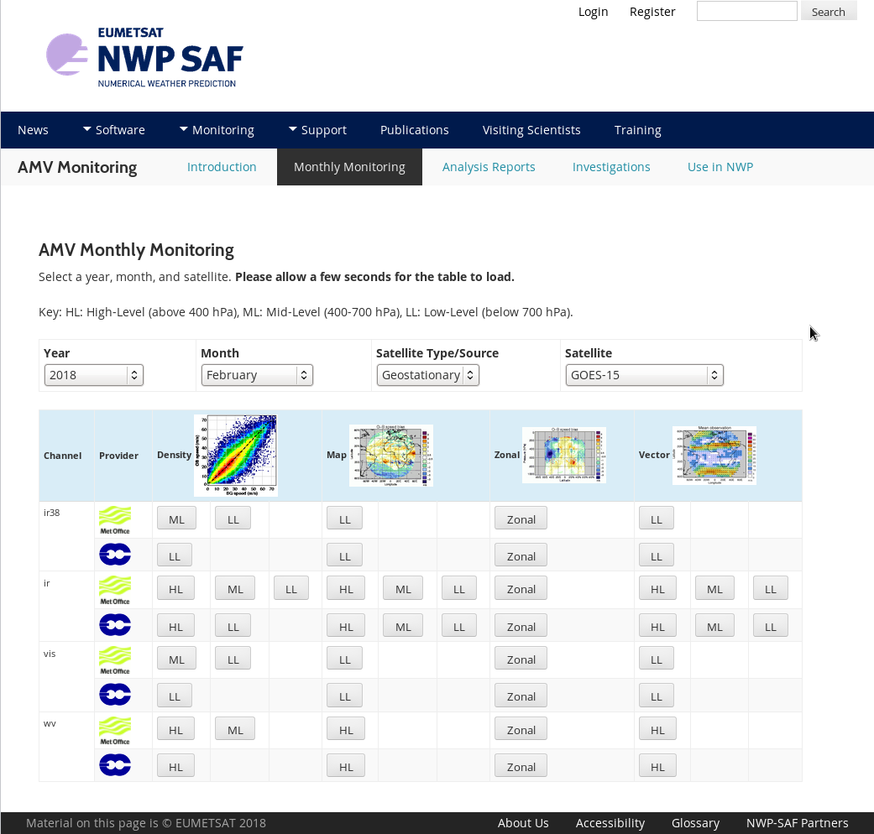
NWP SAF AMV Monitoring
nwpsaf.eu -> Monitoring -> Winds Quality Evaluation -> AMVs
AMV usage by NWP centre
Monthly monitoring plots versus Met Office and ECMWF models
Analysis reports every two years
One-off investigations

Slide 3
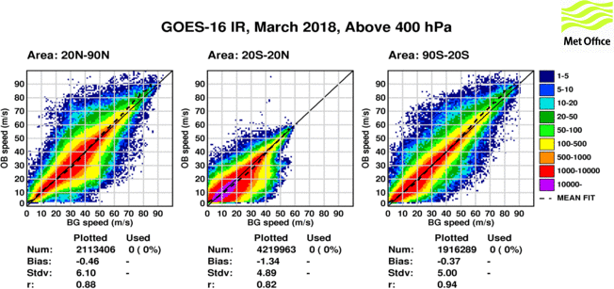
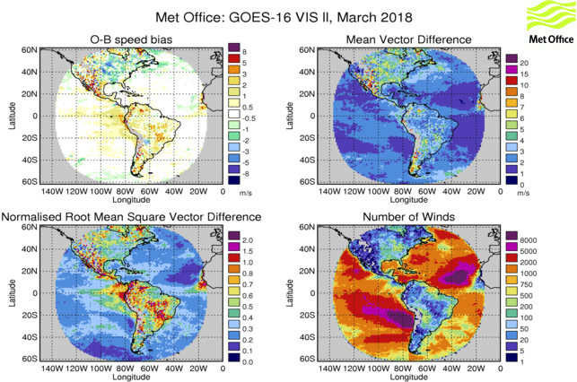
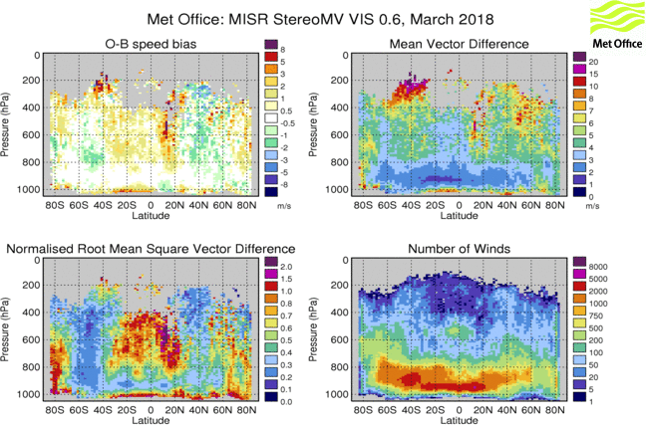
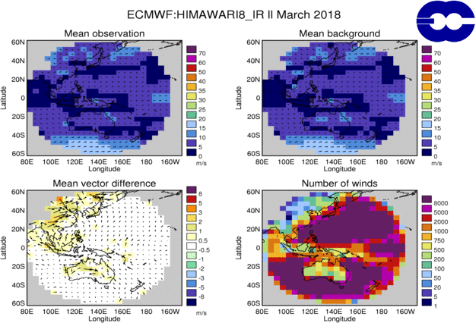
Speed Histograms
Maps
Maps with Wind Vectors
Zonal Plots

Slide 4
Jet Region Negative Speed Bias
High–Level (heights above 400 hPa)
Feature 2.10

Slide 5
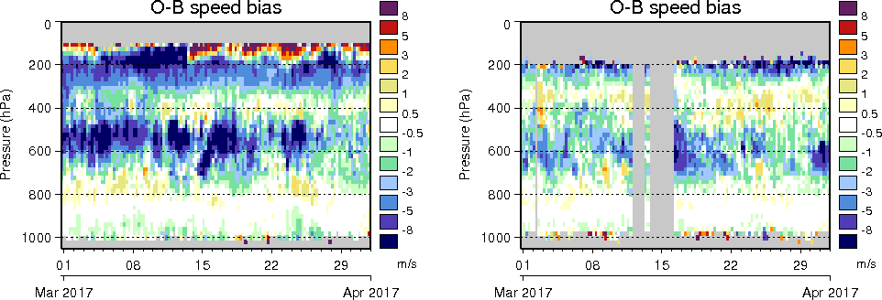
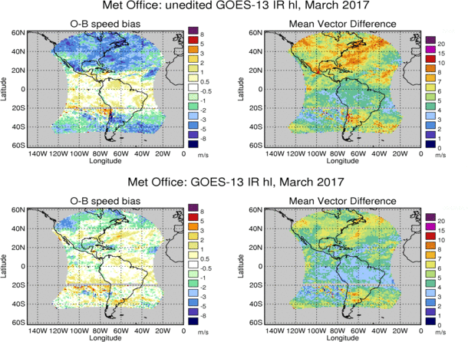
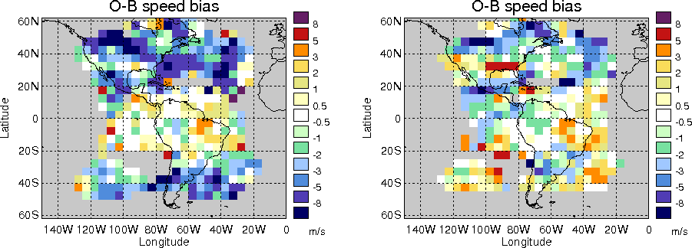
Heritage Algorithm
(Un-edited)
Heritage Algorithm
(Un-edited)
Nested Tracking
Nested Tracking

Slide 6
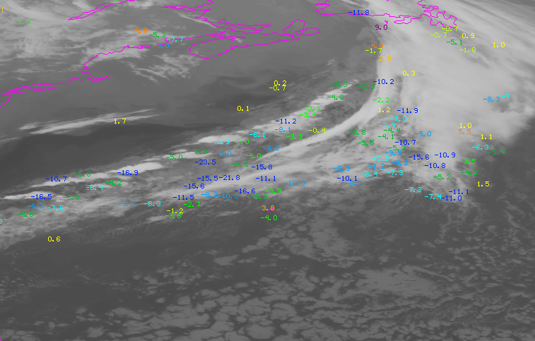
O-B Speed Differences
Heritage Algorithm
(Un-edited)
9th March 2017
0545 UTC
GOES-13 IR

Slide 7
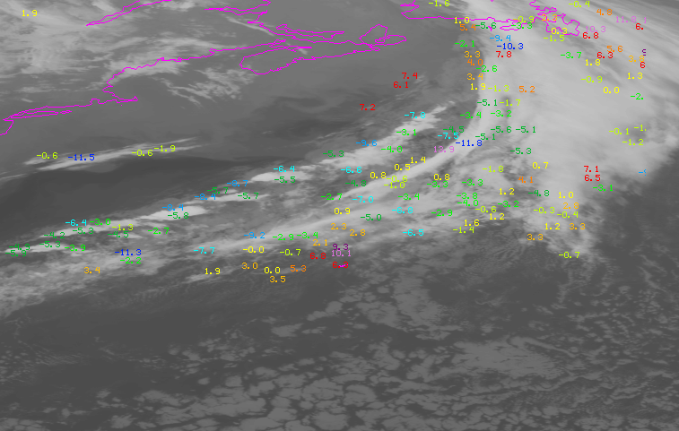
O-B Speed Differences
Nested Tracking
9th March 2017
0545 UTC
GOES-13 IR

Slide 8
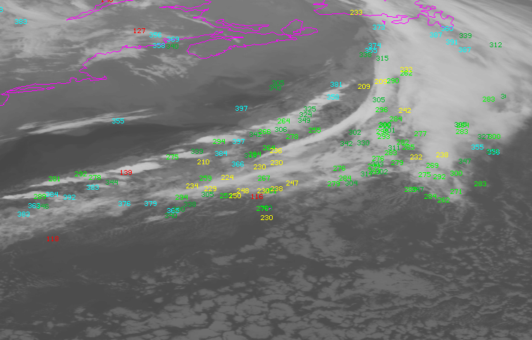
Heritage Algorithm
(Un-edited)
9th March 2017
0545 UTC
GOES-13 IR

Slide 9
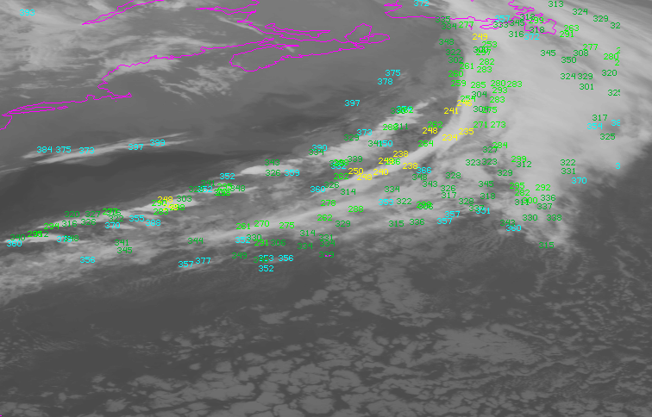
Nested Tracking
9th March 2017
0545 UTC
GOES-13 IR

Slide 10
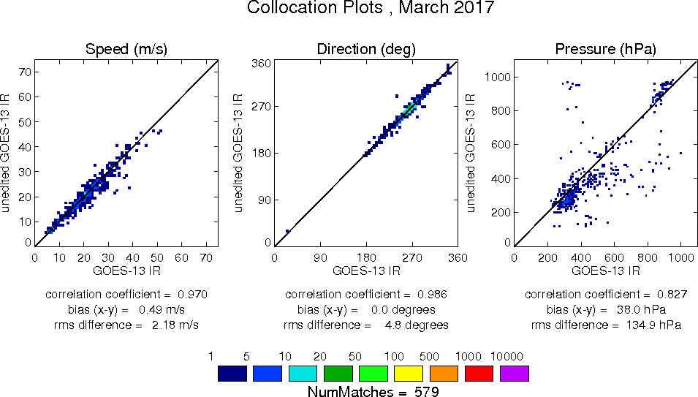
Co-located within 10km, 10 minutes.
9th March 2017 06Z cycle

Slide 11
Positive Speed Bias in Tropics
High–Level (heights above 400 hPa)
Feature 2.13

Slide 12
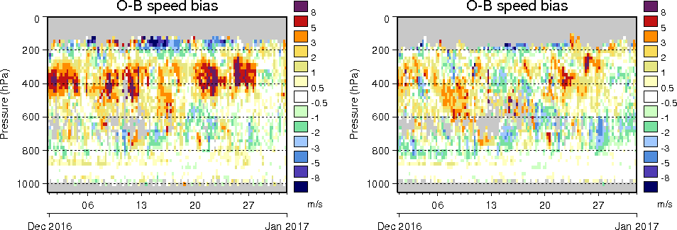
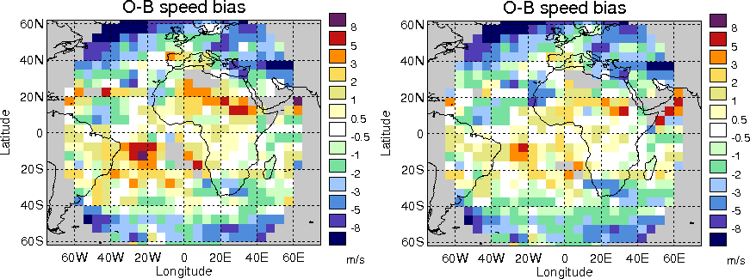
Operational Heights (CLA)
OCA
Infra-red 10.8 micron
December 2016
Data over South Atlantic
Heights above 400 hPa
24th-27th December

Slide 13
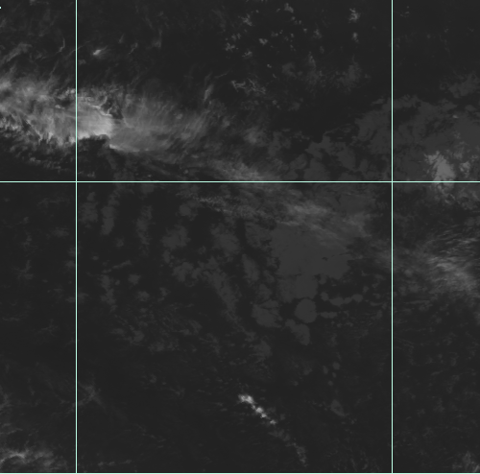
Meteosat-10 IR 10.8
26th December 2016
1500-2100 UTC (18Z cycle)

Slide 14
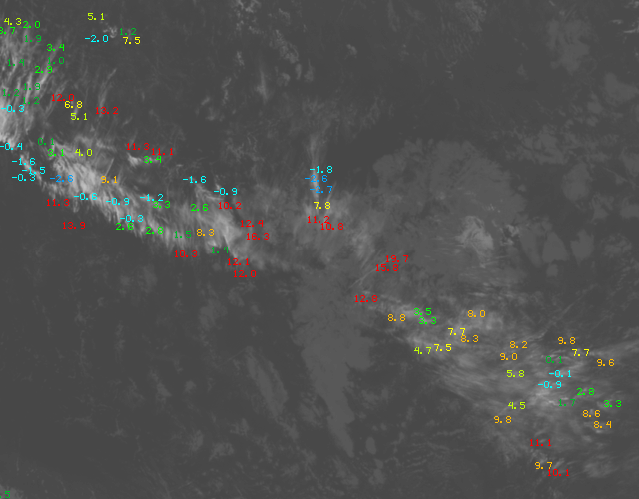
Operational Heights (CLA)
Meteosat-10 infra-red 10.8 micron
1815 UTC
26/12/2016

Slide 15
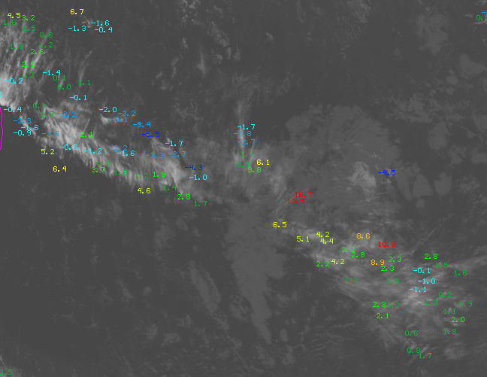
OCA
Meteosat-10 infra-red 10.8 micron
1815 UTC
26/12/2016

Slide 16
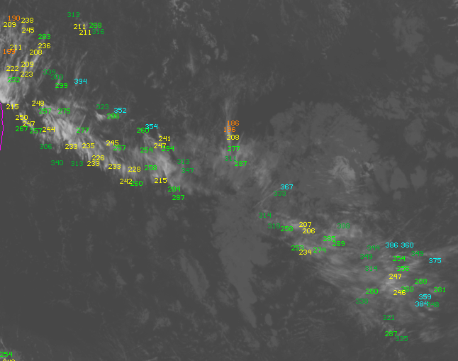
Operational Heights (CLA)
Meteosat-10 infra-red 10.8 micron
1815 UTC
26/12/2016

Slide 17
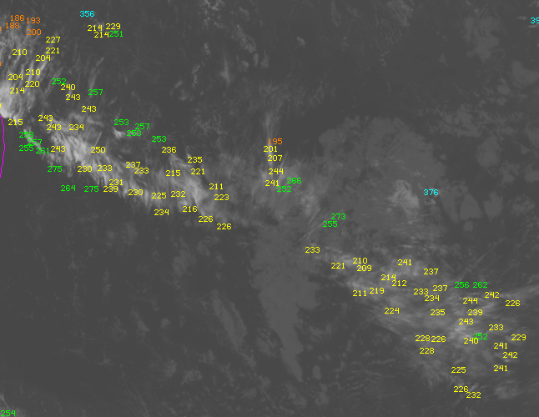
OCA
Meteosat-10 infra-red 10.8 micron
1815 UTC
26/12/2016

Slide 18
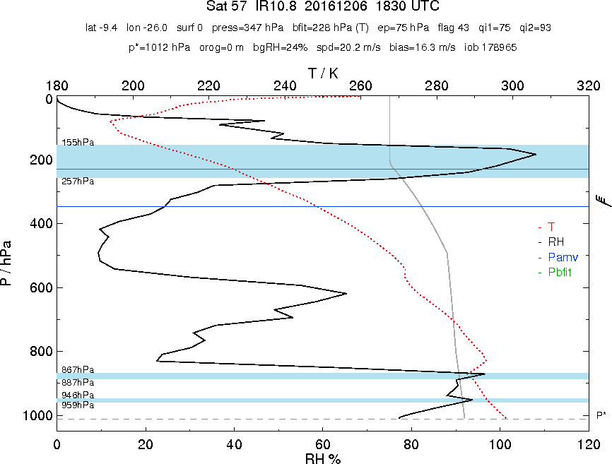
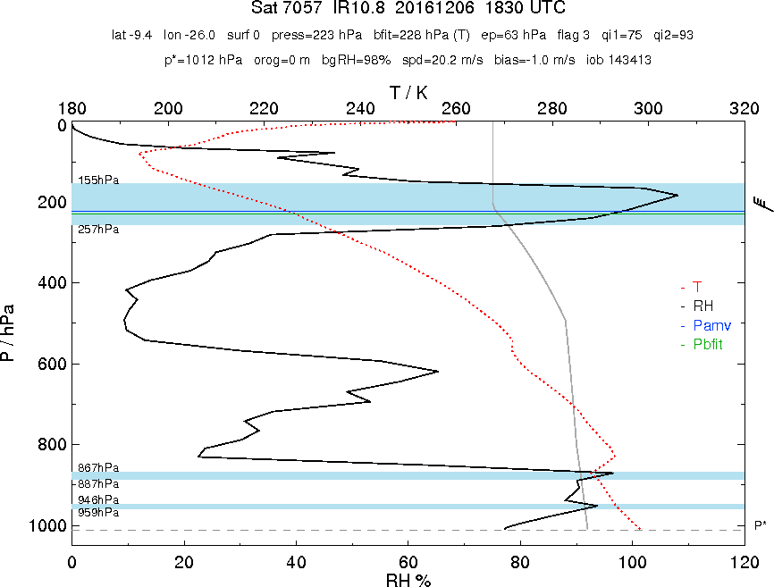
Operational Heights (CLA)
OCA

Slide 19
MSG Positive Bias over North Africa
Low–Level (heights below 700 hPa)
Feature 2.6

Slide 20
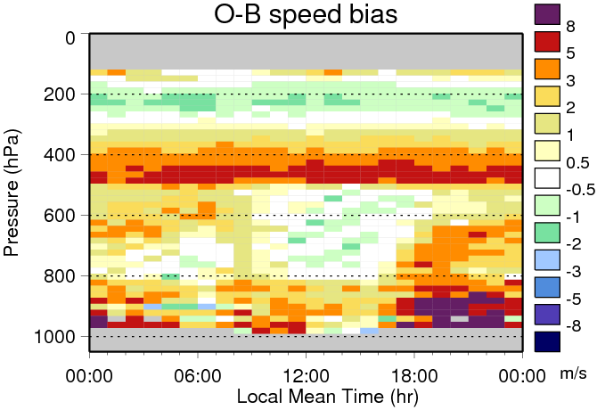
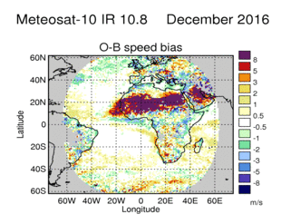
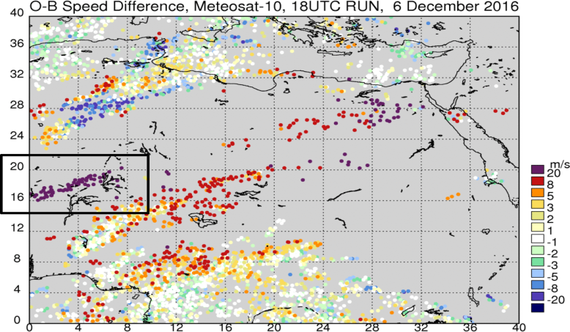
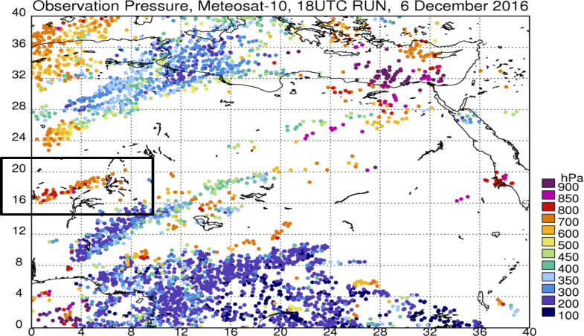
Below 700 hPa
Seen in MSG visible and infra-red over desert
Worse in winter (position of jet)
Linked with cirrus & semi-transparent cloud
Meteosat-10 IR 10.8
Sahara
December 2016

Slide 21
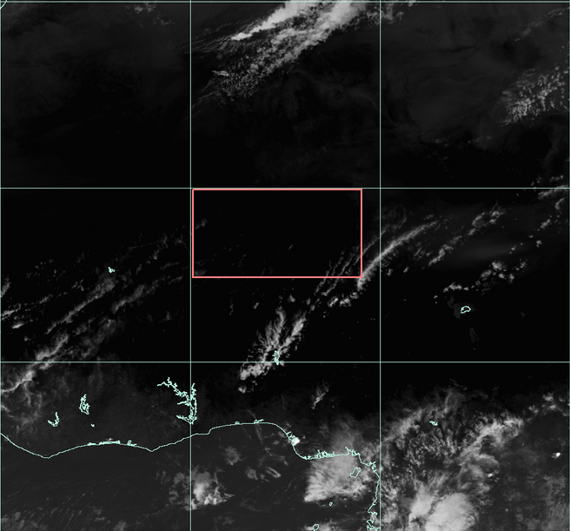
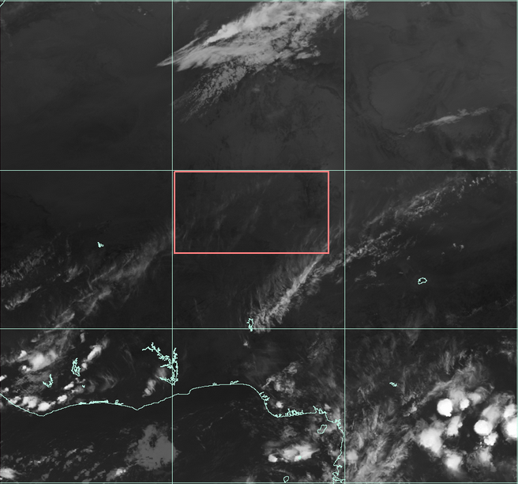
Why is this feature only present in the 18Z cycle, and not the 00, 06 and 12Z cycles?
Faint cloud is moving north-east ward

Slide 22
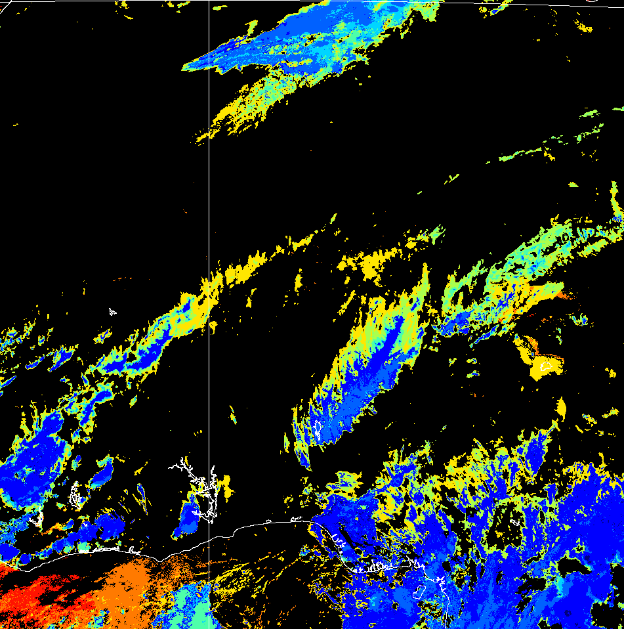
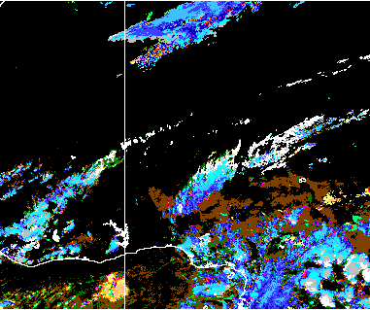
OCA
Met Office Cloud Product

Slide 23
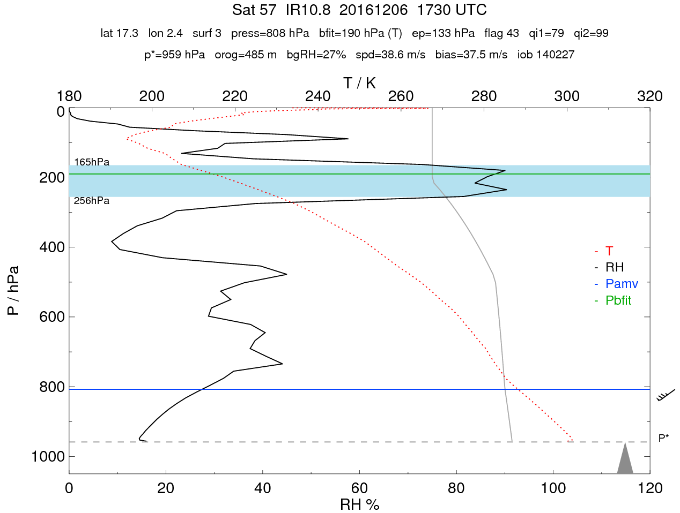

Slide 24
Meteosat-8 (IODC) Positive Speed Difference in the Tropics
Low–Level (heights below 700 hPa)
Feature 8.1

Slide 25
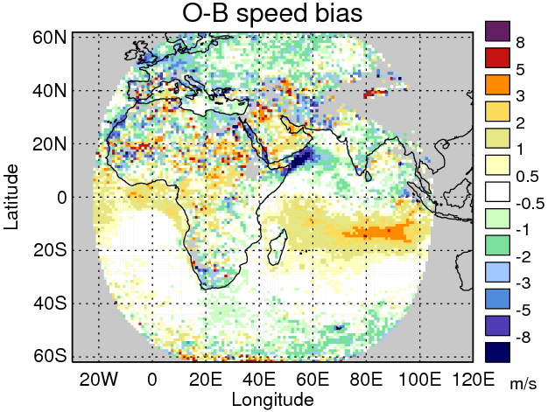
Meteosat-8, visible 0.8 micron channel, August 2017
Feature Background:
Peaks June-August
AMV minus best-fit pressure averages -100 hPa, suggesting AMVs assigned too high

Slide 26
AMV profile versus model
Lack wind shear ~800-950 hPa
(also seen versus ECMWF model)

Slide 27
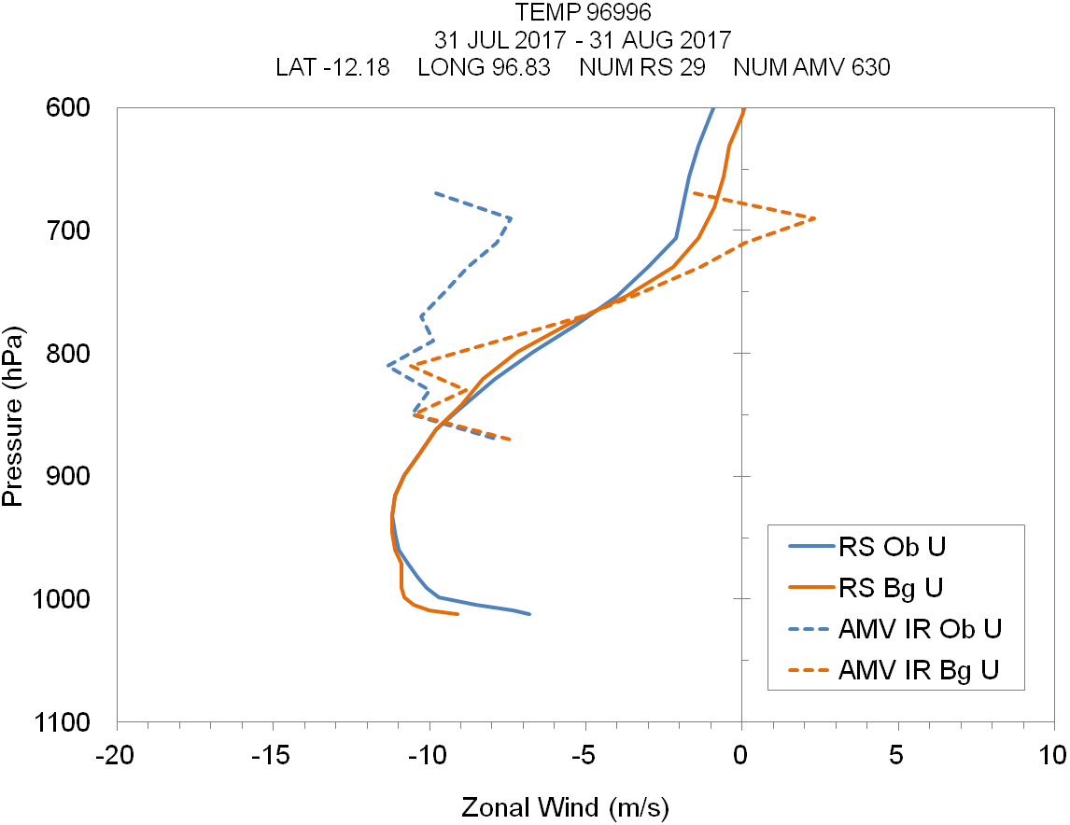
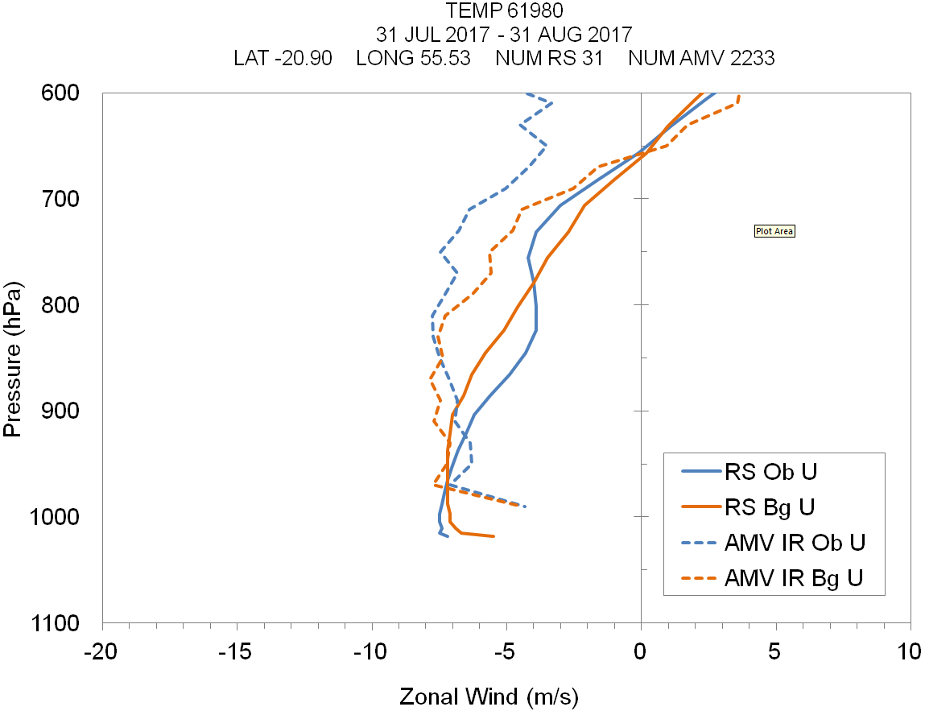
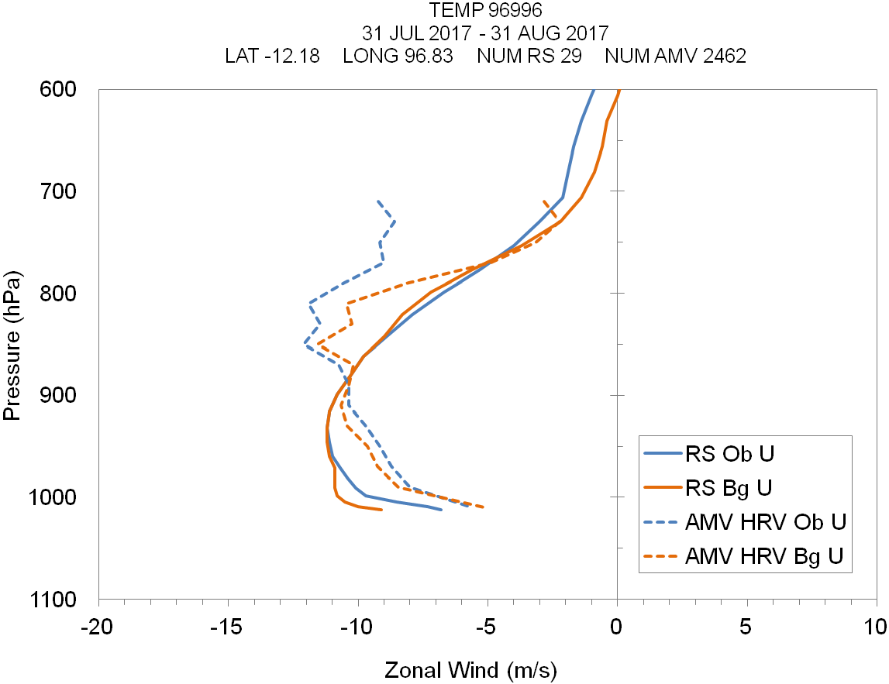
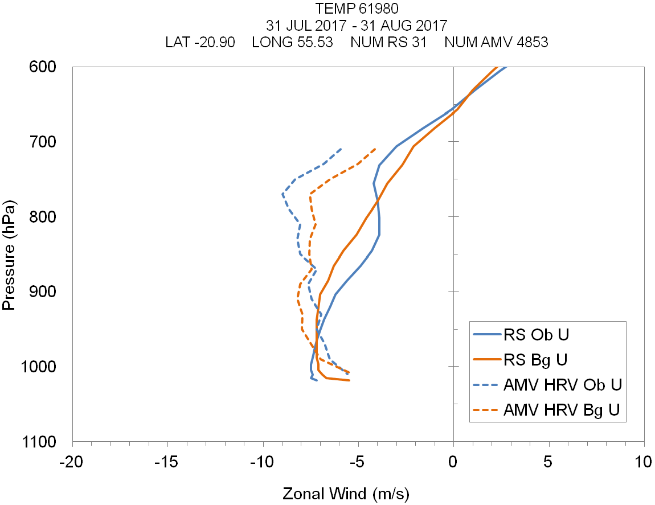
Cocos Islands
Saint Denis, Reunion
AMV profile versus sondes
Only 2 sites available in region of interest…
Saint Denis: background profiles do not match
Cocos Islands: lack of AMV wind shear 700-850 hPa

Slide 28
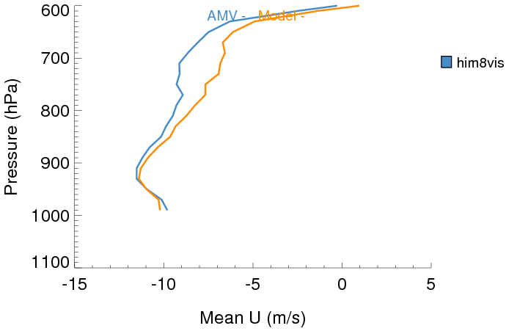
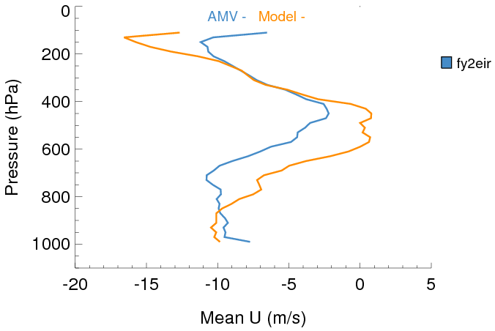
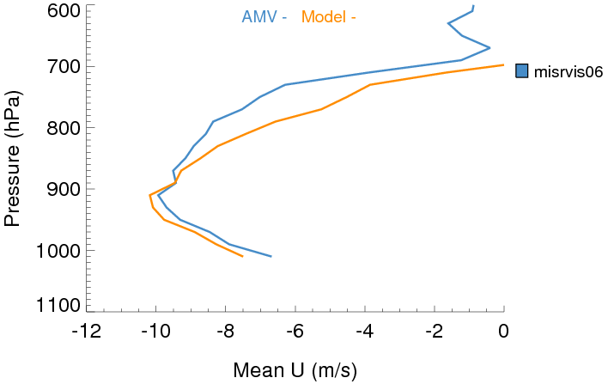
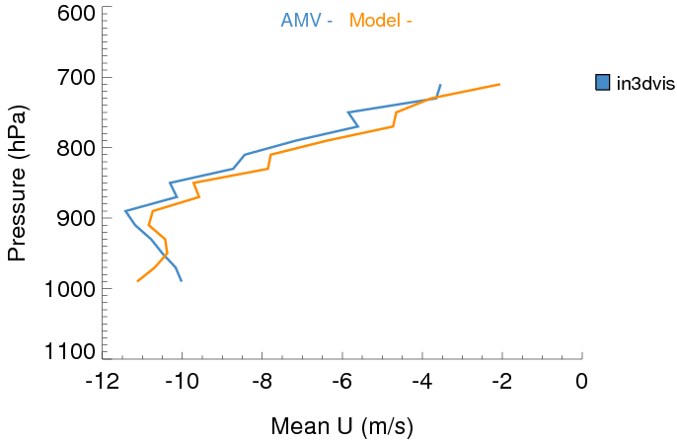
Other AMVs versus Met Office model

Slide 29
Any questions?

