Slide 1
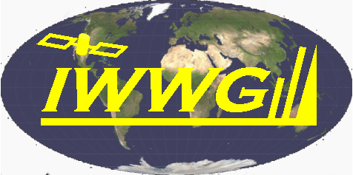
Polar Winds – A Tale of Two Algorithms
Jeff Key*, Rich Dworak⁺, Dave Santek⁺, and Steve Wanzong⁺
*NOAA/National Environmental Satellite, Data, and Information Service, Madison, WI
+ Cooperative Institute for Meteorological Satellite Studies, University of Wisconsin-Madison
14th International Winds Workshop, Jeju City, South Korea, 23-27 April 2018

Slide 2
Nested Tracking versus WINDCO
MODIS winds were used to evaluate the relative accuracies of the VIIRS winds algorithm (“nested tracking”) and the heritage algorithm (“windco”). MODIS winds were used because both algorithms are not implemented for VIIRS. This was the most robust comparison to date. Winds from both algorithms are compared to radiosonde winds.
It was found that the VIIRS algorithm has a significantly lower vector root-mean-square-error (RMSE): 6.05 m/s for nested tracking vs 7.26 m/s for windco with Aqua data. The difference for Terra was somewhat smaller.
The largest increase in accuracy for nested tracking is for high-level winds.
Some differences in vertical distributions and speeds were noted.

Slide 3
Nested Tracking versus WINDCO: Statistics
QI>60
Statistics for 2017-2018, Northern Hemisphere, IR winds
Aqua | Count | Accur. | Prec. | Speed Bias | Speed RMSE
NT | 1158 | 4.99 | 3.41 | -0.21 | 4.32
Windco | 1158 | 5.86 | 4.29 | -0.02 | 4.85
Terra | Count | Accur. | Prec. | Speed Bias | Speed RMSE
NT | 2281 | 4.97 | 3.64 | -0.18 | 3.96
Windco | 2281 | 5.38 | 4.01 | -0.56 | 3.99

Slide 4
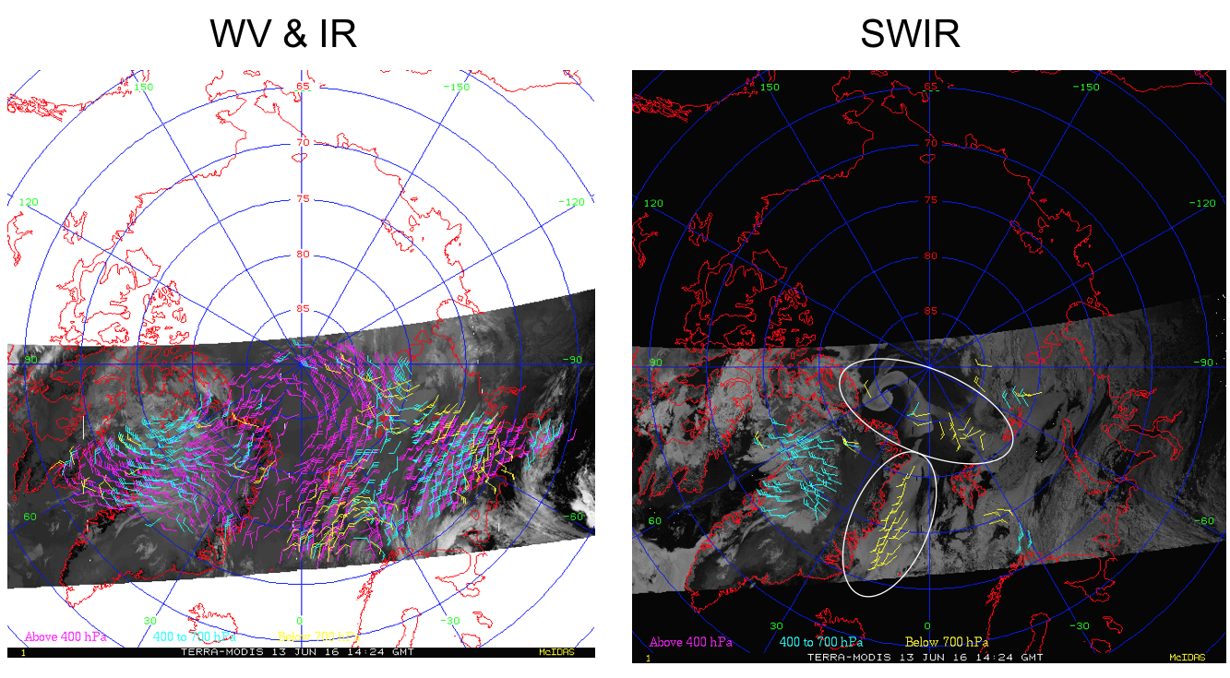
Polar Winds from a SWIR Band: New Statistics

Slide 5
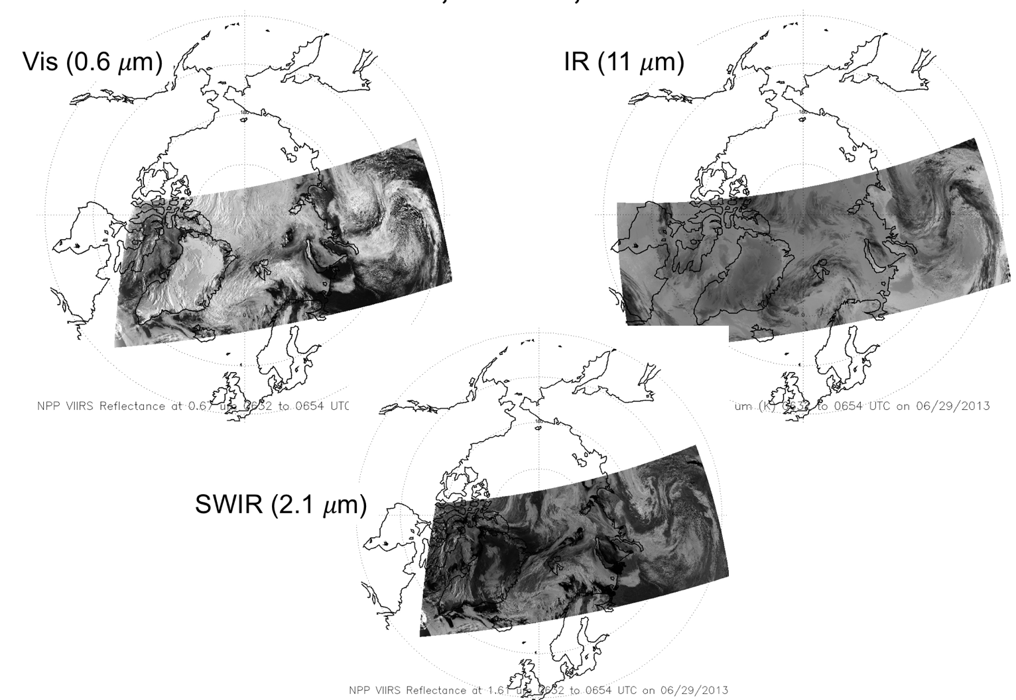
MODIS Visible, SWIR, and IR: Arctic
Imager bands at 1.6 and 2.1 𝜇m are best termed “shortwave infrared” (SWIR).

Slide 6
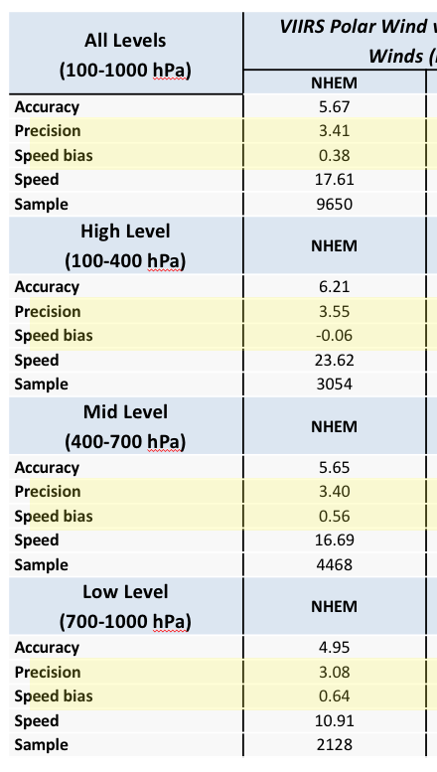
Comparison to Raobs
MODIS Aqua and Terra SWIR, Arctic only
VIIRS IR, Sep 2013 - Jan 2014
Aqua | Count | Accur. | Prec. | Speed Bias | Speed RMSE
HIGH | 759 | 5.62 | 3.13 | -0.35 | 4.48
MID | 4042 | 4.80 | 3.21 | -0.85 | 3.80
LOW | 647 | 4.62 | 3.26 | -0.56 | 3.37
TOTAL | 5488 | 4.90 | 3.22 | -0.75 | 3.85
Terra | Count | Accur. | Prec. | Speed Bias | Speed RMSE
HIGH | 833 | 5.67 | 3.63 | -0.47 | 4.32
MID | 2631 | 4.65 | 3.02 | -0.78 | 3.73
LOW | 670 | 4.17 | 2.40 | -0.48 | 3.23
TOTAL | 4134 | 4.77 | 3.10 | -0.67 | 3.78
Notes:
Definitions:
Accuracy: Mean vector difference (shown as “Vector Diff” for SWIR winds in tables)
Precision: Standard deviation around the mean vector difference. It is not the same as the RMSE, but is related.
VIIRS winds requirements – Accuracy: 7.5 m/s; precision: 3.8 m/s

Slide 7
MODIS SWIR vs IR
MODIS Aqua and Terra SWIR, Arctic only, Apr-Sep 2017 Collocated vectors within 10 km
 | Count | SWIR Vector RMSE | IR Vector RMSE | SWIR Mean Pressure | IR Mean Pressure
Aqua | 645 | 6.02 | 6.26 | 535.91 | 526.71
Terra | 838 | 5.87 | 6.08 | 532.52 | 519.09
Notes:
Definitions:
Accuracy: Mean vector difference (shown as “Vector Diff” for SWIR winds in tables)
Precision: Standard deviation around the mean vector difference. It is not the same as the RMSE, but is related.
VIIRS winds requirements – Accuracy: 7.5 m/s; precision: 3.8 m/s

Slide 8
Feature-tracked 3D winds from Hyperspectral IR Sounder
David Santek¹, Derek Posselt², Will McCarty³
¹Space Science and Engineering Center/University of Wisconsin – Madison
²NASA JPL
³NASA Global Modeling and Assimilation Office

Slide 9
Why 3D Winds?
Importance of global 3D winds in weather predictability
Fill in data void regions, most notably over oceanic, tropical, and polar regions.
This lack of data, especially wind information, is “the number-one unmet measurement objective for improving weather forecasts.” (NRC 2007).
Decadal Survey recommended a 3D tropospheric wind mission, using a space-based LIDAR instrument and/or the use of hyperspectral infrared measurements.

Slide 10
What are 3D Winds?
Create images of horizontal fields of humidity and ozone, derived from retrievals using AIRS, CrIS, IASI
Track humidity and ozone features over time
Advantages:
3D wind distribution
Implicit AMV height
Clear sky and above cloud
Current disadvantages:
Low spatial resolution (13.5 km)
Narrower swath

Slide 11
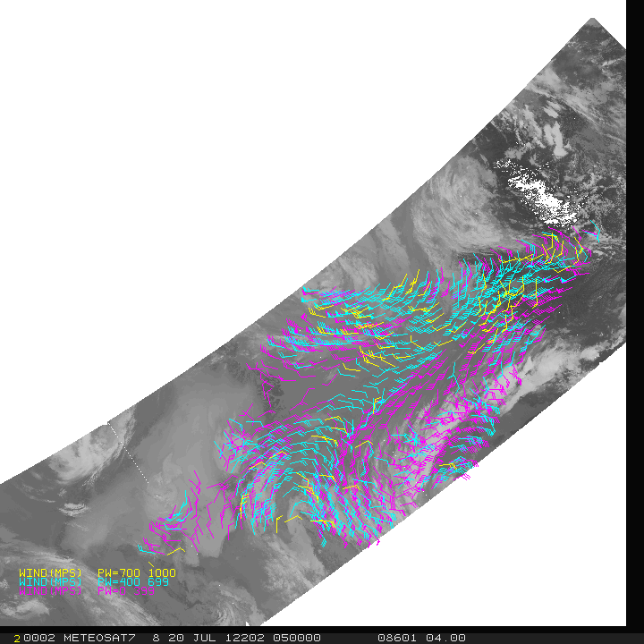
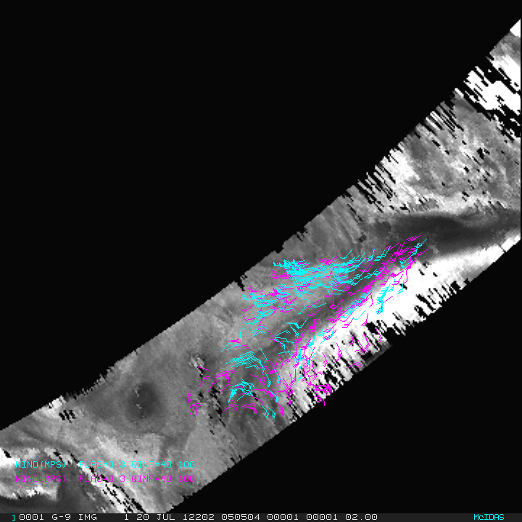
Aqua MODIS AMVs AIRS Retrieval AMVs at All Levels
AIRS 20 July 2012 0505 UTC
Ozone: 103 to 201 hPa Moisture: 359 to 616 hPa
MODIS 20 July 2012 0551 UTC
Infrared and Water Vapor (including clear sky)

Slide 12
New NASA Project
NASA ROSES 2017 A.37: The Science of Terra, Aqua, and Suomi NPP
Proposal selected: Assimilation of 3D Atmospheric Motion Vectors to Improve Subseasonal Numerical Weather Forecasts
PI: D. Santek Co-I: D. Posselt (JPL), W. McCarty (NASA/GMAO)
Previous work only used AIRS; this extends to CrIS and IASI and improvements to algorithm (SSEC)
Better quantify winds uncertainty (JPL)
Evaluate impact in longer range forecasts, on the order of 2 weeks (GMAO)

Slide 13
ICWG Cloud Height Topical Group Activity
Phil Watts (EUMETSAT), Andy Heidinger (NOAA)
Standardization of uncertainty reporting.
Overlap cloud detection methods. Comparison of external and internal methods and use switch between them. EUMETSAT issues resolved.
Planetary Boundary Layer Height Assignment, especially related to AMVs.
Vertical Homogeneity: methods and impact on height retrievals
Optimal cloud microphysical assumptions and their impact
Cloud base estimation. NOAA implemented a cloud base retrieval and other methods exist to infer geometrical extent. Is this of use for AMVs?
EUMETSAT close to Himawari-8/GOES-16 support.

Slide 14
ICWG Cloud Height Intercomparison Plans
Phil Watts (EUMETSAT), Andy Heidinger (NOAA)
Intercomparison Data
July 20 - 21, 2016 JMA HIMAWARI 8 (primary and aligns with IWWG)
August 19, 2015 JMA HIMAWARI 8 (ICWG-1)
June 13, 2008 EUMETSAT MSG (CREW)
NOAA SNPP VIIRS (optional and date to be determined)
NOAA GOES-16 (optional and date to be determined)
Intercomparison Plans
Standard “CREW” analysis will be applied to cloud heights, temperatures and pressures. This includes provider to provider scatterplots, Taylor Plots relative to CALIPSO and individual CALIPSO cross-sections (with AVACS). Providers expected to be CMA, EUMETSAT, JMA, KMA, NOAA, NASA and others
Cloud Height Topical Group will add some IWWG specific analysis
Level of Best Fit from NWP Background and RAOB co-locations
Uncertainty Comparisons (for those that provide this)

Slide 15
Funded JPSS Risk Reduction
Tandem S-NPP/NOAA-20 AMVs
Key, Santek, Daniels, Collard, Borde, Nebuda, Zhang, Dworak
Merging NUCAPS and VIIRS
Heidinger, Wanzong, Nebuda, Quinn, Bearson, Key, Smith
Daniels, Bresky, Bailey
Extending VIIRS spectral coverage
Weisz, Borbas, Menzel, Baum, Moeller, Frey, Wanzong, Goldberg, Santek
Daniels, Bresky, Bailey

Slide 16
Development and Impact of Global Winds from Tandem S-NPP and NOAA 20 VIIRS

Slide 17
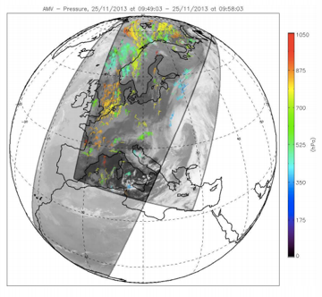
Tandem wind example from Metop-A/B AVHRR.
S-NPP and NOAA-20 (formerly JPSS-1) are ½ orbit apart. There is opportunity to track global winds using tandem VIIRS 50 minutes apart.
Notes:
Jeff had hoped to present this at IWW14, but the processing Framework simply wasn’t ready in time.

Slide 18
Merging NUCAPS with the VIIRS Enterprise Cloud Algorithms for Improved Polar Cloud Detection, Cloud Heights and Polar Winds.

Slide 19
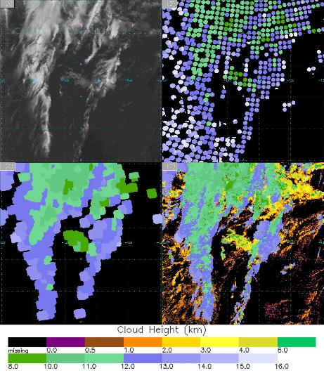
An example region within a granule observed between 2213 and 2221 UTC on 20 Aug 2015 shows (a) 11 𝝁 m brightness temperature (b) sounder height at original resolution (c) smoothed sounder height
background (d) final retrieved cloud height for both water and ice phases. Smoothing is applied to sounder
field of views with cloud pressure less than 440 hPa only in (c). Water cloud retrievals in (d) are not impacted
by sounder. The color bar at the bottom applies to all of the cloud height images.
Notes:
NOAA Unique Combined Processing System (NUCAPS).
Provides cloud fraction and cloud-top pressure at 50 km.
The Bayesian cloud mask and OI cloud height approaches can use prior information. In this case we can use NUCAPS.
Use the spectral resolution of NUCAPS with the horizontal resolution of VIIRS.

Slide 20
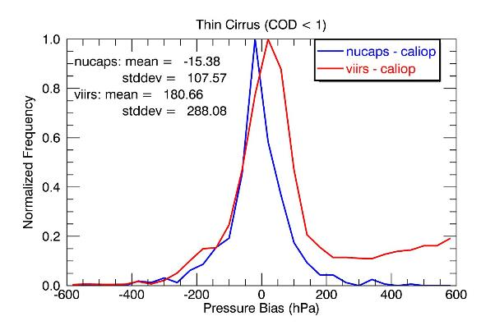
Bias of thin cirrus cloud top pressure from NUCAPS and VIIRS relative to CALIPSO/CALIOP, based on
one day of SNPP/CALIPSO matchups on 20 June 2017. CALIPSO/CALIOP cloud phase and optical depth data
are applied for used to select thin cirrus.
Heidinger, A. K, Y. Li, , S. Wanzong and R. Holz, 2018: Using Sounder Data to Improve Cirrus
Cloud Height Estimation from Satellite Imagers. under review at JTECH .

Slide 21
Concept Study to Extend VIIRS Spectral Coverage Using CrIS Radiance Measurements and to Explore Potential Applications

Slide 22
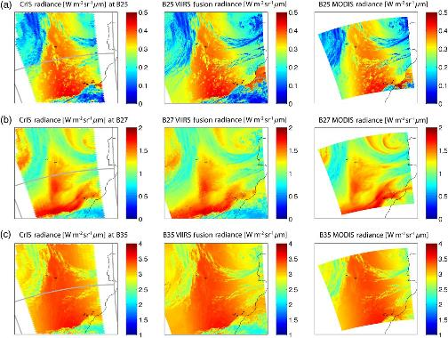
Convolved CrIS radiances (left), newly constructed VIIRS fusion radiances (middle), and
the observed MODIS radiances (right) for the same geographical region for MODIS bands 25, 27,
and 35 in (a–c), respectively. VIIRS granule outlines are shown in gray in the left column.
Weisz, E., B. Baum and W. P. Menzel (2017): Fusion of satellite-based imager and sounder data to construct supplementary high spatial resolution narrowband IR radiances, J. of Applied Remote Sensing, Volume 11, Issue 3, 2017.
Notes:
Use CrIS at 14 km resolution to construct missing IR absorption bands at the high spatial resolution of VIIRS.
Use a k-d tree algorithm on 11/12 um. Sounder radiances are convolved using desired SRFs. MODIS 25 (4.5 [CO2]), 27 (6.7 [H2O]) and 35 (13.9 [CO2]).
Fusion based H2O bands for Polar AMVs.

Slide 23
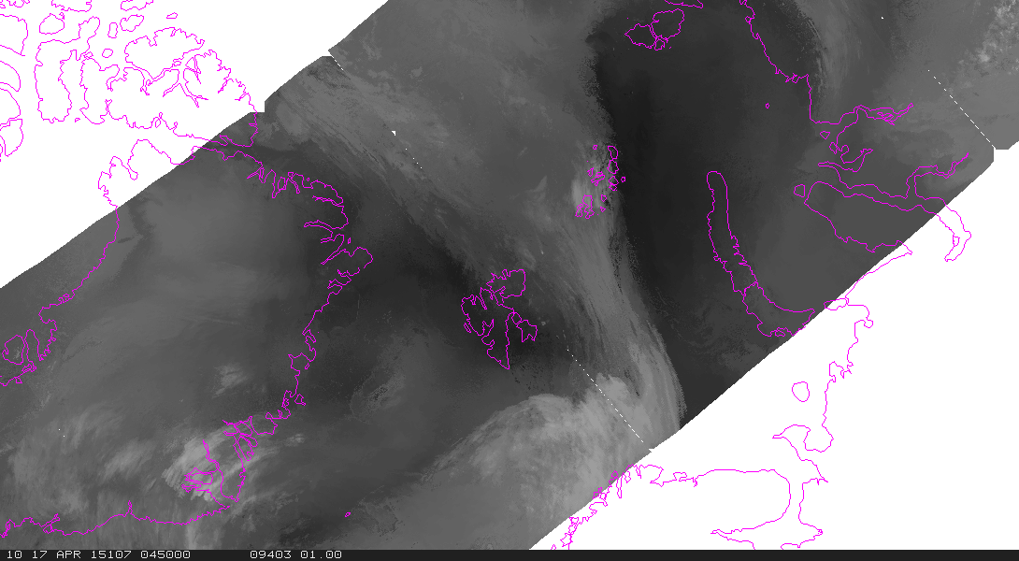
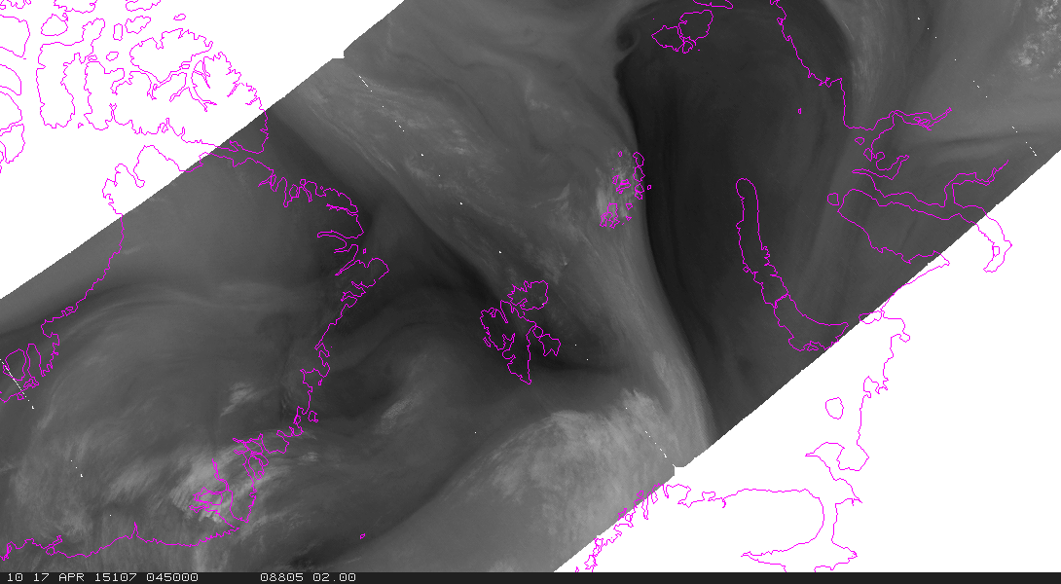
Fusion
Original
MODIS

