Slide 1
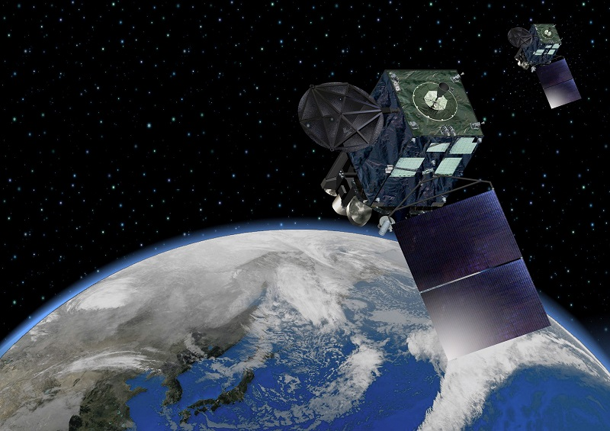
Reprocessing of Atmospheric Motion Vector for JRA-3Q at JMA/MSC
Miki ABE
Meteorological Satellite Center (MSC)
Japan Meteorological Agency (JMA)
25 April, 2018
INTERNATIONAL WINDS WORKSHOP 14 (IWW14)
@Jeju City, South Korea

Slide 2
CONTENTS
Importance of long-term reanalysis
Overview of JRA-3Q ( The Japanese 75-years Reanalysis )
AMV Reprocessing for JRA-3Q
Current status and future plan
Summary

Slide 3
Importance of long-term reanalysis
The climate research and seasonal forecasts demand for the re-analysis for quantitative assessment of past and current climate conditions to analyse extreme weather and climate monitoring.
Long-term high-quality dataset with homogeneity in time and space
is essential.
AMV derivation algorithm
improve
The operational Data Assimilation (DA) system
improve
Reprocess with
the latest and consistent DA system and algorithm
Get for long-term high-quality dataset with homogeneity
Past analysis dataset
Current analysis dataset
The difference in the quality of analysis
creates a lack of long-term data homogeneity

Slide 4
Importance of long-term reanalysis
The climate research and seasonal forecasts demand for the re-analysis for quantitative assessment of past and current climate conditions to analyse extreme weather and climate monitoring.
Long-term high-quality dataset with homogeneity in time and space
is essential.
High-quality reprocessed satellite data (AMV)
are assimilated
The latest DA system
is used consistently
Reprocess with
the latest and consistent DA system and algorithm
Get for long-term high-quality dataset with homogeneity
Higher-quality and more homogeneous climate dataset covering the last several decades.
As many observations as possible

Slide 5
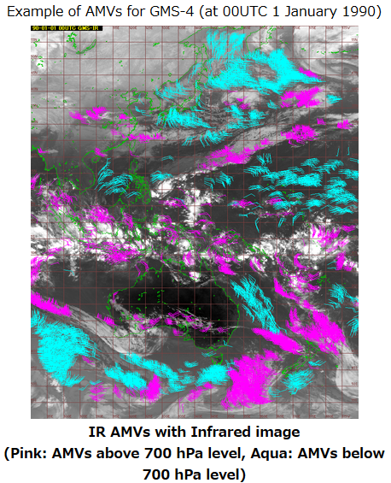
Overview of JRA-3Q ( The Japanese 75-years Reanalysis )
JMA have the long-term re-analysis projects:
JRA-XX : The Japanese XX-years Reanalysis
JRA-25 ( 1979 – 2004 )
JRA-55 ( 1958 – 2016 )
JRA-3Q ( 1948 ( planned ) ) <= Next Project
Three Quarters of a century ( 75 years ) -> 3Q
* In Japanese, “3” is pronounced as “San” -> San-Q -> Thank you!
JMA has “JRA team” is composed by climate related JMA staff.
Outline of AMV reprocess for JRA-55

Slide 6
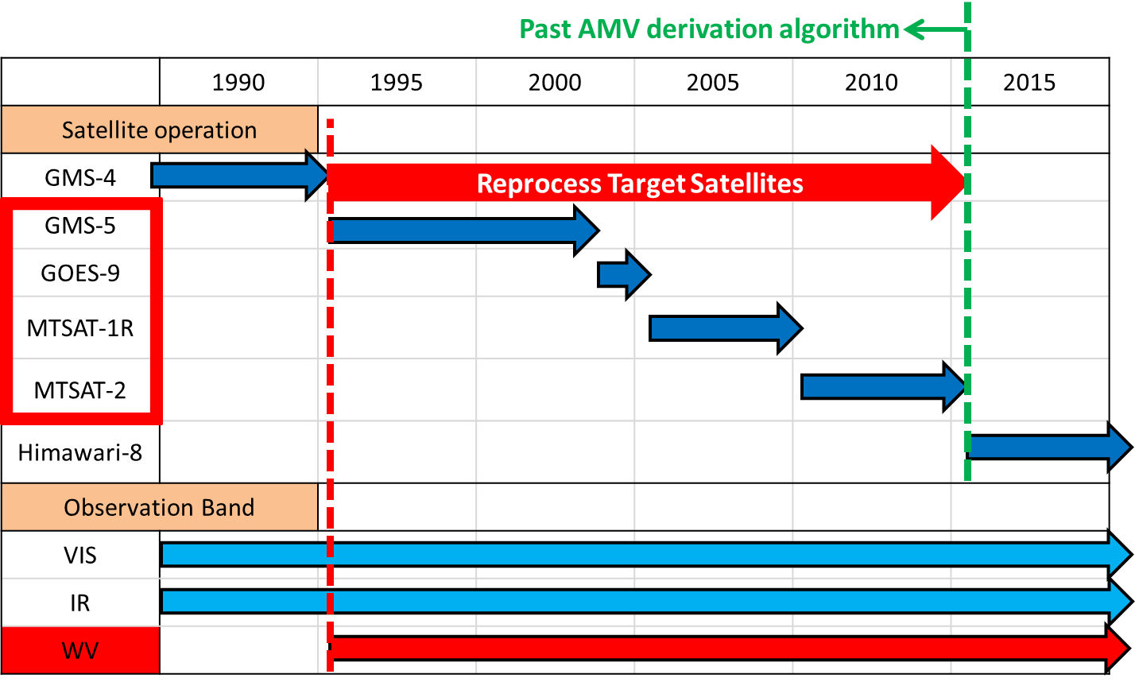
AMV Reprocessing for JRA-3Q
JMA is reprocessing with
the latest derivation algorithm of Himawari-8 AMV to cooperate on JRA-3Q.
Target Satellites :
MTSAT-2 ( 2010-2015 ), MTSAT-1R ( 2005-2010 ),
GOES-9 ( 2003-2005 ), GMS-5 ( 1995-2003 )
Reason :
Water vapor images are necessary for Himawari-8 AMV algorithm.

Slide 7
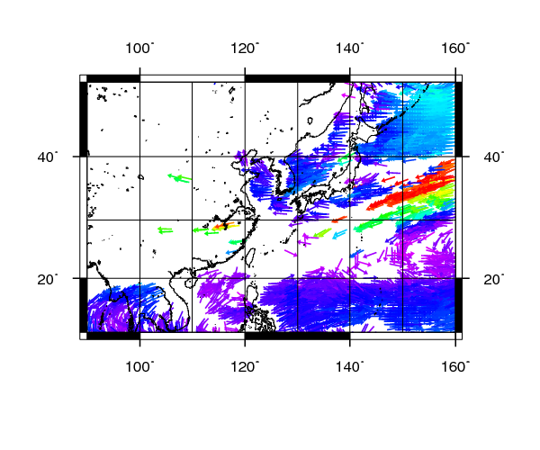
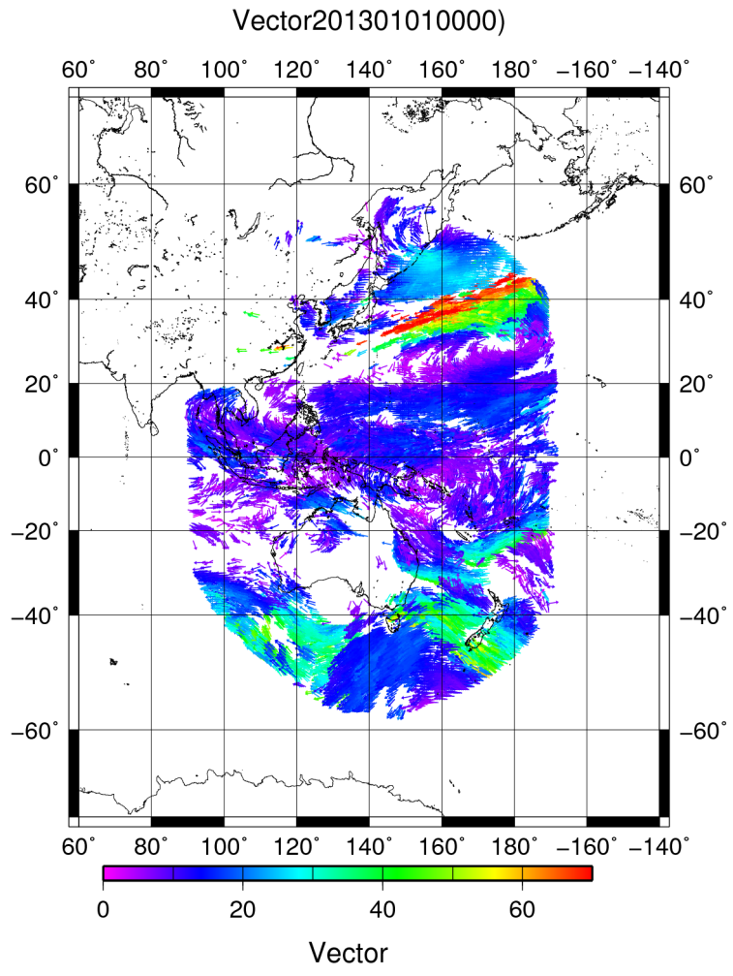
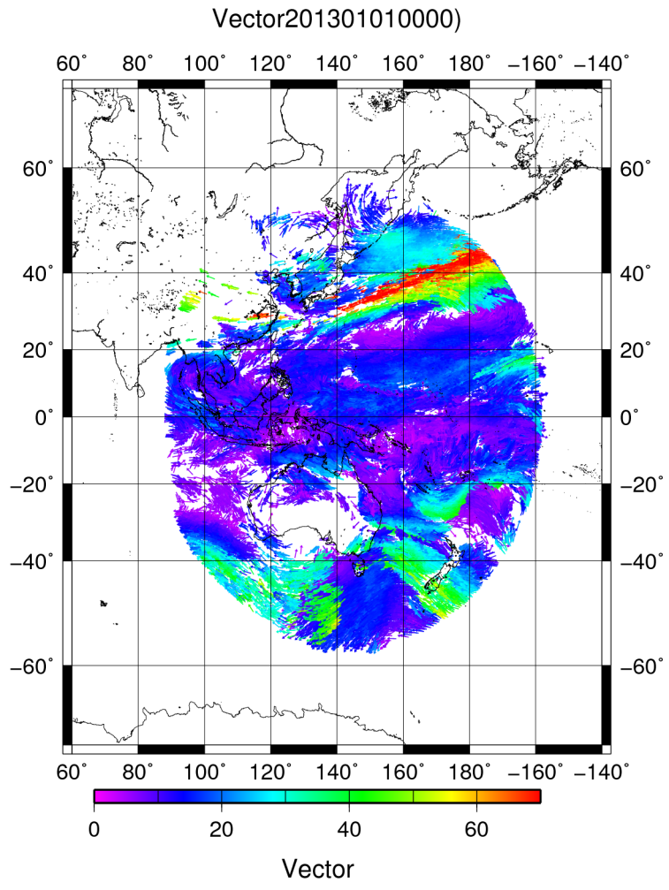
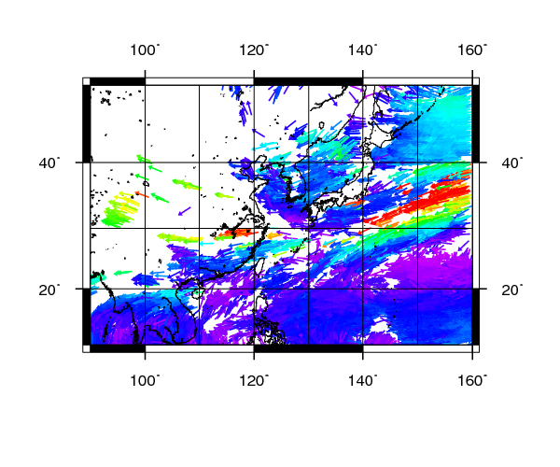
Coverage is improved by New Algorithm
DATE :
1st January 2013 00UTC
Satellite images : MTSAT-2
BAND : IR(10.3-11.3μm)
QI(fcst) > 85
【The difference point of JRA-55 algorithm】
Target assignment processing is designed to avoid correlated AMV errors.
Averaging of similarity surfaces is utilized for noise reduction in the tracking process.
The height assignment method uses maximum likelihood.
A
A
B
B
New algorithm :
Coverage is improved !!
Wind Vector of Past algorithm
Wind Vector of New algorithm

Slide 8
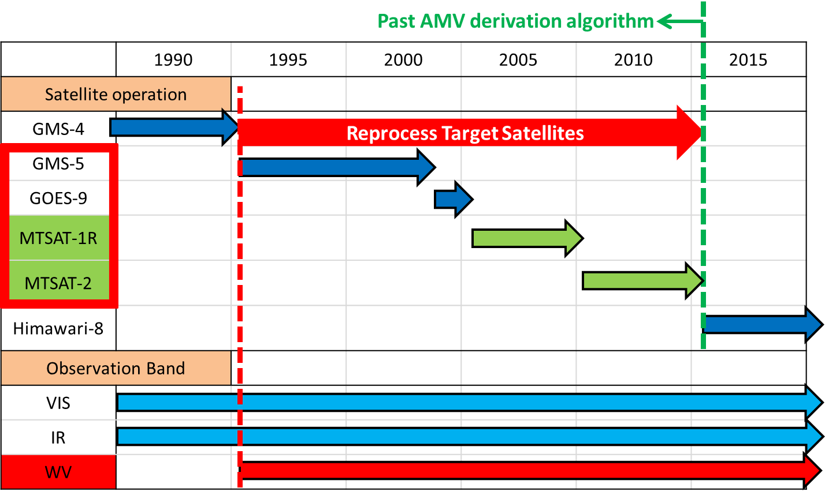
Current status
JMA has almost finished to reprocess of MTSAT series ( 2005-2015 ).
We checked a validation of reprocessed AMV data.
* Tools for sonde statistics are under development.
Almost finished

Slide 9
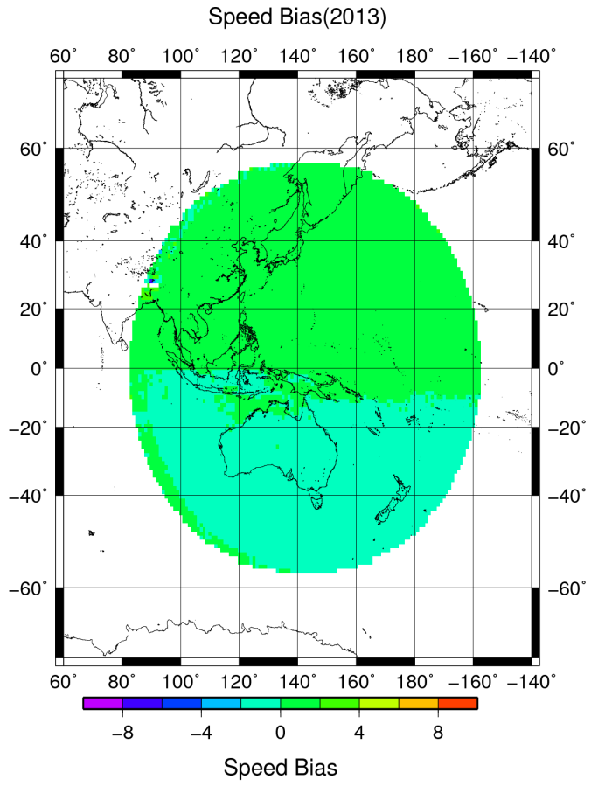
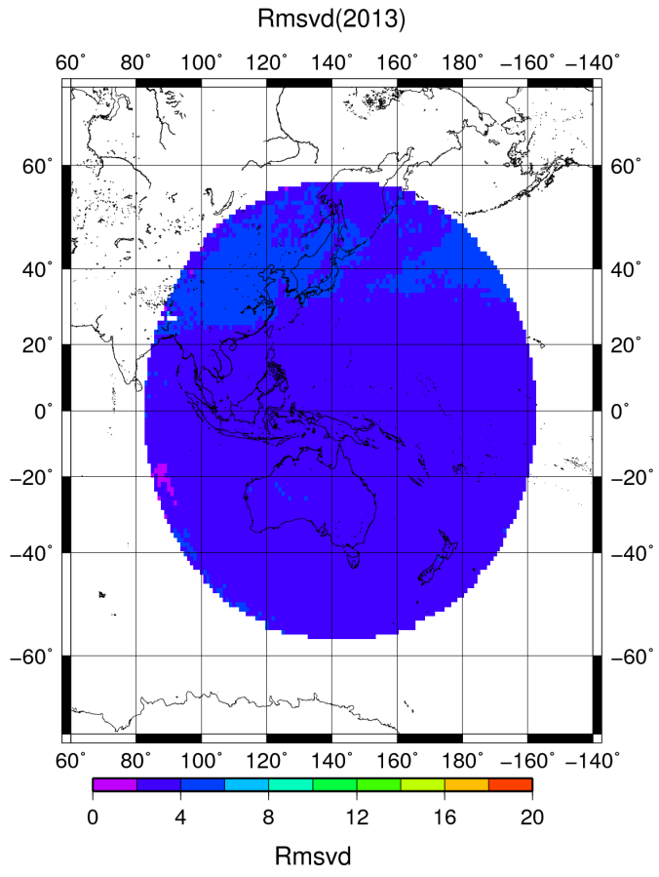
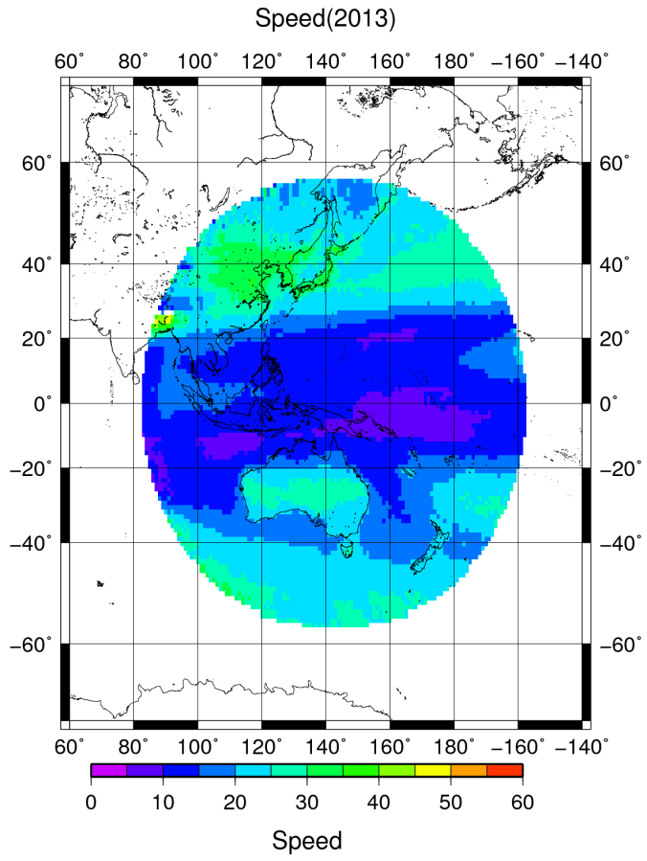
O-B statistics ( AMV vs first guesses in JMA’s Global Spectral Model (GSM) )
MTSAT-2, IR(10.3-11.3μm)
1st January 2013
– 31st December 2013
Speed Bias
Rmsvd
Speed
 | ALL | NH | TROP | SH
Upper | 0.36 | 1.20 | 0.56 | -0.75
Middle | 0.54 | 1.03 | 0.51 | 0.11
Low | 0.29 | 0.75 | 0.37 | -0.18
ALL | NH | TROP | SH
3.82 | 4.39 | 3.30 | 3.97
3.34 | 3.81 | 0.51 | 3.65
2.24 | 2.48 | 2.07 | 2.26
ALL | NH | TROP | SH
23.89 | 29.37 | 14.97 | 31.05
16.27 | 19.93 | 9.08 | 22.66
10.39 | 11.52 | 8.25 | 12.3

Slide 10
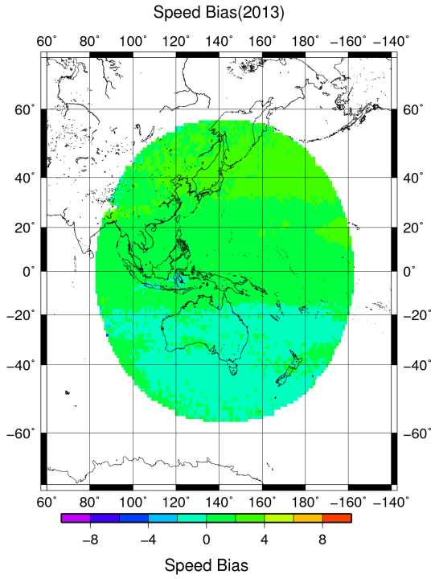
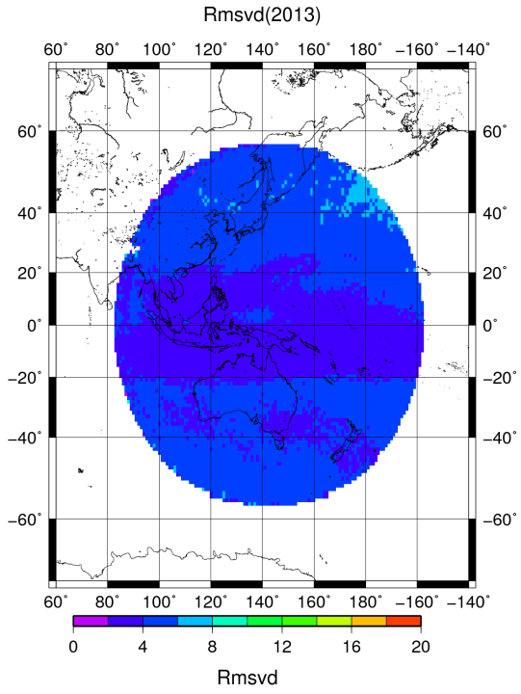
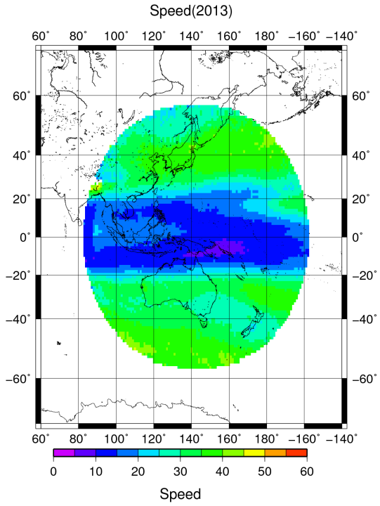
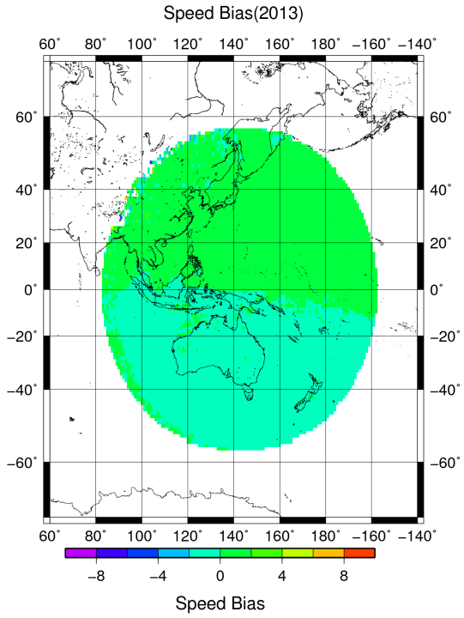
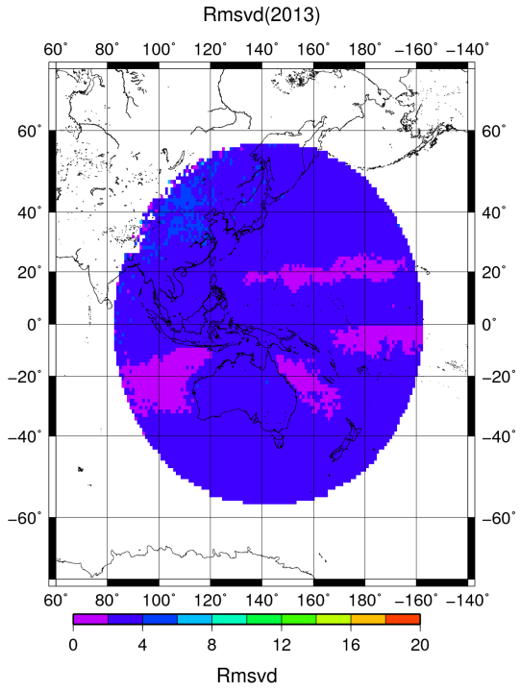
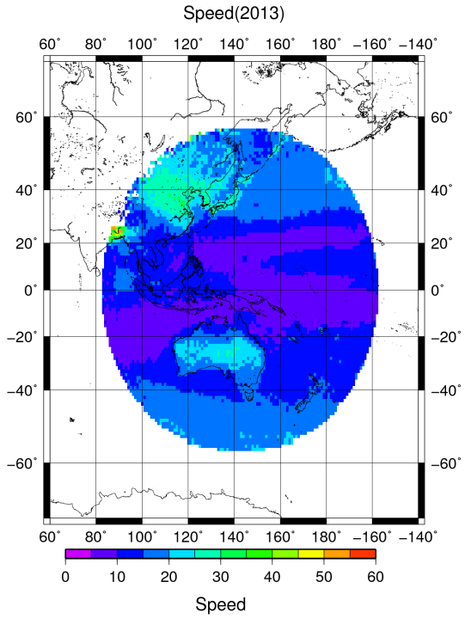
O-B statistics ( vs GSM : JMA-Global Model )
MTSAT-2, IR
1st January 2013 – 31st December 2013
WV
(6.5-7.0μm)
VIS
(0.55-0.90 μm)

Slide 11
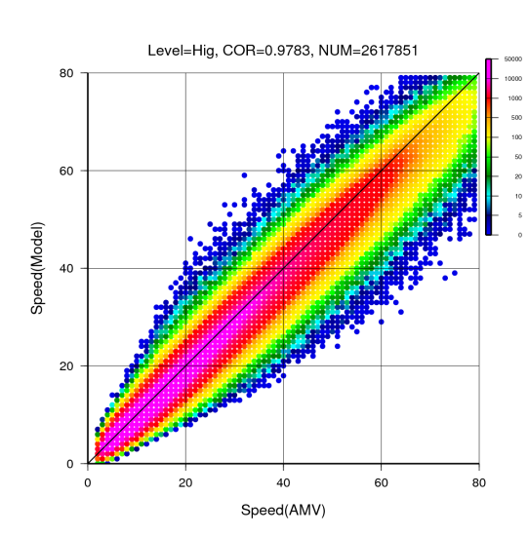
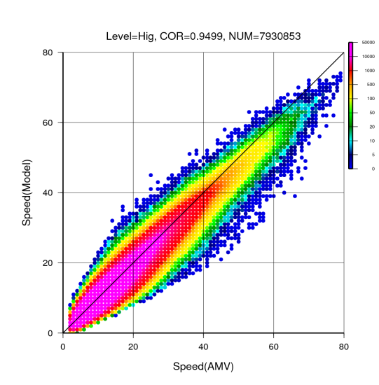
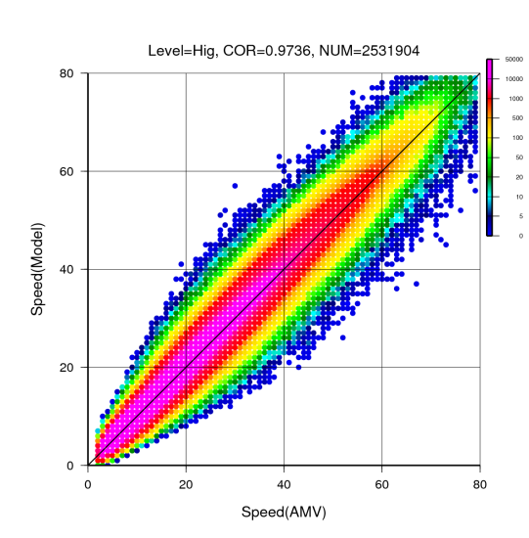
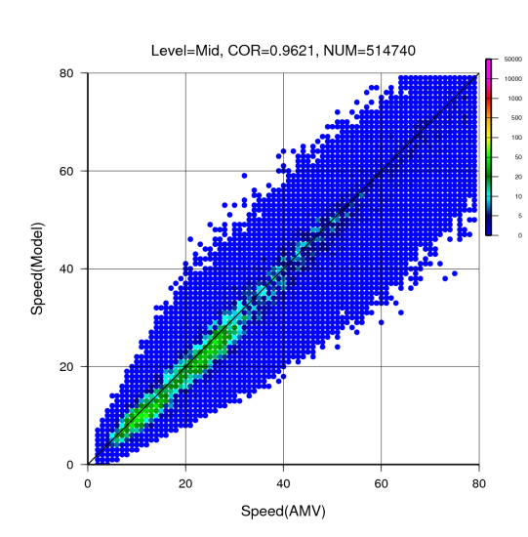
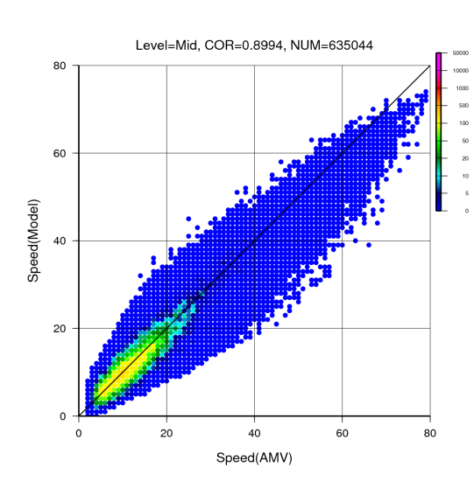
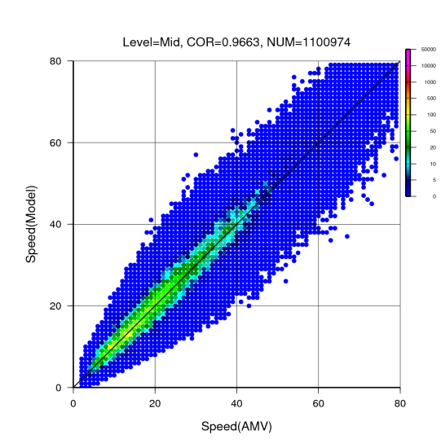
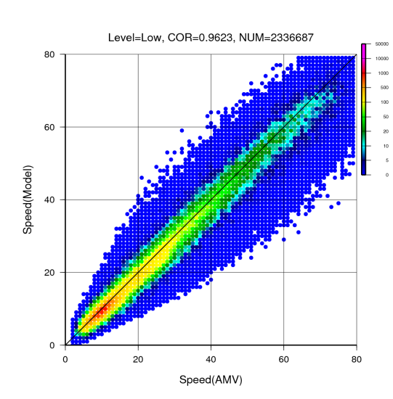
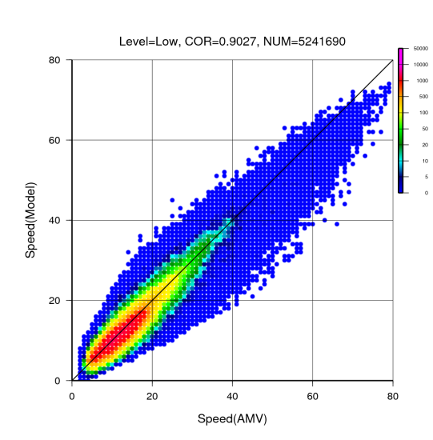
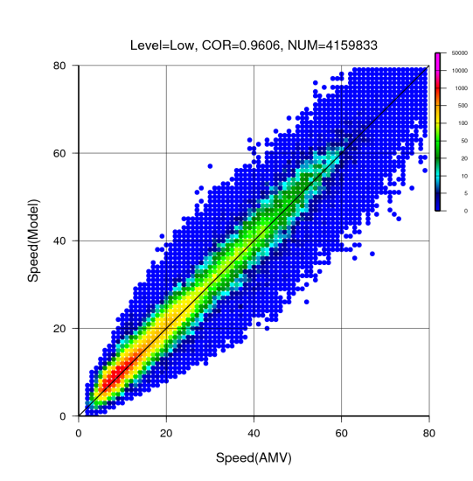
Wind speed correlation
( MTSAT-2 AMV vs FG )
N Hemisphere (poleward of 20N)
Tropics
S Hemisphere (poleward of 20S)
FG(m/s)
FG(m/s)
FG(m/s)
Upper Layer
( < 400hPa )
AMV(m/s)
AMV(m/s)
AMV(m/s)
Middle Layer
( >= 400hPa
< 700hPa )
FG(m/s)
FG(m/s)
FG(m/s)
AMV(m/s)
AMV(m/s)
AMV(m/s)
FG(m/s)
FG(m/s)
FG(m/s)
Low Layer
( >= 700hPa )
14th International Winds Workshop
AMV(m/s)
AMV(m/s)
AMV(m/s)

Slide 12
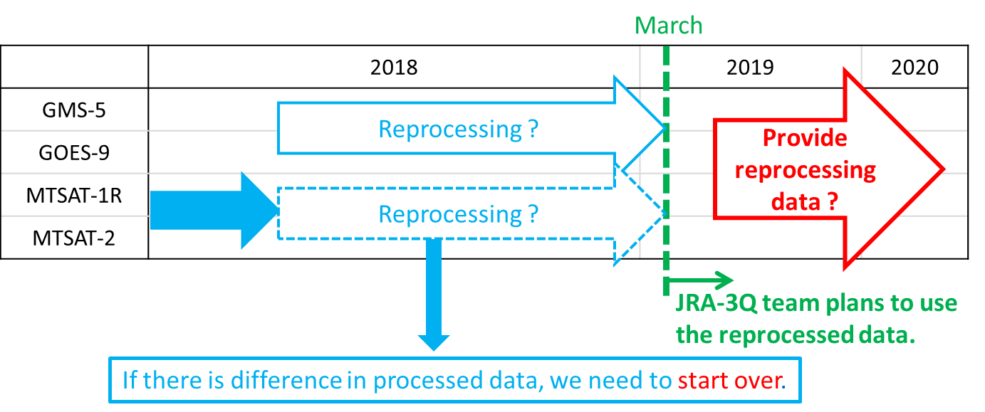
Reprocessing Plan
JRA-3Q team plans to use the reprocessed AMV data from the end of March 2019.
If there are time and resources, we will reprocess AMV of satellite that have not been reprocessed yet.
< About provision reprocessing data >
JMA plans to provide the reprocessed data, but it is now under consideration.
14th International Winds Workshop

Slide 13
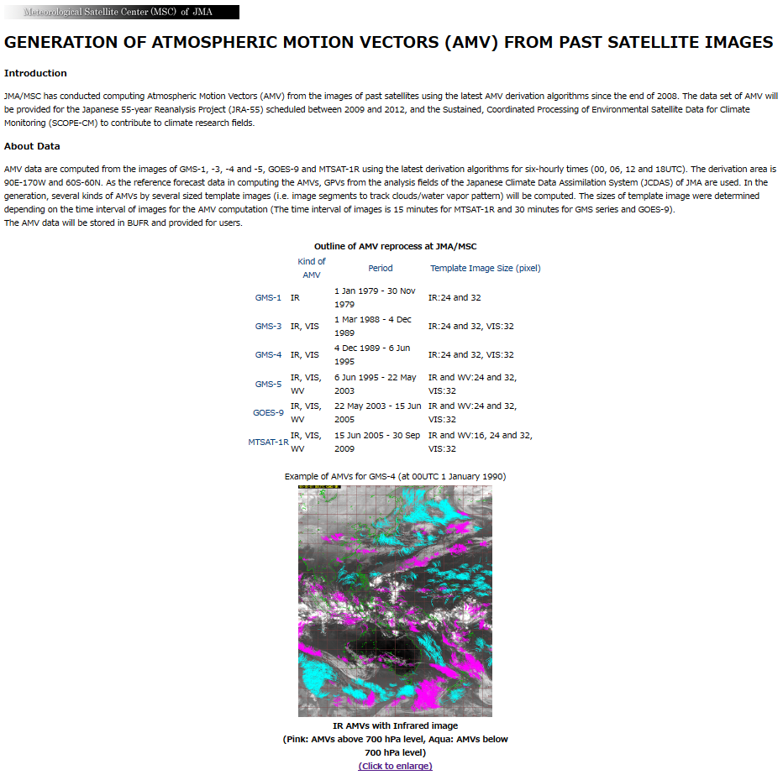
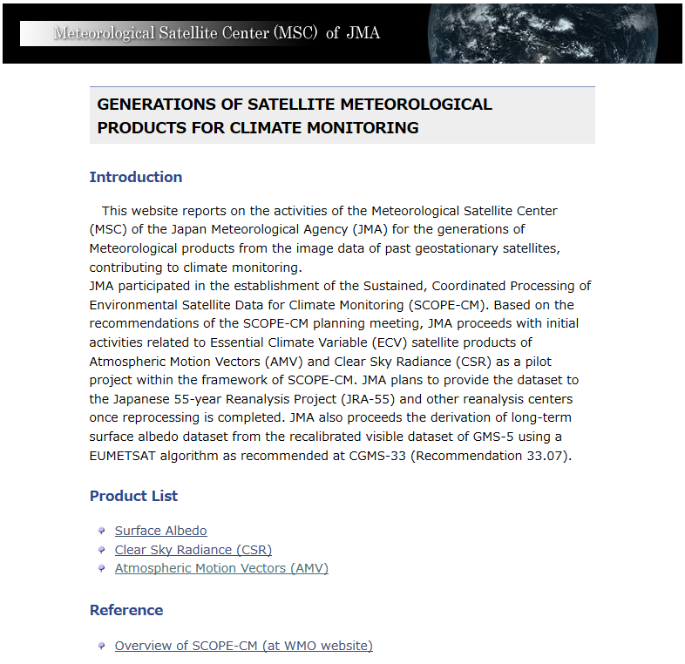
Information of reprocessing AMV for user
< Example to inform of reprocessing AMV for JRA-3Q for user by website>
Information about reprocessing AMV for JRA-3Q will be introduced on web page.
http://www.data.jma.go.jp/mscweb/en/product/reprocess/
* Now, the above web page is for JRA-55.
This is webpage of reprocessed AMV
for JRA-55 project.
To be updated for JRA-3Q
14th International Winds Workshop

Slide 14
Summary
JMA plans AMV reprocessing using latest algorithm for JMA’s past satellite images for JRA-3Q project.
The Himawari-8 algorithm need a water vapor band for cloud height assignment. Therefore AMVs from MTSAT-1R, 2 and GMS-5 is planned to be reprocessed.
JMA plans to provide the reprocessed data for overseas users, but it is now under consideration.

Slide 15
Thank you for your time !!
14th International Winds Workshop

Slide 16
Preliminary Data
14th International Winds Workshop

Slide 17
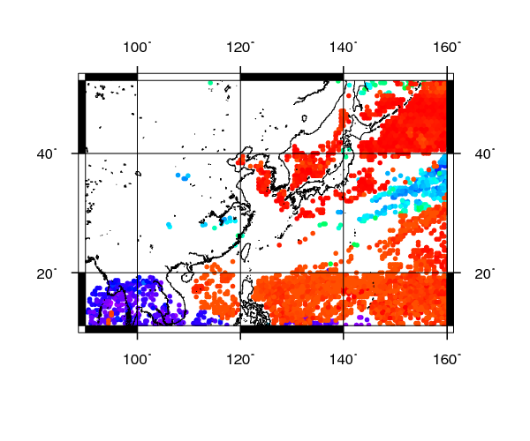
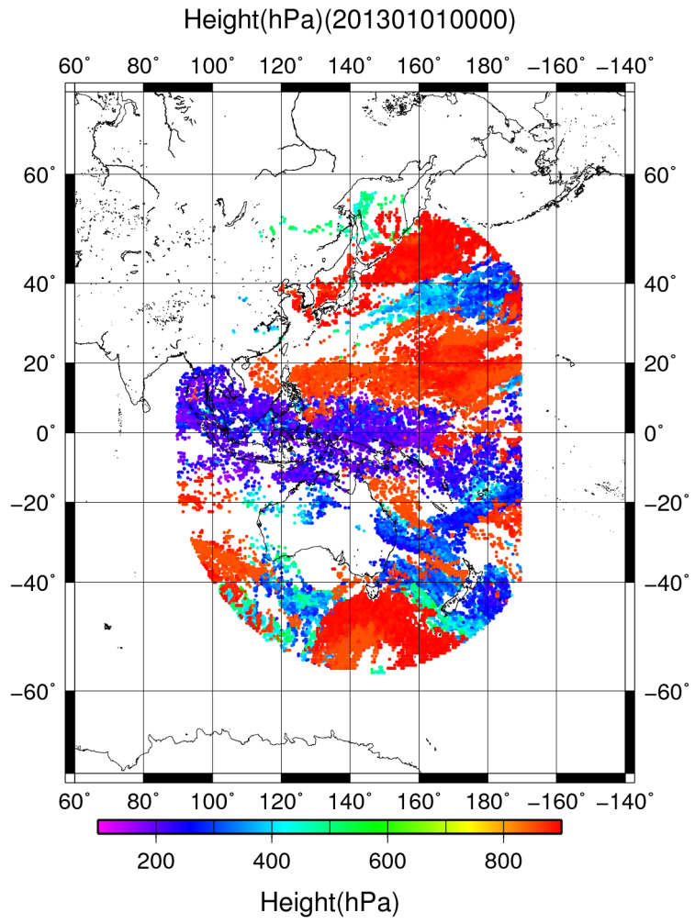
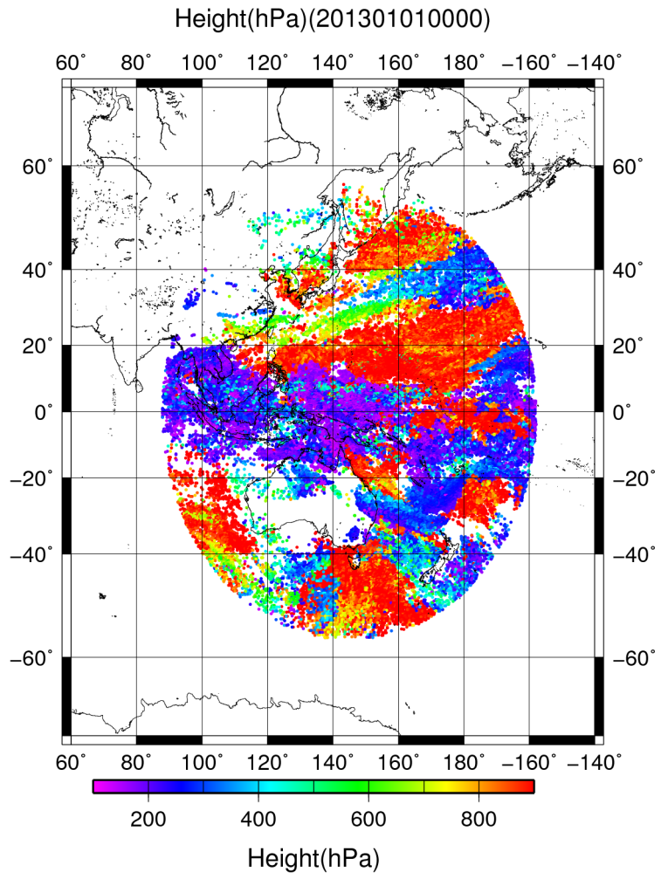
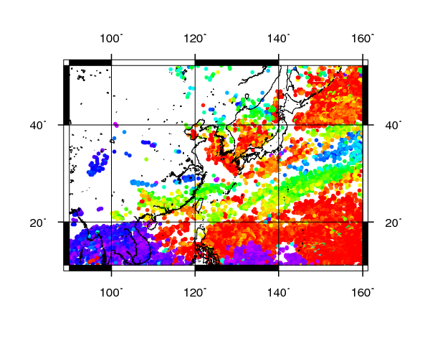
Coverage is improved by New Algorithm
DATE :
1st January 2013 00UTC
Satellite images : MTSAT-2
BAND : IR
QI(fcst) > 85
【The difference point of JRA-55 algorithm】
Target assignment processing is designed to avoid correlated AMV errors.
Averaging of similarity surfaces is utilized for noise reduction in the tracking process.
The height assignment method uses maximum likelihood..
A
A
B
B
New algorithm :
Coverage is improved !!
Height of Past algorithm
Height of New algorithm

Slide 18
Wind speed correlation
( MTSAT-2 AMV vs FG )
N Hemisphere (poleward of 20N)
Tropics
S Hemisphere (poleward of 20N)
FG(m/s)
FG(m/s)
FG(m/s)
Upper Layer
( < 400hPa )
AMV(m/s)
AMV(m/s)
AMV(m/s)
Reason is Tropical typhoon ?
It’s hard for GSM to express
a high-speed of narrow area ?
Middle Layer
( >= 400hPa
< 700hPa )
FG(m/s)
FG(m/s)
FG(m/s)
AMV(m/s)
AMV(m/s)
AMV(m/s)
FG(m/s)
FG(m/s)
FG(m/s)
Low Layer
( >= 700hPa )
14th International Winds Workshop
AMV(m/s)
AMV(m/s)
AMV(m/s)
Notes:
It seems like that tropics range has effect of negative wind speed bias in GSM

Slide 19
Element of the statistics
MVD : Mean of motion vector difference
$$MVD=\frac{1}{N}\sum_{i, r=1}^{N}{\sqrt{{(u_{i}−u_{r})}^{2}+{(v_{i}−v_{r})}^{2}}}$$
RMSVD : Root mean square vector difference
$$RMSVD=\sqrt{\frac{1}{N}\sum_{i, r=1}^{N}{[{\left(u_{i}−u_{r}\right)}^{2}+{\left(v_{i}−v_{r}\right)}^{2}]}}$$
BIAS : Wind speed bias
$$BIAS=\frac{1}{N}\sum_{i, r=1}^{N}{[\sqrt{u_{i}2+v_{i}2}−\sqrt{u_{r}2+v_{r}2}]}$$
SPD : Mean Wind Speed ( Model )
NC : Number of collocation
*X_{i} : AMV element, X_{r} : Model element
14th International Winds Workshop

Slide 20
Reference materials
Meteorological Satellite Center Technical Note
March 2017, No.62 (The author is Mr. Shimoji of JMA)
“Introduction to the Himawari-8 Atmospheric Motion Vector Algorithm”
http://www.data.jma.go.jp/mscweb/technotes/msctechrep62-4.pdf
Mr. Shimoji’s presentation materials of JMA at the time of IWW12
“MOTION TRACKING AND CLOUD HEIGHT ASSIGNMENT METHODS FOR HIMAWARI-8 AMV”
http://cimss.ssec.wisc.edu/iwwg/iww12/talks/01_Monday/1710_IWWG_0616_2_algorithm_Shimoji_final.pdf
TCC Training Seminar ( 14 NOV. 2016 )
“Introduction to Reanalysis and JRA” ( The author is Mr. Harada of JMA )
https://ds.data.jma.go.jp/tcc/tcc/library/library2016/lectures/7_Introduction_to_Reanalysis_and_JRA.pdf
14th International Winds Workshop

Slide 21
Tracking process
http://cimss.ssec.wisc.edu/iwwg/iww12/talks/01_Monday/1710_IWWG_0616_2_algorithm_Shimoji_final.pdf
14th International Winds Workshop

Slide 22
Tracking process
http://cimss.ssec.wisc.edu/iwwg/iww12/talks/01_Monday/1710_IWWG_0616_2_algorithm_Shimoji_final.pdf
14th International Winds Workshop

Slide 23
Tracking process
http://cimss.ssec.wisc.edu/iwwg/iww12/talks/01_Monday/1710_IWWG_0616_2_algorithm_Shimoji_final.pdf
14th International Winds Workshop

Slide 24
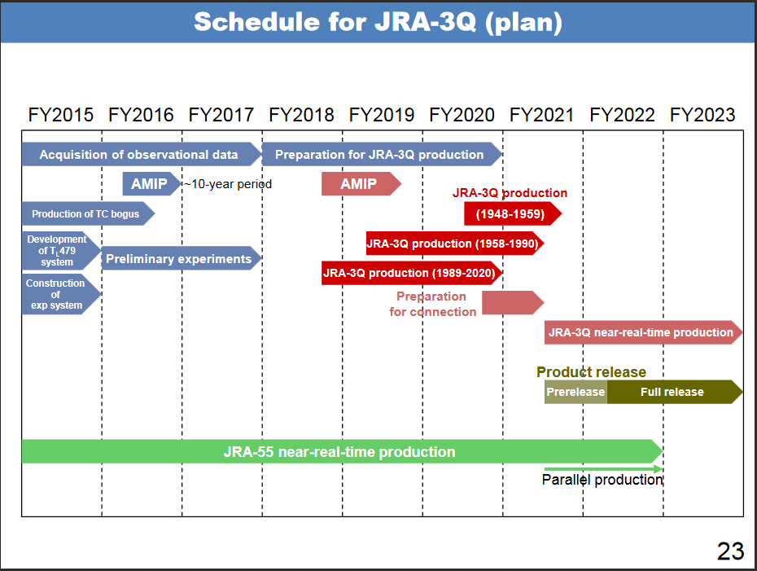
The plan of JRA-3Q team
https://ds.data.jma.go.jp/tcc/tcc/library/library2016/lectures/7_Introduction_to_Reanalysis_and_JRA.pdf
14th International Winds Workshop

Slide 25
Difference of JRA-25 and JRA-55 (NWP)
https://ds.data.jma.go.jp/tcc/tcc/library/library2016/lectures/7_Introduction_to_Reanalysis_and_JRA.pdf
14th International Winds Workshop

Slide 26
JRA-3Q (NWP)
https://ds.data.jma.go.jp/tcc/tcc/library/library2016/lectures/7_Introduction_to_Reanalysis_and_JRA.pdf
14th International Winds Workshop

