Slide 1
Impact of hyperspectral IR radiances on wind analyses
Kirsti Salonen and Anthony McNally
Kirsti.Salonen@ecmwf.int

Slide 2
Motivation
The upcoming hyper-spectral IR instruments on geostationary satellites will provide information with high vertical and temporal resolution.
Positive impact on wind analysis/forecasts has been demonstrated with
  Geostationary radiances (Peuby and McNally 2009, Lupu and McNally 2012, Lupu and McNally 2013)
  Microwave instruments in the all-sky framework (Geer et al, 2014).
Here focus is on the current hyper-spectral IR instruments on board polar orbiting satellites.

Slide 3
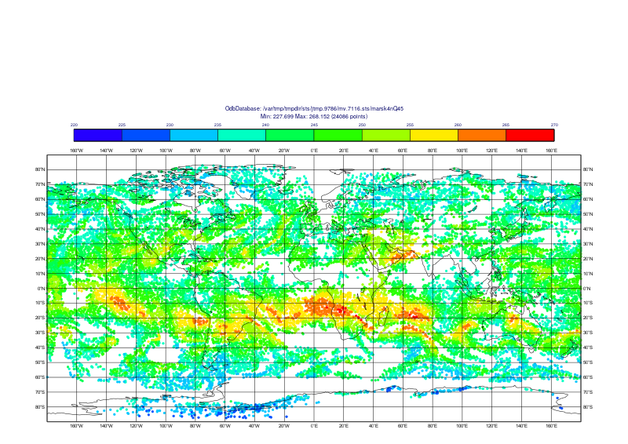
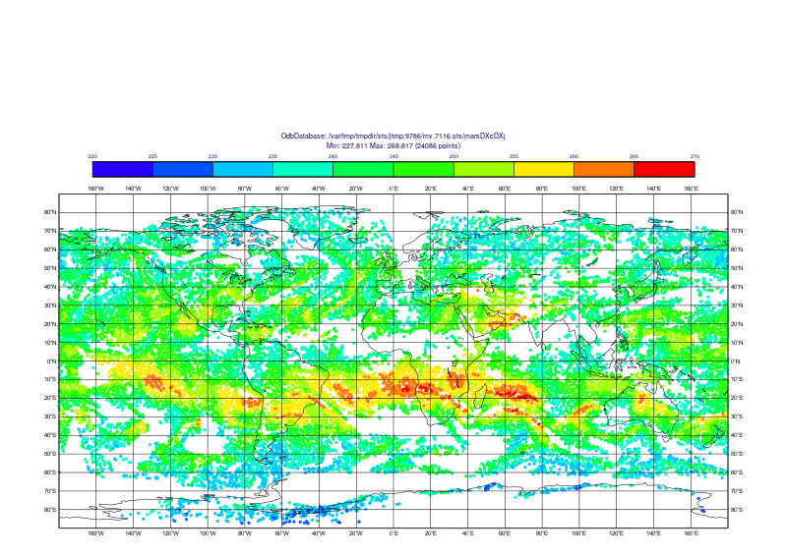
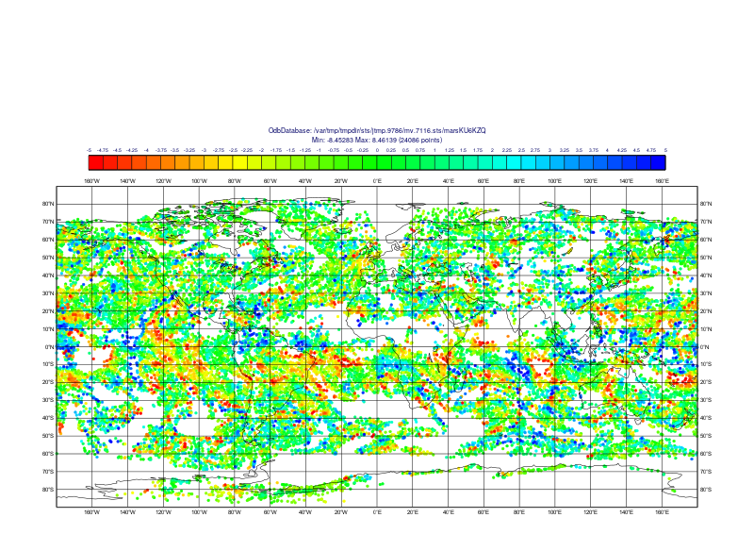
Radiance observations in 4D-Var, impact on wind analysis
Adjustments in the mass fields of the atmosphere.
Assimilation system has freedom to adjust the wind field of the initial conditions directly.
x_{a} = x_{b} + K (y - Hx_{b})
220 270
220 270
-5 5
K = BH^{T}(HBH^{T}+R)⁻¹
Example: IASI channel 3002

Slide 4
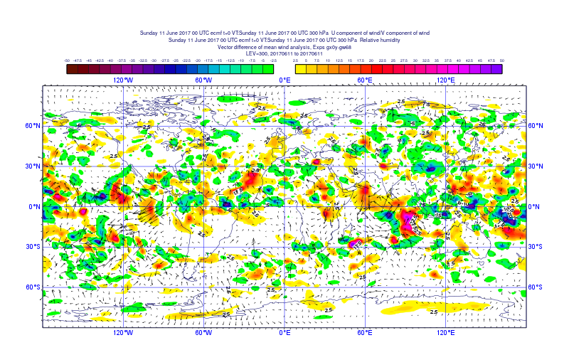
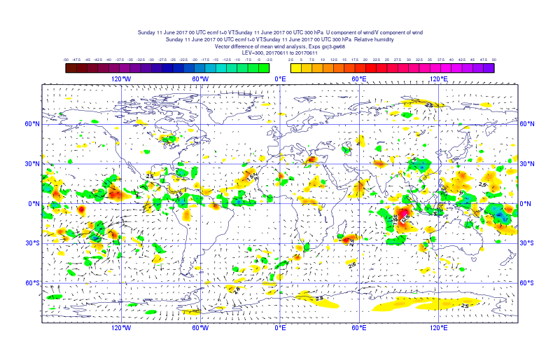
Example: 300 hPa R and wind analysis increments 1.11.2016 00 UTC
WV absorption band channels from IASI, CrIS
and AIRS used in assimilation
No WV absorption band channels from
hyperspectral IR instruments used in assimilation
-50% 0 50%
-50% 0 50%

Slide 5
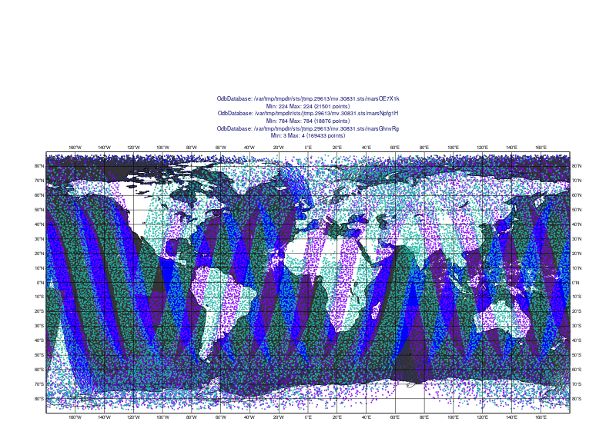
Experimentation setup
IFS cycle 43R3, 1.11-31.12.2016
  Baseline: Conventional observations + AMSU-A
  HyIR: Baseline + IASI (Metop-A, Metop-B), Cris, AIRS
  AMV: Baseline + all operationally used AMVs
  All: Full observing system
12-hour sample coverage of active hyperspectral IR data
Metop-A IASI
Metop-B IASI
Aqua AIRS
Suomi-NPP Cris

Slide 6
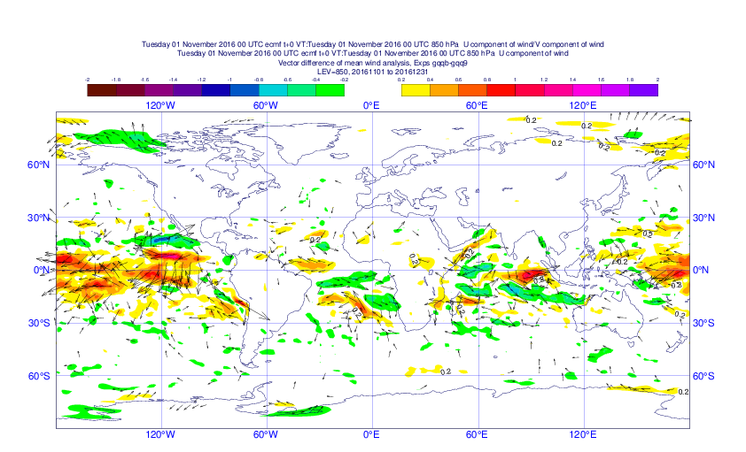
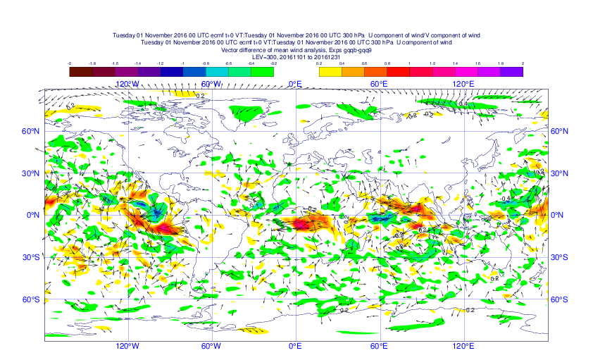
Differences in the mean wind analysis (HyIR-Baseline, 1.11-31.12.2016)
850 hPa
300 hPa
-2 -1 0 1 2
-2 -1 0 1 2

Slide 7
Wind analysis scores
Wind analysis error: departure from the ECMWF analysis using full observing system.
The analysis error is compared to that of Baseline experiment.
  Wind analysis score = 0%, no improvement over the baseline experiment (conventional + AMSU-A)
  Wind analysis score = 100%, no error with respect to the full observing system analysis

Slide 8
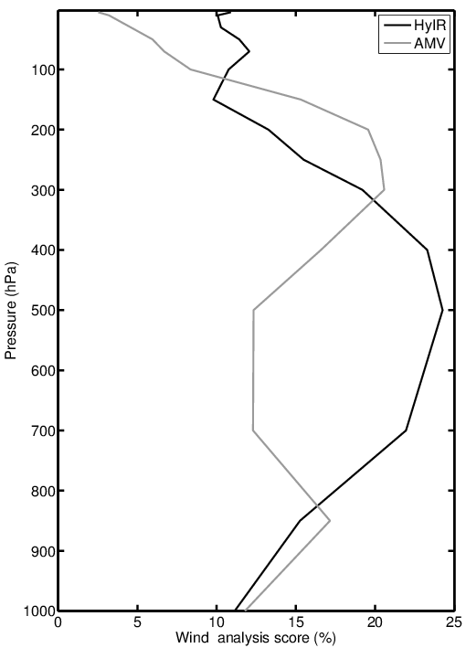
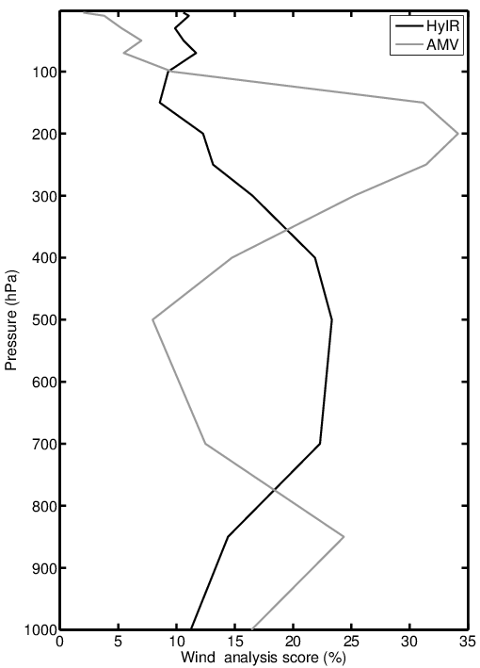
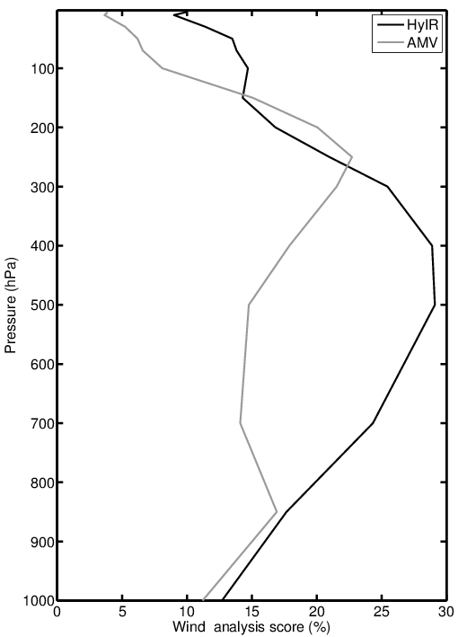
Wind analysis scores
NH
TR
SH
Pressure (hPa)
Pressure (hPa)
Pressure (hPa)
Wind analysis score (%)
Wind analysis score (%)
Wind analysis score (%)

Slide 9
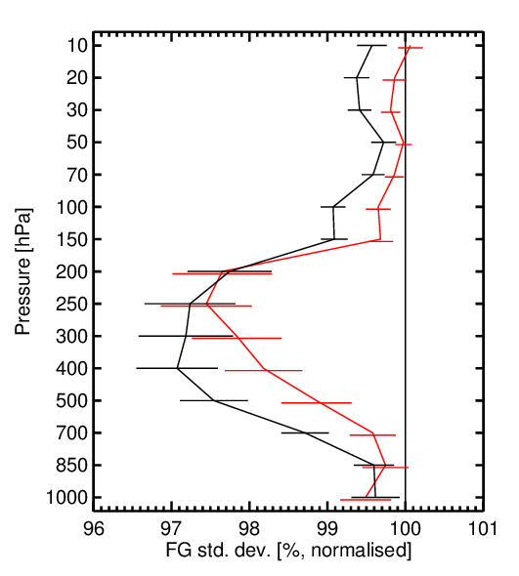
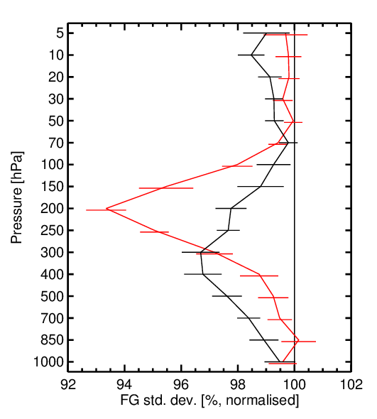
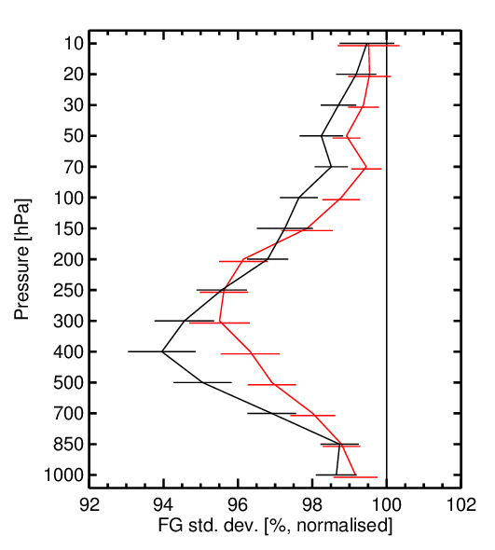
Impact on short range wind forecasts
HyIR: CTL + 2 IASI + CrIS + AIRS
AMV: CTL + All operatinally used AMVs
Good Bad
Wind, NH
Wind, TR
Wind, SH
Pressure (hPa)
Pressure (hPa)
Pressure (hPa)
FG sdev (%, normalised)
FG sdev (%, normalised)
FG sdev (%, normalised)

Slide 10
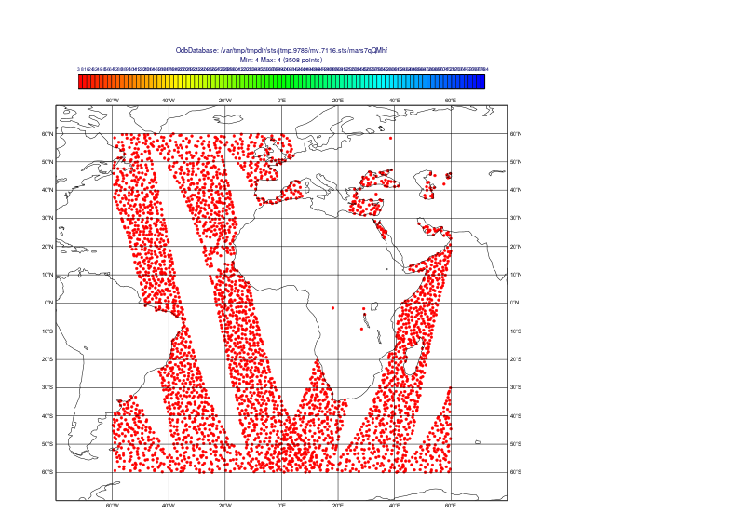
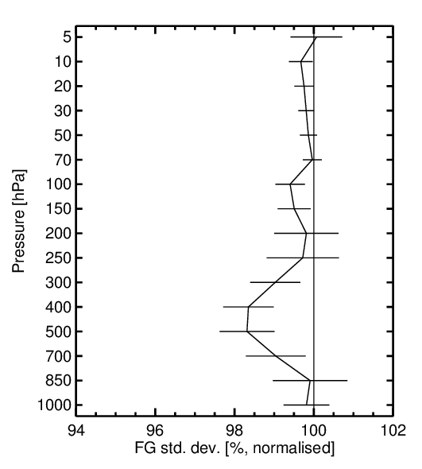
Role of spatial and temporal sampling
CTL: Conv + AMSU-A
EXP: CTL + Metop-A IASI
Wind
Pressure (hPa)
Metop-A
FG sdev (%, normalised)
Verification over Meteosat-11 disc

Slide 11
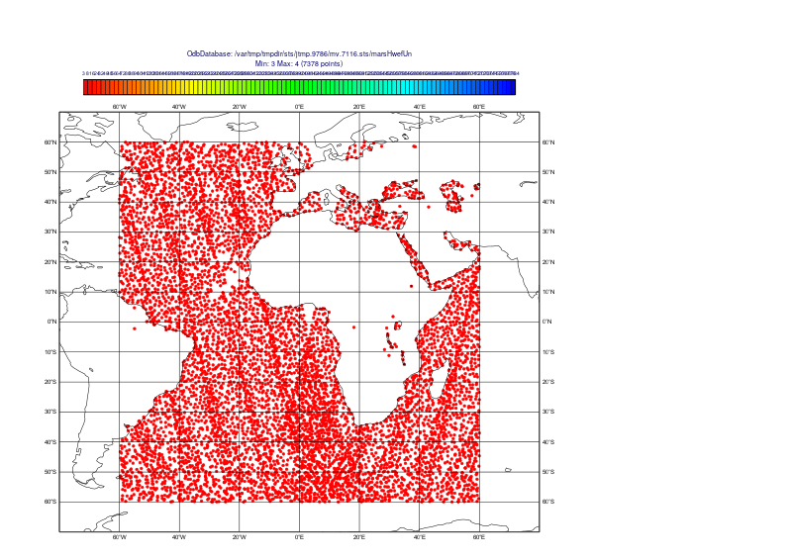
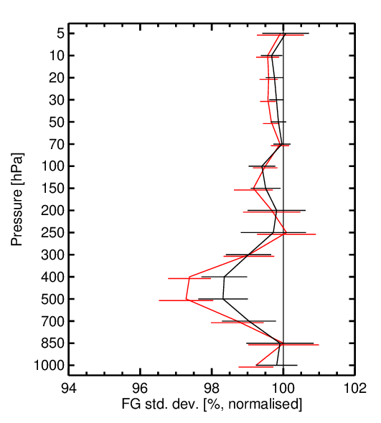
Role of spatial and temporal sampling
CTL: Conv + AMSU-A
EXP: CTL + 2 IASI
Wind
Pressure (hPa)
Metop-A Metop-B
FG sdev (%, normalised)
Verification over Meteosat-11 disc

Slide 12
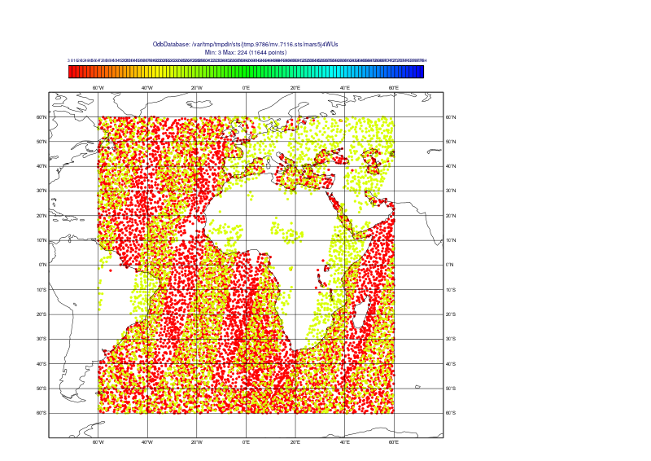
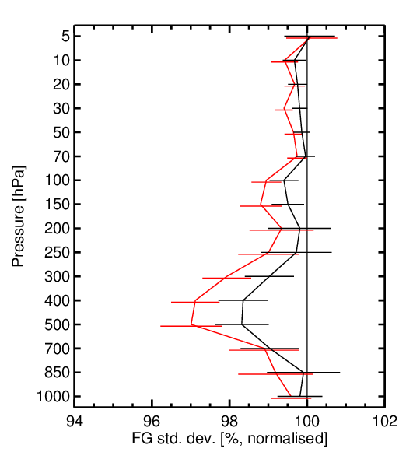
Role of spatial and temporal sampling
CTL: Conv + AMSU-A
EXP: CTL + 2 IASI + CrIS
Wind
Pressure (hPa)
Metop-A Metop-B CrIS
FG sdev (%, normalised)
Verification over Meteosat-11 disc

Slide 13
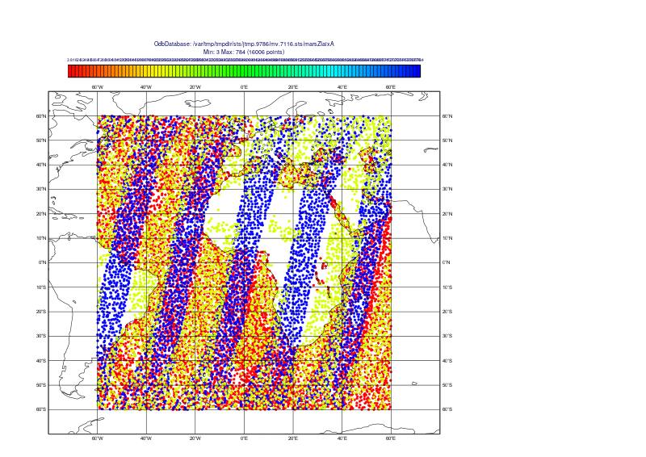
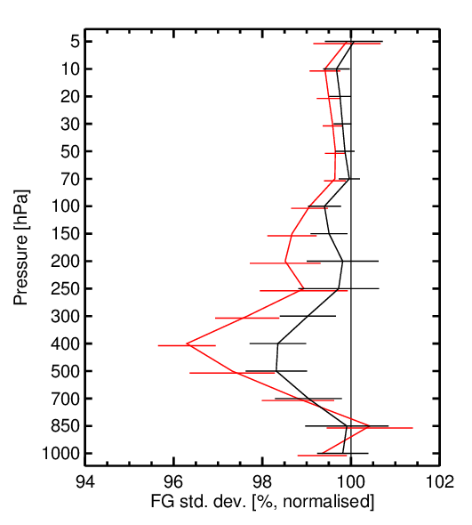
Role of spatial and temporal sampling
CTL: Conv + AMSU-A
EXP: CTL + 2 IASI + CrIS + AIRS
Wind
Pressure (hPa)
Metop-A Metop-B CrIS AIRS
FG sdev (%, normalised)
Verification over Meteosat-11 disc

Slide 14
Conclusions
Assimilation of humidity sensitive radiance observations in 4D-Var impact the wind analysis via
  Adjustments in the mass fields of the atmosphere.
  Adjustments in the wind field directly
Hyperspectral IR observations from polar orbiting satellites have clear positive impact on wind analysis and forecasts.
  Majority of the impact comes from the water vapour channels
  Currently only 10 water vapour channels from IASI and 7 channels both from CrIS and AIRS are used operationally
Upcoming hyperspectral IR instruments on geostationary satellites will provide observations up to 30 min time resolution and have enormous potential for NWP.

