Slide 1
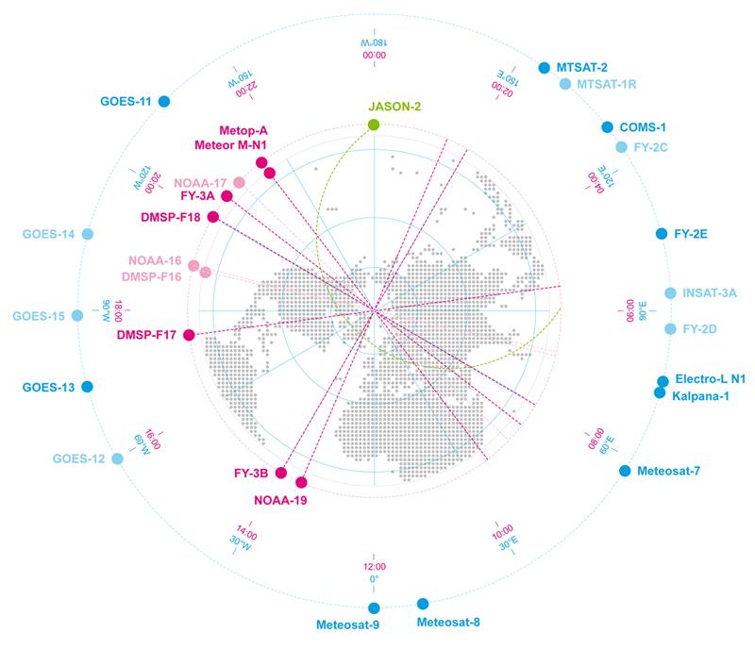
8th CGMS Risk Assessment
Outcome from the 8th Risk Assessment Workshop, 3-5 February 2026

Slide 2
CGMS Baseline - Background
The CGMS Baseline enumerates the sustained observations, measurements, and services that form the CGMS contribution to observing the Earth System, Space Environment and the Sun.
The CGMS Baseline responds to end-user requirements expressed in WMO’s Rolling Review of Requirements (RRR).
The CGMS Baseline strives to support the WMO Integrated Global Observing System (WIGOS) 2040 vision.
Key principles:
Commitment: The CGMS Members are providing, or have firm plans to provide, the observations, measurements, and services enumerated in the Baseline
Sustained: The observations, measurements, and services are provided on a sustained basis
Available: The observations, measurements, and services are available on a free and open basis
Operational: The data and products can be utilized in operational applications

Slide 3
CGMS Baseline - Background
The CGMS Baseline constitutes the CGMS response to the WIGOS 2040 Vision to document what missions are currently being, or planned on being flown. The CGMS baseline will be included in the WMO Manual on WIGOS.
WMO will conduct a Gap Analysis between the WIGOS 2040 Vision Tier 1 and the CGMS Baseline to review implementation of WIGOS.
CGMS conducts an annual Risk Assessment against the baseline to track how CGMS is meeting its commitments.
The CGMS Risk Assessment will be completed every year forming the basis for CGMS actions to ensure continuity.

Slide 4
CGMS Baseline Update / Risk Assessment Process
Prior Year Assessment
Member
Input
Reconcile OSCAR (CGMS Secretariat)
Satellite Flyout to 10 years
Satellite Flyout
Activities Conducted Prior to Workshop
Member updates include those at Workshop and from previous CGMS reports
Update with Member Reports
Risk assessment includes evaluation of data quality and distribution
Risk Assessment
CGMS Baseline
Activities Conducted At Workshop
Activities Conducted At CGMS
WG-III Review
Other WG Review
Actions / HLPP
Report to CGMS Plenary

Slide 5
CGMS Risk Assessment Assumptions
The top-level risk assessment for each sensor/observation is based on a qualitative analysis of all the orbits and satellite missions from which the observation is provided.
This assessment is given from a CGMS Member prospective and may not:
Include contributions from non-CGMS agencies
Include contributions from commercial providers
Incorporate all WMO requirements (which are covered by the gap analysis).
CGMS Members will develop and operate satellites in response to their national priorities.
System resiliency, nor the consequence of not meeting commitments was not specifically addressed.
Lack of a satellite in geostationary orbit is more likely to cause a gap in observations, while a lack of a satellite in low-Earth orbit may only degrade system performance.
Quality and availability were not analyzed in detail for all measurements.
The assessment is based on planned launch dates, design life, and is updated by operational experience.
Agency commitment to mission assumes related user readiness and ground segment operationalization.

Slide 6
CGMS Risk Assessment Assumptions
The information and assessment are based on member organizations and WGIII participants, direct input from CGMS Members, and the OSCAR Database as updated by WMO.
The assessment is a qualitative assessment done by Risk Assessment Workshop participants.
There is uncertainty in planned launch dates, satellite lifetimes (e.g., satellites often operate beyond their design life), operational readiness, and on-orbit health – all of which impact the risk assessment and ultimately the users.
Member owned and operated payloads hosted on commercial platforms are included when launch dates are determined
Note: The detailed charts are by calendar year. As such, if a mission launches in June, it will appear for the full calendar year, or if it’s EOL is June, it will also still appear to go through the end of the calendar year.

Slide 7
Updates - 2026
Updates to mission data were solicited in December 2025
Each flyout chart has been updated with the new launch and EOL information:
ACE EOL moved to 2026
ALOS-2 EOL moved to 2026
CO2M-A launch moved to 2027 and EOL to 2034
CO2M-B launch moved to 2028 and EOL to 2034
CO2M-C launch moved to 2029 and EOL to 2035
CryoSat-2 EOL moved to 2028
DSCOVR EOL moved to 2029
EarthCARE EOL moved to 2028
Electro-L N5 launch moved to 2026
Electro-M N1 launch moved to 2036 and EOL to 2046
FY-3D EOL moved to 2026
FY-3E EOL moved to 2029
FY-3F EOL moved to 2031
FY-3G EOL moved to 2029
FY-3H EOL moved to 2033
FY-3I launch moved to 2027 and EOL to 2033
FY-3J launch moved to 2026 and EOL to 2034
FY-4B EOL moved to 2029
FY-4C EOL moved to 2033
GCOM-C EOL moved to 2026
GCOM-W EOL moved to 2026
GeoXO-2 launch moved to 2033 and EOL to 2041
GOES-18 EOL moved to 2041
GOES-19 EOL moved to 2043
GOSAT EOL moved to 2026
GOSAT-2 EOL moved to 2026
Himawari-9 EOL moved to 2034
Himawari-10 launch moved to 2030 and EOL to 2046
Jason-3 EOL moved to 2027
Meteor-M N2-5 launch moved to 2027 and EOL to 2032
Meteor-M N2-6 launch moved to 2028 and EOL to 2033
Meteor-MP N1 launch moved to 2036 and EOL to 2043

Slide 8
Updates cont.
Launch and EOL updates continued:
MetOp-SG-A1 EOL moved to 2034
MetOp-SG-A2 launch moved to 2033 and EOL to 2042
MetOp-SG-B1 EOL moved to 2035
Meteosat-12 EOL moved to 2033
MTG-I2 EOL moved to 2037
MTG-I3 EOL moved to 2044
MTG-I4 EOL moved to 2047
MTG-S1 EOL moved to 2036
MTG-S2 EOL moved to 2046
NOAA-20 EOL moved to 2032
NOAA-21 EOL moved to 2030
OceanSat 3A launch moved to 2026
S-NPP EOL moved to 2029
Sentinel-2A EOL moved to 2026

Slide 9
Updates cont.
The flyout charts also reflect the following additional updates:
Electro-L N6 and Electro-L N7 have been added to the flyouts for GEO Imager, Energetic Particle Sensor (Low, High and Very High), and Magnetometer in GEO
Electro-M N1 has been added to the flyouts for the Hyperspectral Infrared Sounder, Energetic Particle Sensor (Low, High and Very High), and Magnetometer in GEO
EPS-Sterna 1, 2 and 3 has been added to the flyout for Microwave Sounder
GEO-KOMPSAT-5 was added to the flyout for Energetic Particle Sensor (Very High)
GeoXO-2 has been added to the flyout for the Hyperspectral Infrared Sounder
Meteor-M N2-2, Meteor-M N2-3, Meteor-M N2-4, Meteor-M N2-5, Meteor-M N2-6, and Meteor-MP N1 have been added to the flyout for Multi-purpose Meteorological Imager LEO
Meteor-M N2-7 and Meteor-M N2-8 have been added to the flyouts for Multi-purpose Meteorological Imager LEO, Microwave Imager, Synthetic Aperture Radar, and Energetic Particle Sensor LEO
Sentinel-6C has been added to the flyouts for Radio Occultation, Radar Altimetry and Energetic Particle Sensor LEO
SOHO was added to the flyout for Energetic Particle Sensor at L1

Slide 10
CGMS Risk Assessment Assumptions
CGMS Risk Assessment uses Green, Yellow, and Red to graphically represent the overall status of that sensor/observation. The criteria for each colour is as follows:
Green: CGMS Baseline met with a low risk of a gap.
Yellow: The CGMS Baseline is at moderate risk of not being fully met. Some mitigation by CGMS Members may be required.
Red: There is a high risk of not meeting the CGMS Baseline without CGMS Member action
No Colour: Observation is not planned to be available until a later date
CGMS Baseline met with a low risk of a gap
CGMS Baseline at moderate risk of gap or performance degradation
CGMS Baseline at high risk of a gap in service

Slide 11
Top-Level Risk Assessment - Earth Observations (2025)
No commitment for low-inclination RO observations after COSMIC-2
Sensor | 2025 | 2026 | 2027 | 2028 | 2029 | 2030 | 2031 | 2032 | 2033 | 2034 | 2035 | 2036
Microwave Sounder
Hyperspectral Infrared Sounder
Radio Occultation
Multi-purpose Meteorological Imager
Multi-viewing, Multi-channel, Multi-polarisation Imager
Lightning Mapper
Broadband Short/Long Wave Radiometer
Visible/UV Radiometer
UV Limb Spectrometer
SWIR Imaging Spectrometer
Precipitation Radar
Microwave Imager
Narrow Band Visible & Near Infrared Imager
Radar Altimetry
Scatterometer
Sub-Millimeter Ice Cloud Imager
Synthetic Aperture Radar
High Resolution Optical Imager
Chart included from the risk assessment of 2025 for comparison purposes only.
Earth Observations

Slide 12
Top-Level Risk Assessment - Solar/Space Observations (2025)
Sensor | 2024 | 2025 | 2026 | 2027 | 2028 | 2029 | 2030 | 2031 | 2032 | 2033 | 2034 | 2035
Coronagraph
EUV Imager
X-ray Spectrograph
Energetic Particle Sensor LEO (Magnetospheric)
Energetic Particle Sensor L1 (Solar Energetic Particles)
Low Energy Electrons & Protons
High Energy Electrons & Protons
Very High Energy Protons
Energetic Heavy Ions
Magnetometer GEO (Earth’s Magnetic Field)
Magnetometer L1 (Interplanetary Magnetic Field)
Plasma Analyzer
Chart included from the risk assessment of 2025 for comparison purposes only.
Solar / Space Observations

Slide 13
Top-Level Risk Assessment - Earth Observations (2026)
No commitment for low-inclination RO observations after COSMIC-2
Sensor | 2026 | 2027 | 2028 | 2029 | 2030 | 2031 | 2032 | 2033 | 2034 | 2035 | 2036 | 2037
Microwave Sounder
Hyperspectral Infrared Sounder
Radio Occultation
Multi-purpose Meteorological Imager
Multi-viewing, Multi-channel, Multi-polarisation Imager
Lightning Mapper
Broadband Short/Long Wave Radiometer
Visible/UV Radiometer
UV Limb Spectrometer
SWIR Imaging Spectrometer
Precipitation Radar
Microwave Imager
Narrow Band Visible & Near Infrared Imager
Radar Altimetry
Scatterometer
Sub-Millimeter Ice Cloud Imager
Synthetic Aperture Radar
High Resolution Optical Imager
Earth Observations

Slide 14
Top-Level Risk Assessment - Solar/Space Observations (2026)
Sensor | 2026 | 2027 | 2028 | 2029 | 2030 | 2031 | 2032 | 2033 | 2034 | 2035 | 2036 | 2037
Coronagraph
EUV Imager
X-ray Spectrograph
Low Energy Electrons & Protons
High Energy Electrons & Protons
Energetic Heavy Ions
Very High Energy Protons
Energetic Particle Sensor LEO (Magnetospheric)
Energetic Particle Sensor L1 (Solar Energetic Particles)
Magnetometer GEO (Earth’s Magnetic Field)
Magnetometer L1 (Interplanetary Magnetic Field)
Plasma Analyzer
Solar / Space Observations

Slide 15
Top-Level Risk Assessment – Focus Areas
High risk of a gap in service
Continuity risk from RO observations in low inclination orbits in the later part of the decade as there is no commitment for a follow-on to COSMIC-2.
SWCG to make a recommendation to WGIII how to separate RO and Ionospheric Electron Density profiles.
Moderate risk of gap or performance degradation
Continuity risk for the UV Limb Spectrometer in the 2030s.
WGII to investigate other capabilities for UV limb sounding to complement JPSS
Slight long-term continuity risk for the SWIR Imaging Spectrometer in the late 2030s.
GHG TT via WGII has action to indicate if SWIR missions for CH4 and CO2 be added to the baseline.
Slight long-term continuity risk for the Precipitation Radar in the late 2030s.
NASA and JAXA to provide additional information on the GPM continuation mission.
Continuity risk for Scatterometry in the early to mid 2030s.
Slight continuity risk for Magnetometer in GEO in 2030.
Continuity risk for Energetic Particle Sensor in LEO in the early to mid 2030s.

Slide 16
Top-Level Risk Assessment – Associated Actions
Associated Open Actions
WGII to consider whether observations from geostationary orbit should be added to the CGMS baseline requirements for the broadband short/long wave radiometer.
WGII to articulate how MW missions with different frequencies should be addressed and visualized in the CGMS Baseline and Risk Assessment.
WGII to investigate other capabilities for UV limb sounding to complement JPSS
GHG TT (via WGII) to indicate if SWIR missions for CH4 and CO2 missions should be added to the CGMS baseline and the risk assessment.
SWCG to make a recommendation to WGIII how to separate RO and Ionospheric Electron Density profiles in the CGMS Baseline and Risk Assessment.
NASA and JAXA to provide a coordinated update on possible GPM continuation mission.
NASA to provide update during 8th RAW on IMAP mission data compliance with CGMS Baseline criteria to be incorporated into the Risk Assessment.
WGIII to determine how to visually represent all attributes specified in the Baseline for the Multi-Purpose Meteorological Imagers in LEO risk assessment chart

Slide 17
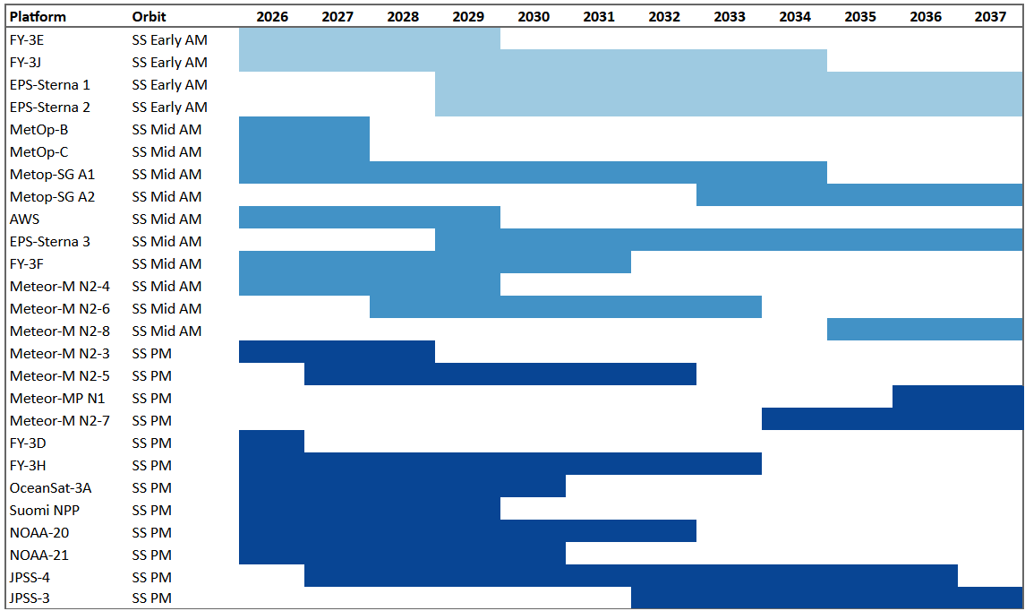
Microwave Sounder (Atmospheric Temperature, Humidity, and Precipitation)
LEO - 3 Orbits
Sun-synchronous early morning
Sun-synchronous mid-morning
Sun-synchronous afternoon
Today
WGIII Assessment: Low risk of not meeting the CGMS Baseline commitment.

Slide 18
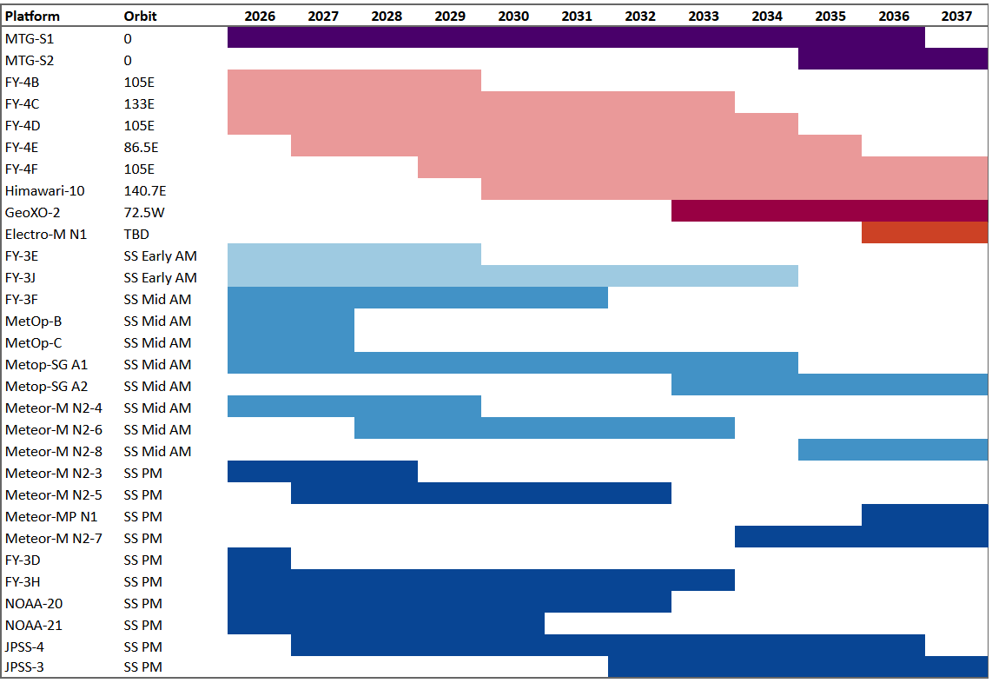
Hyperspectral Infrared Sounder (Atmospheric temperature, humidity, and winds Atmospheric composition: CO, CO2, SO2 , depending on spectral band also CH4 and NH3)
GEO - 2 Slots
0°
86.5°-140°E range
LEO - 3 Orbits
Sun-synchronous early morning
Sun-synchronous mid-morning
Sun-synchronous afternoon
Today
WGIII Assessment: Low risk of not meeting CGMS Baseline commitment. Note the HLPP objective (1.2) to expand hyperspectral sounding from GEO to the full geostationary ring.

Slide 19
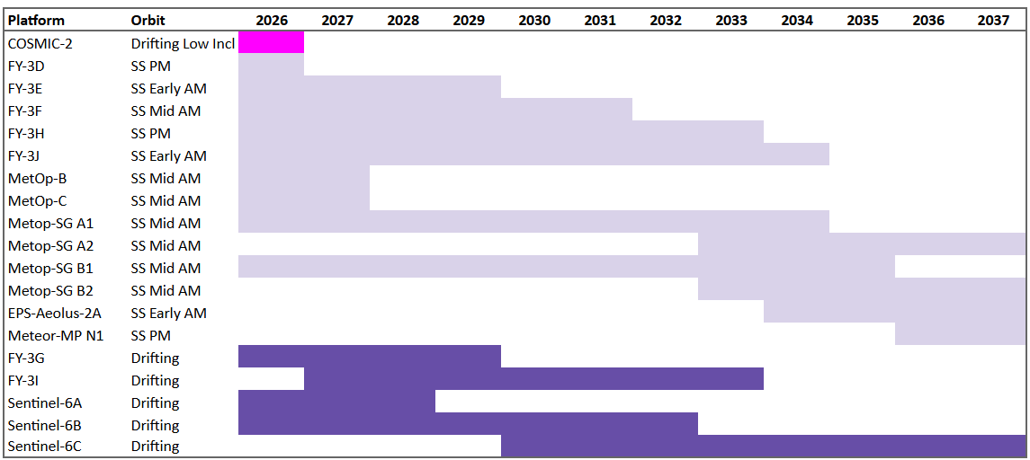
Radio Occultation (Atmospheric Temperature, Humidity, and Ionospheric Electron Density)
Today
LEO - 3 Orbits
6000 occultations from low inclination (<30°)
7600 occultations from sun-synchronous
1000 occultations from other drifting orbits
WGIII Assessment: Risk of not meeting the CGMS Baseline commitment in low-inclination RO observations after COSMIC-2 at the end of this decade. The SWCG to make a recommendation to WGIII how to separate RO and Ionospheric Electron Density profiles in the CGMS Baseline and Risk Assessment.

Slide 20
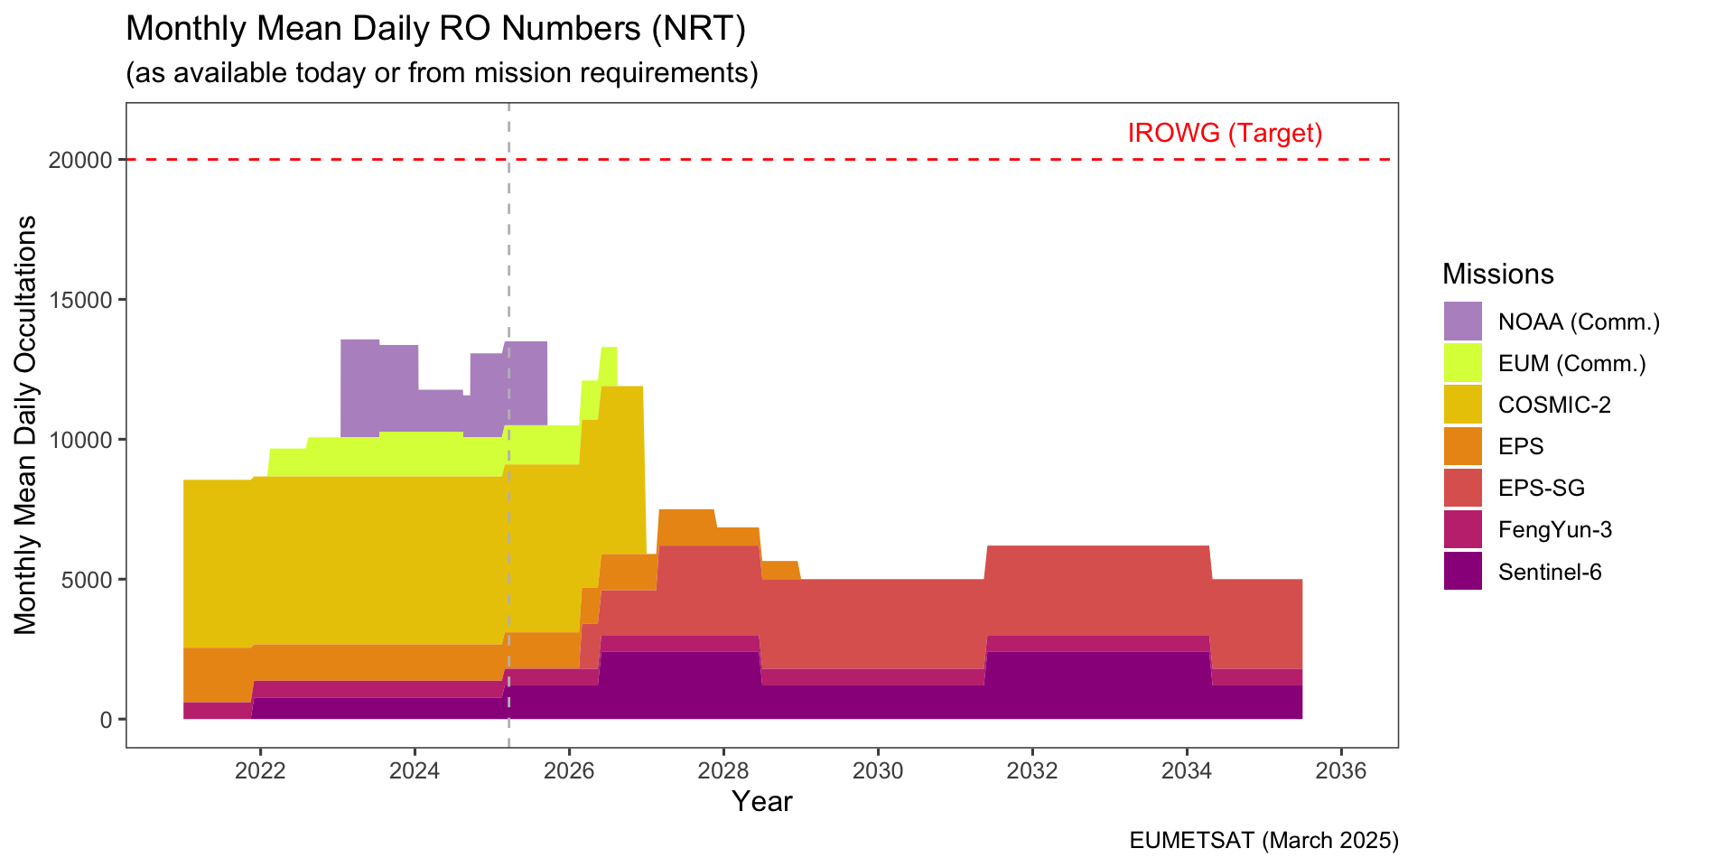
Radio Occultation (Atmospheric Temperature, Humidity, and Ionospheric Electron Density)
CGMS Baseline Target
*
* Metop-SG A1/B1 launch scheduled 2025 & 2026; data to be available 6 months after

Slide 21
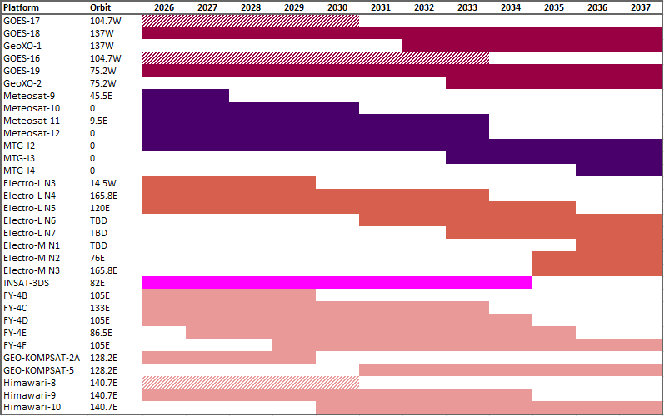
Multi-purpose Meteorological Imagers (multispectral, visible and IR) (Sea Surface Temperature, Aerosols, Land Surface Temperature, Cloud Properties, Feature Tracking Winds (AMV), Flood Mapping, Fires, Cryosphere Applications (sea ice, snow cover, etc.)
GEO - Evenly spaced satellites
137°W
75.2°W
0°-45.5°E range
14.5°W-165.8°E range
74°-82°E range
86.5°-140°E range
Today
WGIII Assessment: Low risk of not meeting the CGMS Baseline commitment.

Slide 22
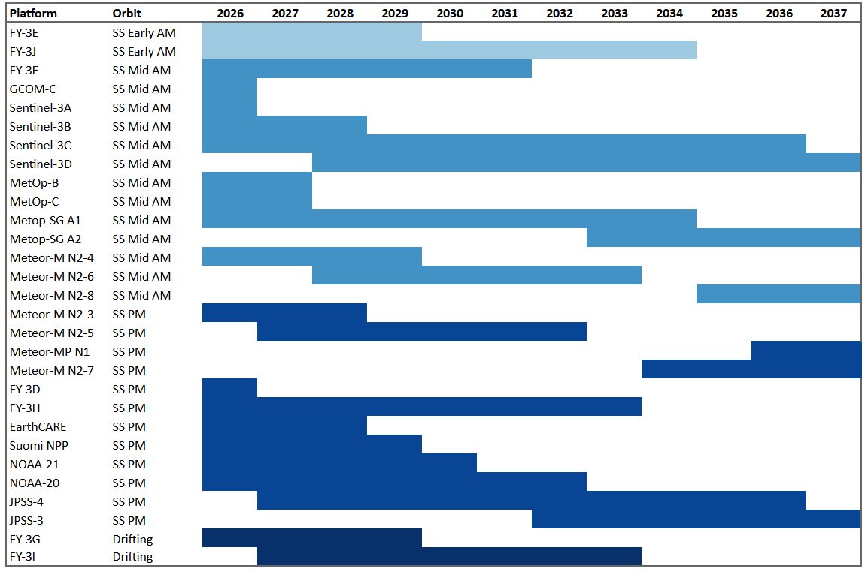
Multi-purpose Meteorological Imagers (multispectral, visible and IR) (Sea Surface Temperature, Aerosols, Land Surface Temperature, Cloud Properties, Feature Tracking Winds (AMV), Flood Mapping, Fires, Cryosphere Applications (sea ice, snow cover, etc.),
LEO
Sun-synchronous early morning
Sun-synchronous mid-morning
Sun-synchronous afternoon
Today
WGIII Assessment: Low risk of not meeting the CGMS Baseline commitment.

Slide 23
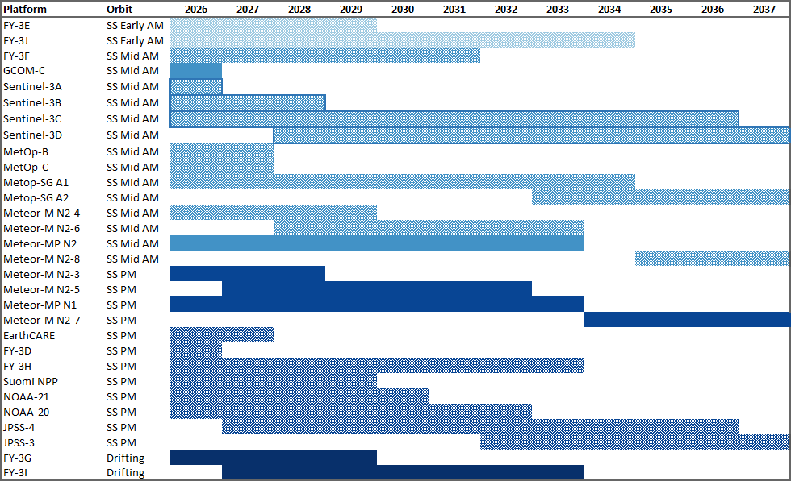
Multi-purpose Meteorological Imagers (multispectral, visible and IR) (Sea Surface Temperature, Aerosols, Land Surface Temperature, Cloud Properties, Feature Tracking Winds (AMV), Flood Mapping, Fires, Cryosphere Applications (sea ice, snow cover, etc.),
Proposed solution to action requesting all attributes in the baseline for the multi-purpose meteorological imager in LEO be visually represented in the risk assessment
LEO
Sun-synchronous early morning
Sun-synchronous mid-morning
Sun-synchronous afternoon
A day-night visible channel (early morning and afternoon)
IR dual-angle view imagery for high-accuracy SST (morning)

Slide 24
Multi-viewing, Multi-channel, Multi-polarisation Imager (Aerosol)
Today
LEO - 1 orbit
Sun-synchronous
WGIII Assessment: Low risk of not meeting the CGMS Baseline commitment.

Slide 25
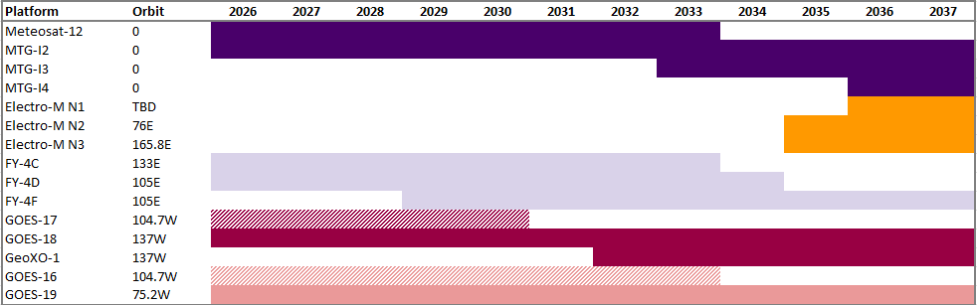
Lightning Mapper (Lightning)
Today
GEO - 4 slots
0°
86.5°-105°E range
137°W
75.2°W
WGIII Assessment: Low risk of not meeting the CGMS Baseline commitment. An HLPP objective (1.2) exists to provide the capability for the whole geostationary ring.

Slide 26
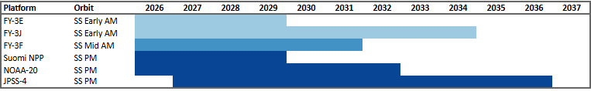
Broadband Short/Long Wave Radiometer (Radiation Balance)
Today
LEO - 2 Orbits
Sun-synchronous morning
Sun-synchronous afternoon
WGIII Assessment: Low risk of not meeting the CGMS baseline commitment. Action on WGII to investigate the addition of GEO contributions to the CGMS Baseline.

Slide 27
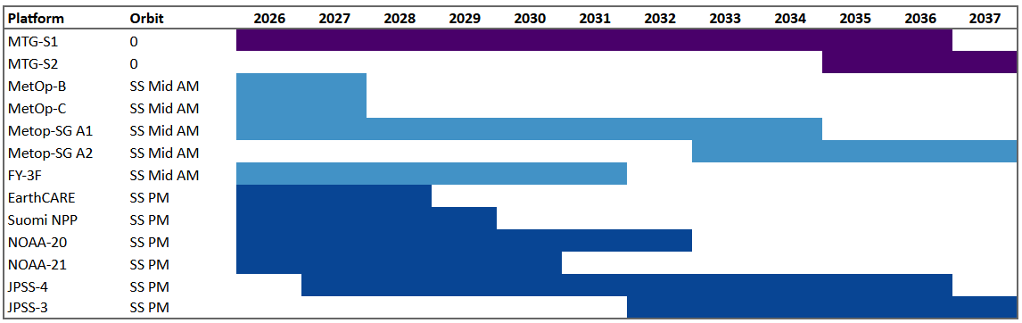
Visible / UV Spectrometer (Aerosol, Atmospheric Composition: O3, CO2, NO2, SO2, BrO. C)
GEO - 1 Slot
0°
LEO - 2 Orbits
Sun-synchronous mid-morning
Sun-synchronous afternoon
Today
WGIII Assessment: Low risk of not meeting the CGMS Baseline commitment.

Slide 28
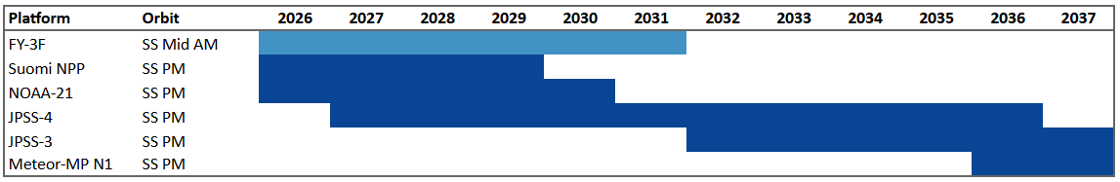
UV Limb Spectrometer (Aerosol, Atmospheric Composition: O3)
Today
LEO - 2 Orbits
Sun-synchronous mid-morning
Sun-synchronous afternoon
WGIII Assessment: Risk of not meeting the CGMS Baseline commitment in the mid-morning orbit in the mid 2030s. WGII is investigating other capabilities for UV limb sounding to complement JPSS.

Slide 29
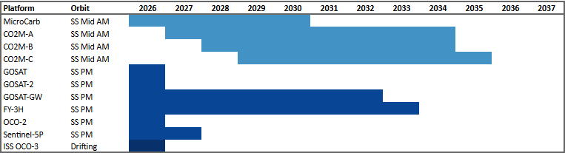
SWIR Imaging Spectrometer (Atmospheric Composition: CO2, CH4)
Today
LEO - 2 Orbits
Sun-synchronous late morning
Sun-synchronous afternoon
WGIII Assessment: Slight risk of not meeting CGMS Baseline commitment in the mid 2030s in the afternoon orbit. GHG TT via WGII has action to indicate if SWIR missions for CH4 and CO2 be added to the baseline.

Slide 30
Precipitation Radar (Precipitation)
Today
LEO - 1 orbit
Drifting
WGIII Assessment: Slight risk of not meeting the GGMS Baseline commitment in the early 2030s. NASA and JAXA to provide additional information on the GPM continuation mission.

Slide 31
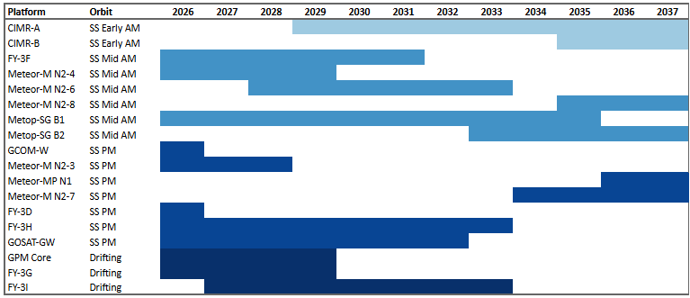
Microwave Imager (Sea Surface Temperature, Ocean Surface Winds, Precipitable Water, Soil Moisture, Snow and Ice properties, Sea Ice Properties)
LEO - 2 Orbits
Sun-synchronous mid-morning
Sun-synchronous afternoon
Today
WGIII Assessment: Low risk of not meeting the CGMS Baseline commitment. WGIII reviewing WGII proposal to articulate how MW missions with different frequencies should be addressed and visualized in the CGMS Baseline and Risk Assessment.

Slide 32
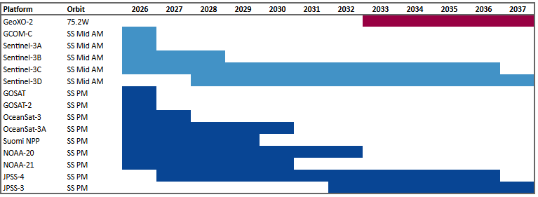
Narrow Band Visible IR Imager (Ocean Colour, Aerosols)
Today
LEO - 2 Orbits
Sun-synchronous mid-morning
Sun-synchronous afternoon
WGIII Assessment: Low risk of not meeting the CGMS Baseline commitment.

Slide 33
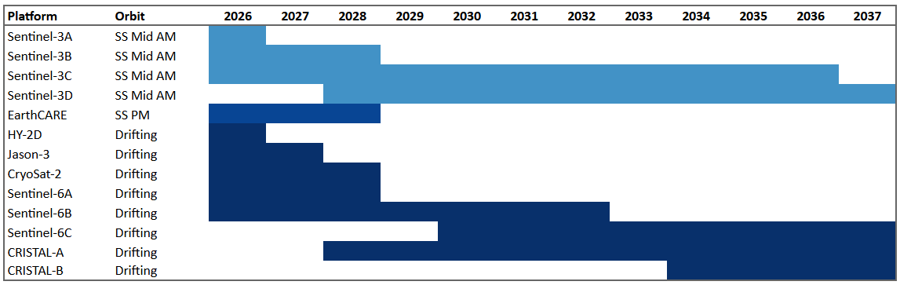
Radar Altimetry (Ocean Surface Topography)
LEO - 1 Orbit
Sun-synchronous mid-morning
Reference mission on a high-precision, drifting orbit
Today
WGIII Assessment: Low risk of not meeting the CGMS Baseline commitment.

Slide 34
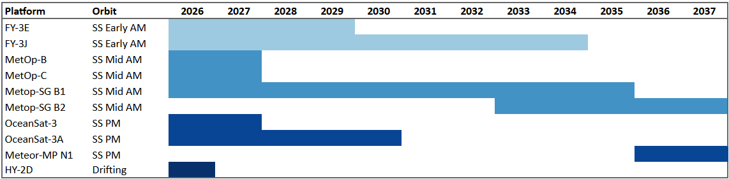
Scatterometry (Ocean Surface Winds)
Today
LEO
Sun-synchronous early morning
Sun-synchronous mid-morning
Sun-synchronous afternoon
WGIII Assessment: Risk of not meeting the CGMS Baseline commitment in the afternoon orbit in the early 2030s.

Slide 35
Sub-millimetre Ice Cloud Imager (Cloud Ice)
Today
LEO - 1 Orbit
Sun-synchronous mid-morning
WGIII Assessment: Low risk of not meeting the CGMS Baseline commitment

Slide 36
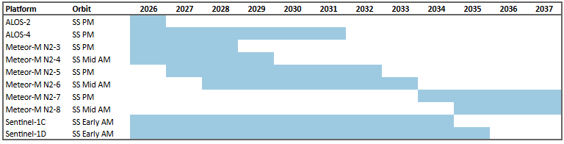
Synthetic Aperture Radar (Soil Moisture, Sea Ice)
LEO - 1 Orbit
Sun-synchronous
Today
WGIII Assessment: Low risk of not meeting the CGMS Baseline commitment

Slide 37
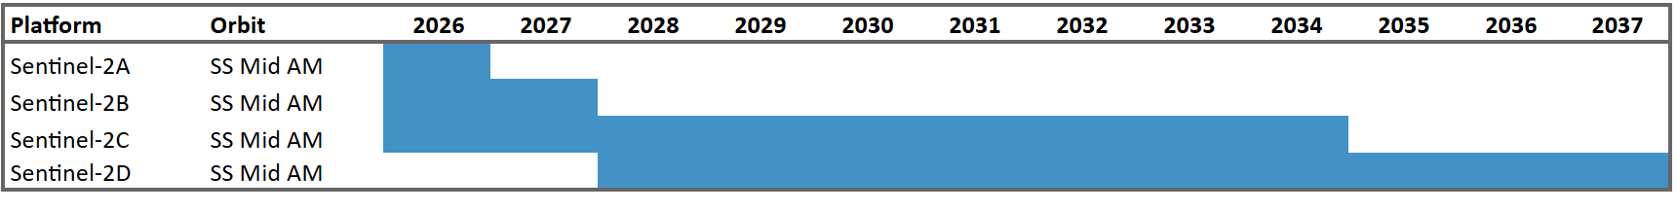
High Resolution Optical Imager (Land Use, Vegetation Type and Status, Aerosols)
Today
LEO - 1 Orbit
Sun-synchronous
WGIII Assessment: Low risk of not meeting the CGMS Baseline commitment

Slide 38
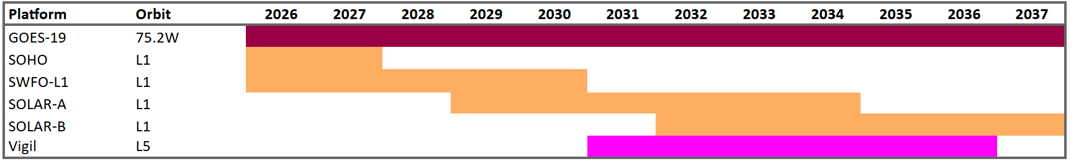
Coronagraph (Coronagraphy)
Today
On Sun-Earth Line
L1
GEO - 1 slot
Off Sun-Earth Line
L5
WGIII Assessment: Low risk of not meeting the CGMS Baseline commitment

Slide 39
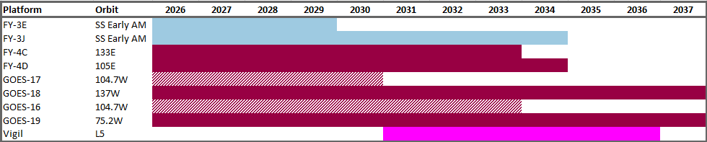
EUV Imager (EUV Imagery)
Today
On Sun-Earth Line
LEO - 1 orbit
GEO - 2 slots
Off Sun-Earth Line
L5
WGIII Assessment: Low risk of not meeting the CGMS Baseline commitment

Slide 40
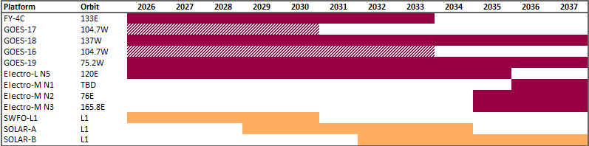
X-Ray Spectrograph (X-Ray Flux)
Today
On Sun-Earth Line
GEO - 5 slots
L1
WGIII Assessment (2025): Low risk of not meeting CGMS Baseline commitment.
WGIII Assessment (2026 - Proposed): Low risk of not meeting the CGMS Baseline commitment

Slide 41
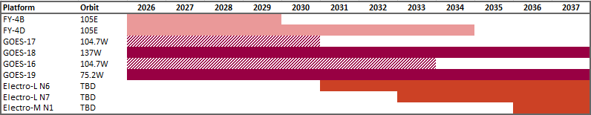
Low Energy Electrons and Protons (Magnetospheric particles)
Today
GEO, as in-situ measurements
105°E
75.2°W, 104.7°W, 137.2°W
WGIII Assessment: Low risk of not meeting the CGMS Baseline commitment

Slide 42
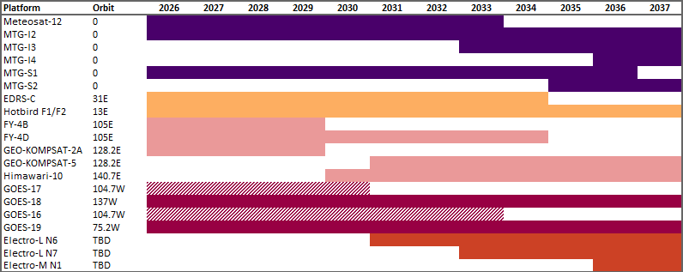
High Energy Electrons and Protons (Magnetospheric and solar energetic particles)
Today
GEO, as in-situ measurements
0°
13°E, 31°E
105°E, 128°E, 140.7°E
75.2°W, 104.7°W, 137.2°W
WGIII Assessment: Low risk of not meeting the CGMS Baseline commitment

Slide 43
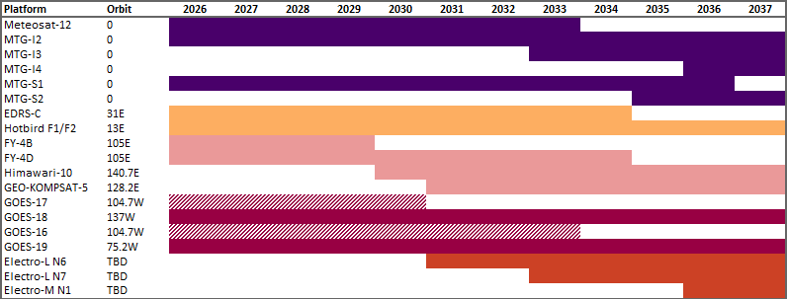
Very High Energy Protons (Magnetospheric and solar energetic particles)
GEO, as in-situ measurements
0°
13°E, 31°E
105°E, 140.7°E
75.2°W, 104.7°W, 137.2°W
Today
WGIII Assessment: Low risk of not meeting the CGMS Baseline commitment

Slide 44
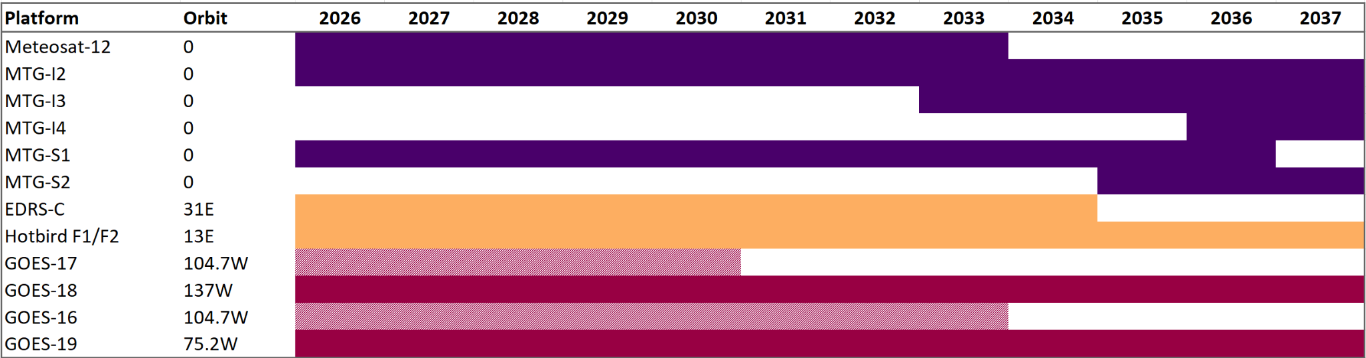
Energetic Heavy Ions (Magnetospheric and solar energetic particles)
Today
GEO, as in-situ measurements
0°
13°E, 31°E
75.2°W, 104.7°W, 137.2°W
WGIII Assessment (2026 - Proposed): Low risk of not meeting the CGMS Baseline commitment

Slide 45
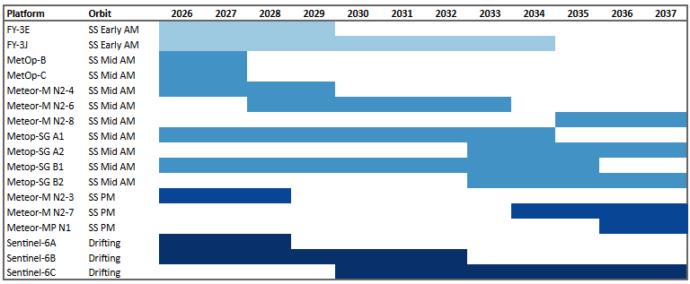
Energetic Particle Sensor LEO (Magnetospheric)
Today
LEO - 3 orbits as in-situ measurements
WGIII Assessment: Risk of not meeting the CGMS Baseline commitment in the afternoon orbit in the early 2030s.

Slide 46
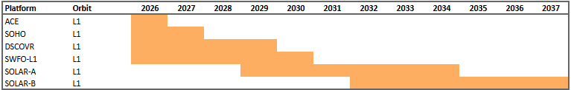
Energetic Particle Sensor L1 (Solar Energetic Particles)
L1 as in-situ measurement
Today
WGIII Assessment: Low risk of not meeting the CGMS Baseline commitment

Slide 47
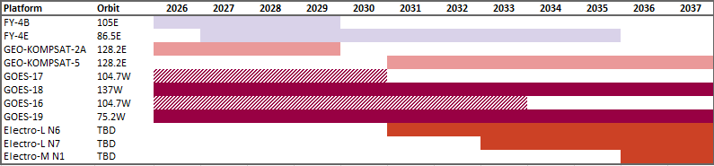
Magnetometer GEO (Earth’s Magnetic Field)
Today
GEO, as in-situ measurements
86.5°E, 105°E
128°E
137°W, 104.7°W, 75.2°W
WGIII Assessment: Slight risk of not meeting the CGMS Baseline commitment at 128°E in 2030.

Slide 48
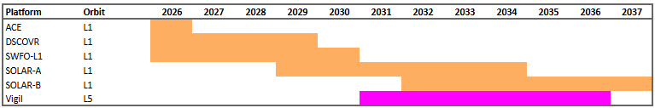
Magnetometer L1 (Interplanetary Magnetic Field)
Today
L1, as an in-situ measurement
L5, as an in-situ measurement
WGIII Assessment: Low risk of not meeting the CGMS Baseline commitment

Slide 49
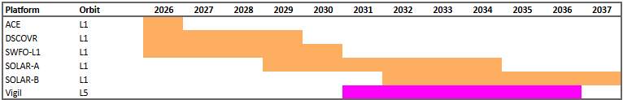
Plasma Analyzer (Solar Wind)
Today
L1, as an in-situ measurement
L5, as an in-situ measurement
WGIII Assessment: Low risk of not meeting the CGMS Baseline commitment

